Slide 1


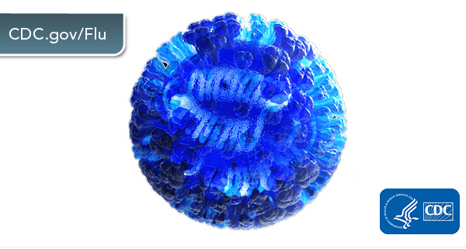
Influenza: What can we expect?
Dr. Rodney E. Rohde
Texas State University
Hosted by Clare Barry
www.webbertraining.com
September 15, 2022

Slide 2
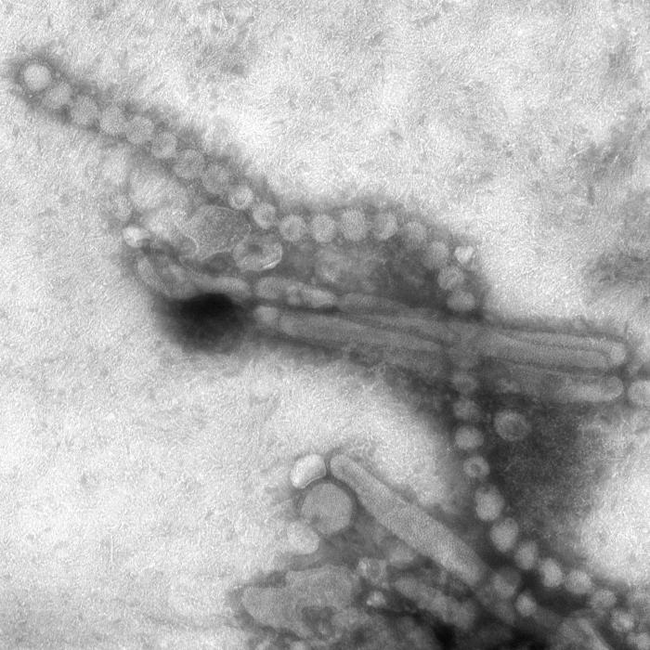
Influenza: What can we expect?
This illustration captured in 2013, is a negative stained transmission electron microscopic (TEM) image captured some of the ultrastructural details exhibited by the new influenza A (H7N9) virus.
This image is in the public domain and thus free of any copyright restrictions. See PHIL 15670, CDC/ Cynthia S. Goldsmith and Thomas Rowe Photo credit. https://phil.cdc.gov/details.aspx?pid=15670

Slide 3
Influenza: What can we expect?
Objectives
1. Describe Influenza (flu) history and background.
2. Summarize the risk factors associated with influenza.
3. Describe the diagnostic microbiology, clinical laboratory role and molecular epidemiology of influenza viruses.
4. Review the changing epidemiology of influenza between the community, healthcare setting and occupational health.
5. Understand infection prevention and control in the environment, including the types of PPE to be utilized.
6. What does the 2022-2023 influenza season look like?

Slide 4
Influenza: What can we expect?
Overview
History / Background
At risk populations
Epidemiology
Signs / Symptoms / Spectrum of disease
Diagnosis (with basic lab information)
Treatment
Infection prevention / control / PPE
Environmental cleaning (surfaces, etc.)
Final thoughts

Slide 5

Influenza: What can we expect?
From: Bird Flu: A Virus of our own Hatching
http://birdflubook.com/a.php?id=56

Slide 6
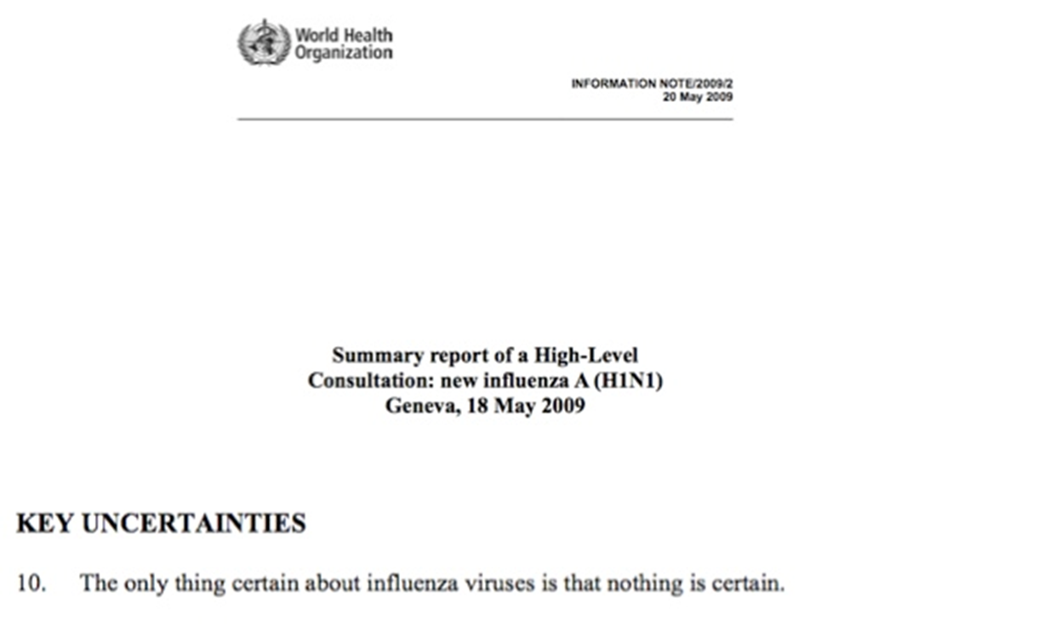
Influenza: What can we expect?

Slide 7
Influenza: What can we expect?
History and background
Influenza (flu) is an RNA virus that is notorious, and some might say diabolical, in its ability to mutate from year to year.
RNA viruses (like flu and SARS-CoV2) are unfortunately very smart and mischievous in this aspect. Flu, like SARS, also has the ability to live as a zoonotic agent.
The flu virus has long been an inhabitant of swine, fowl, and humans, which continually allow for antigenic drift (small changes in the virus genome) and shift (major changes in the virus genome).

Slide 8
Influenza: What can we expect?
History and background
It is a contagious respiratory illness, which can cause mild to severe illness resulting in hospitalization or death.
Some people, such as older people, young children, and people with certain health conditions, are at high risk of serious flu complications.
There are two main types of influenza (flu) virus: Types A and B. Type C is not clinically relevant to humans and Type D is only found in pigs and cattle. The influenza A and B viruses that routinely spread in people (human influenza viruses) are responsible for seasonal flu epidemics each year. Type A = pandemic strains.

Slide 9

Influenza: What can we expect?
H
N
M2 Ion Channel
RNP
This is a picture of an influenza virus. Influenza A viruses are classified by subtypes based on the properties of their hemagglutinin (H) and neuraminidase (N) surface proteins. There are 18 different HA subtypes and 11 different NA subtypes. Subtypes are named by combining the H and N numbers – e.g., A(H1N1), A(H3N2). https://www.cdc.gov/flu/about/viruses/types.htm

Slide 10
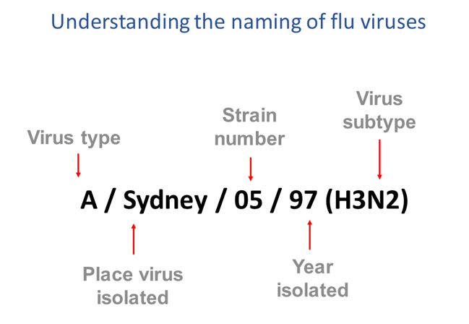
Influenza: What can we expect?
This image shows how influenza viruses are named. The name starts with the virus type, followed by the place the virus was isolated, followed by the virus strain number, the year isolated, and finally, the virus subtype. https://www.cdc.gov/flu/about/viruses/types.htm

Slide 11
Influenza: What can we expect?
History and background
Most experts believe that flu viruses spread mainly by tiny droplets made when people with flu cough, sneeze or talk.
These droplets can land in the mouths or noses of people who are nearby [up to six feet or more].
Less often, a person might get flu by touching a surface or object that has flu virus on it and then touching their own mouth, nose or possibly their eyes.

Slide 12
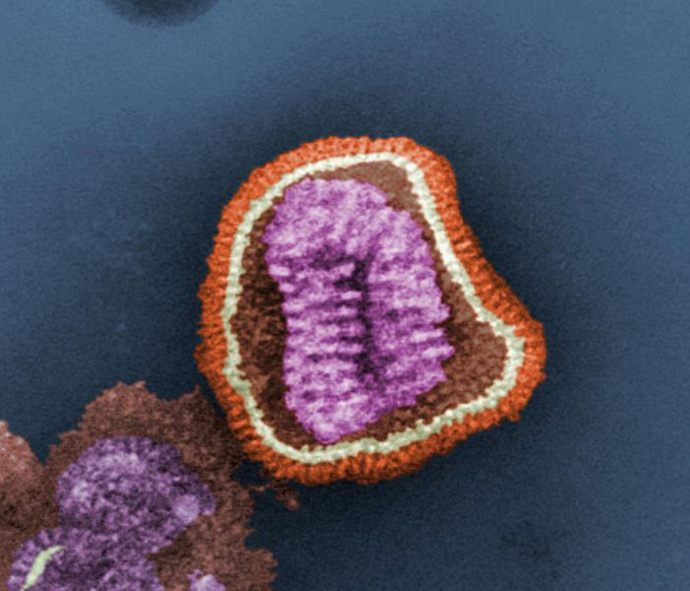
Influenza: What can we expect?
The ultrastructural details of an influenza virus particle.
TEM Image from the Centers for Disease Control and Prevention's Public Health Image Library (PHIL), with identification number #10073. This image is in the public domain and thus free of any copyright restrictions.
https://phil.cdc.gov/details.aspx?pid=10073
VIDEO:
https://pmdvod.nationalgeographic.com/NG_Video/931/407/swine-flu-overview_4x3_wCredits_SD__781080.mp4

Slide 13
Influenza: What can we expect?
History and background – How flu spreads
Person to person – direct transmission
Indirect via “high-touch” surfaces / fomites
People with flu are most contagious in the first three to four days after their illness begins. Most healthy adults may be able to infect others beginning 1 day before symptoms develop and up to 5 to 7 days after becoming sick. Children and some people with weakened immune systems may pass the virus for longer than 7 days.
You may be able to pass on flu to someone else before you know you are sick, as well as while you are sick.

Slide 14
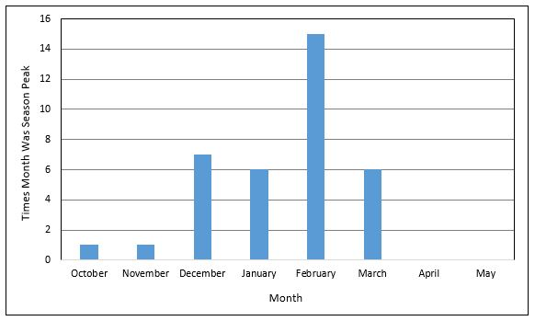
Influenza: What can we expect?
History and background
When is the flu season in the United States?
In the U.S., flu season occurs in the fall and winter. While influenza viruses circulate year-round, most of the time flu activity peaks between December and February, but activity can last as late as May.
https://www.cdc.gov/flu/about/season/flu-season.htm

Slide 15
Influenza: What can we expect?
Risk groups – Flu
Adults 65 Years and Older
Adults with Chronic Health Conditions
  Asthma
  Heart Disease and Stroke
  Diabetes
  Chronic Kidney Disease

Slide 16
Influenza: What can we expect?
Risk groups – Specific High Risk Groups
HIV / AIDS
Pregnant Women
Cancer
Young children
  Children younger than 5 years old–especially those younger than 2– are at high risk of developing serious flu-related complications.

Slide 17
Influenza: What can we expect?
Risk groups – Specific High Risk Groups
Neurologic and neurodevelopment conditions
Blood disorders (such as sickle cell disease)
Chronic lung disease (such as chronic obstructive pulmonary disease [COPD] and cystic fibrosis)
Endocrine disorders (such as diabetes mellitus)
Immunocompromised [in general]

Slide 18
Influenza: What can we expect?
Risk groups – Specific High Risk Groups
Liver disorders
Metabolic disorders (such as inherited metabolic disorders and mitochondrial disorders)
People who are obese with a body mass index [BMI] of 40 or higher
People younger than 19 years old on long-term aspirin- or salicylate-containing medications.

Slide 19
Influenza: What can we expect?
Risk groups – Specific High Risk Groups
People who live in nursing homes and other long-term care facilities
People from certain racial and ethnic minority groups are at increased risk for hospitalization with flu, including non-Hispanic Black persons, Hispanic or Latino persons, and American Indian or Alaska Native persons

Slide 20
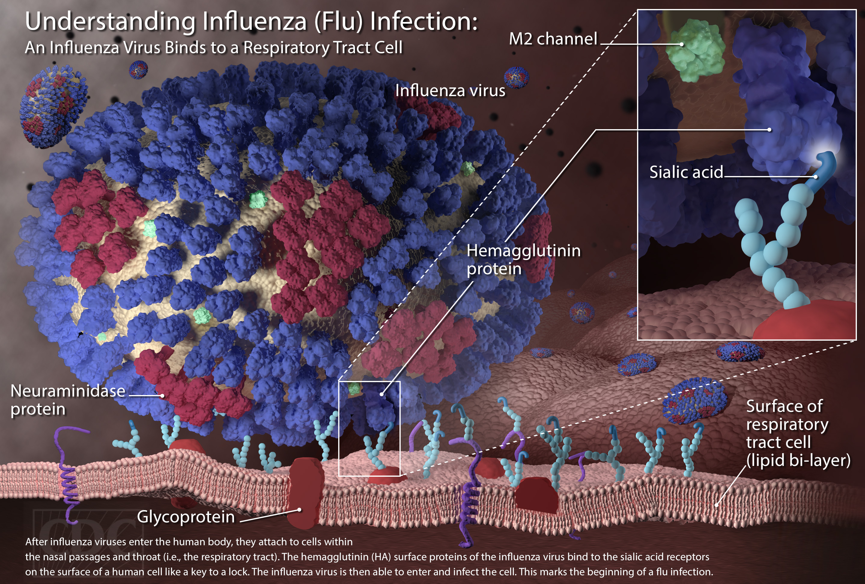
Influenza: What can we expect?
https://www.cdc.gov/flu/resource-center/freeresources/graphics/images.htm
Epidemiology

Slide 21
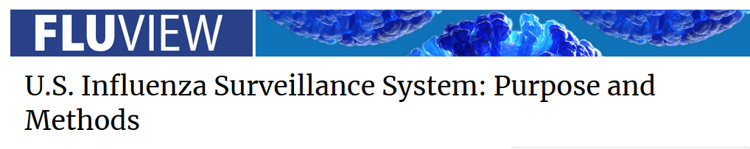
Influenza: What can we expect?
Epidemiology
The Influenza Division at CDC collects, compiles and analyzes information on influenza activity year-round in the United States. FluView, a weekly influenza surveillance report, and FluView Interactive, an online application which allows for more in-depth exploration of influenza surveillance data, are updated each week. The data presented each week are preliminary and may change as more data is received.

Slide 22
Influenza: What can we expect?
Epidemiology
It is a collaborative effort between CDC and its many partners in state, local, and territorial health departments, public health and clinical laboratories, vital statistics offices, healthcare providers, clinics, and emergency departments. Information in five categories is collected from eight data sources in order to:
Find out when and where influenza activity is occurring;
Determine what influenza viruses are circulating;
Detect changes in influenza viruses; and
Measure the impact influenza is having on outpatient illness, hospitalizations and deaths.

Slide 23
Influenza: What can we expect?
Epidemiology – Why is this important?
Flu viruses are constantly changing (referred to as antigenic drift).
Influenza viruses can also undergo an abrupt, major change (referred to as antigenic shift) that results novel viruses.
Vaccines must be administered annually and are updated regularly based on surveillance findings.
Flu treatment is guided by laboratory surveillance for antiviral resistance.
Flu surveillance and targeted research studies are used to monitor the impact of influenza on different segments of the population (e.g. age groups, underlying medical conditions).

Slide 24
Influenza: What can we expect?
Epidemiology – Surveillance System Components
Virologic Surveillance – Virus characterization / Novel A strains.
Outpatient Illness Surveillance – Influenza-like Illness Surveillance Network (ILINet).
Summary of the Geographic Spread of Influenza – Weekly State and Territorial Epidemiologists Report.
Hospitalization Surveillance – Laboratory confirmed influenza-associated hospitalizations are monitored through the Influenza Hospitalization Surveillance Network (FluSurv-NET).
National Center for Health Statistics (NCHS) mortality surveillance data .

Slide 25
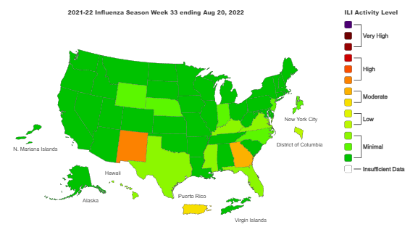
Influenza: What can we expect?

Slide 26
Influenza: What can we expect?
During the 2021-2022 flu season, influenza activity in the United States was lower than pre-pandemic levels despite increased reporting and testing, possibly owing to COVID-19 precautions, according to a new report from the US Centers for Disease Control and Prevention (CDC).
Influenza activity continued from October 2021 through mid-June 2022, with A(H3N2) viruses predominating throughout the season.

Slide 27
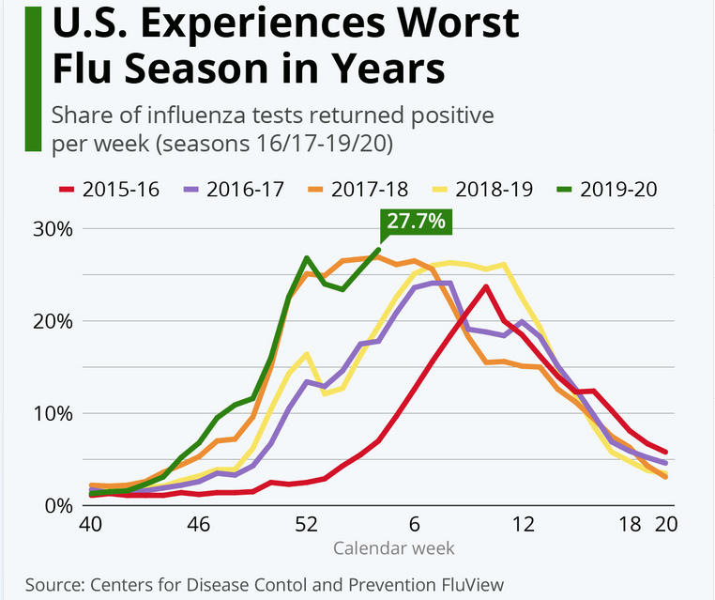
Influenza: What can we expect?

Slide 28
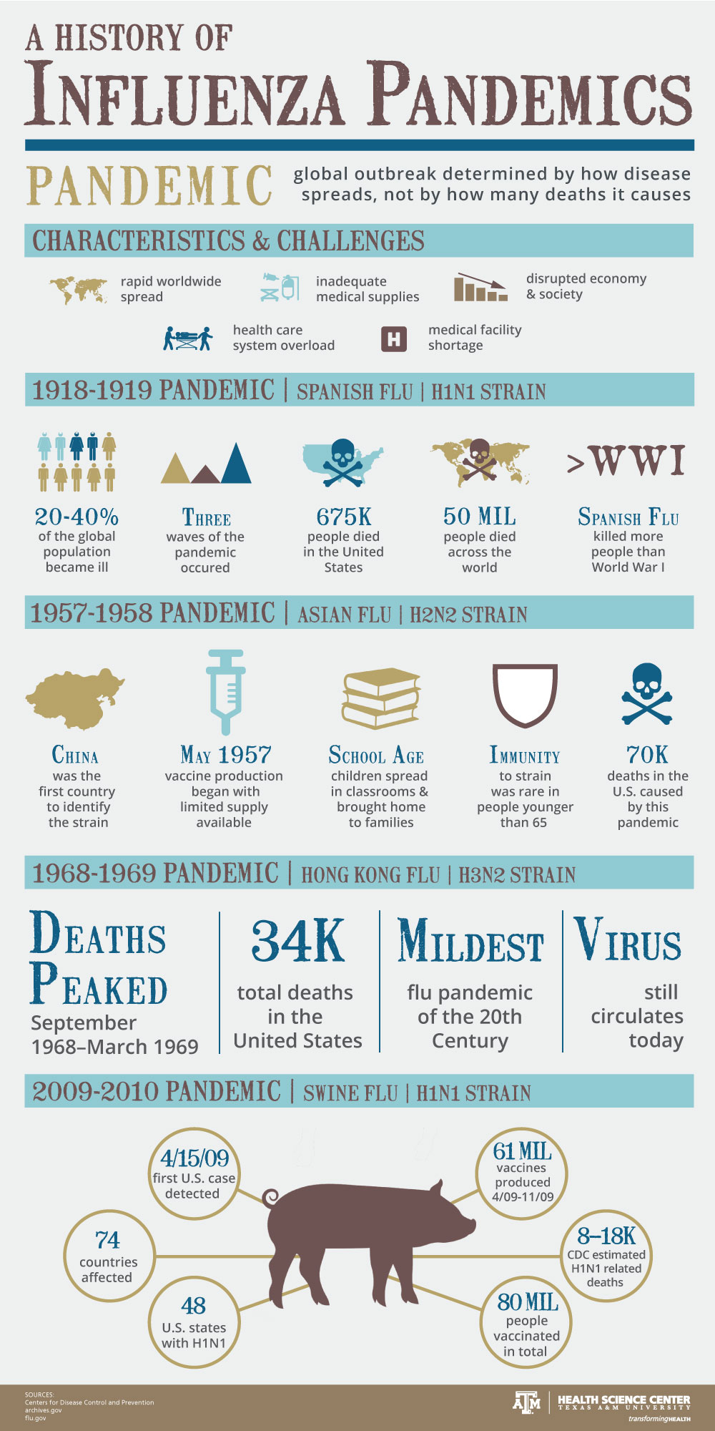
https://vitalrecord.tamhsc.edu/a-history-of-influenza-pandemics/infographic-11-25-pandemicinfluenzahistory-final/

Slide 29
Influenza: What can we expect?
Signs / Symptoms / Spectrum of Disease
Flu signs and symptoms usually come on suddenly.
People who are sick with flu often feel some or all of these symptoms:
Fever* or feeling feverish/chills
Cough
Sore throat
Runny or stuffy nose
Muscle or body aches

Slide 30
Influenza: What can we expect?
Signs / Symptoms / Spectrum of Disease
Headaches
Fatigue (tiredness)
Some people may have vomiting and diarrhea, though this is more common in children than adults.
*It’s important to note that not everyone with flu will have a fever.

Slide 31
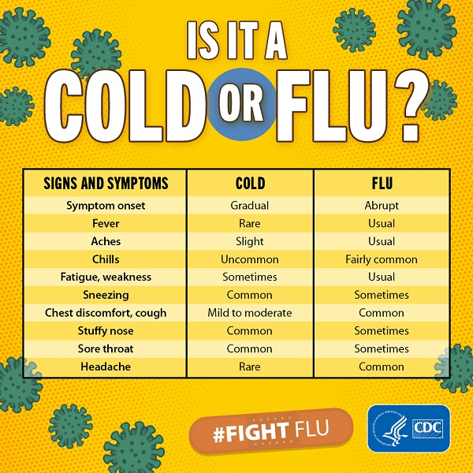
Influenza: What can we expect?

Slide 32
Influenza: What can we expect?
Signs / Symptoms / Spectrum of Disease
What is the difference between Influenza (Flu) and COVID-19?
Influenza (Flu) and COVID-19 are both contagious respiratory illnesses, but they are caused by different viruses. COVID-19 is caused by infection with a new coronavirus (called SARS-CoV-2) and flu is caused by infection with influenza viruses.

Slide 33
Influenza: What can we expect?
Signs / Symptoms / Spectrum of Disease
Key differences:
  COVID-19 seems to spread more easily than flu and causes more serious illnesses in some people.
  COVID-19 can also take longer before people show symptoms and people can be contagious for longer.
  There is a vaccine to protect against flu and COVID-19.

Slide 34
Influenza: What can we expect?
Signs / Symptoms / Spectrum of Disease
Because some of the symptoms of flu and COVID-19 are similar, it may be hard to tell the difference between them based on symptoms alone, and testing may be needed to help confirm a diagnosis.
The best way to prevent infection is to avoid being exposed to the virus.

Slide 35
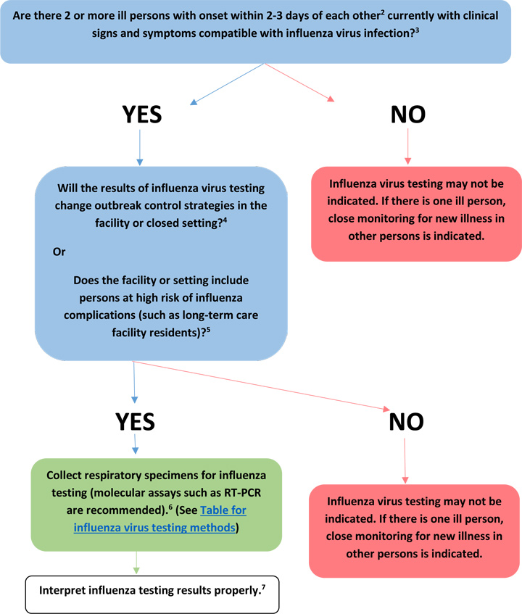
Influenza: What can we expect?
Infectious Diseases Society of America (IDSA) Influenza Clinical Practice Guidelines.
Figure: Guide to use of influenza virus diagnostic tests in investigating outbreaks in institutional or other closed settings.
https://www.cdc.gov/flu/professionals/diagnosis/guide-virus-diagnostic-tests.htm

Slide 36
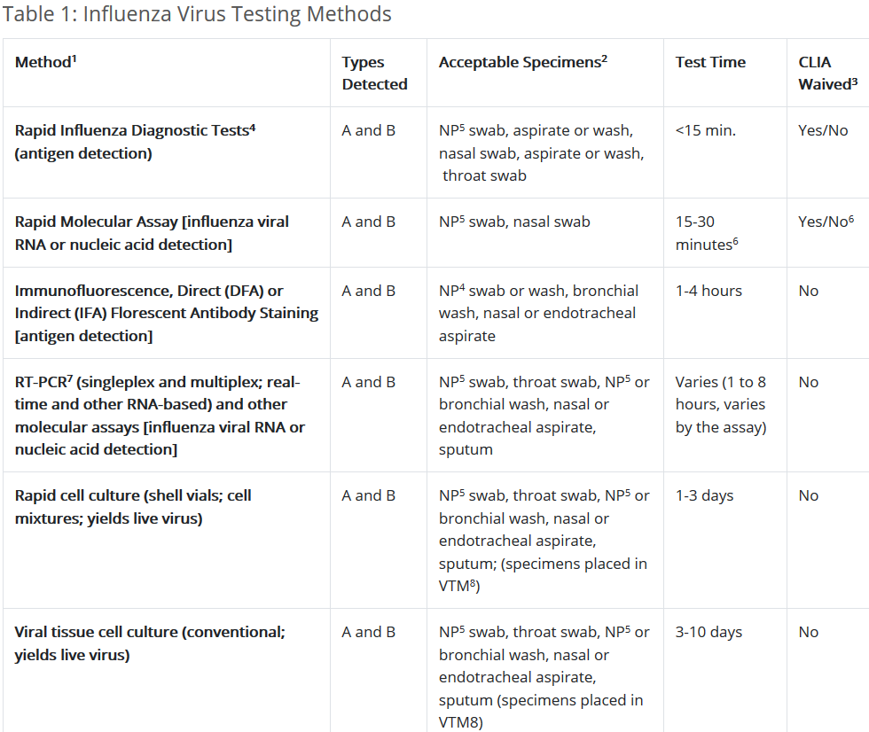
Influenza: What can we expect?
Flu testing / Diagnosis
https://www.cdc.gov/flu/professionals/diagnosis/table-testing-methods.htm

Slide 37
Influenza: What can we expect?
Flu testing / Diagnosis
The Infectious Diseases Society of America (IDSA) recommends use of rapid influenza molecular assays over rapid influenza diagnostic tests (RIDTs) for detection of influenza viruses in respiratory specimens of outpatients.
IDSA recommends use of RT-PCR or other molecular assays for detection of influenza viruses in respiratory specimens of hospitalized patients. Consult the IDSA Influenza Clinical Practice Guidelines for recommendations on influenza testing and information on interpretation of testing results.

Slide 38

Influenza: What can we expect?
Flu testing / Diagnosis
What about testing accuracy?
Rapid influenza diagnostic tests identify the presence of influenza A and B in respiratory tract secretions.
The results are ready in as little as 15 minutes, but the rapid tests aren’t as accurate as other tests that need to be sent to a lab. Accuracy of rapid flu tests can range anywhere from 50% to 90%, depending on the test, the individual, and the prevalence of the flu in the community.

Slide 39
Influenza: What can we expect?
Flu testing / Diagnosis
Factors that can affect the outcome of the rapid flu test include:
Timing: Tests are most accurate when specimens are collected within 3-4 days of the onset of symptoms, when influenza viral shedding is highest.
Collection: Each test has its own specifications for specimen collection—nasopharyngeal, nasal, throat swab, or aspirate—which must be followed for accuracy.
Flu type: Rapid flu tests are better able to detect influenza A than influenza B.
Current flu activity: False negatives are more likely when flu activity is high, but can occur at any time. Similarly, false positives are more common when flu activity is low.

Slide 40
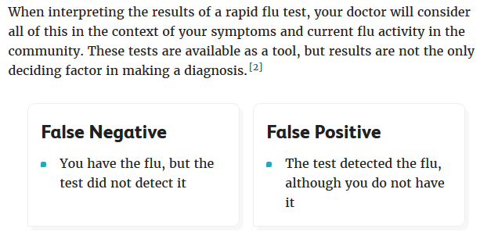
Influenza: What can we expect?
Flu testing / Diagnosis
**Soapbox statement: It is CRITICAL for a medical laboratory professional to
conduct and interpret all medical laboratory testing.

Slide 41
Influenza: What can we expect?
Prevention and treatment.
CDC VIDEO – How Does Flu Make You Sick?
https://www.youtube.com/watch?v=MfX6xGdQco0
Flu virus infection triggers inflammation in your body. Severe inflammation can cause lung damage and other serious problems. Everyone 6 months and older needs flu vaccine each year.

Slide 42

Influenza: What can we expect?
Prevention and treatment.
The best way to prevent seasonal flu is to get vaccinated every year.
https://www.cdc.gov/flu/images/prevent/get-vaccinated.png

Slide 43
Influenza: What can we expect?
Prevention and treatment.
Different flu vaccines are approved for use in different groups of people – discuss these options with your HCP.
Flu shots are approved for use in children as young as 6 months old and flu shots approved for use in adults 65 years and older.
Flu shots also are recommended and approved for use in pregnant women and people with certain chronic health conditions.
The nasal spray flu vaccine is approved for use in non-pregnant individuals who are 2 years through 49 years of age. People with some certain medical conditions should not receive the nasal spray flu vaccine.

Slide 44
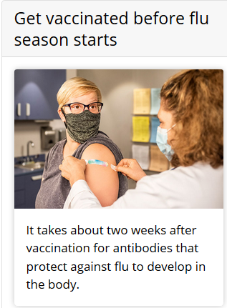
Influenza: What can we expect?
Prevention and treatment.
Make plans to get vaccinated early in fall, before flu season begins. CDC recommends that people get a flu vaccine by the end of October.
However, getting vaccinated early (for example, in July or August) is likely to be associated with reduced protection against flu infection later in the flu season, particularly among older adults.
https://www.cdc.gov/flu/images/prevent/H_PN_CDC-5656.jpg

Slide 45

Influenza: What can we expect?
Prevention and treatment.
https://www.cdc.gov/flu/images/flu-antiviral-drugs-sm.jpg
There are four FDA-approved antiviral
drugs recommended by CDC to treat flu this season.
oseltamivir phosphate (available as a generic version or under the trade name Tamiflu®),
zanamivir (trade name Relenza®)
peramivir (trade name Rapivab®), and.
baloxavir marboxil (trade name Xofluza®).

Slide 46
Influenza: What can we expect?
Infection prevention / control
Take everyday precautions to protect others while sick
While sick, limit contact with others as much as possible to keep from infecting them.
Cover your nose and mouth with a tissue when you cough or sneeze. Throw the tissue in the trash after you use it.

Slide 47

Influenza: What can we expect?
Infection prevention / control
Wash your hands often with soap and water. If soap and water are not available, use an alcohol-based hand rub.
Clean and disinfect surfaces and objects that may be contaminated with germs like flu.

Slide 48
Influenza: What can we expect?
Infection prevention / control
Cover your mouth. Teach your children to cover their mouths when they cough or sneeze.
Don't share personal items. Don't share drinking glasses or eating utensils. Wash dishes in hot, soapy water or in a dishwasher.

Slide 49
Influenza: What can we expect?
Infection prevention / control
Stay home until you are better
If you are sick with flu-like illness, CDC recommends that you stay home for at least 24 hours after your fever is gone except to get medical care or for other necessities. Your fever should be gone without the use of fever-reducing medicine.

Slide 50
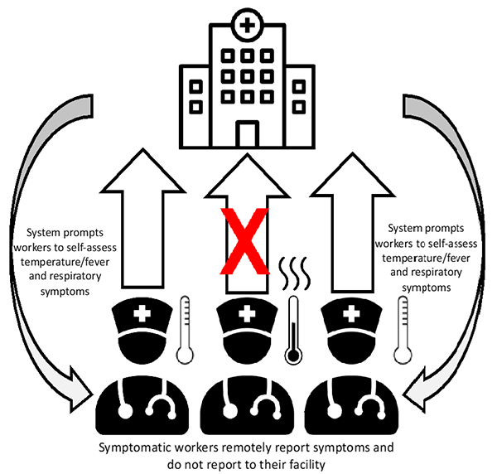
Influenza: What can we expect?
If it’s good enough for COVID-19,
then it’s good enough for flu!

Slide 51
Influenza: What can we expect?
The role of environmental surfaces…
Environmental Infection Control
Dedicated medical equipment.
Ensure that environmental cleaning and disinfection procedures are followed consistently and correctly.
Management of laundry, food service utensils, and medical waste.
Terminal cleaning of rooms and PPE to be worn by environmental services personnel.

Slide 52
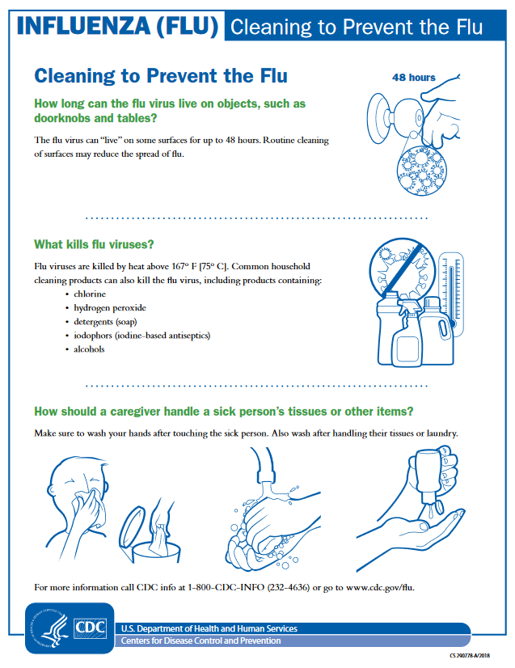
The role of environmental surfaces…
#SurfacesMatter
https://www.cdc.gov/flu/resource-center/images/multi-language-pdfs/contamination_cleaning_english_508.pdf

Slide 53
Influenza: What can we expect?
Infection prevention / control –
Ongoing Education / transparency
Standardized education and printable materials for providers and patients.
  Signage, Video, etc.
Increased and early case finding (testing use)
Methods to identify patients at high risk to encourage prompt testing and contact precautions.
Expanded infection-control measures.

Slide 54
Influenza: What can we expect?
2022–2023
No one truly knows what to expect! ☺
The vaccines for the 2022-2023 season have been chosen to match viruses currently circulating during the protracted tail end of the 2021-2022 season
Receiving a seasonal influenza vaccine each year remains the best way to protect against seasonal influenza and its poten­tially severe consequences.
Influenza surveillance reports for the US are published online weekly at https://www.cdc.gov/flu/weekly

Slide 55
References
Centers for Disease Control and Prevention (CDC). Influenza (Flu). Accessed October 22, 2020 from https://www.cdc.gov/flu/about/index.html
CDC. Types of Influenza Viruses. Accessed on October 22, 2020 from https://www.cdc.gov/flu/about/viruses/types.htm
CDC. Disease Burden of Influenza. Accessed on October 23, 2020 from https://www.cdc.gov/flu/about/burden/index.html
Influenza. Accessed on October 22, 2020 from https://en.wikipedia.org/wiki/Influenza
Mayo Clinic. Influenza. Accessed on October 23, 2020 from https://www.mayoclinic.org/diseases-conditions/flu/symptoms-causes/syc-20351719
Windsor W. Jon & Rohde R.E. An Evaluation of the Influenza Hospitalization Surveillance Network (IHSN). American Society for Clinical Laboratory Science, Clin Lab Sci October 2019, ascls.119.001834; DOI: https://doi.org/10.29074/ascls.119.001834
World Health Organization (WHO)). Influenza. Accessed on October 23, 2020 from https://www.who.int/influenza/en/

Slide 56

