Slide 1
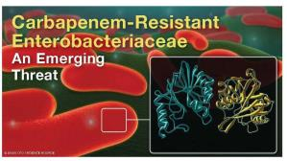

Making Sense of Alphabet Soup:
Antimicrobial Resistance in
Gram-Negative Bacilli
Broadcast live from
IPAC Canada conference
Andrew E. Simor, MD, FRCPC, FACP
Sunnybrook Health Sciences Centre
and the University of Toronto
Teleclass broadcast sponsored by
Sealed Air Diversey Care
www.sealedair.com
www.webbertraining.com
June 20, 2017

Slide 2
Disclosures
I have received grants, and served as a consultant on Advisory Boards for:
  Merck Canada Inc.
I will not be discussing ESBLs or fluoroquinolone resistance in GNBs

Slide 3
Objectives
to understand the mechanisms of carbapenem resistance in GNBs
to appreciate the epidemiology, risks, and clinical significance of carbapenem resistance
to consider evidence-based infection prevention and control strategies to limit the emergence and spread of carbapenem-resistant GNBs

Slide 4
Why Do We Care
(about GNB resistance)?
GNBs are major causes of infection, especially nosocomial or healthcare-associated
GNB infections are associated with significant morbidity and mortality
increasing incidence of multidrug-resistant GNB; treatment options are often limited

Slide 5
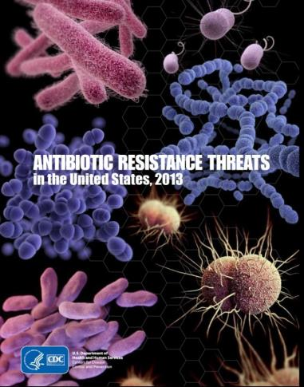
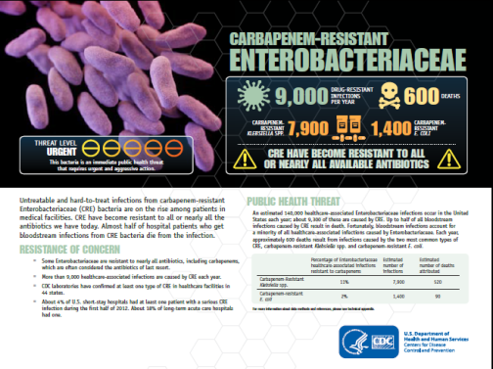
Antibiotic Resistance Threats
CDC, 2013

Slide 6

NDM-1
Antimicrobial | Antimicrobial Susceptibilities
 | MIC₉₀(mg/L) | % Susceptible
Imipenem | 128 | 0
Meropenem | 32 | 3
Pip/Tazo | >64 | 0
Cefotaxime | >256 | 0
Ceftazidime | >256 | 0
Ciprofloxacin | >8 | 8
Tobramycin | >32 | 0
Amikacin | >64 | 0
Tigecycline | 4 | 67
Colistin | 8 | 100
Kumarasamy, Lancet Infect Dis 2010

Slide 7
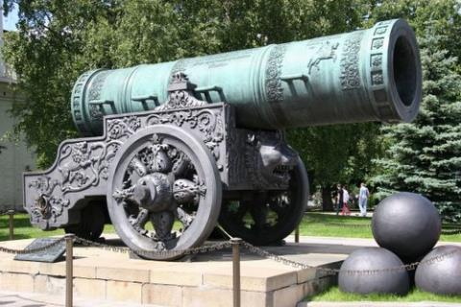
Carbapenems
“The Big Gun”
ertapenem
imipenem
meropenem
doripenem

Slide 8
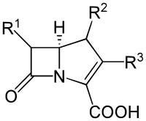
Carbapenems
Active against most:
Streptococci
Enterococci MSSA
Enterobacteriaceae GNB afermenters (eg. Pseudomonas) Anaerobes
Ertapenem is not active against Pseudomonas

Slide 9
Carbapenems
Common Indications
Syndrome
sepsis NYD
HAP, VAP
intra-abd sepsis
Pathogen
polymicrobial (GNB + anaerobes)
ESBLs
P. aeruginosa
Acinetobacter spp.

Slide 10

Carbapenem Resistance in GNB
Pseudomonas aeruginosa
Acinetobacter spp.
Enterobacteriaceae

Slide 11
Carbapenem Resistance in Pseudomonas and Acinetobacter
In the US, 15-22% of P. aeruginosa and 21-48% of Acinetobacter spp. are carbapenem-resistant
In Canada, 10-24% of P. aeruginosa and <10% of Acinetobacter are carbapenem-resistant
Davies, J Antimicrob Chemother 2011; McCracken, Diagn Microbiol Infect Dis 2011; Mataseje, J Antimicrob Chemother 2012; Zilberberg, J Hosp Med 2016

Slide 12
Mechanisms of
Carbapenem Resistance
changes in OMPs (permeability barrier: porin loss + ESBL/AmpC ß-lactamase); especially in Pseudomonas, or if isolate is R only to ertapenem and not to other carbapenems
carbapenemases

Slide 13
Carbapenemases
Enzymes that hydrolyze carbapenem antibiotics (and typically also most other
β-lactams and β-lactamase inhibitors);
may be chromosomally encoded or
more commonly plasmid-mediated

Slide 14
Carbapenemases
(“alphabet soup”)
Class A (serine) Class B (MBL) SME (Serratia) VIM (Pseudomonas) IMI (Enterobacter) IMP, SPM, GIM, SIM GES (Pseudomonas) NDM KPC (Klebsiella)
Class D carbapenemase OXA (Acinetobacter) OXA-48 (Enterobacteriaceae)

Slide 15
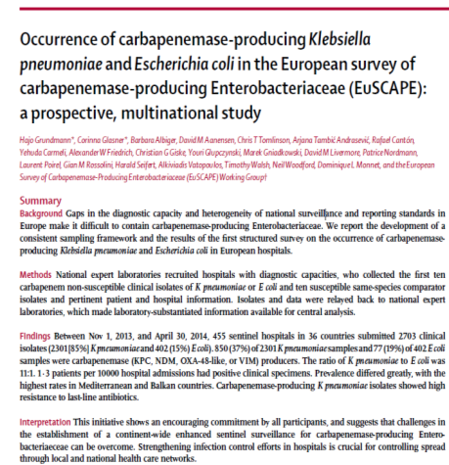
CPE in Europe, 2014
455 hospitals in 36 countries
402 E. coli: 19% CPE
2,301 K. pneumoniae: 3.7% CPE
mainly KPC, NDM, OXA-48, VIM
Grundmann, Lancet Infect Dis 2017

Slide 16
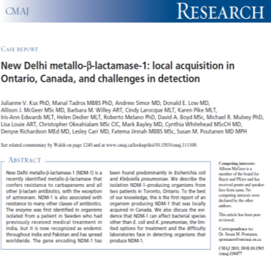
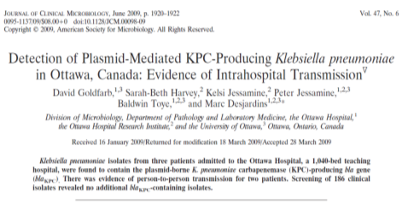
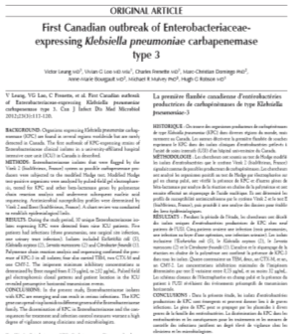
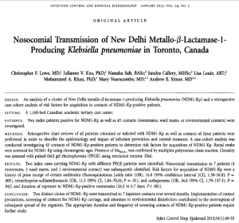
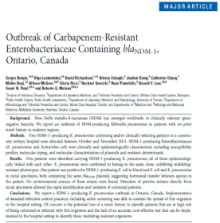
CPEs in Canada

Slide 17

CPE Surveillance in Canada
CNISP 2010-2014
Overall incidence: 0.07 per 1,000 admissions 0.09 per 10,000 patient-days (about 1/100th of MRSA rates) < 1% of E. coli or Klebsiella
Mataseje, Antimicrob Agents Chemother 2017

Slide 18
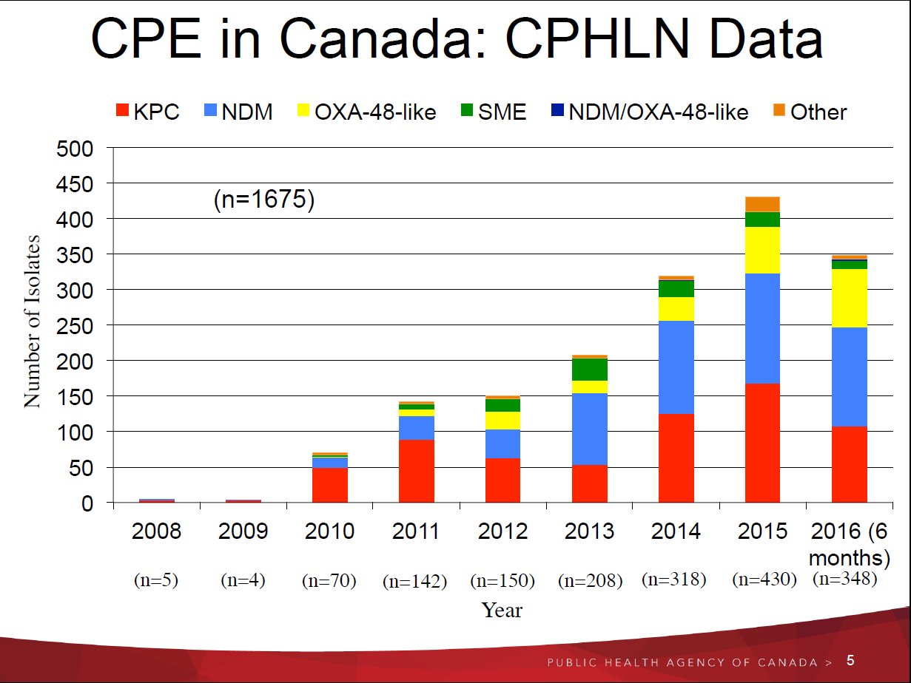

Slide 19
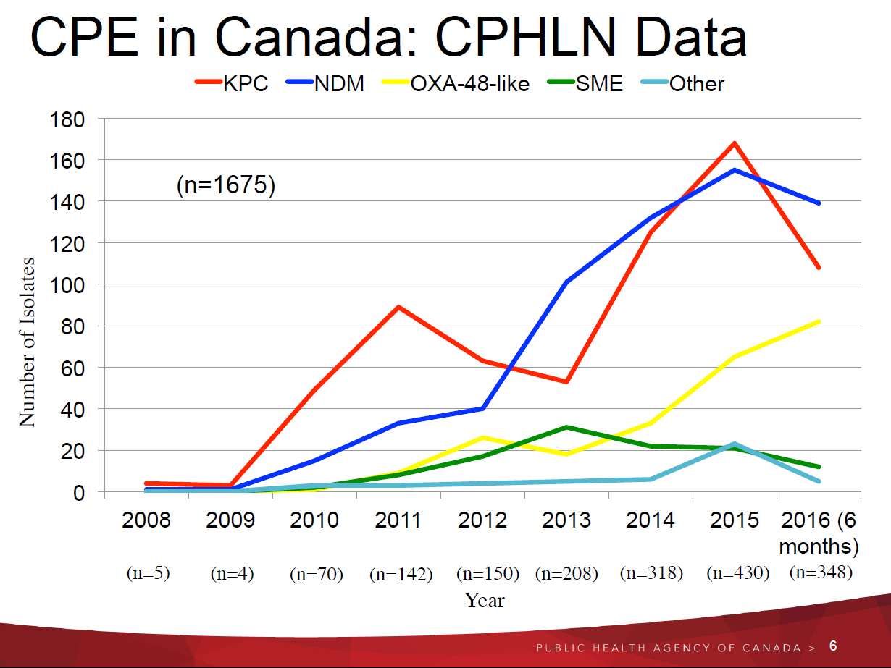

Slide 20
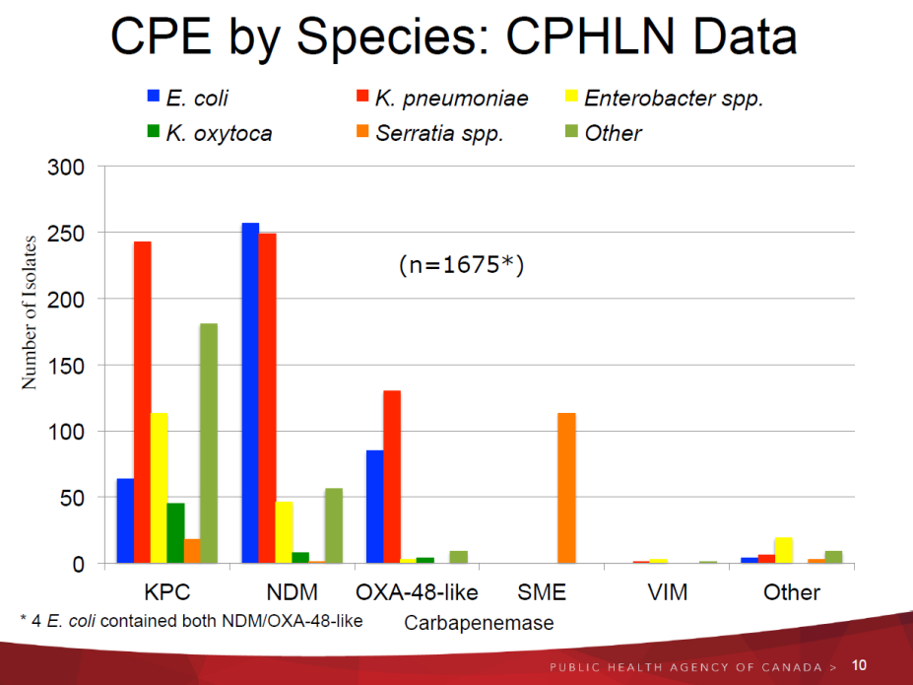

Slide 21
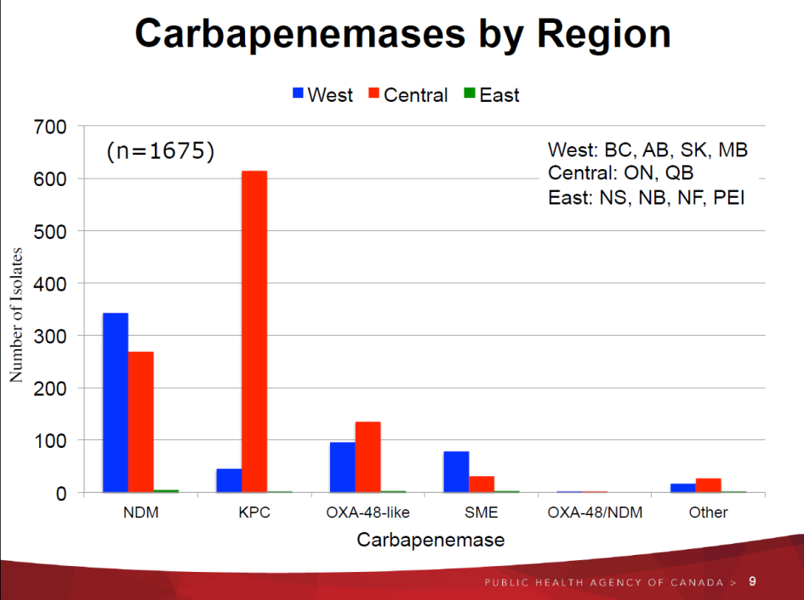

Slide 22


Travel Related
Antibiotic Resistance including Medical Tourism

Slide 23
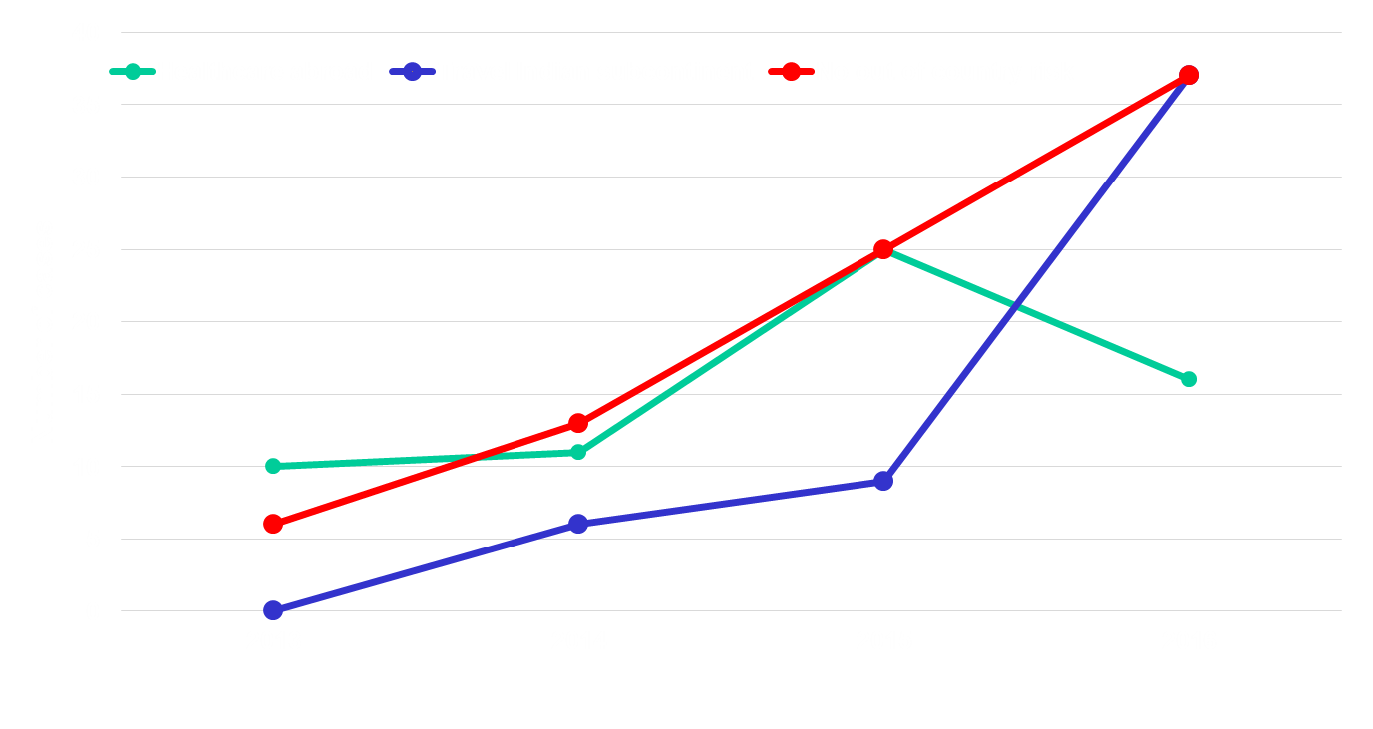
CPE in Toronto/Peel, colonized/infected patients
TIBDN, 2017 (A. McGeer)

Slide 24

CPE Risk Factors
Similar as for other AROs: - recent hospitalization - ICU admission - invasive medical devices - antibiotic exposure - chronic wounds
Savard, Infect Control Hosp Epidemiol 2013

Slide 25
CPE Fecal Carriage
mean duration of CPE fecal carriage post-hospital discharge: 387 days; 39% still carrying CPE at 1-year post-discharge
risks associated with prolonged carriage: - repeat hospitalization - CPE in clinical culture
(not just screening cultures)
Zimmerman, Am J Infect Control 2013

Slide 26
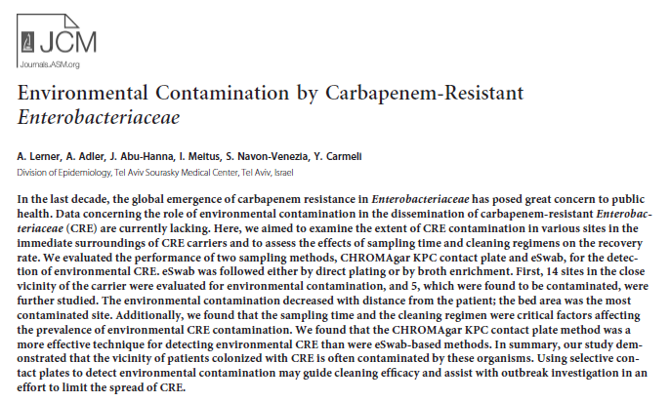
Environmental contamination of the hospital environment is common
Lerner, J Clin Microbiol 2013

Slide 27
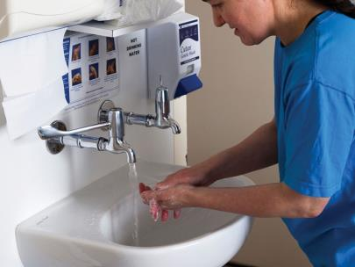
Contaminated Hospital Sinks
contaminated handwashing sinks identified as a source/reservoir for ongoing transmission of CPEs
Lowe, Infect Control Hosp Epidemiol 2013
Vergara-Lopez, Clin Microbiol Infect 2013;
Leitner, Antimicrob Agents Chemother 2015

Slide 28
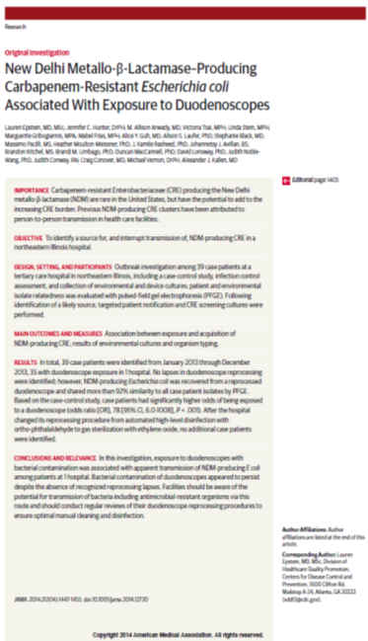
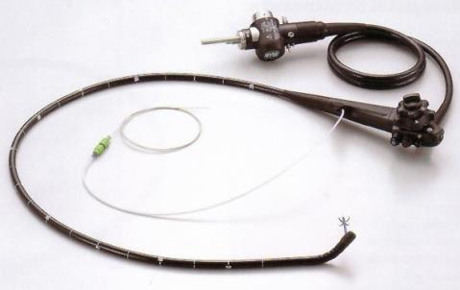
CRE Transmission via Duodenescopes

Slide 29
CRE Transmission via ERCP Scopes
A US Senate investigation found 250 scope-related CRE infections reported from 25 hospitals/clinics in the US and Europe, 2012-2015
Promed-mail, Apr. 16, 2016

Slide 30
Carbapenemase-Producing Enterobacteriaceae
KPC (Klebsiella pneumoniae carbapenemase)
NDM-1 (New Delhi metallo-β-lactamase)

Slide 31
KPC
K. pneumoniae carbapenemase (Ambler class A serine β-lactamase)
bla_{KPC} gene resides on a transposon, Tn4401
hydrolyzes all β-lactams, and typically multidrug-resistant

Slide 32
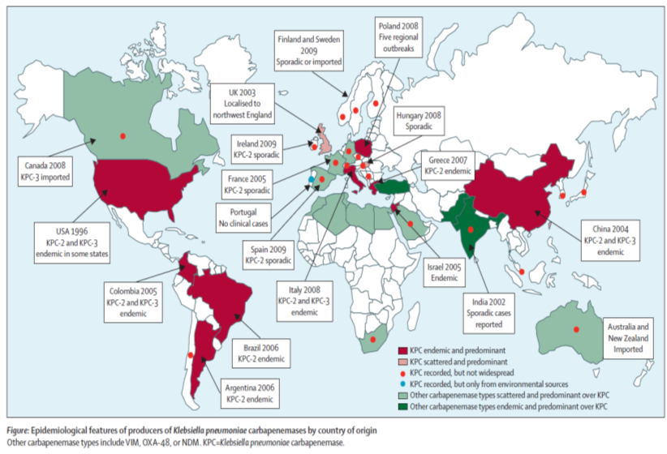
K. pneumoniae Carbapenemase
Munoz-Price, Lancet Infect Dis 2013

Slide 33
KPC - Epidemiology
clonal outbreaks in New York, Israel, Greece, Colombia, Brazil, China
outbreaks in Montreal and Toronto hospitals

Slide 34
KPC in the US
KPC is the most common carbapenemase in the US, and is endemic in many areas
NYC: 2% of ICU patients colonized or infected with KPC, and KPC accounted for 26% of all invasive K. pneumoniae infections
Chicago: 3% of ICU patients and 30% of LTACH residents
Calfee, Infect Control Hosp Epidemiol 2008; Patel, Infect Control Hosp Epidemiol 2008; Lin, Clin Infect Dis 2013

Slide 35
KPC in the US
meropenem-resist K. pneumoniae increased from 0.6% in 2004 to 5.6% in 2008¹
NHSN surveillance of device-related infections (2006-07): carbapenem-resist in 10.8% K. pneumoniae and 4.0% E. coli ²
¹Rhomberg, Diagn Microbiol Infect Dis 2009; ²Hidron, Infect Control Hosp Epidemiol 2008

Slide 36
KPC
Risk Factors
prior use of multiple antibiotics, especially a β-lactam or fluoroquinolone
prolonged hospitalization
ICU admission
Woodward, Antimicrob Agents Chemother 2004; Bratu,
Arch Intern Med 2005; Nordmann, Lancet Infect Dis 2009

Slide 37
KPC
Outcome
KPC infection associated with higher mortality than that caused by carbapenem-susceptible organism (Bratu, Arch Intern Med 2005; Marchaim, Antimicrob Agents Chemother 2008)
KPC BSI associated with 40%-70% crude mortality, and attributable mortality as high as 50% (Schwaber, Antimicrob Agents Chemother 2008; Borer, Infect Control Hosp Epidemiol 2009; Ben-David, Clin Microbiol Infect 2012; Tumbarello, Clin Infect Dis 2012)

Slide 38
NDM-1
New Delhi metallo-β-lactamase plasmid-mediated
has been found in many different coliform species
resistant to all β-lactams and to most other classes of antibiotics

Slide 39
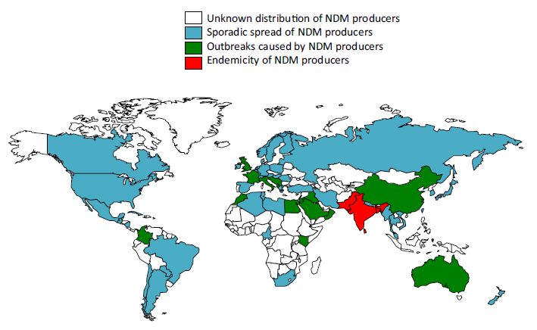
NDM-1
Endemic in south Asia
Kumarasamy, Lancet Infect Dis 2010; Nordmann, Clin Microbiol Infect 2014

Slide 40
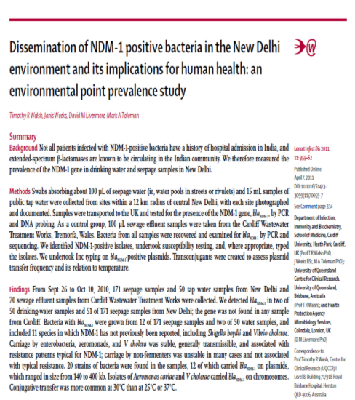
NDM-1 widespread in tap water and sewage in New Delhi, India
2/50 water specimens
and 12/170 sewage
specimens
20 different bacterial species
(can also be found in surface water and sewage in Canada)
Walsh, Lancet Infect Dis 2011

Slide 41
NDM-1
Outcome
In a case–control study of patients with hospital-acquired NDM-1 infection, adjusting for co-morbidity, NDM-1 infected patients had: - longer mean LOS (44 vs. 13 days; p<0.001) - higher mortality (55% vs. 15%; aOR 11.3)
De Jager, PLoS One 2015

Slide 42
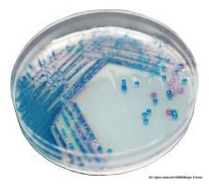

Carbapenem Resistance
Diagnosis/Detection
Lab detection challenging due to heterogeneous expression of resistance to β-lactams

Slide 43

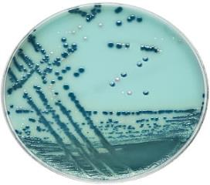
KPC Chromagar (Colorex)
Chromogenic Media
KPC Chromagar
for KPC detection:
100% sensitive
98% specific
less sensitive for other carbapenemases
Brilliance CRE
Perry, J Antimicrob Chemother 2011;
Wilkinson, J Clin Microbiol 2012;
Simner, J Clin Microbiol 2016

Slide 44
Tests for Carbapenemases
Phenotypic tests - Modified Hodge Test (MHT) - Carba NP - Carbapenem Inactivation Method
Molecular tests - PCR

Slide 45
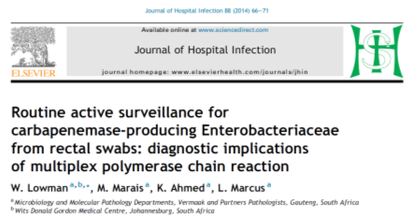

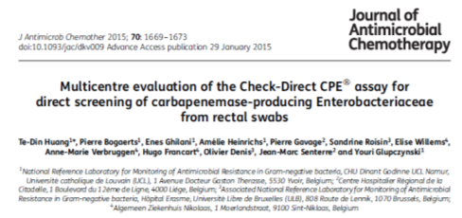
PCR for CPE Screening from Rectal Swabs
GeneXpert Carba-R
bla_{KPC}
bla_{NDM}
bla_{VIM}
bla_{oxa-48}
bla_{IMP}

Slide 46
CPE Challenges
multiresistant (few treatment options)
lab detection may be difficult (screening media; confirmation of CPE)
prolonged fecal carriage and easily transmitted (clonal spread or plasmids)
environmental contamination may be common, unrecognized (sinks, endoscopes)
lack of data re: effective infection control

Slide 47
KPC & NDM-1 Outbreaks Controlled with ‘bundles’:
attention to hand hygiene
active screening
contact precautions
cohorting as required
enhanced environmental cleaning
antibiotic stewardship
Kochar, Infect Control Hosp Epidemiol 2009; Borgia, Clin Infect Dis 2012; Lowe, Infect Control Hosp Epidemiol 2013; Fournier, Euro Surveill 2014; Abdallah, J Antimicrob Chemother 2016

Slide 48
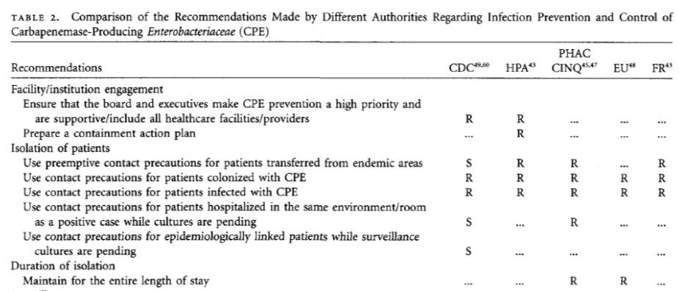
CPE Infection Control Guidelines
R, Recommended; S, Suggested
Savard, Infect Control Hosp Epidemiol 2013

Slide 49
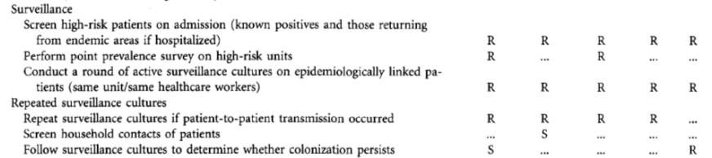
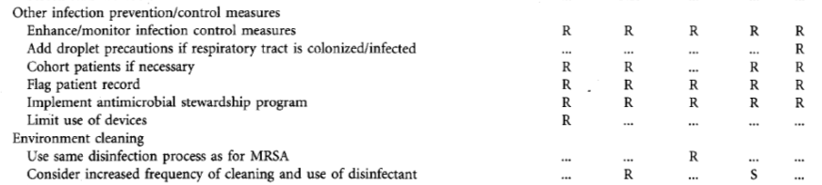
CPE Infection Control Guidelines
Savard, Infect Control Hosp Epidemiol 2013

Slide 50
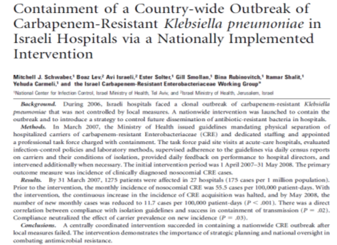
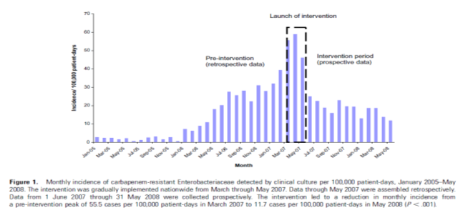

Nation-wide Control of KPCs in Israel
Schwaber, Clin Infect Dis 2011

Slide 51

KPC Control in Israel
Nationally mandated IP&C “bundle” implemented in 2007-2008:
active surveillance (rectal swab) for all high-risk patients
contact precautions in private room or cohorting of all CRE patients; cohorting staff and dedicated equipment
flag patients on readmission
mandatory reporting to public health of every CRE patient, and daily census
national task force to oversee, provide feedback, and advice to individual hospitals
Cohen, ICHE 2011; Borer, ICHE 2011; Schwaber, CID 2011; Schwaber, CID 2014

Slide 52
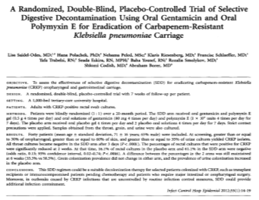
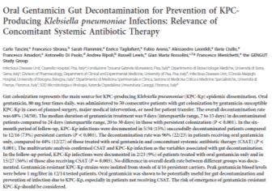
KPC Decolonization
RTC: oral gentamicin + polymyxin E vs. placebo X 7 days
↓ KPC rectal carriage for up to 6 weeks
case series, 50 patients
oral gentamicin
↓ KPC colonization
↓ KPC infections

Slide 53
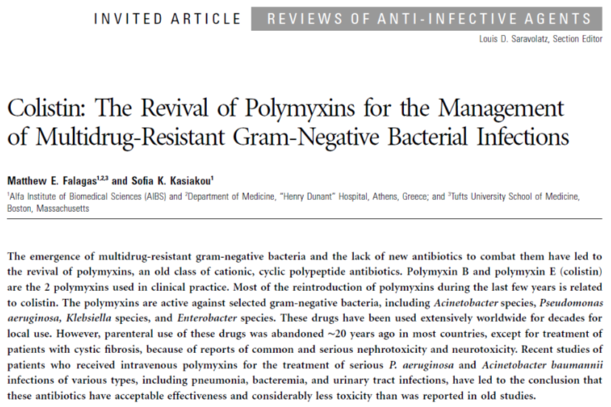
Colistin
Falagas, Clin Infect Dis 2005

Slide 54
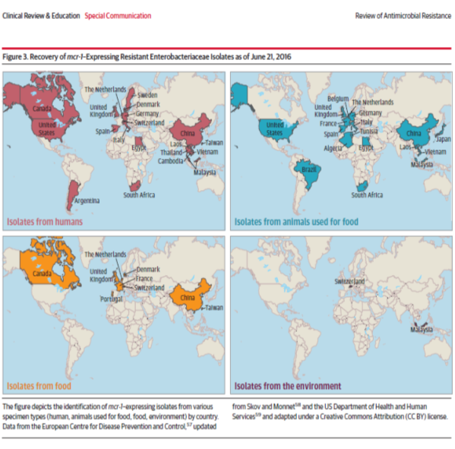
Colistin-Resistant Enterobacteriaceae
Marston, JAMA 2016

Slide 55
mcr-1-positive Colistin-Resistance in Canada
A few reports of mcr resistance in human isolates reported as of Mar. 2017:
Mulvey, Lancet Infect Dis 2016;
Payne, Emerg Infect Dis 2016;
Walkty, CMAJ Open 2016

Slide 56
Summary
Although still uncommon in Canadian hospitals, the incidence of CPEs is rising, including increased rates of nosocomial transmission
Enormous impact on patient mortality and outcome
IP&C and antimicrobial stewardship are critical to reduce emergence and spread

Slide 57
