Slide 1

Epidemiology, Prevention and Control of Gram Negative Antibiotic Resistant Rods
Elaine Larson
Professor of Epidemiology
Joseph Mailman School of Public Health
Columbia University
Hosted by Paul Webber
paul@webbertraining.com
www.webbertraining.com
January 21, 2016

Slide 2
Outline
General National Trends in Prevalence/Incidence
  E. coli
  A. baumannii
  K. pneumoniae
  P. aeruginosa
Focus on hospitals, pediatrics, nursing homes
What next?

Slide 3
National Trends

Slide 4
Percent (Rank) of GNB Causing HAI (2009-10)
Organism | CLABSI | CAUTI | VAP | SSI | Total
A. baumannii | 2.1% (13) | 0.9% | 6.6% (5) | 0.6% | 1.8% (14)
E. coli | 4.0% (9) | 26.8% (1) | 5.9% (6) | 9.4% (3) | 11.5% (2)
K. pneumoniae | 7.9% (5) | 11.2% (3) | 10.1% (3) | 4.0% (7) | 8.0% (4)
P. aeruginosa | 3.8% (10) | 11.3% (2) | 16.6% (2) | 5.5% (5) | 7.5% (5)
Sievert, et al. Infect Contr Hosp Epidemiol 2013; 34:7

Slide 5
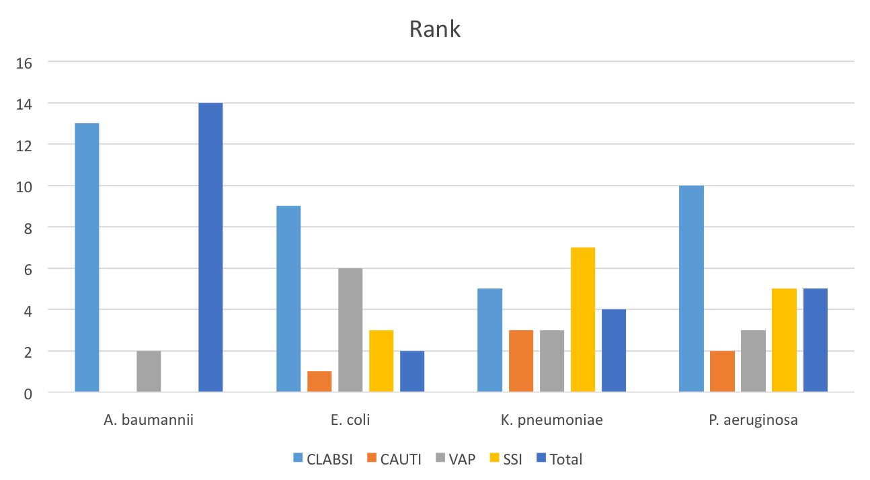
Rank of total HAIs caused by selected GNBs

Slide 6
Top Contenders
(in alphabetical order)
  Acinetobacter baumannii (carbapenem/colistin resistant)
Carbapenem resistant Enterobacteriaceae
  Escherichia coli (ESBL producing)
  Klebsiella pneumoniae (ESBL producing, carbapenem resistant)
Extended spectrum β-lactamase (ESBL) producing Enterobacteriaceae

Slide 7
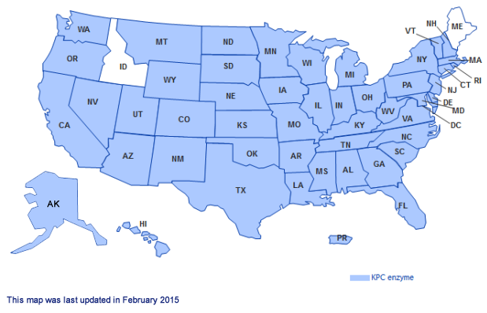
Carbpenemase-Resistant Enterobacteriaceae: US, 1915
http://www.cdc.gov/hai/organisms/cre/TrackingCRE.html

Slide 8
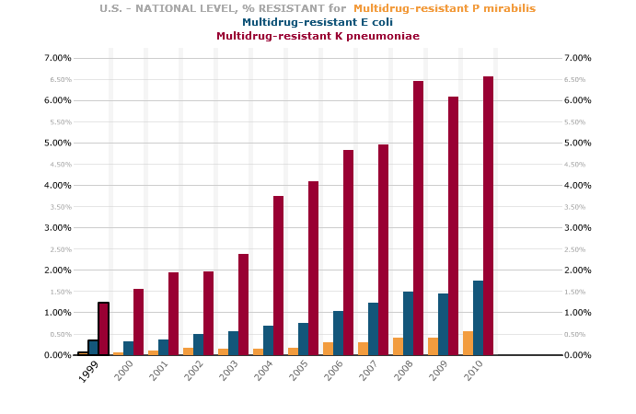
http://www.cddep.org/projects/resistance_map/resistance_overview_0

Slide 9
Intra-abdominal isolates (2002-12)
Decreased activity of amikacin, ceftazidime, ceftriaxone, ciprofloxacin, levofloxacin, imipenem-cilastatin against all Enterobacteriaceae from ICUs
Reduced susceptibility of A. baumannii
ESBL-positive isolates between 2007-8 and 2010-12
  E. coli increased from 4.6% to 6.8% (2007 to 2012)
  K. pneumoniae decreased from 17.5% to 12.7%
ESBL rates in pediatric ICU isolates, 2010
  E. coli: 4%
  K. pneumoniae: 25%
    Hackel, et al. Surg Infect 2015; 16: epub ahead of print

Slide 10
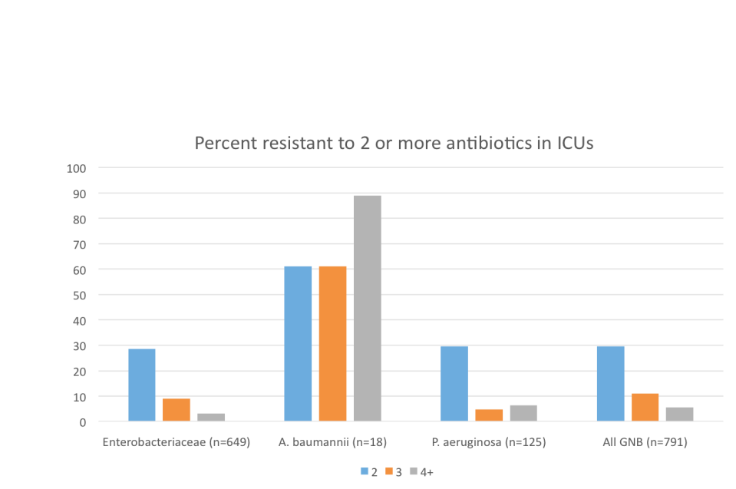
Intra-abdominal isolates:
US 2010-12
Hackel, et al. Surg Infect 2015; 16: epub ahead of print

Slide 11
MMWR Morb Mortal Wkly Rep. 2013
Mar 8;62(9):165-70.
In 2012, 4.6% of acute-care hospitals reported at least one CRE HAI (short-stay hospitals, 3.9%; long-term acute-care hospitals, 17.8%)
The proportion of Enterobacteriaceae that were CRE increased from 1.2% in 2001 to 4.2% in 2011
Most of the increase was observed in Klebsiella species (from 1.6% to 10.4% in NNIS/NHSN)
92% of CRE episodes occurred in patients with substantial health-care exposures.

Slide 12
CRE in US military system
75 million person-years and 1,969,315 cultures from all 266 hospitals US military health system (2005-2012)
Incidence remained under 1 case per 100,000 person-years
Incidence increased relative to 2005 baseline levels in 3 of 7 subsequent years, then decreased in 2012 (P<0.05)
Inpatient consumption of fluoroquinolones was significantly correlated (P=0.0007) with CR in E. coli
  Lesho EP, et.al. Diagn Microbiol Infect Dis 2015; 81:119-25.

Slide 13
Multi-Site Gram-Negative Bacilli Surveillance Initiative (MuGSI)
Established in 2012 as part of Emerging Infections Program of CDC
Objectives:
  Determine the extent of CRE and MDR Acinetobacter disease in the United States
  Identify people most at risk for illness from these organisms
  Measure trends of disease over time
As of 2014, surveillance in 8 states, population of 13,725,041

Slide 14
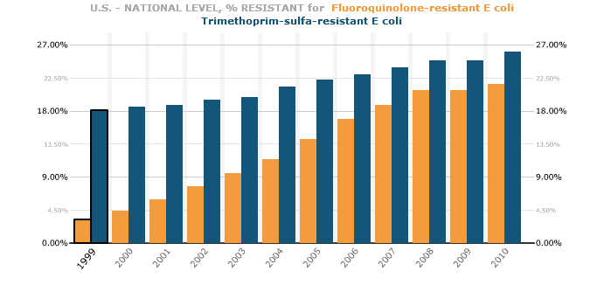
http://www.cddep.org/projects/resistance_map/escherichia_coli_overview_0

Slide 15
Status: E. coli
Resistance to trimethoprim-sulfamethoxazole (TMP-SMZ) and fluoroquinolones has been climbing at a steady pace over the last decade.
Since the 1990s, fluoroquionolones like ciprofloxacin have been prescribed in place of the older therapies, particularly in communities where TMP resistance exceeds 20%.
National-level E. coli multidrug resistance (simultaneous resistance to third-generation cephalosporin, aminoglycoside and fluoroquinolone) increased yearly from 0.37% in 1999 to 1.76% in 2010.
Growing resistance spread uniformly throughout the country, starting from East North Central states.
http://www.cddep.org/projects/resistance_map/multidrug_resistant_escherichia_coli

Slide 16
Status:
Acinetobacter baumannii
Drug-resistant A.baumannii frequently dwells on IV and catheter lines of ICU patients.
Because of Acinetobacter’s low virulence, few colonized patients develop a disease. However, when an infection does occur, it often results in hospital-wide outbreaks and relatively high rates of mortality.
In the outpatient setting, the pathogen has been associated with wound infections among soldiers, earning it the name “Iraqibacter.”

Slide 17
Antibiotic Resistance Genes in Multidrug-Resistant Acinetobacter sp. Isolates from Patients Treated at Army Hospital
Sixteen unique resistance genes and four mobile genetic elements detected in 75 unique patient isolates
89% resistant to at least 3 antibiotic classes; 15% resistant to all antibiotics tested
Eight major clonal types, very complex genetic background
Hujer et al, Antimicrob Agents Chemother 2006; 50:4114-23.

Slide 18
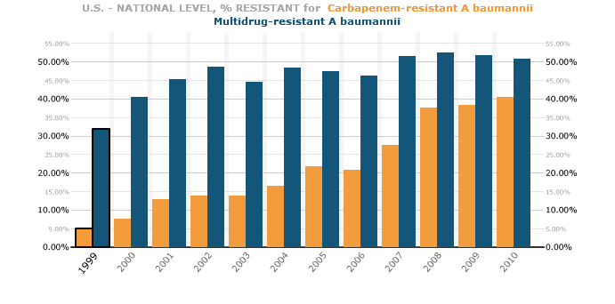
http://www.cddep.org/projects/resistance_map/acinetobacter_baumannii_overview

Slide 19
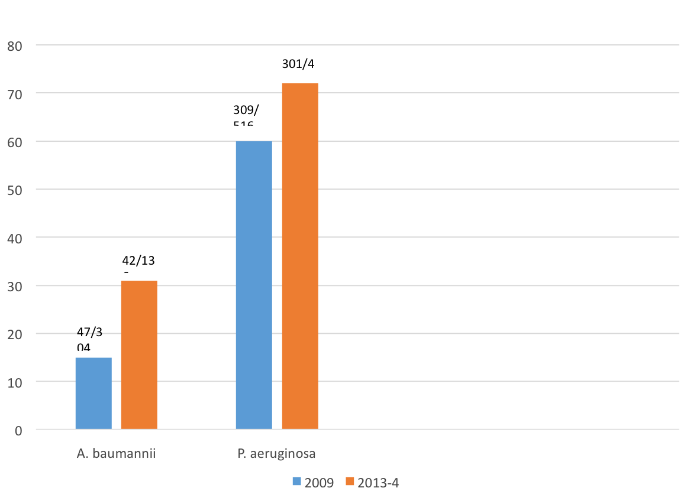
Meropenem susceptible isolates of A. baumannii and P. aeruginosa:
10 New York City hospitals
Abdallah, et al. AJIC 2015; epub Mar 26

Slide 20
Healthcare-associated resistant vs. susceptible A. baumannii strains in two NYC hospitals
Two-sided Cochran-Armitage trend test, p-value=0.73
Ellis, Cohen, Liu, Larson, in press

Slide 21
Factors associated with HAIs caused by antimicrobial resistant vs. susceptible
A. baumannii
Covariates | Odds ratio
Length of Stay Prior to Infection | 1.03 (1.01, 1.04)
Hospital A vs. B | 0.35 (0.13, 0.93)
Respiratory Infection | 2.96 (1.04, 8.44)
Antibiotic Use Prior to Infection | 2.88 (1.02, 8.13

Slide 22
Fatal Outbreak of Emerging Clone of Extensively Resistant A. baumannii
Six immunocompetent patient deaths, 2011
Mean: 60 years (28-81), none traveled outside U.S.
Two unrelated clades were associated
Clade B was distinct from other international clonal complexes and more virulent than comparator strains
Jones, et.al. Clinical Infectious Diseases 2015;61(2):145

Slide 23
Features of the A. baumannii Strain in Jones et al Compared With “Typical” Healthcare-Associated Strains Reported Around the World
Feature | Jones et al | Typical strains
Geographic locale | Northwestern United States | Worldwide
Belongs to international clonal complex | No (ST10) | Typically
Carbapenem resistant | Sometimes | Frequently
Mechanism of carbapenem resistance | Porin loss; no carbapenemase | Carbapenemase (typically)
Virulence | Highly virulent | Low virulence
Jones, et.al. Clinical Infectious Diseases 2015;61(2):145;
Peterson DL, Harris PNA. Clin Infect Dis 2015; 61(2):155-6

Slide 24
Conclusions
Clade B isolates resist early innate effectors, leading to sustained bacteremia
…”these findings support the contention that the first dose of antibiotic is the most crucial and so should be rationally dosed for greatest impact.”
“Clinicians and infection preventionists should remain vigilant for XDR and highly virulent clade B”

Slide 25
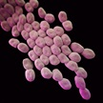
Colistin-resistant A. baumannii:
Beyond carbapenem resistance
20 patients at U Pittsburgh Med Center
19/20 had received colistin for carbapenem resistant A. baumannii
30% mortality rate
Qureshi, et al. Clin Infect Dis 2015; 60 (1 May): 1295-1304

Slide 26
Status: K. pneumoniae
Carbapenem-resistant K. pneumoniae (KPC) originated in North Carolina in 1996. Within two years, KPC was reported in every census division with national levels of resistance growing every year.
Major outbreaks in New York City (2000s) and spread internationally
Parallel to KPC, rates of multidrug-resistant K. pneumoniae (simultaneously resistant to third-generation cephalosporins, fluoroquinolones in blue and aminoglycosides in orange) have been increasing each year and now exceed 6% nationally.
Of note is the rise and overlapping trend in resistance to fluoroquinolones and third-generation cephalosporins, likely due to the spread of ESBL-producing strains from cities on the East Coast into other parts of the country.
  http://www.cddep.org/projects/resistance_map/klebsiella_pneumoniae_overview
  Hawkey PM, J Hosp Infect 2015; 89:241-7.

Slide 27
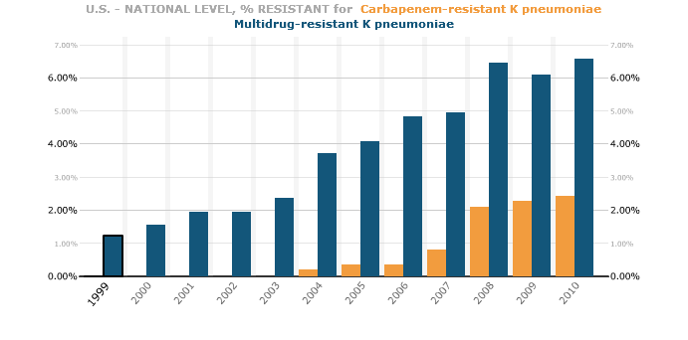
http://www.cddep.org/projects/resistance_map/klebsiella_pneumoniae_overview

Slide 28
CRE K. pneumoniae outbreak
At US NIH Clinical Center, 2011
18 patients, 11 died
Patient 1 known to be colonized with CRE-KP admitted to ICU
Immediately placed on contact precautions in private room
No spread noted during her hospitalization
Patient 2, 3 weeks later, positive tracheal aspirate
In following weeks, about 1 new case/week for the next 6 months was detected
Snitkin ES, et.al. Science Translational Medicine 2012; 4(148):116

Slide 29
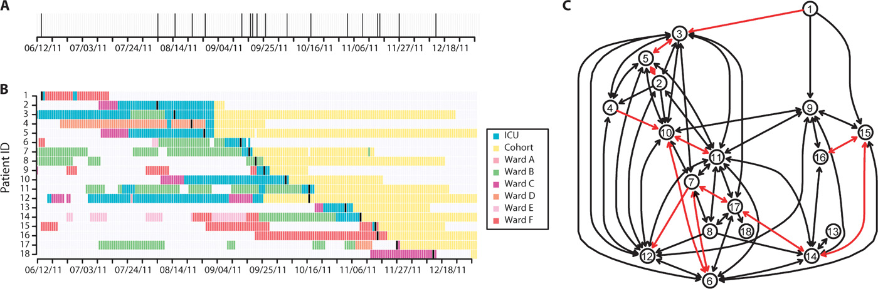

Slide 30
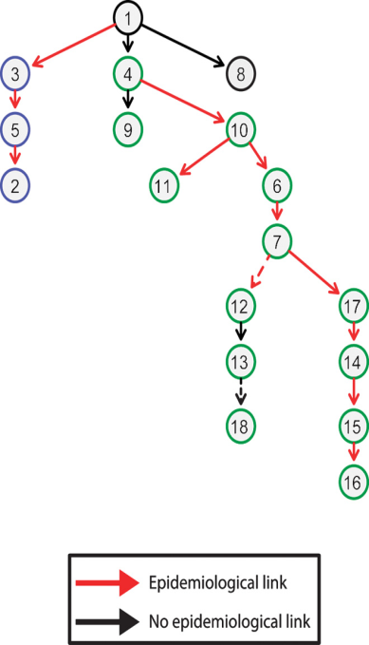
Transmission Map
Blue, cluster I;
Green, cluster II.
Red arrows, opportunity for direct transmission from patients overlapping in the same ward;
Black arrows, transmission events that cannot be explained by patient overlap (may result from a more complicated transmission route or an intermediate patient or environmental source);
Dashed lines, at least one other transmission link exists leading to the given patient.

Slide 31

Conclusions
(based on genomic and epidemiologic analyses)
All cases likely originated from at least two different body sites in the index patient
There were at least three different initial transmission events
One of the infections could be linked to contamination of a ventilator
Traditional contact precautions and patient isolation were insufficient to stop transmission

Slide 32
In the Hospital Environment
119 samples from 15 rooms (8 surfaces) that housed CRE-positive patients
Infrequent environmental surface contamination (8.4%) and at low levels (average, 5.1 colony-forming units [CFU]/120 cm² per contaminated surface)
Three species of CRE (Klebsiella, Enterobacter, and Escherichia) survived poorly (>85% die-off in 24 hours) with ~2 log10 CFU inoculated onto 5 different environmental surfaces
  Weber, et.al. Infect Contr Hosp Epidemiol 2015; 36:590

Slide 33
CRE Klebsiella
Carbapenem-resistant Klebsiella in US hospitals: < 1% in 2000, 8% in 2006–2007, 12% in 2009–2010
Initial outbreaks of KPC-producing Klebsiella occurred in NYC hospitals in 2003-2004
We examined all data from all patient discharges, 2006-12 from 4 NYC hospital, n=761,426

Slide 34
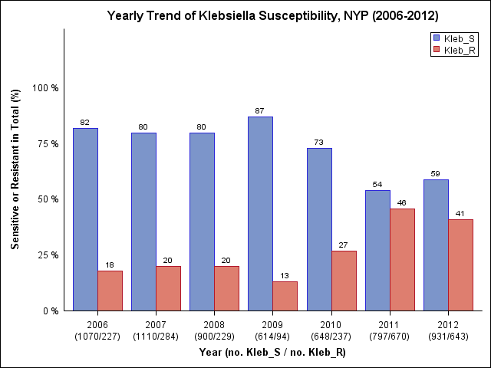
Carbapenem-resistant Klebsiella, 2006-2012
Dramatic increase in 2010-2012
18-20% in 2006-2007 (8% national rate)
13-27% in 2009-2010 (12% national rate)

Slide 35
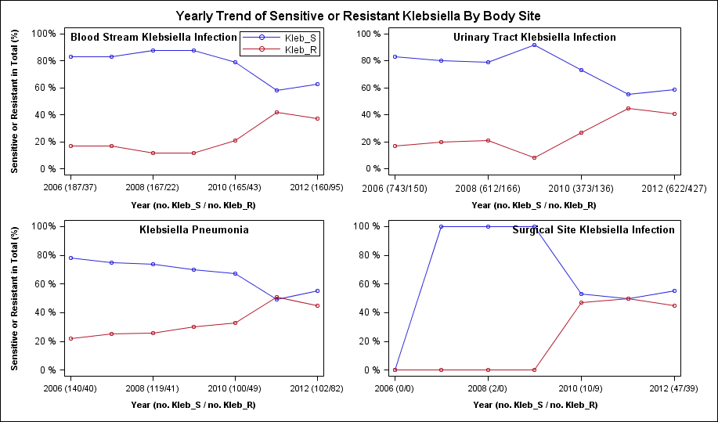
Carbapenem-resistant Klebsiella by body site, 2006-2012

Slide 36
Sensitive and resistant Klebsiella infections by body site:
CAI vs. HAI
Blood stream infection resistance (18.7% vs. 28.2%)
UTI resistance (26.8% vs. 29.3%)
Pneumonia resistance (23.7% vs.33.2%)

Slide 37
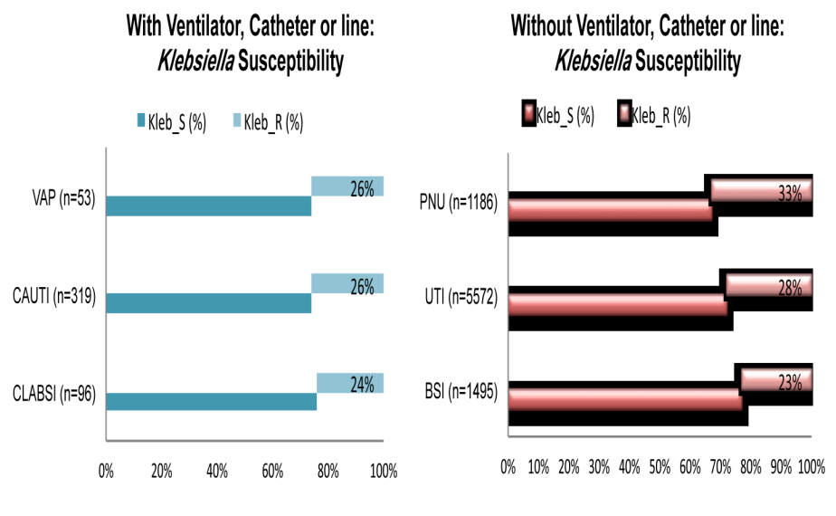
Device-associated Klebsiella resistance, 2006-2012

Slide 38
In Pediatrics
347-bedpediatric tertiary care center in Los Angeles, CA
Eleven CRE isolates recovered from 10 patients between April 2011 and May 2013
Sporadic cases with no molecular or epidemiologic links to one another
CRE in pediatric patients still rare
  Pia, et.al. Pediatr Infect Dis J 2015; 34:11

Slide 39
Genomically informed surveillance
41 carbapenem-resistant K. pneumoniae and E. cloacae isolates collected over 3 years underwent whole genome sequencing
Limited outbreaks; rather sporadic detection of identical plasmids up to more than a year apart
No common hospital reservoir could be identified
Still much to learn!
Pecora, et al. mBio 2015; Jul 28;6(4). pii: e01030-15. doi: 10.1128/mBio.01030-15

Slide 40
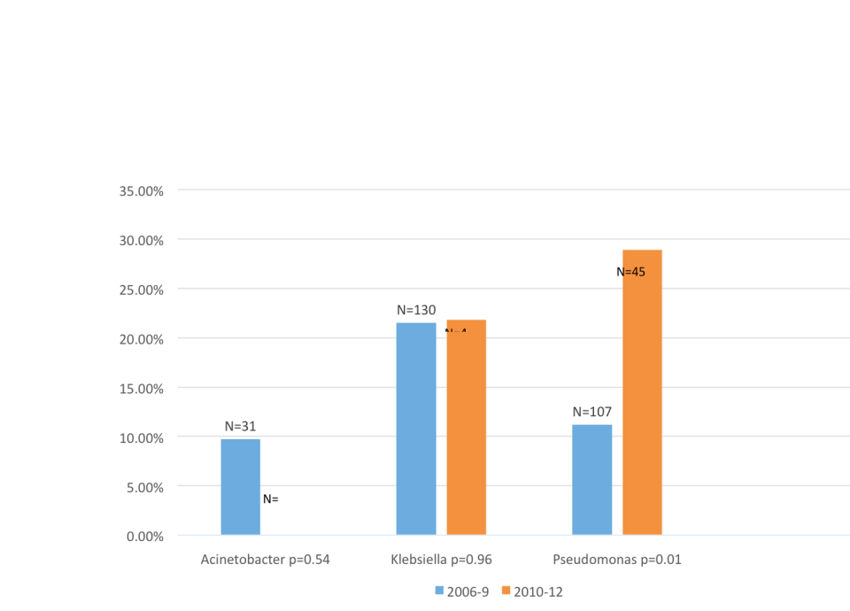
MDRO GNB infections: Tertiary Care Pediatric Hospital NYC (n=87,132 discharges)
Ellis, Cohen, Liu, Larson, in press

Slide 41
In Nursing Homes
22 nursing homes, Boston, 2009-14
Among residents with advanced dementia
57.9% (110/190) of samples tested grew MDR-GNB resistant to ≥3 of the following: ciprofloxacin, extended-spectrum penicillins, meropenem, gentamicin, third-generation cephalosporins
Percent clonally related: 0-36% (mean: 36%)
>50% strains clonally related in 3 nursing homes
Co-colonization with several MDR-GNB in 18.4% of residents

Slide 42
KPC-Producing Bacteria in 4 Longterm Care Hospitals: Chicago, 2012-13
Interventions ongoing
  Screening for KPC rectal carriage, daily chlorhexidine bathing, medical staff education
  Cohorting: (1) all KPC-positive patients on 1 floor), (2) single rooms for KPC-positive patients, and (3)all KPC-positive patients on 1 floor, supplemented with KPC-negative patients
95,982 patient days and 3,257 admissions of 2,575 unique patients
KPC colonization was 29.3%; 18% on admission
Conclusion: Cohorting or single rooms for KPC-positive patients seemed to limit transmission
Haverkate, et.al. Infec Contr Hosp Epidemiol 2015; 36(10):1148-1154

Slide 43
Nursing Homes and MDR A. baumannii
Four nursing homes in Michigan
15% (25/168) colonized with MDR A. baumannii
88% were colonized with multiple antibiotic-resistant organisms and 64% were co-colonized with at least one other resistant gram-negative bacteria.
Compared with controls, cases were significantly more disabled, colonized with Proteus mirabilis, and diabetic.
Mody, et al. Infec Contr Hosp Epidemiol 2015; 36(10): 1155-1162

Slide 44
Fluoroquinolone (FQ)-resistant E. coli in nursing homes
50% of NH residents with FQ-susceptible E. coli acquire FQ-resistance within a year
Risk factors: fecal incontinence, urinary catheter, amoxicillin-clavulanate
  Han, et al. J Infect Dis 2014; 209:420
In a case-control study, 12% (11/94) NH residents colonized rectally with FQ-resistant E. coli became clinically infected within 1 year.
Risk factors for infection: urinary catheter or tracheostomy, diabetes, SMZ-TMP
  Manning, et al. Infect Contr Hosp Epidemiol 2015; 36:575
Conclusion: FQ-resistant E. coli is highly prevalent in nursing homes

Slide 45
In the food supply
2012, Arizona
241/508 (47%) meat samples from 9 food store chains positive
174/1728 (10%) urine samples positive
32% of meat isolates and 8% of clinical isolates were multi-resistant (p=0.01)
Third generation cephalosporin resistance and ESBL production was only in meat samples
Close genetic relationship between meat and clinical isolates
In same time period, >5.9 million kg of tetracyclines and >270,000 kg of aminoglycosides were sold for food animal production
  Davis, et.al., Clin Infect Dis 2015; 61(6):892-900.

Slide 46
Antibiotics in Agriculture
In 2011, 30 million pounds of antibiotics were sold for use in beef, pork and poultry production. That’s four times the amount sold to humans who were sick
(NY Times, Jul 10, 2013)
Many of the antibiotics used in this setting are of the same class as those used to treat human infections
  Macrolides, tetracyclines, glycopeptides

Slide 47
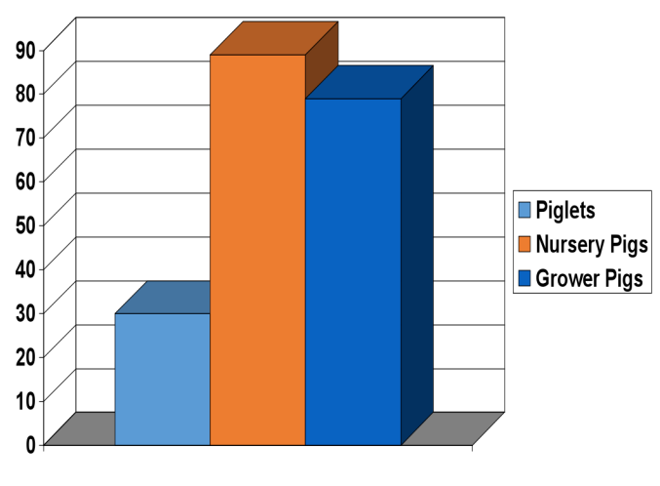
Percentage U.S. swine receiving antibiotics in their feed
US DOA, 2007 cited in NY Times, 12/16/07

Slide 48
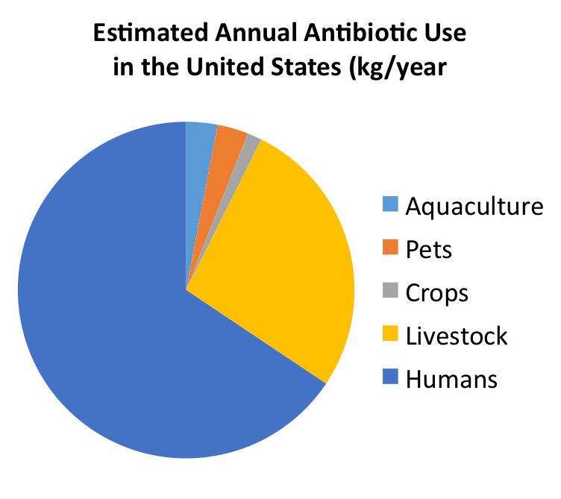
NEJM 2013; 369:2474

Slide 49
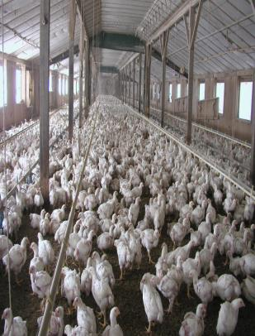
Science, 1/27/14
“A federal analysis of 30 antibiotics used in animal feed found that the majority of them were likely to be contributing to the growing problem of bacterial infections that are resistant to treatment in people”

Slide 50
“More than 30 years ago when I was commissioner of FDA we proposed eliminating the use of penicillin and two other antibiotics to promote growth in animals raised for food.
When agribusiness interests persuaded Congress not to approve that regulation, we saw first-hand how strong politics can grump wise policy and good science.”
Donald Kennedy, NY Times, 4/18/10

Slide 51
Nov 10,2011
FDA denied a pair of long-pending petitions from consumer and other groups to limit the use of several antibiotics in farm animals, saying a voluntary approach the agency proposed last year will lead to more "judicious use" of the drugs in agriculture.
Center for Infectious Disease Research and Policy (http://www.cidrap.umn.edu/cidrap/content/fs/food-disease/news/nov1011petitions.html, accessed 11/11/11)

Slide 52
Progress?
“The FDA released a policy document stating that agricultural uses of antibiotics should be limited to assuring animal health, and that veterinarians should be involved in the drugs’ uses.
While doing nothing to change the present oversight of antibiotics, the document is the first signal in years that the agency intends to rejoin the battle to crack down on agricultural uses of antibiotics that many infectious disease experts oppose. “
NY Times, Jun 29, 2010S

Slide 53
April 10, 2012
New FDA ruling after trying for more than 35 years to stop feeding antibiotics to cattle, pigs, chickens and other animals as growth promoters
Farmers and ranchers for the first time need a prescription from a veterinarian before using antibiotics in farm animals

Slide 54
CDC Report: Antibiotic Resistance Threats in the United States, 2013
Four core actions to fight antibiotic resistance:
Preventing infections, preventing the spread of resistance
Tracking resistance patterns
Improving use of antibiotics
Developing new antibiotics and diagnostic tests
http://www.cdc.gov/narms/resources/threats.html

Slide 55
Presidential Advisory Council on Combating Antibiotic-Resistant Bacteria
First meeting Sept 25, 2015
http://www.hhs.gov/ash/carb/index.html
Provides advice, information, and recommendations regarding programs and policies intended to support and evaluate the National Strategy for Combating Antibiotic-Resistant Bacteria (Strategy) and the National Action Plan for Combating Antibiotic-Resistant Bacteria (Action Plan).

Slide 56
Can CRE be eradicated?
276 prior CRE carriers declared CRE-free
36 (13%) had recurrence of CRE carriage within a year
Factors significantly associated with CRE recurrence:
  time in months between the last positive CRE sample and presumed eradication (odds ratio, 0.94 [95% CI, 0.89-0.99] per month),
  presence of foreign bodies at the time of presumed eradication (4.6 [1.64-12.85]),
  recurrent admissions to healthcare facilities during follow-up (3.15 [1.05-9.47]).
Recurrence rate: 25% when carrier status was presumed to be eradicated 6 months after the last known CRE-positive sample, compared with 7.5% if presumed to be eradicated after 1 year.
  Bart Y, et.al., Infect Contr Hosp Epidemiol 2015; 36(8):936-41.

Slide 57
Perhaps much relates to behavior and systems
420 health care workers from 1 acute care and 1 long-term care facility (Israel)
Organizational culture/staff engagement positively correlated with infection prevention attitudes and compliance with contact precaution protocols and negatively correlated with CRE acquisition rate
Fedorowsky R. AJIC 2015 Jun 23 (epub ahead of print)

Slide 58
Contact precautions significantly reduced the proportion of hospital acquired MDR A. baumannii
 | Standard Precautions: All positive | Contact Precautions/Cohort: All positive | Contact Precautions/Cohort:Only MDR positive | P value
Patient Days | 18,074 | 10,604 | 13,853
MDR A. baumannii | 19% (4/21) | 14% (2/14) | 8% (1/13) | NS
Hosp-acquired | 95% (20/21) | 64% (9/14) | 69% (9/13) | 0.03
Tawney, et al. Infec Contr Hosp Epidemiol 2015; 36(9): 1108-10

Slide 59
What Next?
Rethink barrier/isolation precautions
Rethink impact of organization systems and culture
Maintain carrier status for at least 1 year following ‘eradication’
Consider enhanced environmental cleaning
Enhance antibiotic stewardship program
“Yet, at the present time, our best defense against (MDRO)…remains old-fashioned, stringent infection control measures combined with the application of effective antimicrobial stewardship.”
  Peterson and Harris. Clin Infect Dis 2015; 61(2):156

Slide 60
Happy Reading
Report to the President on Combating Antibiotic Resistance, 2014:
https://www.whitehouse.gov/sites/default/files/microsites/ostp/PCAST/pcast_carb_report_sept2014.pdf
Antibiotic Resistance Threats in the US, 2013:
http://www.cdc.gov/drugresistance/threat-report-2013/pdf/ar-threats-2013-508.pdf#page=6
CDC Antibiotic Resistance Website:
http://www.cdc.gov/drugresistance/index.html

Slide 61

January 28 MRSA IN THE HOSPITAL AND THE COMMUNITY
Dr. Geoffrey Taylor, University of Alberta
February 17 (Free WHO Teleclass ... North America)
SUCCESSFUL IMPLEMENTATION STRATEGY FOR THE
PREVENTION OF SURGICAL SITE INFECTIONS
Prof. Sean Berenholtz, Johns Hopkins Schools of Medicine, Baltimore
February 24 (South Pacific Teleclass)
PATIENT EMPOWERMENT AS PART OF AN ASIAN HAND HYGIENE
PROGRAMME
Prof. Yee Chun Chen, National Taiwan University Hospital and College of Medicine
March 3 MERS-COV: IMPLICATIONS FOR HEALTHCARE FACILITIES
Prof. Sotirios Tsiodras, University of Athens Medical School, Greece
March 10 (FREE Teleclass)
BARRIERS TO TB INFECTION CONTROL IN DEVELOPING COUNTRIES

Slide 62

THANKS FOR YOUR SUPPORT

Slide 63


