Slide 1
Current Trends in Salmonella: Epidemiology, infection and control
DR KEITH WARRINER
DEPT FOOD SCIENCE
UNIVERSITY OF GUELPH
KWARRINE@UOGUELPH.CA
HOSTED BY NICOLE KENNY
VIROX TECHNOLOGIES INC.
www.webbertraining.com
November 12, 2015

Slide 2
Outline
Description of Salmonella -- classification, sources, physiology, and mode of drug resistance
Recent outbreaks and recalls linked to Salmonella
Routes of introducing and the dissemination of Salmonella in the food chain
Overview of the Salmonella Action Plan and implications to the industry
On farm interventions
Processing interventions
Trends in Salmonella diagnostics
Conclusions and research needs

Slide 3
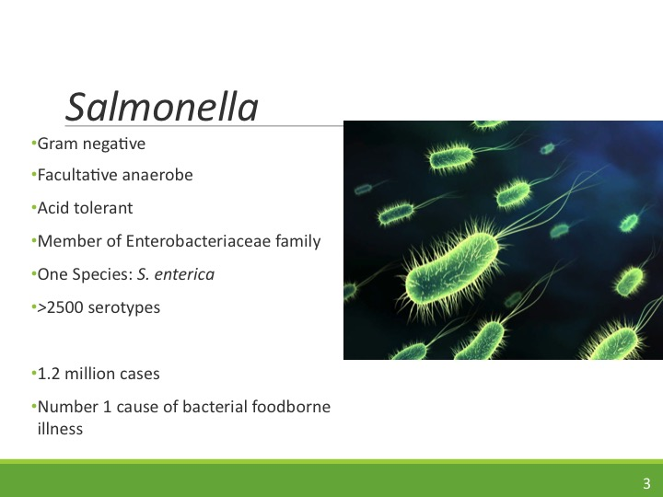

Slide 4
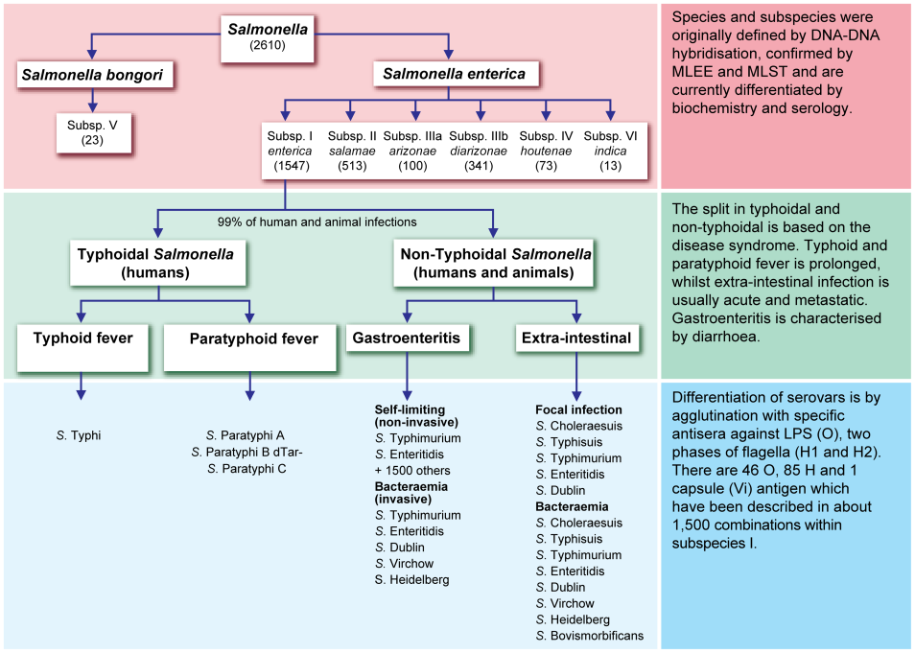

Slide 5
Rank | Serovar | Number of Cases | Incidence per 100,000
1 | Enterititis | 1062 | 2.33
2 | Typhimurium | 1006 | 2.17
3 | Newport | 656 | 1.44
4 | I, 4,[5], 12, i | 383 | 0.79
5 | Javiana | 347 | 0.76
6 | Heidleberg | 243 | 0.53
7 | Montevideo | 211 | 0.46
8 | Muenchen | 194 | 0.43
9 | Tennessee | 140 | 0.31
10 | Saint Paul | 117 | 0.26

Slide 6
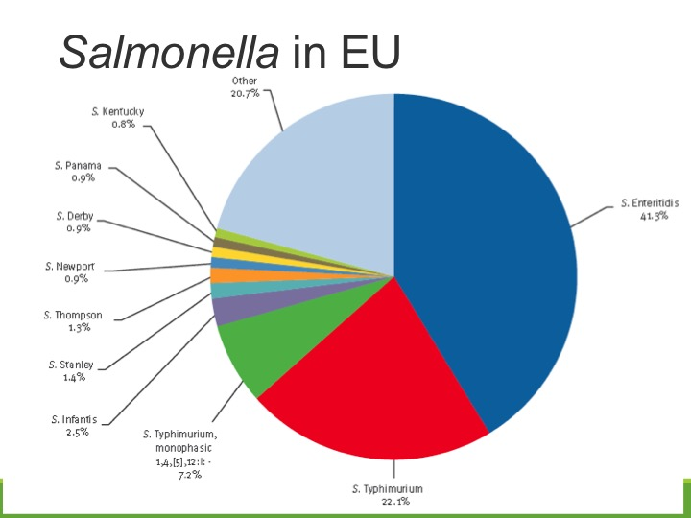

Slide 7
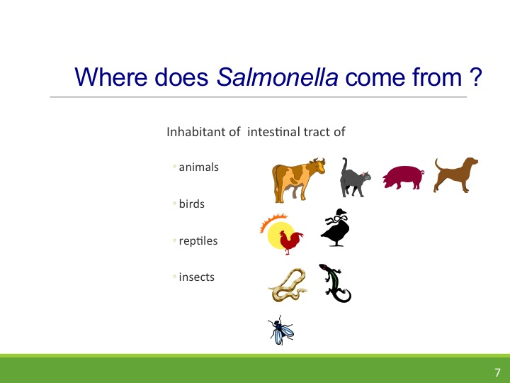

Slide 8
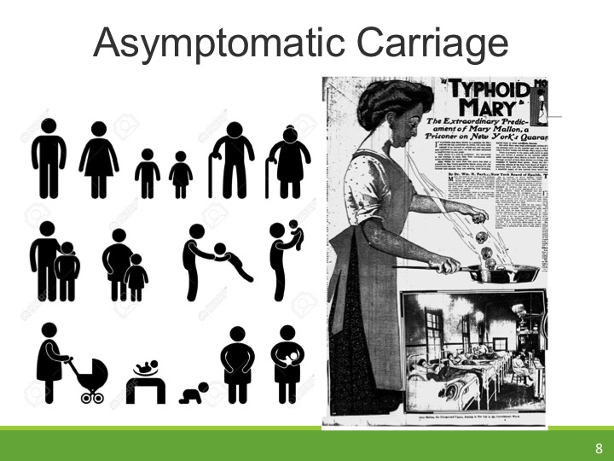

Slide 9
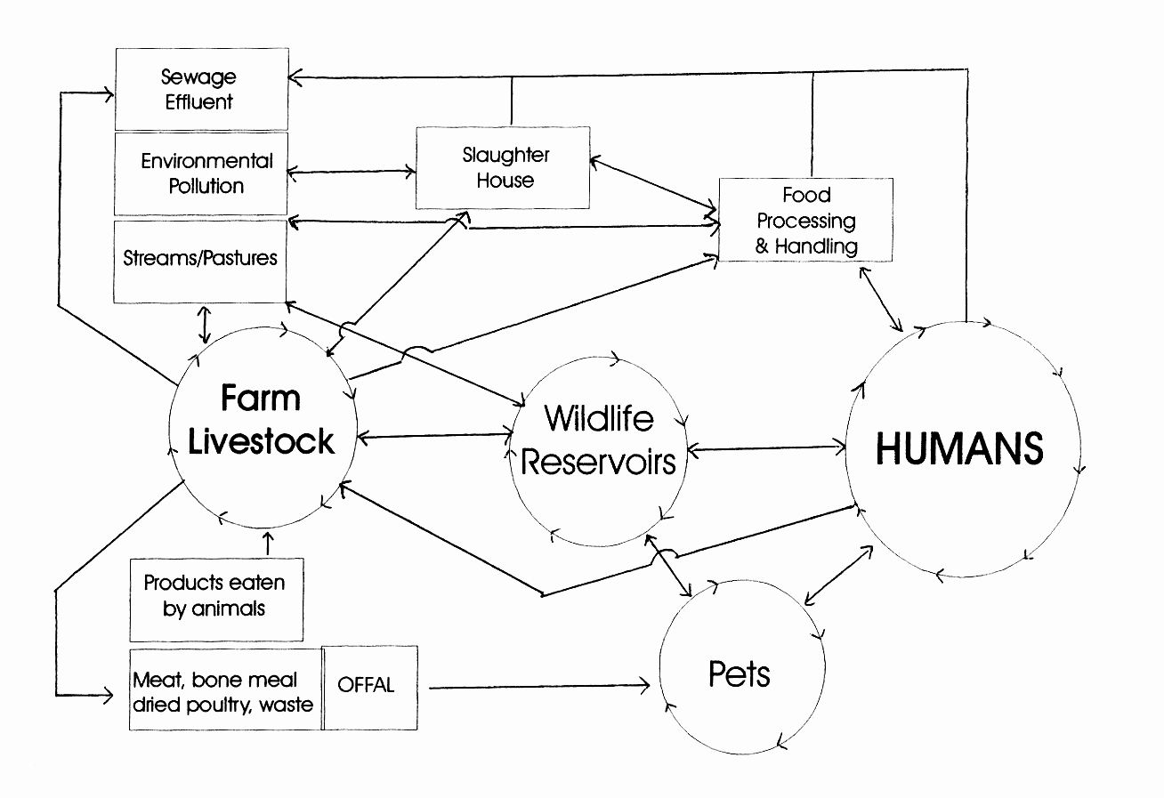
Salmonella Cycling and Recycling

Slide 10
Pasture and soil ---- 200 days
Garden soil ---- 251 days
Liquid manure --- 27 days ( S. Dublin), --- 286 days ( S. Anatum)
Slurry - 84 to 250 days
Infected feces stored in cans - 159 days
(S. Dublin)

Slide 11
Growth Parameters
Temp: 7 – 49°C Opt 37°C Some serovars grow <7°C
pH 3.8 – 9.5 Opt 7.0 – 7.5 (less acid resistant compared to E. coli)
Facultative anaerobe: Can grow in presence of 20-80% carbon dioxide.
Water Activity: 0.94-0.99

Slide 12
Controls
Survives freezing
Thermal resistance is serovar specific
Growth inhibited by 0.1% acetic acid
Irradiation: D 0.5-0.8
Low water activity: enhances Salmonella survival and increased thermal resistance

Slide 13
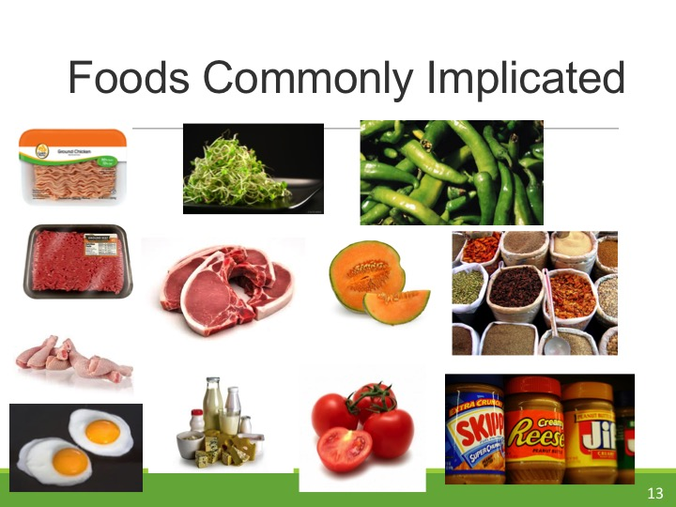

Slide 14
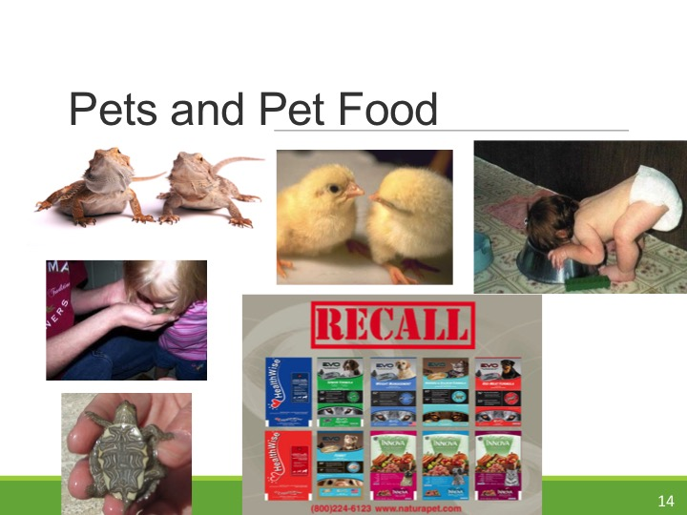

Slide 15
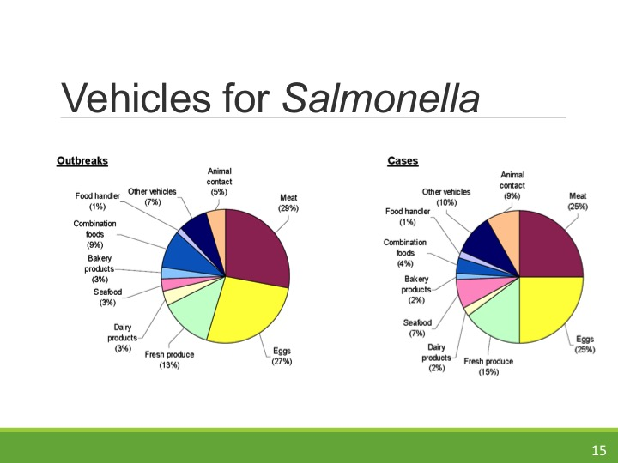

Slide 16
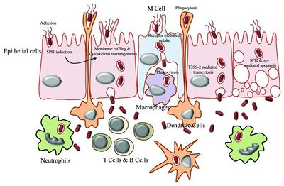

Slide 17
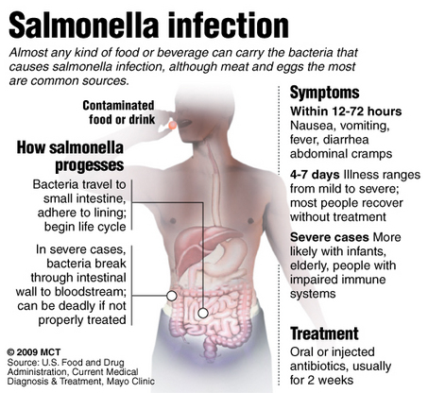
Illness

Slide 18
Treatment
None: Let infection run its course; fluid replenishment
Antibiotics: Ciprofloxacin for 10-14 days
Antibiotics for immuno-compromised, infants and elderly

Slide 19
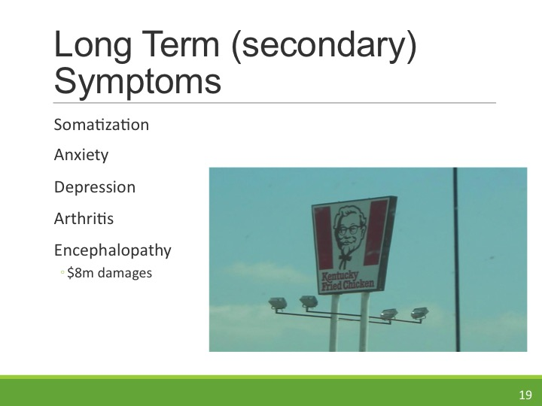

Slide 20
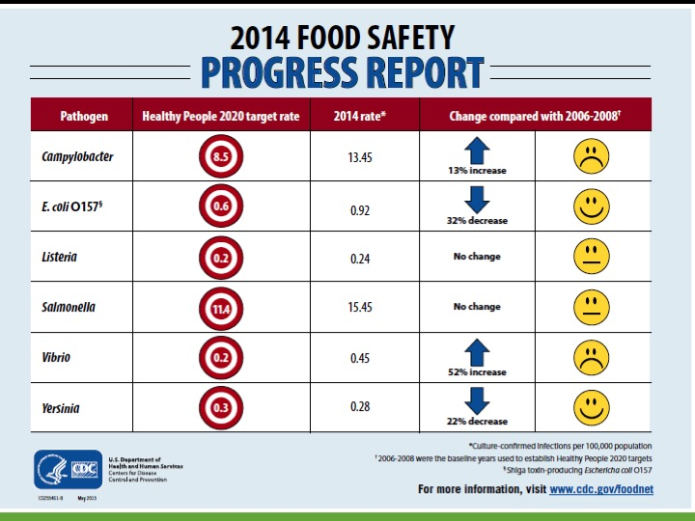

Slide 21
Selected Outbreaks
Year | Serovar | Number of Cases | Product
2012 | Typhimurium | 19 | Ground Beef
2011 | Heidelberg | 190 | Chicken Livers
2011 | Heidelberg | 111 | Turkey meat
2010 | Newport | 24 | Alfalfa sprouts
2010 | Enteritidis | 1700 | Eggs
2010 | Typhimurium | 23 | Bagged lettuce
2010 | Montevideo | 204 | Pepper
2009 | Typhimurium | 714 | Peanut butter
2009 | Saint Paul | 235 | Alfalfa sprouts
2008 | Saint Paul | 1400 | Tomato/Peppers
2007 | Montevideo | 37 | Chocolate
2007 | Typhimurium | 167 | Pot Pies
2006-2008 | Schwarzengrund | 32 | Dry Pet Food
2002 | Poona | 46 | Melon

Slide 22
Outbreaks 2014
Serotype | Source | Cases
Stanley | Raw Cashew Cheese | 17
Heildelberg | Tyson Chicken | 9
Cothan and Kisarawe | Bearded Dragons | 150
Infantis and Newport | Live Poultry | 251
Typhimurium | Feeder Rodents | 41
Newport, Hartford, Oranienburg | Sprouted Chia Powder | 21
Typhimurium | Lab Exposure | 41
Stanley | Turkey meat | 700 (2011-Present)
Typhimurium | Seaweed | 19
Enteritidis | Raw Egg | >200
Heidelberg | Foster Farms Raw Poultry | 574 (2013-2014)

Slide 23
Outbreaks 2015
Serotype | Source | Cases
Typhimurium | Restaurant | 280
Enteritidis | Breaded poultry | 44
Enteritidis | Poultry Entrees US) | 24
I, 4, 5, 12:i | Pork (Pig Roast) | 90
Enteritidis | Chicks | 6
Typhimurium | Pet frogs | 200
Paratyphoid | Frozen tuna | 62
Typhimurium | Portland Conference | 51
Enteritidis | School | 175
Newport | Cucumber | 780
Enteritidis | Bean Sprouts | 115
Infantis | Unknown | 34

Slide 24
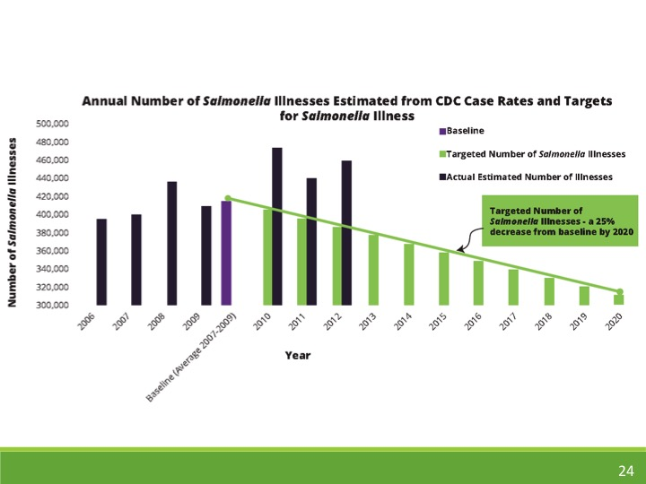

Slide 26
Food Safety Inspection Service Salmonella Action Plan

Slide 27
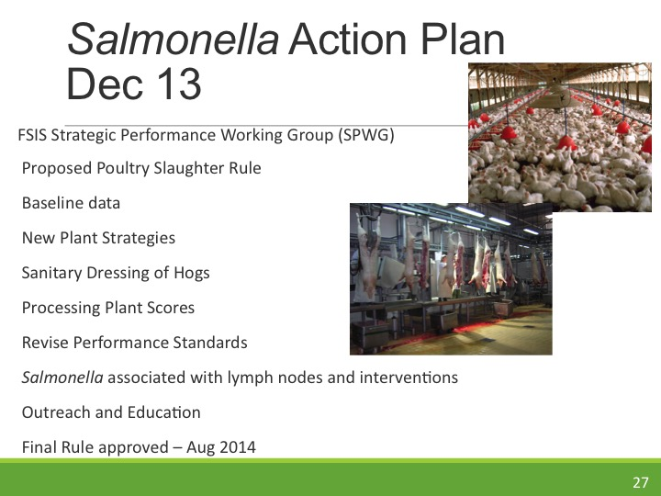

Slide 28
Poultry Products Inspection Act (1968)
HACCP
Sanitation Standard Operating Procedure
Generic Escherichia coli testing: Trend analysis
Salmonella performance standards
Inspection (Postmortem)
  Head
  Viscera
  Carcass

Slide 29
Verification Testing in Poultry Processing
One carcass per day for 51 consecutive processing days
Carcass rinse
>13 positive indicates failure
Provide 30 days to correct
Failure for second sampling: Write a corrective action plan
Third failure: Withdraw inspection – plant closure

Slide 30
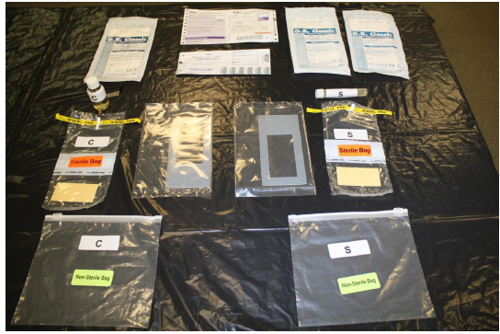
Salmonella Performance Standards
FSIS 2011
Carcass rinse or sponge samples
5 positive/51 carcasses Chicken
4 positive/56 for turkey
Cat 3: Failure to meet standard >7.5% Positives
Cat 2: Meet Standard 7.5% Positives
Cat 1: Exceed Standard <7.5% Positives

Slide 31
Poultry Slaughter Rule
Processing plant personnel to inspect carcasses: Verified by FSIS
Reduce FSIS inspectors (one per line)
Inspectors to verify off-line activities (documentation, sanitation)
Permit faster line speeds
Abolish Finished Product Standards: Ready to Cook Poultry Standards
More efficient FSIS inspection
Finished Product Standards
  Stop Generic E. coli testing
  Poor indicator for presence of Salmonella
Ready to Cook Poultry Standards
Sample at points at CCP’s
Processor must establish sample frequency and target
Standards to be established

Slide 32
Sampling Activities
FSIS Annual Sampling Plan Microbiological and Residual Sampling Program 2014
Establish baseline for comminuted poultry and parts
Testing ground beef for Salmonella, in addition to STEC
Develop Salmonella sampling plan for raw pork and raw pork products: Currently not performed

Slide 33
Develop New in Plant Strategies
Identify developing in-plant conditions (i.e. increasing trend of non-compliance, inability to control Salmonella)
Categorize plants based on Salmonella control performance (C1, C2 and C3): Positing operators names in C2 and C3 classes
Food Safety Assessment of comminuted poultry operations
Extend Hazard Analysis Verification in poultry operations

Slide 34

Pre-Harvest Related Activities and Outreach
Identify practices that leads to increased Salmonella prevalence
Evidence based interventions
Transparency and closer links with industry
Provide Salmonella specific food safety advice to consumers

Slide 35
Will the Action Plan Work?
Essentially deregulation of poultry industry: Self policing throw back to 1990’s
Increased line speeds: Increase efficiency or increased risk?
Failure to address multi-drug resistant Salmonella
More focus on testing that introduction of novel decontaminating technologies
Implications for beef and pork processors
Focus on data gathering rather than interventions

Slide 36
What does it mean to industry?
In theory carriage of Salmonella decrease by 4.5%; Save FSIS $90m per year
Greater responsibility of the processor to reduce Salmonella carriage
Cost saving (abolish E coli testing)
Increased costs
Extended Salmonella testing (pre- and post chill points)
Interventions
Personnel for inspection

Slide 37
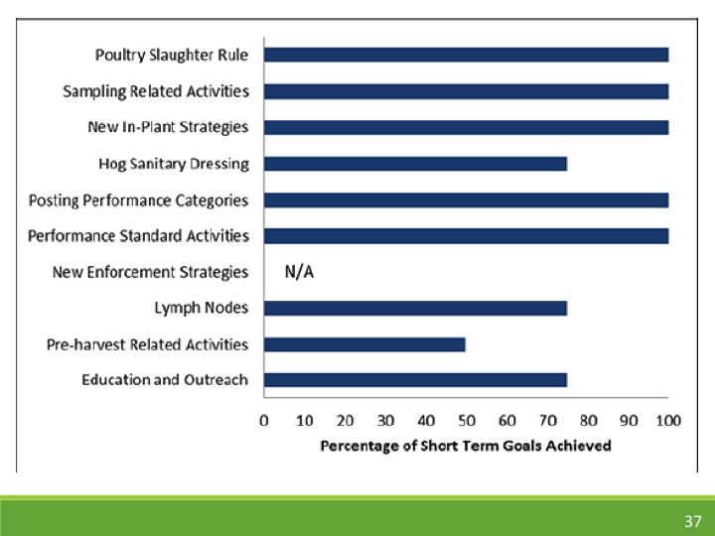

Slide 38

USDA
Species | Salmonella Prevalence 2011 | Salmonella Prevalence 2012
Steers | 0.5% | 1.1%
Market bulls and cows | 0.8% | 0
Poultry | 6.5% | 4.3%
Ground poultry | 30.9% | 28%
Pork | 3.3% | 1.3%

Slide 39
Opening the door for Zero Tolerance for Salmonella
Salmonella is not considered an adulterant in meat
Petition to class top 4 serovars as adulterants
Heildelberg
Newport
Hadar
Typhimurium
Technically achievable?

Slide 40
Is Zero Tolerance Achievable?
EU Danish and Swedish models: <1% Salmonella
North America
Centralized and intensive production
Reliance on antimicrobials
Lack of interventions or willingness to adopt
Definition of zero: Depends on diagnostics

Slide 41
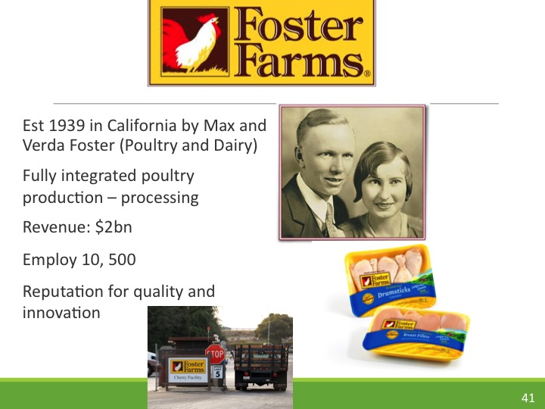

Slide 42
Foster Farms
On-Farm
  Salmonella screening of breeder hens
  Probiotic supplements
  Vaccination
  Biosecurity
  Sanitation
Processing Plant
  Increase sanitation
  In-line conveyor disinfection
  Steam pasteurization
  Anti-microbial washes

Slide 43
Incidence
1997: Strike due to labor practices
1998: Dumped 11 million gallons manure polluted water into a lake
2013
  Salmonella Heidelberg
  278 cases
Refused to recall
Eventual recall due to insect infestation
Salmonella Hiedelberg
High virulence
Rapid mutation rate
Antibiotic resistant
Strains
B182
SL476
SL486
>700 cases

Slide 44
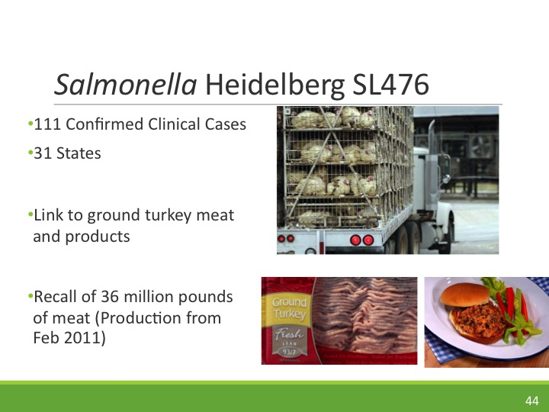

Slide 45
Multi-Drug Resistant Salmonella
Resistant to two or more antimicrobial agents
  Plasmid
  Chromosome
3rd generation cephalosporin
Quinolone
Fluroquinolone
Ciprofloxacin
Nalidixic acid

Slide 46
Sources of Antibiotic Resistant Salmonella
Widespread use of antibiotics
Imported foods
Travel
Zoonotic

Slide 47
Antibiotic Usage
Agriculture: 12 million kg per year
5.1 million kg: Pig production
5.2 million kg: Poultry production
1.6 million kg: Cattle
Prevent infection
Compensate for high density of animals and poor sanitation
Promote growth

Slide 48
Reasons for Emergence of Antibiotic Resistance in Developing Countries
Little or no regulation on antibiotic usage
Poor quality antimicrobial products (low activity)
Poor infection prevention and control
Lack of surveillance
Antibiotics in environment

Slide 49
Preservation of Antibiotics for Medical Treatment Act
FDA banned enrofloxacin (fluroquinone) 2005 in poultry production
Removal of antibiotics from feed: 30 years in the pipeline
Phase out medicated feed
Sparing use of antibiotics for treating animals
No restriction of antibiotics for non-food animals- pets.

Slide 50

FDA
22nd Dec 2011: FDA withdrew partition
Industry must self-regulate antibiotic use
Ban “non-label use” cephalosporins
  <1% of antibiotics used in agriculture
  Pressure from lobby groups (Dark Money)
  Weight of evidence connecting antibiotic use with drug-resistant pathogens
  Consumer groups taking legal action against FDA
  Guidance 209: Antibiotics should not be used for growth promotion

Slide 51
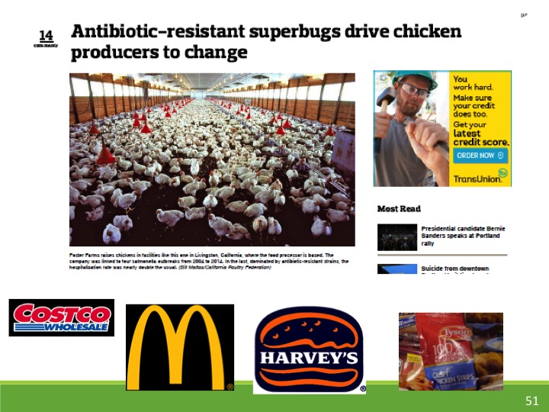

Slide 52
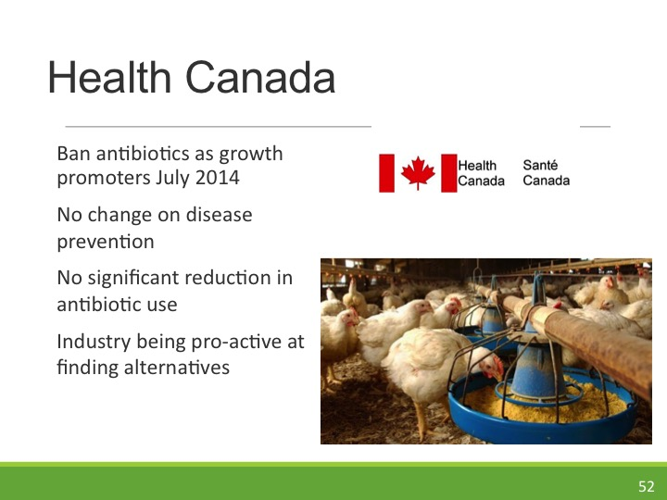

Slide 53
How to Reduce Antibiotic Resistance
Develop/isolate new antibiotics
Removal of antibiotics
Seek alternative antimicrobial agents
Regulations

Slide 54
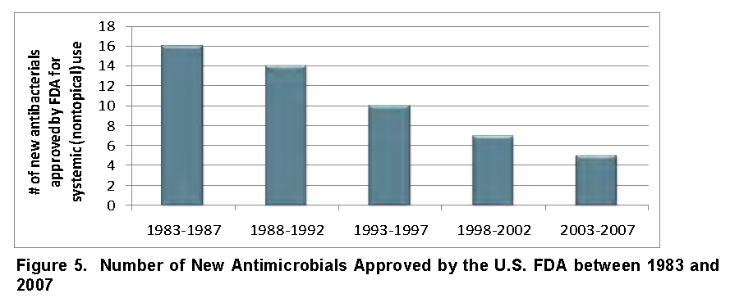
New Antibiotics
No new class of antibiotics have been discovered in the last 30 years

Slide 55
Decreasing Antibiotic Resistance
Remove antibiotics from animal production
Denmark
Removal of avoparcin: 80% reduction in vancomycin resistance
Ban of antibiotics as growth promotors

Slide 56
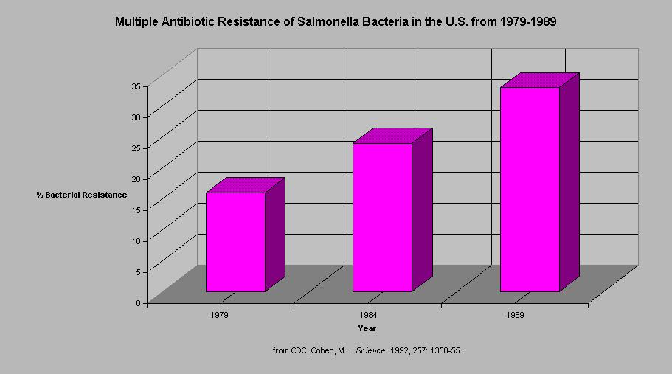
Medicated Feed (Antibiotics)

Slide 57
Denmark Experiment
Withdrew mass use of antibiotics in animal production 12 years ago
Decrease in prevalence of drug resistant Salmonella
Decreased efficacy in animal production
Net benefit through increased exports and reduction in health care costs.

Slide 58
EU Ban
2006: Ban on growth promoting antibiotics
Decrease in avoparcin resistance with no significant effect on animal health
Long term effects yet to be determined
Proposal to take all antibiotics (medicated and therapy) out of animal production

Slide 59
Antibiotic Alternatives
Vaccination
Competitive exclusion
Antimicrobial peptides
Bacteriocins
Natural antimicrobials
Management practice and surveillance
Consumer education

Slide 60
Vaccination
Prime immune system to detect multiple drug resistant strains of Salmonella
Oral administration of antibodies
Cost effective production of antibodies using transgenic plants. ($0.1/g)
Potential allergic reactions

Slide 61
Competitive Exclusion
Probiotics
Engineered E. coli to detect signaling molecules from pathogens then release of anti-microbial agents

Slide 62
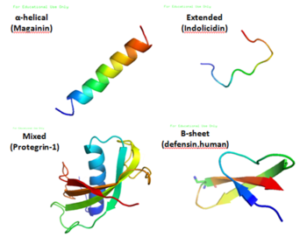
Antimicrobial Peptides
D-amino acid containing peptides: Disrupt cell membranes
Absorb onto pathogen surfaces to block binding
Bind intracellular molecules

Slide 63
Salmonella Control
Focus on high risk foods
Prevention is key
Fresh produce (e.g. sprouts and tomatoes)
Poultry and eggs
Low moisture foods

Slide 64
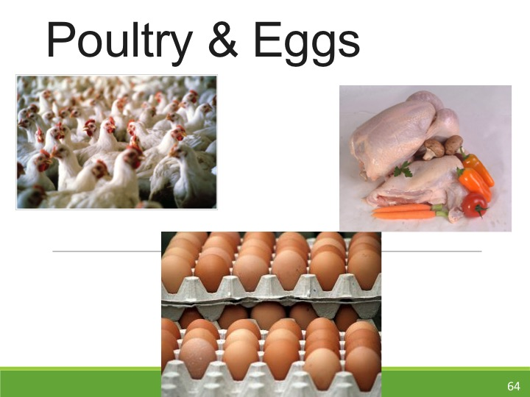

Slide 65
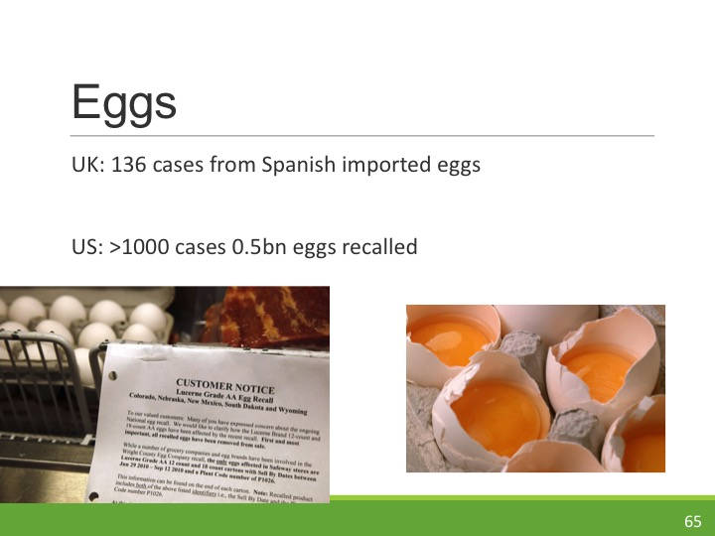

Slide 66
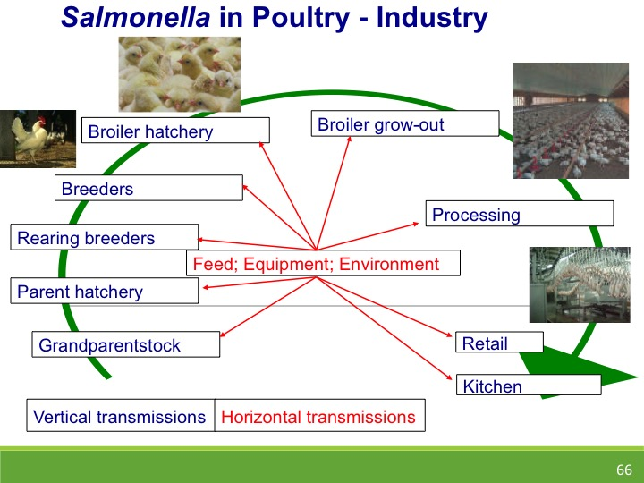

Slide 67
Poultry Production
Feed from HACCP certified mills
Pest-control program
Biosecurity (animals, facility equipment, GAP)
Manure management
Vaccination
Competitive exclusion
Medicated Feed
Surveillance

Slide 68
Manure Management
Compost for at least 120 days
3-12 month period from manure application to planting.
Biosolids < 4 cfu/g Salmonella (US); Not detected (Canada).
50 meter separation from open water
Minimize run off
Liquid manure decreases persistence of Salmonella.

Slide 69
Vaccination
Live (attenuated) Salmonella spray or dead cells incorporated into feed.
Pork farms: No evidence of benefit
Poultry: Permitted but not applied universally in North America.
UK: Extensive vaccination: SE prevalence <1% of flocks.

Slide 70
Competitive Exclusion
Pre- and Probiotics
Produce antimicrobials
Biological buffer
Prevent colinization by Salmonella
Saccharomyces boulardii produce mannose that inhibits attachment of Salmonella

Slide 71
Surveillance
Sampling buildings: Drag swabs
Boot swabs
Fecal samples
Boxes and other contact surfaces
Incoming chicks: 1 week old
If positive for SE the flock destruction eggs diverted to processing.

Slide 72
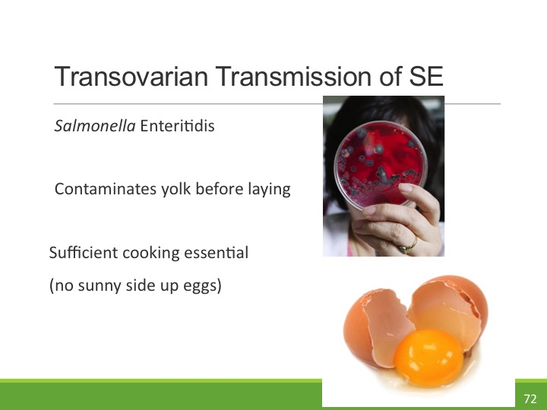

Slide 73
Egg Handling
Rapid cooling can cause shell fracture
Minimize temperature fluctuations
EU: Maintain eggs <15°C cannot vary more than 4°C throughout handling and distribution
FDA: Maintain <7.2°C
Condensation: Surface growth, increased penetration

Slide 74
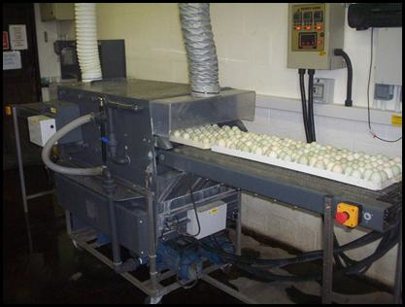
Egg Washing
ADVANTAGES
DISADVANTAGES
Improve egg appearance
Reduction in surface bacterial counts
Remove cutical layer
Potential ingress of water into the shell (use warm water)
No conclusive evidence of efficacy to decrease incidence of Salmonella

Slide 75
Alternative Techniques
Gamma irradiation: 1.5 kGy Impact on sensory quality
Microwave 0.75-2 W/g: Problems with scale-up
Hot air: 600°C for 8s. Effective no changes to egg quality 1 log reduction Salmonella
Gas plasma: 1-5 log reduction Lab based
UV light: Limited efficacy

Slide 76
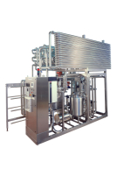
Liquid Egg Pasteurization
56 – 60°C (3-4 weeks shelf life)
Dielectric and gamma irradiation
  Reduction in Salmonella although changes in functionality
  High Hydrostatic Pressure: Cold pasteurization
  protein denaturation (minimize by addition salt or adjusting pH to >7.7)
  Pulsed Electric Fields: SE tolerant to PEF treatment

Slide 77
Egg Rule 2010
Clean and disinfect poultry houses that have tested positive for Salmonella Enteritidis –
Refrigerate eggs at 7.2°C during storage and transportation no later than 36 hours after the eggs are laid
Egg producers must maintain a written Salmonella Enteritidis prevention plan and records documenting their compliance.
Egg producers must also register with the FDA.
Mandatory: July 2012.

Slide 78
FDA Guidelines
Biosecurity
Reduce cross-contamination
Distances of farms from houses
Time period between depopulation and repopulation
Sanitation
http://www.fda.gov/Food/GuidanceComplianceRegulatoryInformation/GuidanceDocuments/FoodSafety/ucm222469.htm

Slide 79
Poultry Processing
Scald tank
  Counter current water flow
  Temp >50°C
  Sanitizers (limited selection)
  Chill tanks
  50 ppm chlorine pH 7 (Only in US)
  Counter-flow
  Fresh water recharging
  Air chilling using ozone

Slide 80
Carcass Decontamination Methods
Hot water wash: 75-80°C 1-3 log reduction Salmonella
Steam pasteurization: 90°C for 12s 3 log reduction in Salmonella
Organic acid wash: 2 % lactate 5 log reduction
Ozonated water: negligible efficacy
Irradiation: Salmonella more sensitive than E. coli D 0.62-0.80.

Slide 81
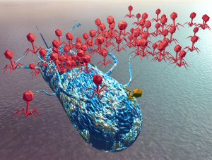
Bacteriophages
Viruses that infect bacteria
Specific to Broad host range
Extensively used in Eastern Europe
High doses required (MOI)
Natural equilibrium establishes between host and phage
Replication in the environment limited
Resistance
Possible route to control Salmonella in lymph nodes

Slide 82
Hide/Skin Treatment
Surface | Target | MOI | Log Reduction | Reference
Cattle Hide | E. coli O157 | 10,000 | 1.5 | Coffey et al., 2003
Poultry | Campylobacter | 100, 000 | 2.0 | Goode et al 2003
Poultry | Pseudomonas | 1000 | 2.0 | Greer, 1982
Pig skin | Salmonella | 10 | 4.0 | Hotton et al., 2011

Slide 83
Salmonella bacteriophages on Poultry Skin
Hungaro et al., 2013

Slide 84
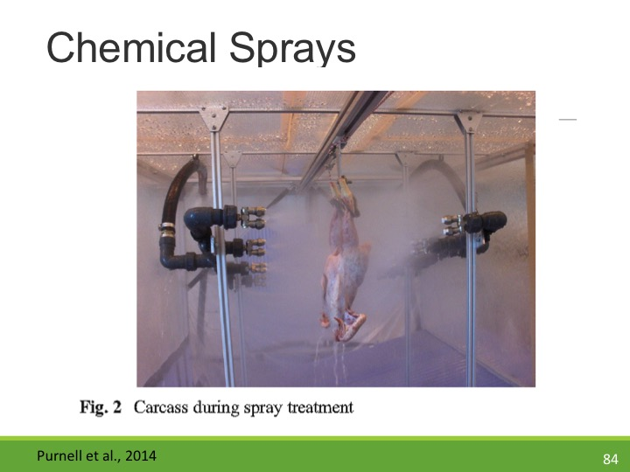

Slide 85
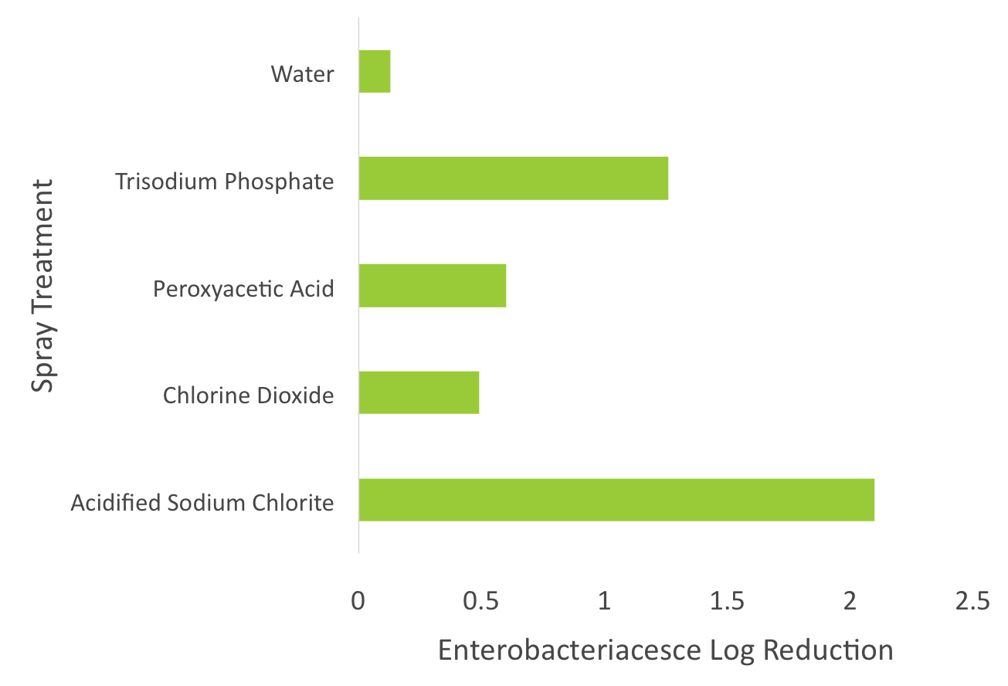

Slide 86
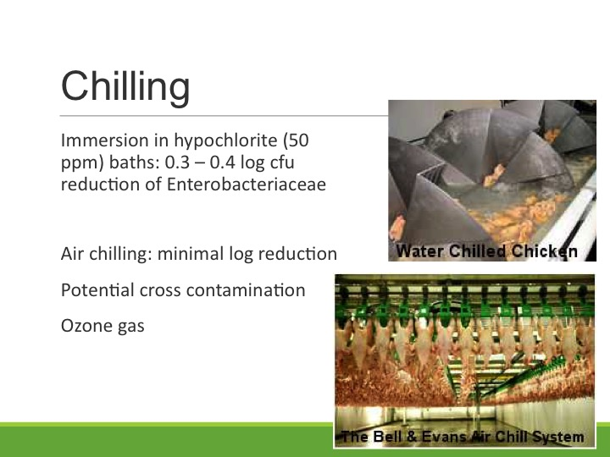

Slide 87
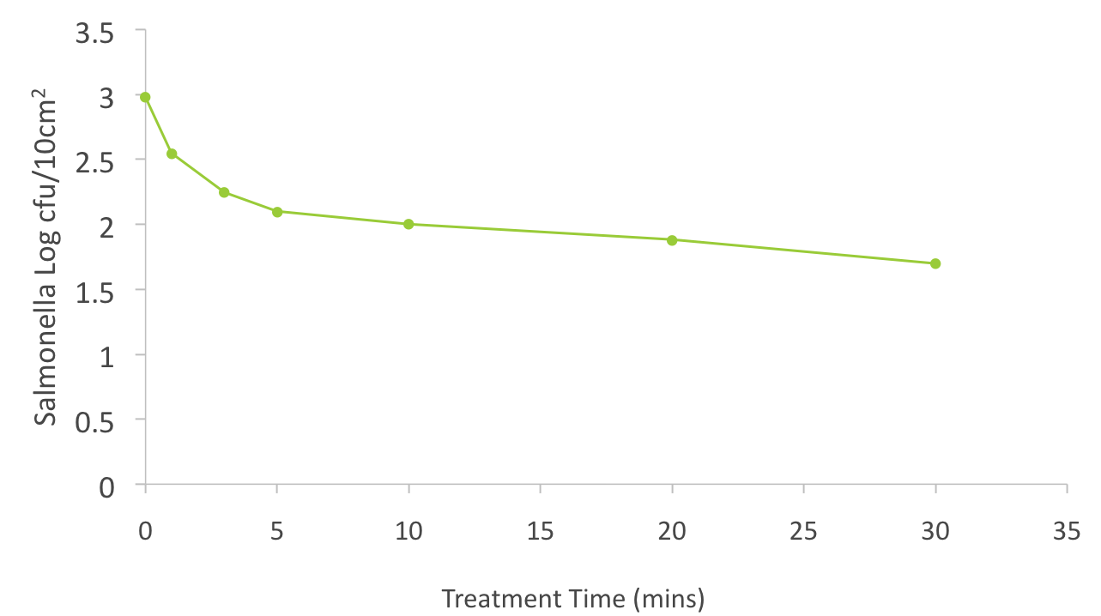
Ozone Gas (2000ppm) Chilling of Poultry Carcasses

Slide 88


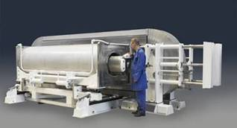
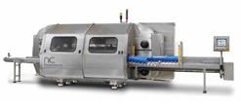
Commercial HPP systems
Wave 6000 /55 L – 420 L
Maximum pressure : 600 MPa
Pressure Hold Time: 3 min
Toll facilities
Lab and industrial
0.1L – 2 L
100 L – 687 L
Toll facilities

Slide 89
Sampling and Detection

Slide 90
Sampling and Detection
Egg sampling (composite)
Carcass sampling (Carcass rinse)

Slide 91

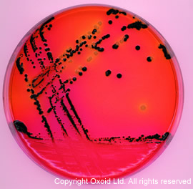
Enumeration and Enrichment
Buffered Peptone Water
37°C 24h
Semi-solid RV Medium
42°C for 16h
XLD agar
37°C 24h
Confirmation (genetic, Immuno, Physiological test)

Slide 92
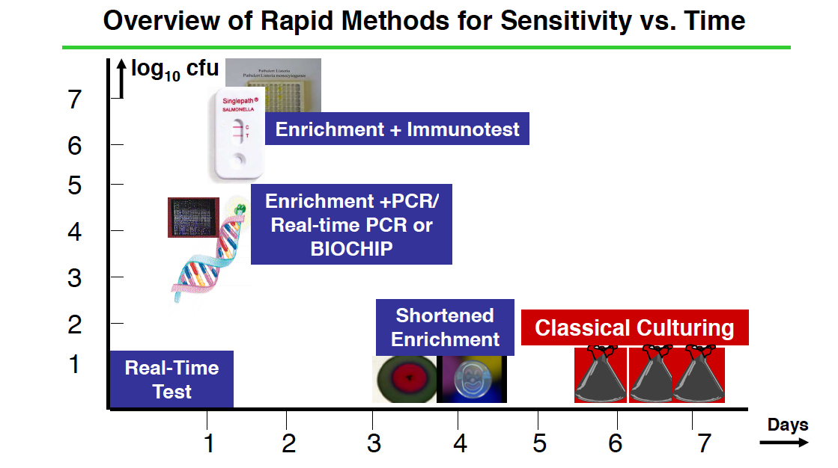
From Christina Harzman Biotecon diagnostics

Slide 93
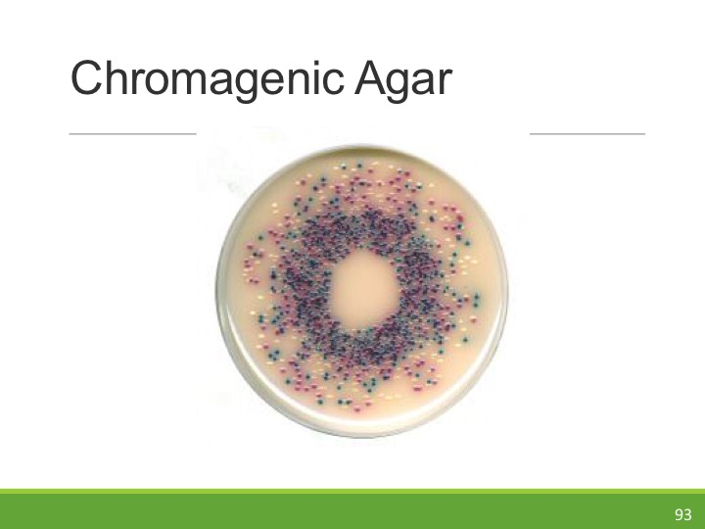

Slide 94
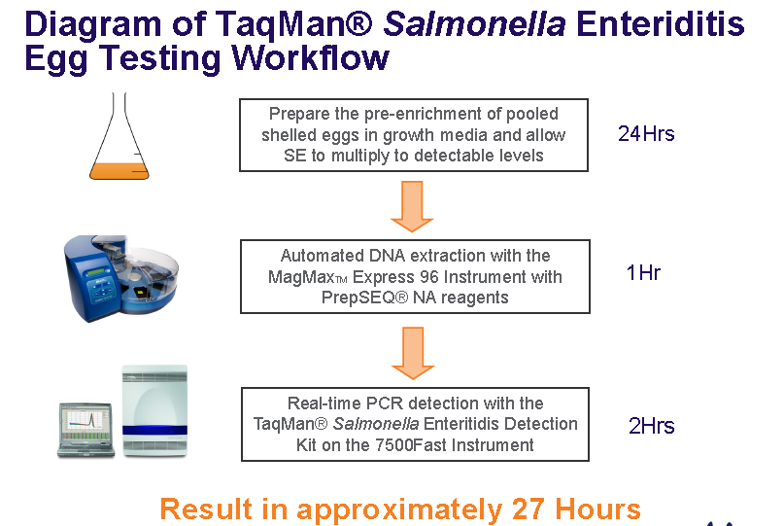

Slide 95
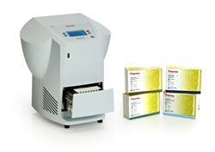
SureTect Salmonella
RT-PCR identification
AOAC approved
Single enrichment
Inclusivity and exclusivity
20 mins analysis time

Slide 96
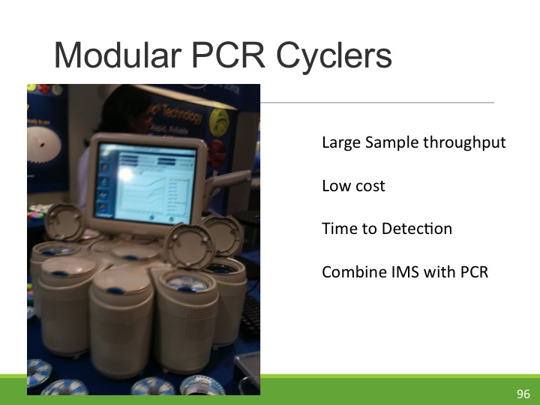

Slide 97
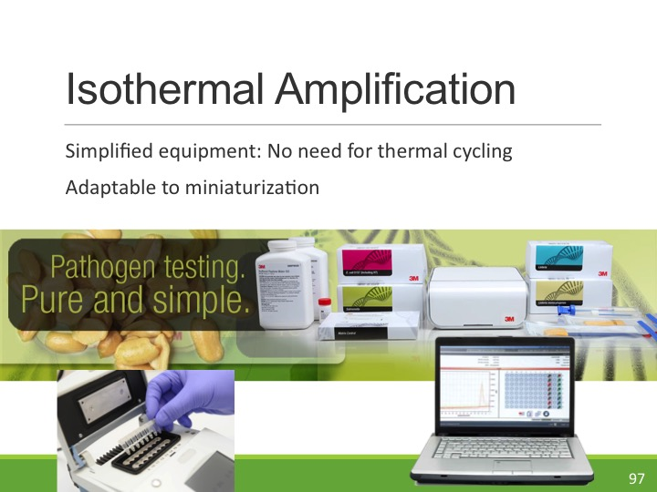

Slide 98
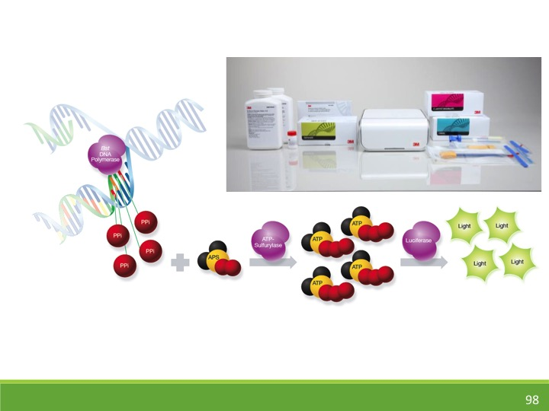

Slide 99
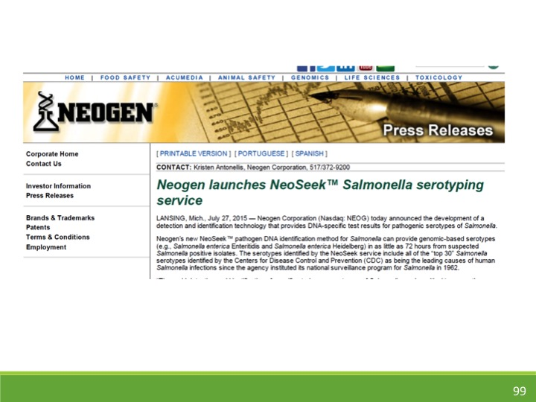

Slide 100
DNA Typing
Track origins of Salmonella
Identify endemic populations
Link between contamination sources
Surveillance

Slide 101
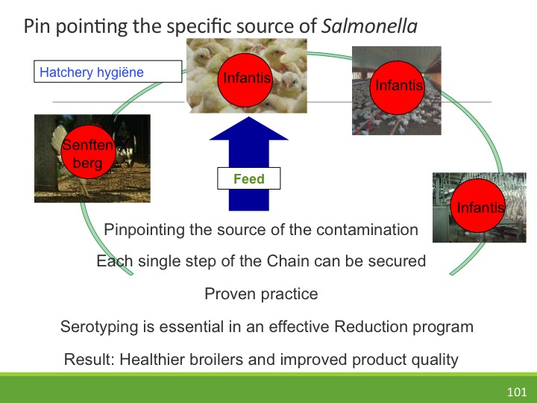

Slide 102
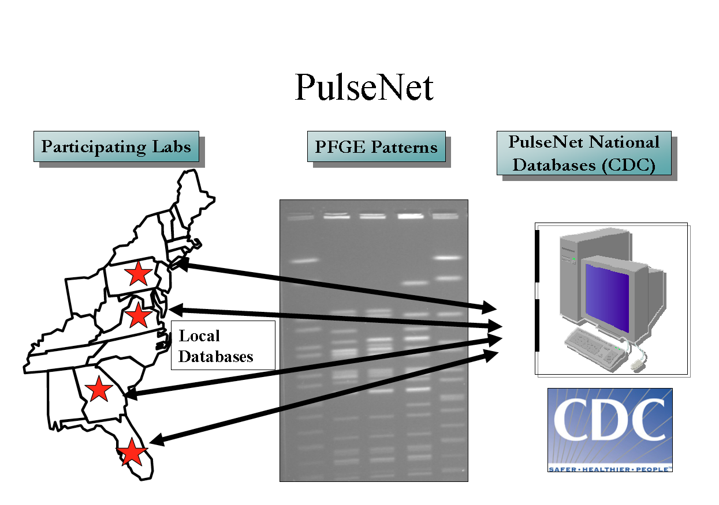

Slide 103
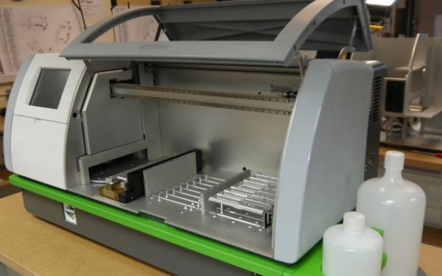
PathoGenetix's Genome
Sequence Scanning
10 million bases per second
5 h assay (40 samples per 24 h)
No specific target pathogen
Current being evaluated by CDC ($40m project)

Slide 104
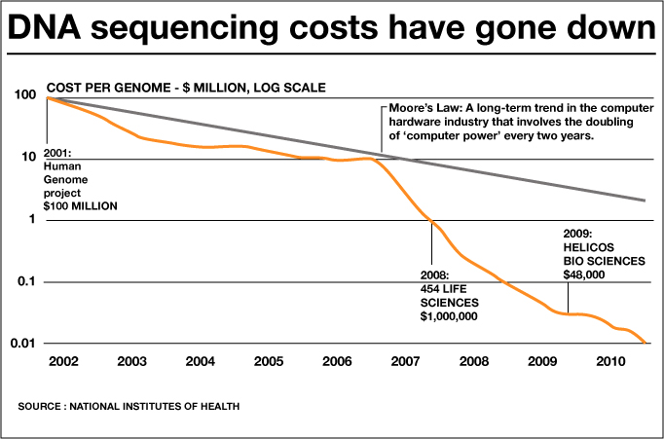

Slide 105


Slide 106
Consumer Education
Sanitation
Food storage
Minimize cross-contamination events
Thermometers to verify adequate cooking

Slide 107

Food Standards Agency UK
Don’t wash chicken
Coordinated media campaign
  Public health units
  TV
  News outlets
  Twitter
  Facebook
  National and International
  >20 million goggle hits
  Simple message but reinforced

Slide 108
Conclusions
Salmonella remains a key foodborne pathogen
Adaptable and high virulence
Broad range of food types affected
Multi-drug resistance needs to be addressed
Interventions and diagnostics available
Is FSIS Strategic Plan going to work?
Can Salmonella be eliminated?

Slide 109


Slide 110


Slide 111


