Slide 1
Infection control guidelines that did not work against Ebola in 2014
Bjørg Marit Andersen
Professor, MD, PhD, Infection control doctor
Speciality: Medical microbiology
Former head of Department Hospital Infections;
Oslo University Hospital-Ullevål, Norway
Hosted by Bruce Gamage
Provincial Infection Control Network of British Columbia
www.webbertraining.com
October 5, 2017

Slide 2
Infection control guidelines that did not work against Ebola in 2014
Objectives:
To analyze the Ebola virus and risk of transmission
To discuss the international Ebola- guidelines for the use of PPE -before and after September 2014
To discuss controversial PPE information and assessment of the Ebola crisis
To evaluate prevention-savy behaviour during serious outbreaks

Slide 3
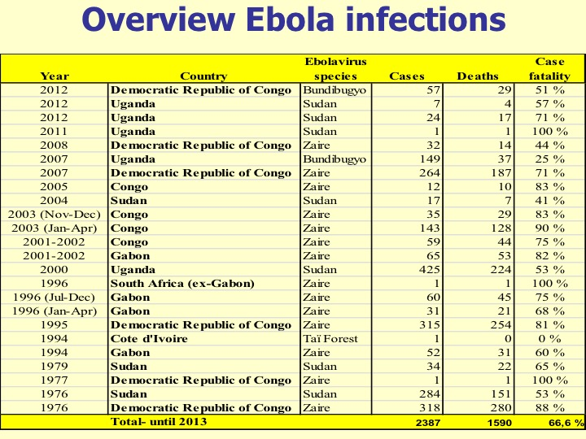

Slide 4
Pandemics and serious outbreaks last 100 years
Type _____ __ Death rate
1918-1977: Seven influenzae pandemics < 3%
2003 SARS: > 8000 cases (20% were HCW) 11%
2005 Avian influenzae: 60%
2009 Pandemic flu -AH1N1: < 0.2%
2013 –MERS(Middle East Resp Syndrome): 33-40%
EBOLA – outbreaks:
1976-2013 (25), 2400 cases 67%(25-90)
2014, West Africa
  28 616 cases and 11 310 deaths 40%
  HCW:> 880 cases and 509 deaths* 58%
Higher death rate among HCW?
- 103-fold higher than general population in Sierra Leone**
*WHO 17 July 2015, ** Kilmarx et al. CDC, MMWR 2014;63: 1168-71.

Slide 5
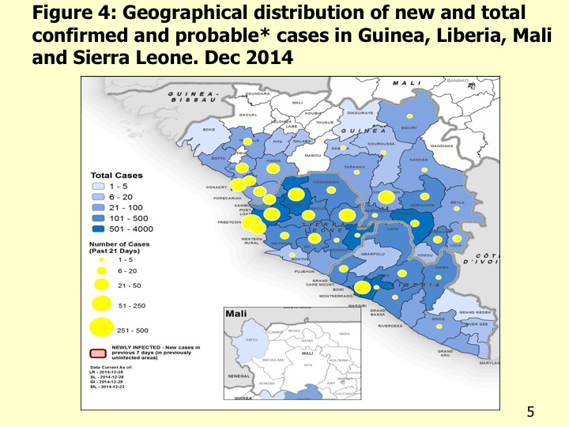
Guinea
Cases and deaths
Cases
Deaths
Guinea
3760
10,673
13,209
1
8
20
1
1
1
4
27,678
2506
4808
3947
0
6
8
0
0
0
1
11,276
Cases: 3760
Liberia
Deaths: 2506
Sierra Leone
Italy
Mali
Nigeria
Senegal
Spain
United Kingdom
United States of America
Total
Data up to 12 July 2015

Slide 6
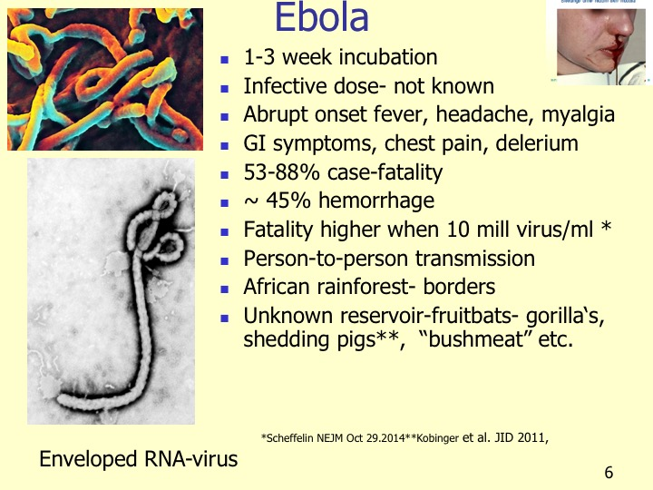

Slide 7
Transmission?

Slide 8
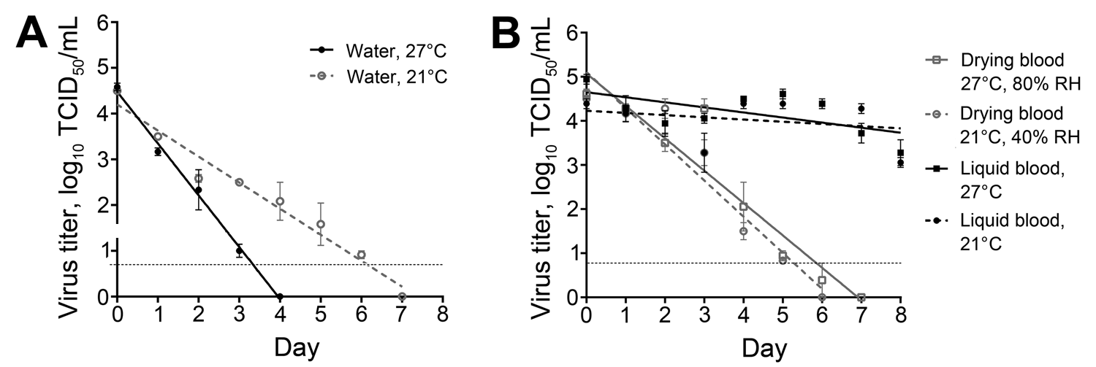
Viable Ebola virus can persist in the environment for 4->15 days blood (dried or liquid), water, and other surfaces - important for transmission Fisher et al. EID 2015;21: 1243-
Suvives and may aerosolize in wastewater. Lin . 26.9.2016.
Survive at least 46 days in liquid media- room tp. Weber ICHE 2015;36:

Slide 9
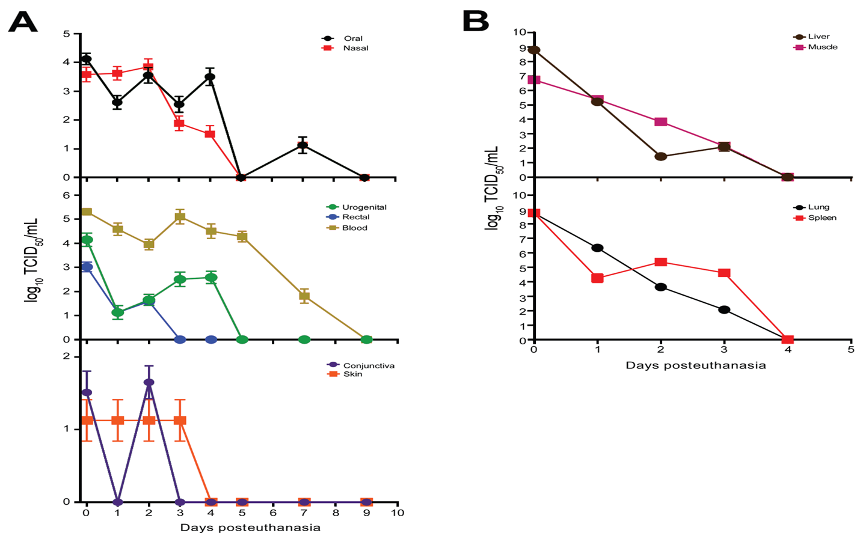
”Viable virus can persist for > 7 days on surfaces on bodies, conferming transmission, even after death”
Prescot et al. EID 2015;21: 856
A high postmortem stability of Ebola virus;
  Isolated (PCR) from oral, nasal, skin, blod, etc. swab for up to 10 weeks from macacques -monkeys
  Living virus isolated 3-4 days to one week or more postmortem, from surface swab samples from skin, conjunctiva, nose, mouth etc Prescot et al. EID 2015;21: 856

Slide 10
Transmission- by air?
Five infected monkeys ” shed infectious virus in various bodily secretions.--- suggesting the potential for generating infectious aerosols. Thus, taking precautions against aerosol exposures to filovirus infected primates, including humans, seems prudent.” Jahrling et al.Arch Vir Suppl 1996;11:115-34
Ebola-Kikwit 1995, person-to-person transmission was the main route of infection, ” but transmission by droplets and small aerosols among infected individuals is discussed.” Feldman ety al Arch Vir Suppl 1996;11:77-100.
Domestic pigs may replicate ZEBOV to high titers (10⁷ ) – mainly in respiratory tract- shedding and transmission to all naive pigs exposed. Kobinger et al. JID 2011;
”Piglets inoculated oro-nasally with ZEBOV were transferred to room housing macaques in an open, inaccessible cage system. All macaques became infected. ----Our finding may influence prevention and control measures--.” Weingartl et al. Sci Rep 2012

Slide 11
Transmission of Ebola virus from pigs to non-human primates- monkeys
Hana M. Weingartl1,2, Carissa Embury-Hyatt1, Charles Nfon1, Anders Leung3, Greg Smith1& Gary Kobinger3,2
1National Centre for Foreign Animal Disease, Canadian Food Inspection Agency, 1015 Arlington St. Winnipeg, Manitoba, R3E
3M4, Canada, 2Department of Medical Microbiology, University of Manitoba, Winnipeg, Canada, 3National Microbiology
Laboratory, Public Health Agency of Canada, 1015 Arlington St., Winnipeg, Manitoba, R3E 3R2, Canada.
ZEBOV transmission from pigs to cynomolgus macaques without direct contact.
Piglets inoculated oro-nasally with ZEBOV were transferred to the room housing macaques in an open inaccessible cage system. All macaques became infected.
Infectious virus was detected in oro-nasal swabs of piglets, and in blood, swabs, and tissues of macaques.
This is the first report of experimental interspecies virus transmission, with the macaques also used as a human surrogate.
Our finding may influence prevention and control measures during EBOV outbreaks.
Weingartl HM,et al. Scientific Rep 2. 2012; article number:811.

Slide 12
Risk of transmission
- to air and environment
”Skin contact transmission as well as airborne transmission are highly suspected” Congo. Mwanatambwe et al. J Nippon Med Sci 2001; 68: 370-
Clinical specimens from 26 laboratory-confirmed human cases:
  ”Virus was detected by culture and/or ”–(PCR)- ”in 16 of 54 clinical specimens (including saliva, stool, semen, breast milk, tears, nasal blood, and a skin swab) and in 2 of 33 environmental specimens.
  We conclude that EBOV is shed in a wide variety of bodily fluids during the acute period of illness”
  Bausch J Inf dis 2007; 196:142-
Old knowledge - before the Europeans in Uganda:
  isolation of sick cases 100 meters from others ---
  ” local people have beliefs and practices in place-- useful to control rapid epidemics, such as EHF,
  -- their knowledge may be useful to national and international teams in their efforts to control emerging diseases.”
Hewlett EID 2003;9: 1242-

Slide 13
Ebola- Lessons learned
Ebun James-DeKam, General Secretary, Council of Churches in Sierra Leone (CCSL)]
Promed 8 August 2014
”When the outbreak did occur, we were not prepared for it;
The necessary PPE (personal prevention equipment i.e. masks, goggles,gloves etc.) were in short supply; testing centers and laboratories were not set up to handle testing for EVD.
Medical staff were not trained in proper use of the PPE; medical expertise with genuine knowledge and experience in dealing with EVD were in extremely short supply.
Tracing units had to be organized and trained; burial teams had to be organized and trained.
Ambulances refitted to accommodate only EVD victims.
The general population began to protest vigorously that regular patients and EVD patients had to go to the same facility for medical attention. This put the uninfected population at higher risk.
Little sensitivity in dealing with customs
It will take time to slow progression of disease ”

Slide 14
Guidelines before and after September 2014

Slide 15
International guidelines used to protect HCW against Ebola, September 2014;
WHO, UK and CDC
WHO. Interim infection prevention and control guidance for care of patients with suspected or confirmed filovirus haemorrhagic fever in health-care settings, with focus on Ebola. September 2014.
UK, Department of Health. Management of hazard group 4 viral haemorrhagic fevers and similar human infectious diseases of high consequences. September 2014.
CDC. Infection prevention and control recommendations for hospitalized patients with known or suspected Ebola haemorrhagic fever in US hospitals. August 2014.
CDC. Guidance on personal protective equipment to be used by healthcare workers during management of patients with Ebola virus disease in U.S.hospitals, October 20, 2014.

Slide 16
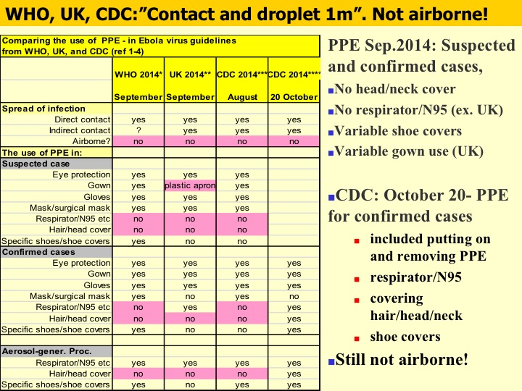

Slide 17
PPE WHO 2014
WHO 2014

Slide 18
SEPTEMBER 2014:
A high death rate
No effective virus medicine
No vaccine
A very poor PPE protection
A very low level of infection control

Slide 19
Promed-mail
3] Infection control is not working
Date: 14 Sep 2014
From: Bjorg Marit Andersen <bomarand@hotmail.com> [edited]
Infection control concerning EVD is not working, especially when more than 240 [now 300] healthcare personnel have been infected, and more than 120 workers have died. Guidelines used to control SARS in 2003 should be used, not "contact and droplet protection of 1-2 meters," as is still recommended by WHO.
Personal protective equipment (PPE) for contact and airborne infections should be used because of
a) respiratory symptoms,
b) a big distance -- up to 9 meters -- for droplets when coughing and sneezing (Bourouiba et al. J Fluid Mechanics 2014;745:537-563.),
c) re-aerolization from the environment, bed clothes etc.,
d) long survival of the virus outside the body, and
e) high lethality.

Slide 20
“Healthcare workers (HCW) and helpers should be protected with PPE as they were during the SARS epidemic. The SARS epidemic was an infection control success by the healthcare system of some countries in Asia in 2003.
- WHO should not repeat the same failure as was done during the early phase of the SARS-epidemic by using "contact and droplet isolation." Separate hospitals for EVD should be built, like in China (1000 beds in 8 days for SARS), and only patients with laboratory documented EVD should be cohorted. Suspected cases should be isolated separately.
HCW and helpers should be trained and especially observed concerning [putting] PPE on and taking [it] off. The observers should also use PPE. During the SARS epidemic, HCW were re-contaminated by not knowing how to take off PPE.
Exposed people and patients with other diseases should be treated in professional triages to reduce the population's fear of being EVD-infected during contact with healthcare. Exposed people should be taken care of by professional helpers.
There is a need for a lot of resources, especially concerning infection control work.”
Andersen BM, promed-mail 14 September 2014
Promed-mail Archive Number: 20140914.2773490
[The above directions are perfectly correct. Unfortunately, investigators are concluding that health worker infections are occurring
outside the hospitals. - Mod.JW]

Slide 21
Aerosol controversy
September 2014; Promed-mail; an intensive discussion
14 Sept.: «Personal protective equipment (PPE) for contact and airborne infections should be used because of a) respiratory symptoms, b) a big distance -- up to 9 meters -- for droplets when coughing and sneezing, c) re-aerolization from the environment, bed clothes etc., d) long survival of the virus outside the body, and e) high lethality.” Bjørg Marit Andersen
Responses came very soon- among others:
17 Sept.: «Healthcare workers need optimal respiratory protection for Ebola»- -for a risk group 4 organism like ebolavirus, the minimum level of protection should be an N95 filtering facepiece respirator» Lisa M Brosseau and Rachel Jones.
19 Sept.:»-it is feasible to make ebolavirus transmit through air» Ben Neuman.
Contra
19 Sept.:-- «we have never seen a human virus change the way it is transmitted» Vincent Racaniello
20 Sept.: «Suggesting airborne precautions for Ebola HCW is a really bad idea (!).-- Ebola is not airborne----Laboratory experiments –have clearly shown that Ebola and Marburg are highly aerosol infectious.-» Heather Lander.
21 Sept.: «--to my knowledge it (EDV) is not aerosol borne so I am at a loss to understand why there is so much emphasis on this route of transmission---» Shahen Mehtar

Slide 22
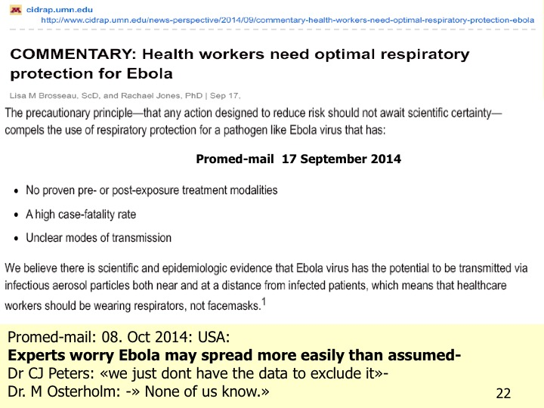

Slide 23
Ebola Virus Disease and the Need for New Personal Protective Equipment
Michael B. Edmond, Daniel J. Diekema, Eli N. Perencevich,
JAMA. 2014;312(23):2495-2496., online October 28, 2014
--” The virus is found in body fluids that health care workers are likely to contact. These include blood, urine, vomitus, and stool.
Gastrointestinal fluid losses can be massive (5-10 L/day), and simulated vomiting studies have shown droplet dispersion greater than 10 ft.⁵
In patients dying of Ebola virus infection, serum viral loads can reach 10 billion copies/mL.^{6»} ---

Slide 24
September 28, 2014:
Rapid decline of new cases
In all three countries

Slide 25
TRIAGE outbreak with droplet protection in
Sierra Leone Sept-Oct 2014
The Bo Ebola Clinic opened 19 September 2014 Medicines sans borders-
Two weeks later, 2-4 October, 4 HCW got Ebola; 2 died.
One of them- a Norwegian case was transferred to a high-level (level 4) isolate in Norway and survived.
All four Ebola cases worked together in the Bo triage area: 25-26 September
Standard equipment in the triage area was gloves and surgical mask, because the HCW --should hold «2 meters distance»» to the patients, according to WHO.
  «Then they could not be infected by droplets», said the Norwegian administrator
  «Triage was an area to talk with the patients– «
  «--little PPE’s were used in order to create confidence in the local population !»

Slide 26
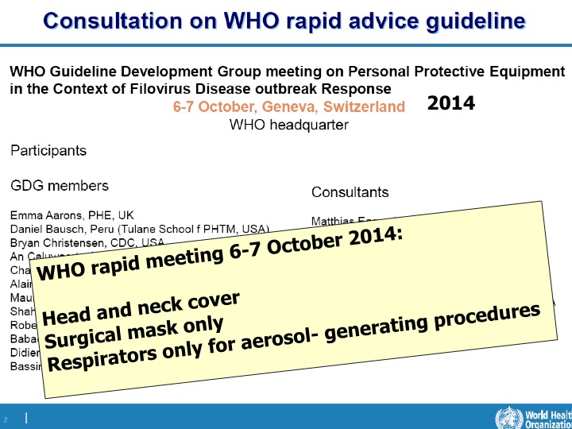

Slide 27
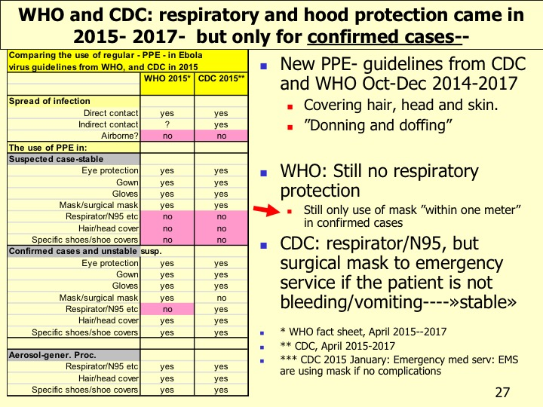

Slide 28
WHO
6 October 2014
Hair, head and neck covered
No respirator/N95
Only use of surgical mask
2017 –PPE the same

Slide 29
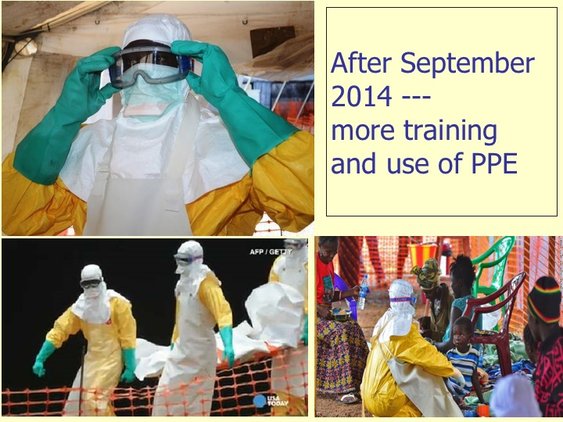

Slide 31
WHO July 20 2015
All countries: 27 652 (11 264 deaths)
Guinea: 3 770 ( 2509)
Liberia:* 10 666 (4806)
Sierra Leone: 13 209 (3947)
WHO:
More than 876 HCW with ebola; 509 deaths
July 17 2015. ” 3-4% of patients are HCW”
Liberia lost ca 8% of nurses and doctors during Ebola 2014!

Slide 32
Controversial information and assessment

Slide 33
Airborne or not?
Controversial information!
WHO 2017
”Ebola virus disease is not transmitted through the air ”---
”If a person sick with Ebola coughs or sneezes,-- and saliva or mucus touches another person's eyes, nose, mouth, or an open cut or wound, these fluids may spread Ebola.”

Slide 34
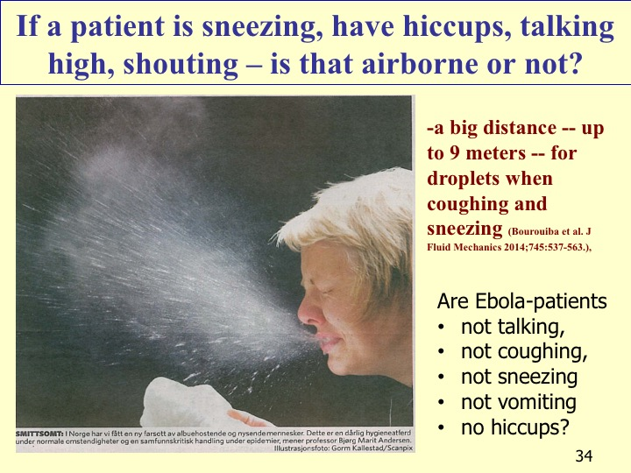

Slide 35
Shedding and re-aerolization from skin, textils, equipment etc
Ebola:- living virus on body surfaces like skin and mucous membranes.
A living person is shedding skin particles-continuously;
30- 60 000 dead skin cells per minute; up to 500 mill/day as small patricles in the air and like grey dust on surfaces.
Re-aerolization, for instance, via bedmaking, cleaning, textiles, spraying, aerosol-generating procedures, etc. Shimori JHI 2002;50:30-35.

Slide 36
Transmission of Ebola Viruses: What We Know and What We Do Not Know
Michael T. Osterholm,a Kristine A. Moore,a Nicholas S. Kelley,a Lisa M. Brosseau,b Gary Wong,c Frederick A. Murphy,d
Clarence J. Peters,d James W. LeDuc,d Phillip K. Russell,e Michel Van Herp,f Jimmy Kapetshi,g Jean-Jacques T. Muyembe,g
Center for Infectious Disease Research and Policy, University of Minnesota, Minneapolis, Minnesota, USAa; Division of Environmental and Occupational Health Sciences, mbio.asm.org 2015;6: e00237-
15.march/april 2015
«Key areas requiring further study include
  the role of aerosol transmission (either via large droplets or small particles in the vicinity of source patients),
  the role of environmental contamination and fomite transmission,
”We also hypothesize that Ebola viruses have the potential to be respiratory pathogens with primary respiratory spread.”
Promed-mail 19 Feb 2015: Limited airborne transmission of
Ebola is «very likely», a new analysis says.

Slide 37
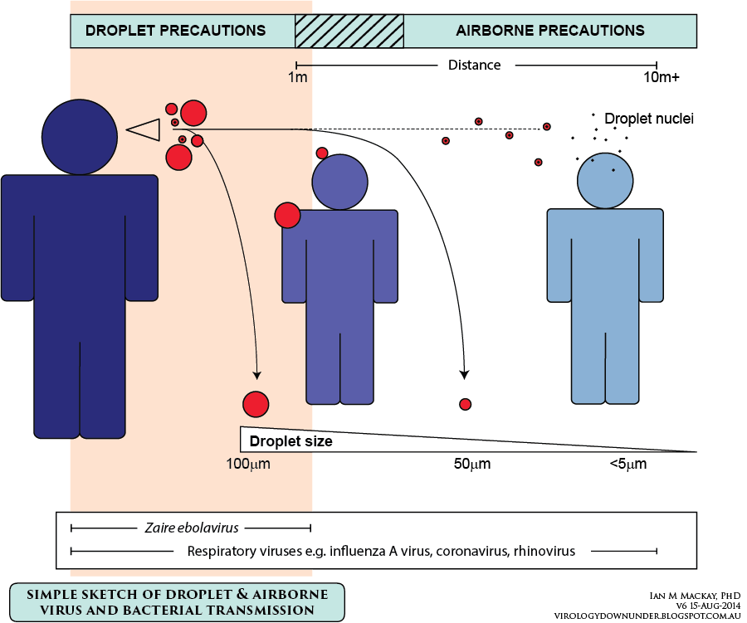
A large difference between «droplet» – and «airborne» precautions!

Slide 38
The start of Ebola:
WHO April 2014
«Cough or sneeze into your arm.
Use a tissue and then throw away.«
From the
CLINICAL MANAGEMENT OF EBOLA

Slide 39
The end of outbreak of Ebola:
WHO Updated April 2015
  The virus is transmitted to people from wild animals and spreads in the human population through human-to-human transmission.
Transmission: “Ebola then spreads through human-to-human transmission via direct contact-----”
Controlling infection in healthcare-settings:---
  “When in close contact (within 1 metre) of patients with EBV, health-care workers should wear face protection (a face shield or a medical mask and goggles), ----a clean, non-sterile long-sleeved gown, and gloves (sterile gloves for some procedures).”

Slide 40
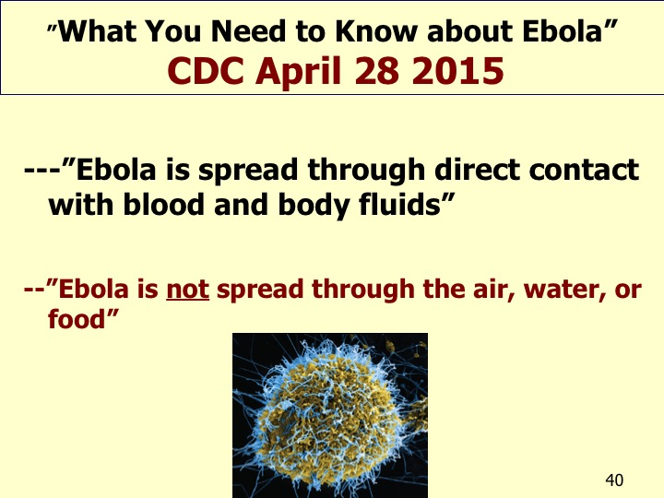

Slide 41
Fact sheet from CDC :
”Why Ebola is Not Likely to Become Airborne”
CDC April 30 2015
”Scientists have not seen any evidence to suggest that the Ebola Virus may be mutating to become more contagious or more easily spread.” CDC
The ”mutation problem”
BUT:
CDC/WHO have no evidence for that:
  ”Ebola is not airborne”

Slide 42
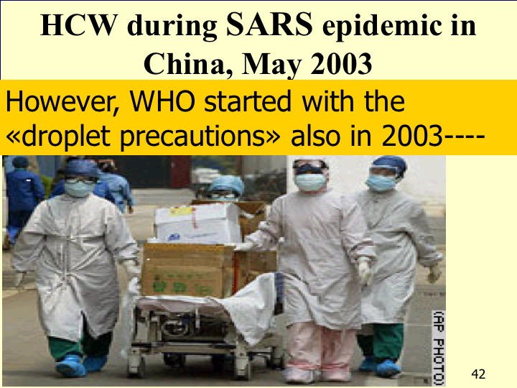

Slide 43
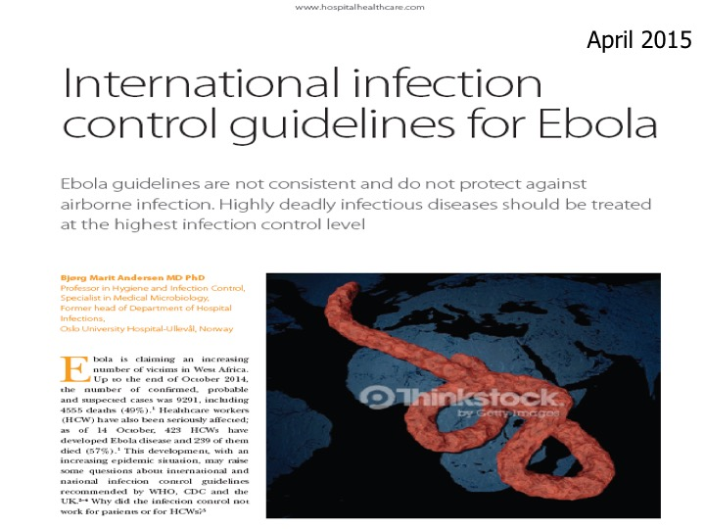

Slide 44
Importance of early and effective preventive behaviour during serious epidemics

Slide 45
Why did WHO and CDC not act preventive?
Ebola is a defined - level 4 high-risk disease that should be treated with high-risk isolation, from the start. Ebola is among the most dangerous diseases in the world.
Why did WHO and CDC recommend to treat this level 4 disease as: ”contact and droplet isolation within one meter”?
Why did WHO and CDC not act preventive for
  A remote disease, with small, but deadly outbreaks!
  A disease with no evidence- based knowledge!
  In a population in a tropical area, at a very high risk!
  Where infections and death among HCW was known high, already from many years ago!
  Why was Ebola handled in USA and Europe – as a level 4 disease?

Slide 46
Report of the Ebola Interim Assessment Panel
Report of the Ebola Interim Assessment Panel, July 2015 to WHO
- The Ebola crisis not only exposed organizational failings in the functioning of WHO, but it also demonstrated shortcomings in the International Health Regulations (2005).
- If the world is to successfully manage the health threats, especially infectious diseases that can affect us all, then the Regulations need to be strengthened.--- -
Had the recommendations for revision made in 2011 by the Review Committee in relation to Pandemic (H1N1) 2009 been implemented, the global community would have been in a far better position to face the Ebola crisis.
«The world simply cannot afford another period of inaction until the next health crisis. ---»
Report of the Ebola Interim Assessment Panel, July 2015 to WHO

Slide 47
Declaring a Public Health Emergency of International Concern (PHEIC)
Sitation:
«20. In the Ebola crisis, a PHEIC under the International Health Regulations (2005) was not declared by the Director-General until 8 August 2014.---
21. WHO does not have a culture of rapid decision-making and tends to adopt a reactive, rather than a proactive, approach to emergencies.---
---There seems to have been a hope that the crisis could be managed by good diplomacy rather than by scaling up emergency action.
At present, WHO does not have the capacity or organizational culture to deliver a full emergency public health response.»
Report of the Ebola Interim Assessment Panel, May and July 2015 to WHO

Slide 48
Cultural Contexts of Ebola in Northern Uganda
Barry S. Hewlett* and Richard P. Amola† 2003
When an illness has been identified and categorized as a killer epidemic (gemo), the family is advised to do the following:
1) Quarantine or isolate the patient in a house at least 100 m from all other houses, with no visitors allowed.
2) A survivor of the epidemic should feed and care for the patient. If no survivors are available, an elderly woman or man should be the caregiver.
3) Houses with ill patients should be identified with two long poles of elephant grass, one on each side of the door.
4) Villages and households with ill patients should place two long poles with a pole across them to notify those approaching.
5) Everyone should limit their movements, that is, stay within their household and not move between villages.
6) No food from outsiders should be eaten.

Slide 49
12) Once the patient no longer has symptoms, he or she should remain in isolation for one full lunar cycle before moving freely in the village.
13) If the person dies, a person who has survived gemo or has taken care of several sick persons and not become ill, should bury the persons; the burial should take place at the edge of the village.
”From a biomedical perspective, this protocol constitutes a broad-spectrum approach to epidemic control.
Isolation and identification of the patient’s home and village were emphasized by all groups interviewed, but sexually transmitted and foodborne transmissions were also frequently listed.
Elders were adamant that this protocol existed before the arrival of Europeans in the late 1800s.”
Barry S. Hewlett* and Richard P. Amola† 2003
Lessons to learn from earlier epidemics--

Slide 50
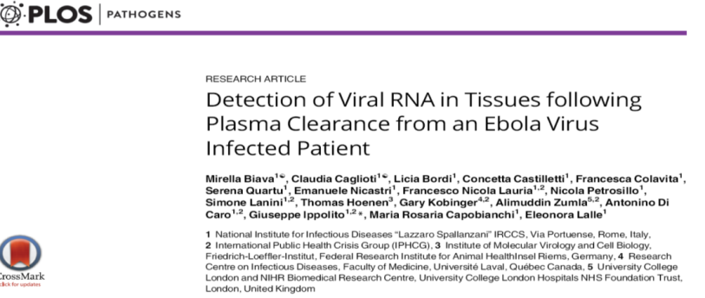
Updating Ebola transmission
Virus shedding ---after intranasal inoculation in guineapigs. --- ”including those transported through air movement over short distances.” Wong J Vir 2015;89:1314
Persistence and recrudescent in some; CNS, eyes, semen (more than 2 years) Ed. JHI 2016;94:
“Hiding in lungs of HCW”. Persistence and local replication. Contribute to the transmission-- Biava et al. PLOS Path Jan 2017
None of tested PPE combinations provided a complete solution for PPE. Canada.Herlihey TA et al. ICHE 2016; 37:1022-

Slide 51


Assessment of self-contamination during removal of PPE for Ebola—
Casanova LM et al. ICHE 2016;37:1156-

Slide 52
Skin, clothes contaminated after protective gear removed. Thomas et al.JAMA Int med 2015;175:1904
435 gown and glove removals- fluorescent lotion tested and bacteriophage MS2.
Contamination of skin or clothing: 46%
More during gloves than gowns: 53% versus 38%
Education and training significantly reduced the contamination rate.
The hands and neck were the most frequent contaminated sites.

Slide 53
Donning and doffing methods – still with some problems---- with doffing--

Slide 54
Complete PPE for occupational Ebola exposure may work!
77 occupational exposures to Ebola virus in 57 HCW (Guinea-2014-2015)
All were using complete PPE;
  3.5 exposures/HCW/year and 18% high risk of transmission,
  no infections. Savini et al. CDC 2017;23:August

Slide 55
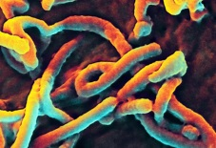
Summary
Ebola has caused a high number of victims, also among healthcare personnel (HCW) –in spite of PPE- recommendations for contact and droplet isolation within one meter from the patient (WHO,CDC,UK).
The PPE- guidelines from WHO and CDC concerning suspected or confirmed Ebola cases were not evidence based and denied the possibility for airborne transmission.
Before infection control was raised to level 4; strict isolation (airborne and contact infection), -more HCWs, helpers, families of cases and the general population were exposed unnecessary to a serious illness.
New, updated guidelines from the WHO and CDC should protect HCW’s, helpers and others working with Ebola and other serious infections in a more safe way, than today.
A dangerous infection should always be met with the highest level of protection, not with the lowest.

Slide 56
Some references
WHO. Interim infection prevention and control guidance for care of patients with suspected or confirmed filovirus haemorrhagic fever in health-care settings, with focus on Ebola. September 2014.
CDC. Infection prevention and control recommendations for hospitalized patients with known or suspected Ebola haemorrhagic fever in US hospitals. August 2014.
UK, Department of Health. Management of hazard group 4 viral haemorrhagic fevers and similar human infectious diseases of high consequences. September 2014.
Weingartl HM, Embury-Hyatt C, Nfon C. Transmission of Ebola virus from pigs to non-human primates. Scientific Rep 2. 2012; article number:811.
Andersen BM. Infection control is not working. Promed-mail 14 September 2014.
Public Health Agency Canada. Ebolavirus. August 2014.
Bourouiba L, Dehandschoewerker E, Bush JWM. Violent expiratory events: on coughing and sneezing. J Fluid Mech 2014; 845: 537–563.
Andersen BM. SARS. Handbook in hygiene and infection control for hospitals. Part 1: Microbiology and infection control. Fagbokforlaget, Oslo 2014:319-341.
Andersen BM. Infection control guidelines for Ebola. Hospital Healthcare Europe. Facilities management. 2015.

Slide 57


Slide 58
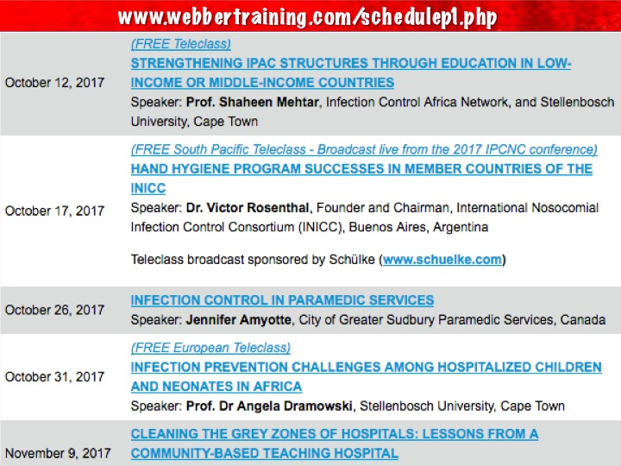

Slide 59


