Slide 1
B. Allegranzi, SDS, HIS, WHO HQ A. Twyman, SDS, HIS, WHO HQ J. Hightower, SDS, HIS, WHO HQ
Ebola outbreak What are the main lessons learned for infection control?
Hosted by Claire Kilpatrick
www.webbertraining.com
January 20, 2016

Slide 2
Magnitude of the Ebola outbreak 2014-15 Combination of determining factors
Geographical: ease of cross border movements, outbreak in urban areas leading to high transmission
Cultural: religious practices and customs facilitating transmission, care-seeking behavior
Structural: poor roads, infrastructure, lack of access to clean water and basic sanitation, weak health systems with limited capacity to detect and control infectious disease outbreaks in the affected countries,
Socioeconomic: high poverty levels, low literacy rates, post conflict environments),
Governance issues: lack of linkages between central and peripheral levels
Poor implementation of International Health Regulations

Slide 3
Key lessons learned for infection prevention and control (IPC) from the Ebola outbreak
Absence of IPC basic measures and infrastructures both in the community and in healthcare settings led to the unprecedented situation of this outbreak

Slide 4
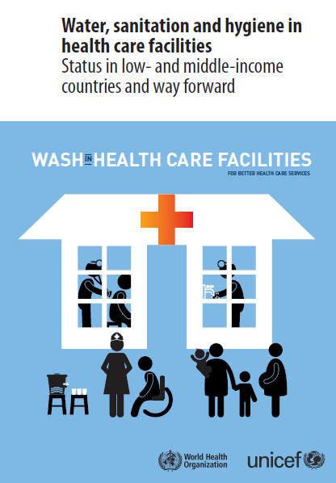
Newly issued on 17 March 2015
54 countries (LMIC)
66,101 facilities
38% no improved water source
19% no improved sanitation
35% no water and soap for handwashing
http://www.who.int/water_sanitation_health/publications/wash-health-care-facilities/en/

Slide 5
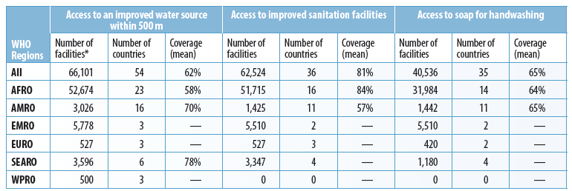
Provision of water, sanitation and hygiene services in healthcare facilities
Country | N°of healthcare facilities (HCFs) | Water coverage in HCFs | Sanitation coverage in HCFs | Soap for HW availability
Guinea | 1401 | 13%
Liberia (2013) | 328 | 50% | 91% | 54%
Sierra Leone | 1264 | 62% | 78% | 95%

Slide 6
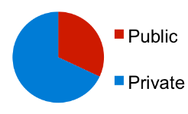
IPC assessments in 113 healthcare facilities in Liberia (February 2015)
32%
68%
FP: focal point; IS: injection safety; WMS: waste management system

Slide 8
Key lessons learned for infection prevention and control (IPC) from the Ebola outbreak
Absence of IPC basic measures and infrastructures both in the community and in healthcare settings led to the unprecedented situation of this outbreak
Importance of consistency and coordination within & among agencies

Slide 9
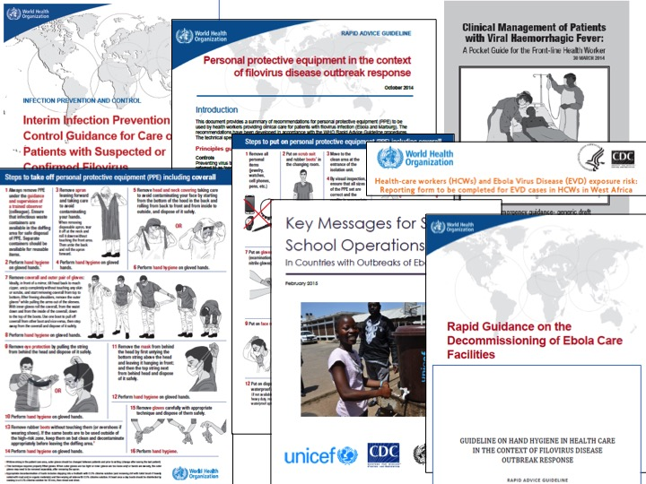

Slide 12
Key lessons learned for infection prevention and control (IPC) from the Ebola outbreak
Absence of IPC basic measures and infrastructures both in the community and in healthcare settings led to the unprecedented situation of this outbreak
Importance of consistency and coordination within & among agencies
Fear factors, especially in emergency situations can lead to misplaced focus in IPC and/or to wrong IPC practices
Notes:
, and changing behaviour during an outbreak proves to be very difficult

Slide 15
Other key elements for IPC…
Standard precautions for all patients at all times
Patient triage and isolation
Hand hygiene
Environmental cleaning and disinfection
Cleaning and disinfection of patient care equipment
Waste disposal
Injection safety and prevention of sharps injuries
Laboratory safety
Safe post-mortem examination
Safe management of dead bodies
Management of exposure risk and accidents

Slide 16
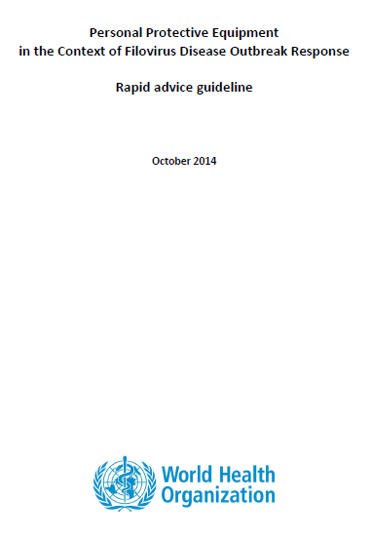
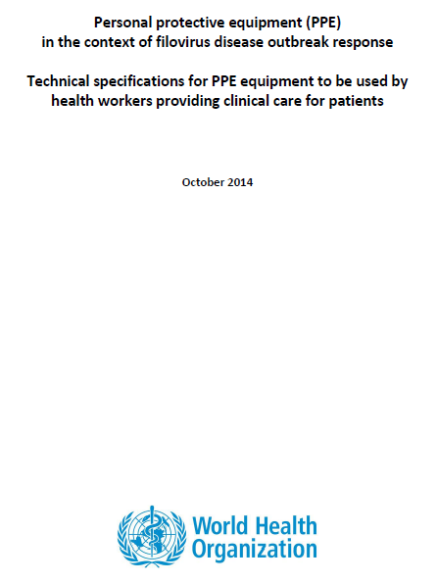
New WHO Guidelines on Personal Protective Equipment (PPE)
Guideline development process
Development of key research questions
Systematic literature reviews
Literature review and an online survey on values and preferences of health workers
Evidence-to-recommendations exercise using the GRADE framework
Expert consultation
WHO Guideline Review Committee
What are the benefits and harms of double gloves, full face protection, head cover, impermeable coveralls, particulate respirators, and rubber boots as PPE when compared with alternative less robust PPE for HCWs caring for patients with filovirus disease?
Issued on
31 October 2014
http://who.int/csr/resources/publications/ebola/infection-prevention/en/

Slide 17
How you use PPE is crucial:
Essential: for putting on and removing PPE, supervision by a trained member of the team
Avoid touching or adjusting PPE
Perform hand hygiene before donning new gloves
Avoid touching your eyes, mouth, or face with gloved or ungloved hands
Leave the red zone and remove PPE if you have to urinate or touch your PPE or eyes, mouth, or face
For removal:
Remove the most contaminated PPE items first and PPE protecting eye, nose and mouth mucosae at last
Be careful to avoid any contact between the soiled items (e.g. gloves, gowns) and any area of the face (i.e. eyes, nose or mouth) or non-intact skin
Discard disposable items in a waste container

Slide 19
Spraying
Spraying chlorine solutions should not be routinely encouraged (WHO Interim IPC Guidance 2014) because:
it is not an evidence-based practice, and
it can cause virus spread through aerosolization,
it gives a false sense of safety (insufficient contact time), and
if extensively used, can lead to adverse events among staff and patients
“Avoid cleaning techniques, such as using pressurized air or water sprays, that may result in the generation of bioaerosols” (OSHA Fact Sheet)
If spraying chlorine solutions is utilized, staff should still maintain maximum attention while manipulating organic material, touching contaminated surfaces, and removing PPE because these may still be contaminated by the Ebola virus

Slide 20
Cleaning and decontamination process
WARNING: chlorine is inactivated when it gets in contact with organic material; therefore, directly pouring chlorine over spills or liquid waste containing blood or body fluids will NOT lead to appropriate decontamination of this waste and of the soiled surfaces
Key principles for environmental cleaning and decontamination:
Remove the soiled with a rag or towel or wipe
Clean with soap/detergent
Disinfect with chlorine solution 0.5%
- Guideline for Disinfection and Sterilization in Healthcare Facilities, 2008
- WHO IPC Interim Guidance. December 2014
- CDC Interim Guidance for Environmental Infection Control in Hospitals for Ebola Virus
Notes:
Cleaning is the removal of visible soil (e.g., organic and inorganic material) from objects and surfaces and normally is accomplished manually or mechanically using water with detergents or enzymatic products. Thorough cleaning is essential before high-level disinfection and sterilization because inorganic and organic materials that remain on the surfaces of instruments interfere with the effectiveness of these processes. (Guideline for Disinfection and Sterilization in Healthcare Facilities, 2008 )

Slide 22
What was wrong about hand hygiene?
Use of chlorine solutions?
Soaking hands in bowls containing chlorine solutions
Inappropriate technique
Insufficient contact time
Inadequate hand hygiene facilities at the point of care
No hand hygiene between patients
Not freshly prepared chlorine solutions
Lack of quality control (adequate concentrations)

Slide 23
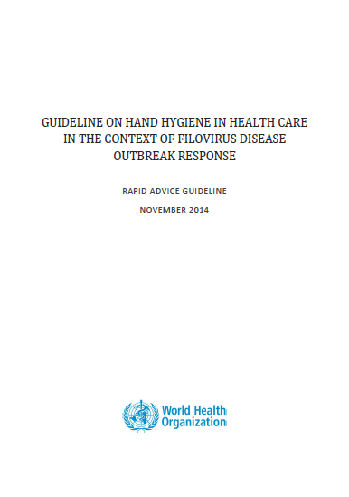
New WHO Guidelines on Hand Hygiene in Health Care in the Context of Filovirus Disease Outbreak Response
Guideline development process
Development of key research questions
Systematic literature reviews
Evidence-to-recommendations exercise using the GRADE framework
Expert consultation
WHO Guideline Review Committee
Issued in December 2014
http://www.who.int/mediacentre/news/
releases/2014/ebola-ppe-guidelines/en/

Slide 24
206 WHO/MOH IPC assessments in Ebola facilities – Sierra Leone
IMPROVEMENT ACTIONS

Slide 25
Key lessons learned for infection prevention and control (IPC) from the Ebola outbreak
Absence of infection prevention and control basic measures and infrastructures both in the community and in healthcare settings led to the unprecedented situation of this outbreak
Importance of consistency and coordination within & among agencies
Fear factors, especially in emergency situations can lead to misplaced focus in IPC and/or to wrong IPC practices
Healthcare workers have been the frontline victims of these vicious circles

Slide 26
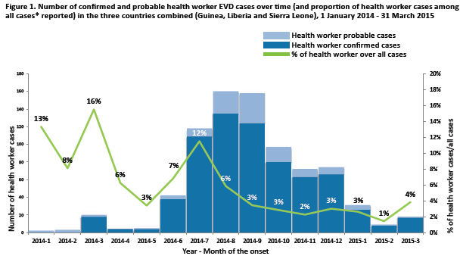
EVD in healthcare workers
HCWs are 21 to 32 times more likely to be infected by EVD than the general population
Total N°EVD in HCWs (3 countries): 815 (3.9% of conf. & probable cases), with 65.5% CFR (418/635)
WHO Interim Report, May 2015, http://www.who.int/csr/resources/publications/ebola/health-worker-infections/en/
Notes:
HCWs are crucial in the fight against EVD. Unfortunately, they are also the most vulnerable population in this crisis.

Slide 27
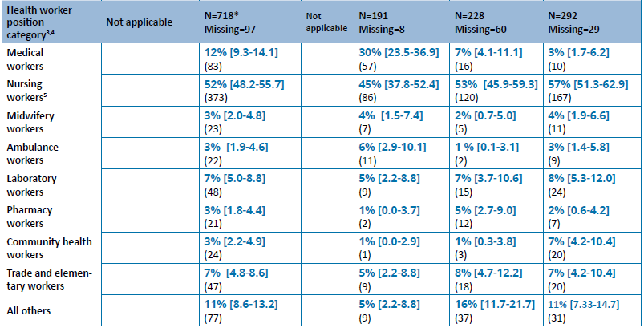
Professional categories

Slide 28
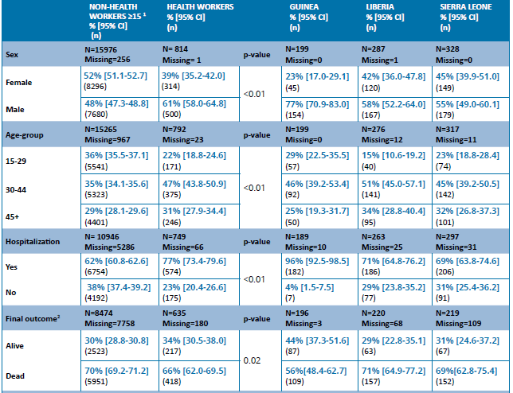

Slide 29
 | Circumstances leading to Exposure | Total Citations
1 | Insufficient / Inadequate PPE / Inconsistent use of PPE | 17
2 | Unrecognized Ebola patients | 7
3 | No soap, chlorine/beach/cleaning supplies, running water, electricity, working waste disposal system | 7
4 | Isolation Areas/Setup - Improper / Inadequate | 4
5 | Barrier Nursing - Improper / Inadequate / Absent | 3
6 | Hygiene / Contaminated Equipment - Surfaces | 3
7 | Washing hands inconsistencies/inadequacies or no hand washing stations | 3
8 | Rubbed eyes with soiled glove | 3
9 | HCW providing nursing care at home | 2
10 | Cadever exposure in hospital and public | 2

Slide 30
Key lessons learned for infection prevention and control (IPC) from the Ebola outbreak
Absence of infection prevention and control basic measures and infrastructures both in the community and in healthcare settings led to the unprecedented situation of this outbreak
Lack of consistency and coordination within & among agencies
Fear factors, especially in emergency situations can lead to misplaced focus in IPC and/or to wrong IPC practices
Healthcare workers have been the frontline victims of these vicious circles
At least, the Ebola outbreak has given the opportunity to get IPC on the top of the national and international agendas

Slide 31
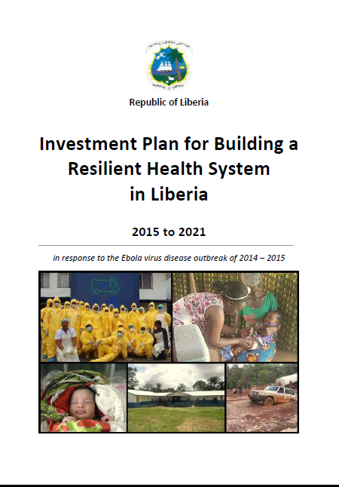
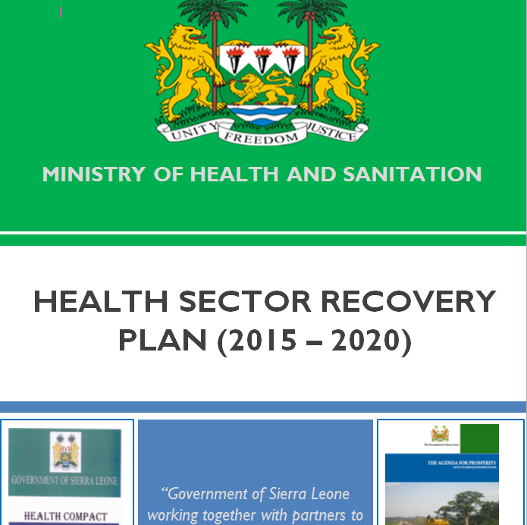
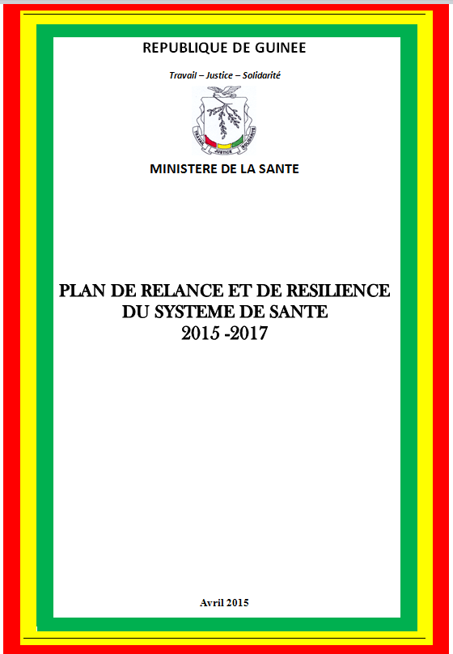
National Recovery Plans

Slide 32
Liberia: Background
At the beginning of the EVD outbreak, there was no organizational unit in MOH dedicated to IPC
However, multiple structures were established to respond:
MOH IPC focal point
County IPC focal points
IPC task force
IPC steering committees
To sustain a culture of IPC, these structures need to be institutionalized in the Liberian healthcare system in the post-EVD era
In addition, IPC policy, SOPs, and guidelines must be integrated into the MOH strategy for building a resilient health system

Slide 34
Liberia: Top 3 Lessons Learned
Accountability needs to be enforced. Health facilities need to comply with standards as was done during the response
Establishing (or empowering) accreditation bodies (i.e. LMDC, embedded TAs)
Patients deserve the right to access SAFE care
A better understanding of risk assessment
Knowing how to identify and categorize risk
Applying risk assessment across all essential health services will better integrate IPC across all essential health services
There is a need to ensure realistic expectations now that these countries are transitioning back to their normal system
During the response, there was a great impetus for immediate progress
Goal is to create a safety culture, both for patients and HCWs
This cannot be done without time and dedication

Slide 35
Guinea: Planning Gaps
Country Level
No national department responsible for effective IPC activity
No comprehensive national IPC plan or strategy
No national or sub-national continuum to rapidly implement IPC response activity
No clear IPC direction for the country
Country NGO defined their own activities
NGOs found back doors and non direct ways of overriding agreed upon standards and activities

Slide 36
Guinea: Planning Gap (2)
International Ebola Response Level
No framework for international humanitarian organizations to work within (governance, regulations, standards for engagement, responsibilities or reports)
No coherent plan, indicators, tools, documentation or goals
Lack of direction and accountability
Lack of standardization for quality and harmonization of implementation

Slide 37
Guinea: Implementation Gaps
Decisions for implementation sites for activity
Based on sites getting international attention after problems developed
Little preventative activity was attempted with the exception of IPC Training which was often seen as non effective despite the evidence of reduction of HCW transmissions where training was done

Slide 38
Guinea: Evaluation Gaps
Inconsistant evaluation information
Many assessments and evaluations were done with unclear methods and tools
Emphasis placed only on the number of lives touched and not on the quality or efficacy of the activity in the short or long run
Many reports were published for the worlds consumption without being given to national leaders to use in making decisions

Slide 39
Guinea: Solutions
Clear Progress was made in IPC:
Framework for activities and overall goals was established
NGO implementing partners agreed on a gap analysis approach for intervention by health districts
Tools were harmonized and validated by the MOH
Standardization of training materials and criteria of trainers

Slide 40
Ebola Lessons Learned: conclusions
IPC/WASH in healthcare settings is a cornerstone of the Ebola response
Need for building upon the current situation of increased
attention on IPC to improve basic structures and standards
Patient safety and healthcare workers safety are equally important during EVD care
Need for including social mobilization and taking culture
into account in IPC messages
Need for adequate preparedness, i.e. meeting minimum requirements for IPC/WASH both in the community and in healthcare
6. MOH leadership, partners coordination, and consistent reference to and implementation of correct IPC standards are paramount

