Slide 1
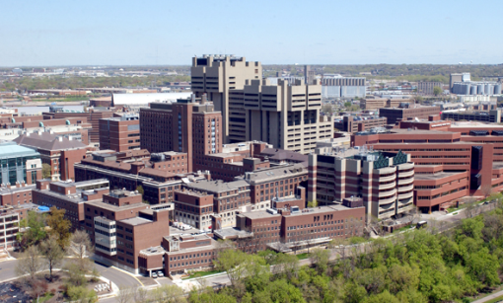
Ventilation for Energy Management
and Infection Prevention
Andrew Streifel
Hospital Environment Specialist
University of Minnesota Medical Center
Hosted by Dr. Lynne Sehulster
Centers for Disease Control, Atlanta
www.webbertraining.com
September 17, 2015

Slide 2

Andrew Streifel
Hospital Environment Specialist
University of Minnesota Medical Center
• 38 years service at U of Minnesota infection prevention.
• Visited over 400 hospitals & assisted in IAQ infection issues.
• Technical expert for ASHRAE, CDC, FGI & other organizations.
• Goal to provide evidence based training for prevention of
infections during construction & maintenance practice.
• Provide guidance for infectious disease prevention design concepts.

Slide 3
Why is energy important to infectious disease management?
Mermazadeh and Xu 2012 recommend site specific risk analysis because increasing or decreasing the room air exchange rate by as little as one air change per hour can result in a differene of $150-250 per year in heating and cooling costs for that room.
Dr. Mermazadeh is the Director of Technical Services NIH.

Slide 4
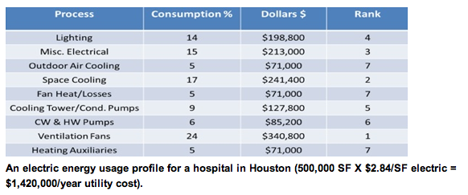
Electrical Usage at Typical Hospital

Slide 5
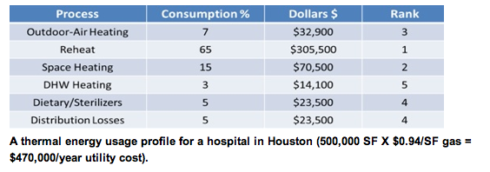
Gas Consumption in a Typical Hospital

Slide 6

Levels of Risk
Healthy person
Chronic obstructive pulmonary disease
Diabetes
Steroids
Cancer - solid tumor
HIV infection-end stage of spectrum
Organ transplant
  Kidney/heart
  Lung/liver
Malignancy - leukemia/lymphoma
Bone marrow transplant (BMT) allograft

Slide 7
What Drives High Energy Use in Healthcare Facilities
•Ventilation
  -High Efficiency Filters
    +90 to 99.97% efficiency
•Indoor Air Quality Standards
-12 to 20 room air exchanges per hour
-waste anesthetic gas, heat, electro-cautery smoke
-microbial shedding and surgical aerosols (no standards)
•Airborne Infection, Protective Rooms, ICU’s and Surgery
-high air exchanges for heat and aerosol control some recirculate
-exhaust from airborne isolation rooms
•IAQ control for temperature, humidity, minimum outdoor air
•Domestic water temperatures
•Laboratory equipment
•Therapeutic and Diagnostic equipment
• 24/7/365 100% ready days with emergency backup

Slide 8
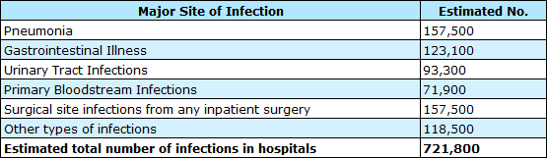
Incidence of Healthcare Associated Infections (HAI), U.S. 2011-2012
  Annual morbidity: 721,800 – Decrease from 1.7 million estimated in 2002 (NEJM, 2014)
  1 in every 25 inpatients has at least 1 HAI
  Most common: Pneumonia and surgical site infection
  Most frequent organism: Clostridium difficile
Annual mortality: 100,000 estimated in 2002 (Klevens, Public Health Reports, 2002)
Direct costs associated with HAI: $28.4-$45 Billion (Scott, CDC Paper, 2012)
Incidence associated with construction unknown; multiple outbreak papers published

Slide 9
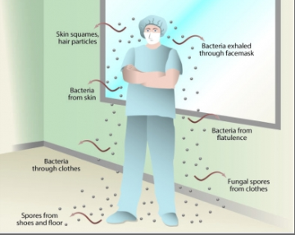
Factors Involved in the Spread of Infectious Diseases
Droplet nuclei transmission dynamics
Nature of dust levels
Health & condition of individual’s nasopharyngeal mucosal lining
Population density in a particular location
Ventilation of the location

Slide 10
Standard Precautions Against Disease Transmission
Early identification of microbes
Development of appropriate SOPs
Use of PPE including:
  Masks & gloves
  Disinfection strategies
  Vaccination
  Appropriate ventilation design

Slide 11
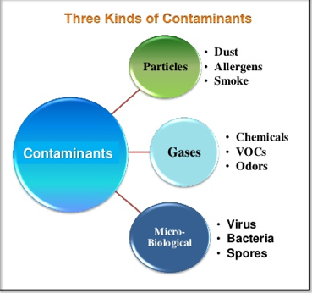
Indoor Air Quality

Slide 12
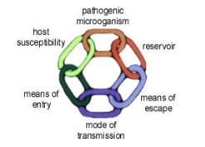
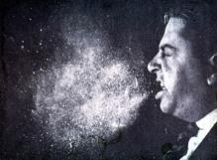
Organisms Associated with Airborne Transmission
 | Fungi | Bacteria | Viruses
Numerous reports in HCF | Aspergillus spp. Mucorales | M. Tuberculosis | Measles virus Varicella-zoster virus
Atypical, occasional reports | Acremonium spp. Fusarium spp Pseudoallescheria boydii Scedosprorium spp. Sporothrix cyanescens | Acinetobacter spp. Bacillus spp. Brucella spp. Staphylococcus aureus Group A. Streptococcus | Smallpox virus Influenza viruses Respiratory syncytial virus Adenoviruses Norwalk-like virus
Airborne in nature; airborne transmission in HCF not described | Coccidioides immitis Cryptococcus spp. Histoplasma capsulatum | Coxiella burnetti (Q fever) | Hantaviruses Lassa virus Marburg virus Ebola virus Crimean-Congo Virus
CDC Guideline for Environmental Infection Control Guidelines 2003

Slide 13
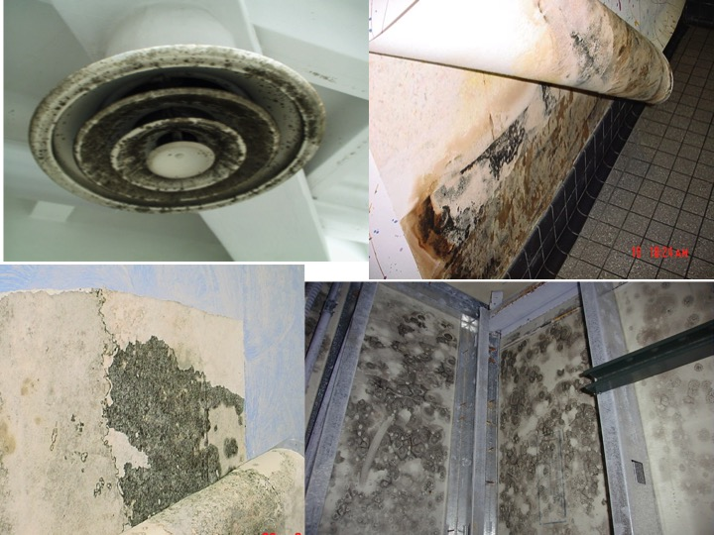

Slide 14
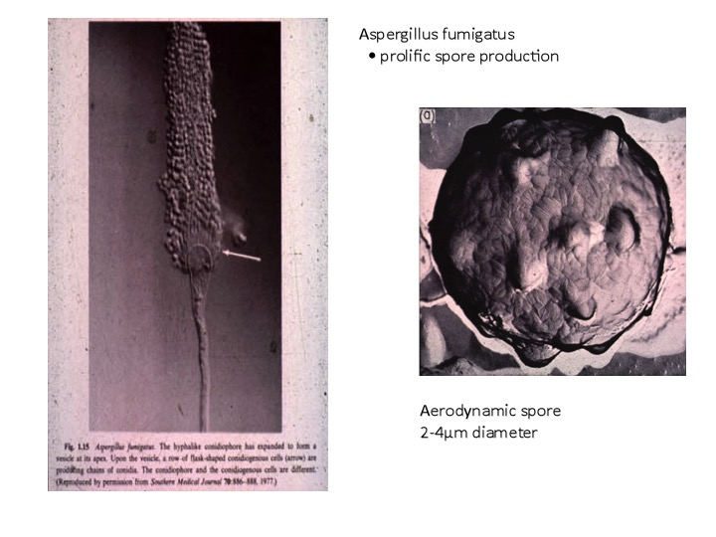

Slide 15

Recent examples of the frequency of invasive aspergillosis
Underlying condition | Incidence | Reference/year
Acute myeloid leukaemia | 8% | Cornet, 2002
Acute lymphatic leukaemia | 6.3% | Cornet, 2002
Allogeneic HSCT | 11-15% | Grow, 2002; Marr, 2002
Lung transplantation | 6.2-12.8% | Minari, 2002; Singh,2003
Heart-lung transplantation | 11% | Duchini, 2002
Small bowel tranplantation | 11% | Duchini, 2002
AIDS | 2.9% | Libanore, 2002

Slide 16
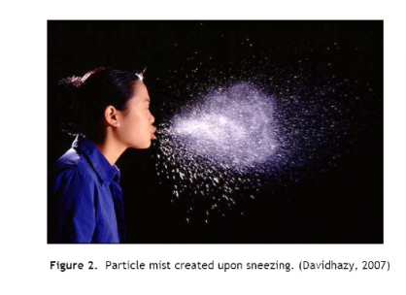
How far can Airborne Bacteria & Viruses Travel?
Large/Small Droplets Droplet Nuclei
Coughing 1-5 feet 160+ feet
Sneezing 8-15 feet 160+ feet
Singing, Talking 1-3 feet 160+ feet
Mouth Breathing 1-3 feet 160+ feet
*Diarrhea 5 feet+ 160+ feet
*As a Result of Toilet Water Aerosolization and Mechanical Fan Dispersion into outdoor air (2003 Hong Kong SARS Virus Epidemic)

Slide 17
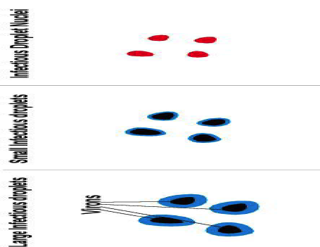
Stages of Infectious Droplets & Droplet Nuclei
1. Mucus/water encased by the infector or by toilet water. These quickly fall to the ground after traveling up to 1-3 feet.
2. Mucus/water coating starts to evaporate. These will travel 3-5 feet before falling to the ground. These droplets can become droplet nuclei.
3. Mucus/water coating has totally evaporated coating the viron particles. These are Droplet Nuclei which are so microscopic they can float in the air.

Slide 18
Evaporation Time & Falling Distance of Droplets Based on Size
Diameter of Droplet (µm) | Evaporation time (sec) | Distance fallen in ft. (before evaporation)
200 | 5.2 | 21.7
100 | 1.3 | 1.4
50 | 0.31 | 0.085
25 | 0.08 | 0.0053
Adapted from: Wells, W.F., 1955, Airborne contagion and air Hygiene, Harvard University Press, Cambridge, Mass.
*particles discharged at 6 ft. > 140µm tend to fall to the ground
*particles discharged at 6 ft. < 140µm evaporate to droplet nuclei

Slide 19
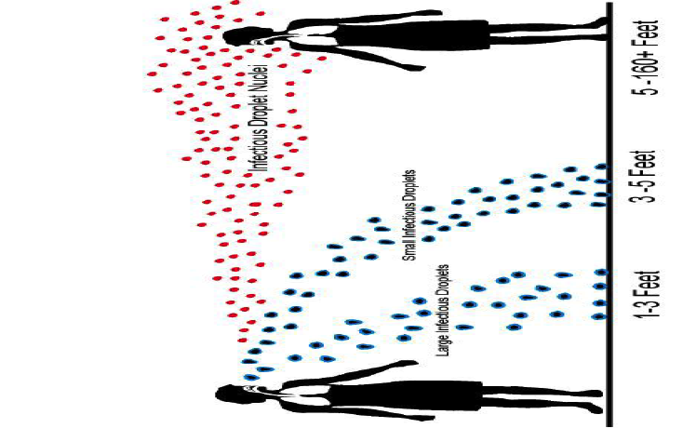
Infectious Droplets & Droplet Nuclei travel lengths

Slide 20
Airborne Transmission depends on people to launch viruses into the air.
People can shed this many Flu Viruses into the air as tissue culture infecting doses (TID)
1. Coughing 3,000+ TID
2. Sneezing 3,000+ TID
3. Breathing: Nose-None
4. Talking/Singing 1,000+ TID
5. Vomiting 1,000+ TID
6. *Diarrhea 20,000+ TID
* As a result of Toilet Water Aerosolization

Slide 21
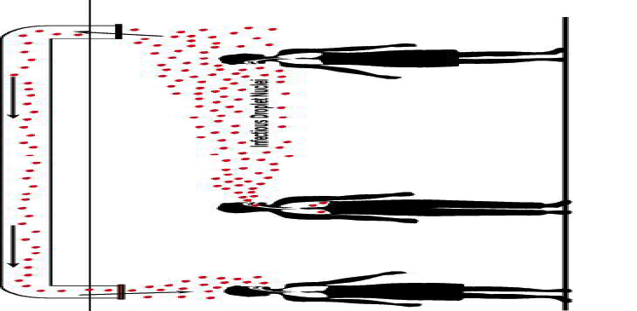
Droplet Nuclei Travel Within Buildings
In hospitals re-circulated air is filtered > 90%

Slide 22
● Viruses Evaporate faster in Low Humidity levels thus creating More Droplet Nuclei.
● Low humidity allows droplet nuclei to stay airborne longer as the droplets do not absorb water weight which would cause them to fall to the ground.
● Indoor Air currents both created by HVAC systems and people movement assure that droplet nuclei will remain airborne Indefinitely.
● This allows HVAC systems to remove and redistribute droplet nuclei throughout the building to infect more occupants.
Low Indoor Humidity Increases Droplet Nuclei Levels (winter)

Slide 23
1) Indoor humidity levels (winter) in the Northern
Hemisphere especially in North America and
Europe are between 15-35%.
2) Studies have proven that there is no “flu season” in the tropics where indoor humidity levels stay above 40% all year long.
There is a DIRECT correlation between low indoor humidity in winter and increases in influenza morbidity and mortality

Slide 24
Facility Guidelines Institute
Design Parameters of Selected Areas
Function of Space Relative Humidity % Design Temperature °F/°C
Classes B & C Operating Rooms 20-60 68-75/20-24
Burn unit 40-60 70-75/21-24
Newborn intensive care 20-60 70-75/21-24
Patient room(s) max 60 70-75/21-24
Protective environment room max 60 70-75/21-24
Airborne Isolation anteroom N/R N/R
ASHRAE STD 170 HEALTHCARE VENTILATION 20% RH CHANGE
ASHRAE Standard 55-1992 recommends: Relative Humidity between 20% and 60%
Less than 50% RH for dust mite control

Slide 25
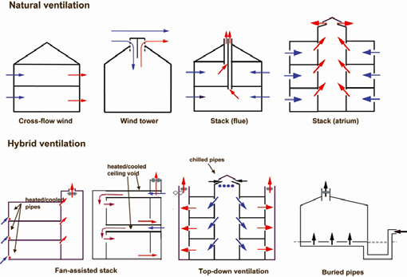
There are six basic types of natural ventilation systems:
• single-side corridor
• central corridor
• courtyard
• wind tower
• atrium and chimney
• hybrid (mixed-mode) ventilation.
World Health Organization Pub/Natural Ventilation for Infection Control in Healthcare-2009

Slide 26
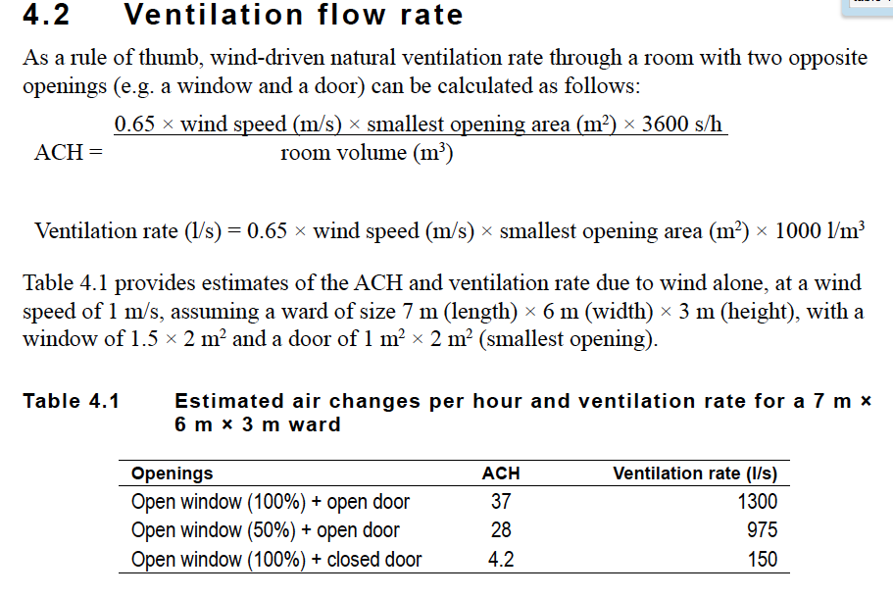

Slide 27
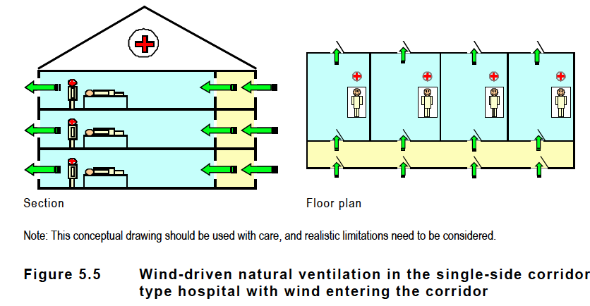

Slide 28
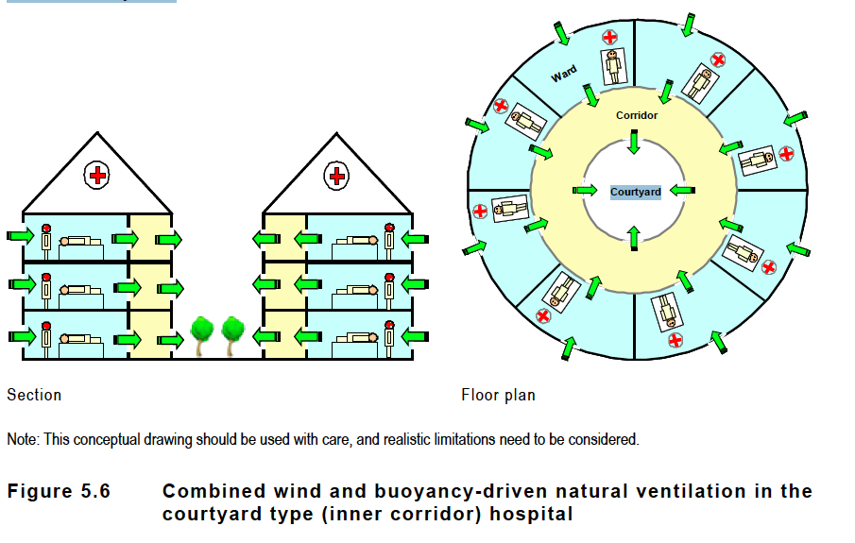

Slide 29
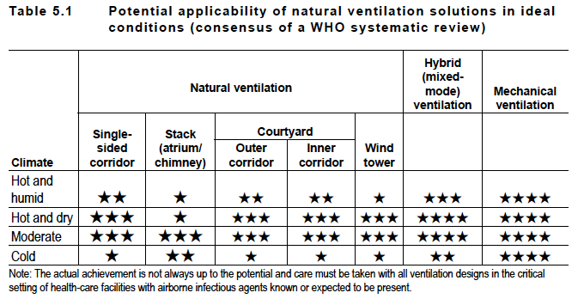
Applicability of natural ventilation systems
Natural ventilation for infection control
in health-care settings.
★ The performance in either thermal comfort or infection control is
unsatisfactory. In terms of infection control, it means the magnitude of
the ventilation rate.
★★ The performance is fair.
★★★ The performance is acceptable, but compromise may be needed in terms
of thermal comfort.
★★★★ The performance is good in terms of both thermal comfort and airborne
infection control.
★★★★★ The performance is very good (satisfactory) in terms of both thermal
comfort and infection control.

Slide 30
Negative Pressure Room for Airborne Infection Isolation
monitor
Bathroom
corridor
Positive Pressure Room for Protective Environment
Monitorr
Bathroom
Corridor
30
Notes:
Environmental Validation Infection Control
Andrew Streifel
30
25

Slide 31
CDC EIC MMWR JUNE 6, 2003
AIA & ASHRAE DESIGN GUIDELINES FOR VENTILATION

Slide 32
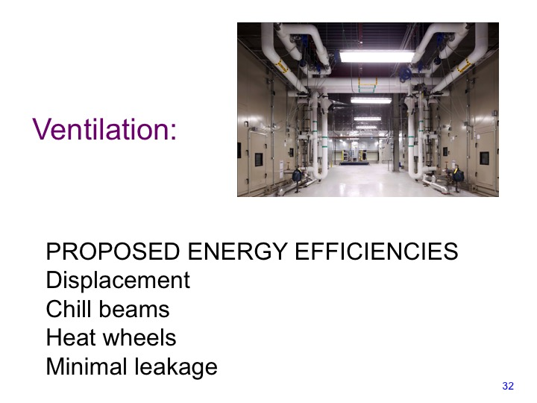
Notes:
32

Slide 33
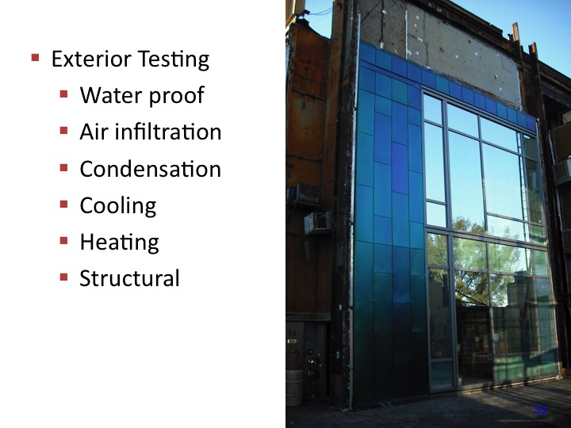
Notes:
33

Slide 34
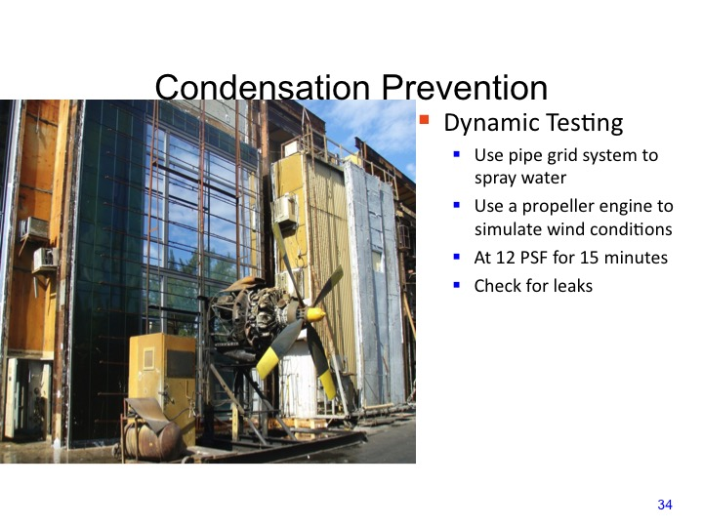
Notes:
34

Slide 35
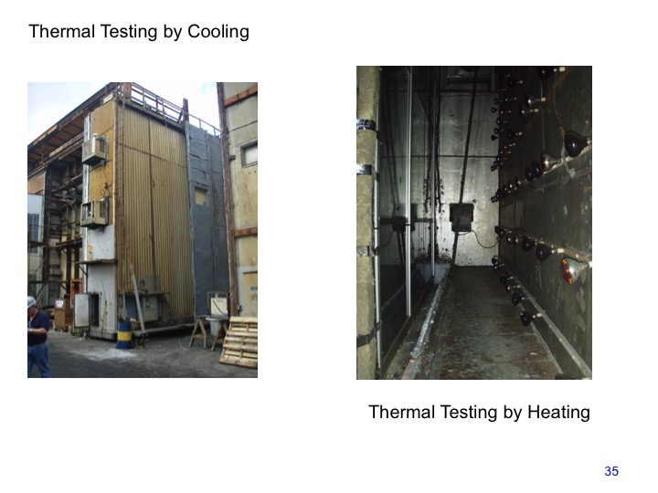

Slide 36
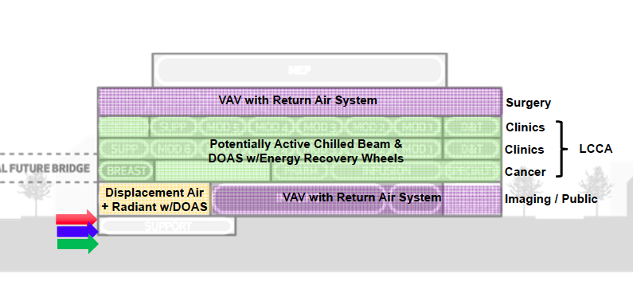
Planning for New Ambulatory Care Center University of Minnesotan Medical Center 2014
Benefits of Active Beams in Healthcare
Reduction in air handling equipment
Minimization and elimination of ductwork
Reduction in reheat
Quiet operation
Improved indoor air quality
Reduced risk of cross contamination

Slide 37
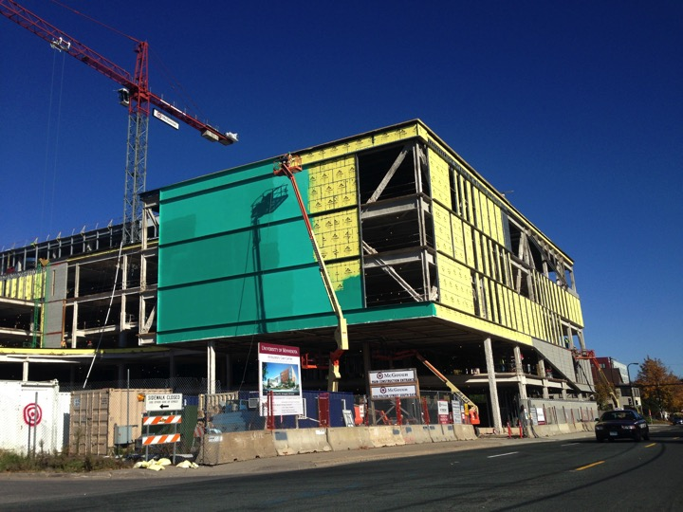

Slide 38
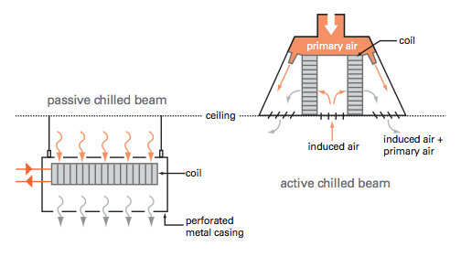
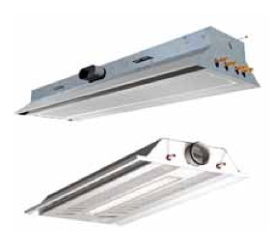
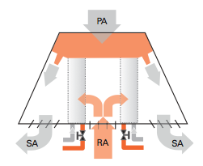
Chill beam advantage is to
separate the cooling component
with the air supply to save energy.

Slide 39
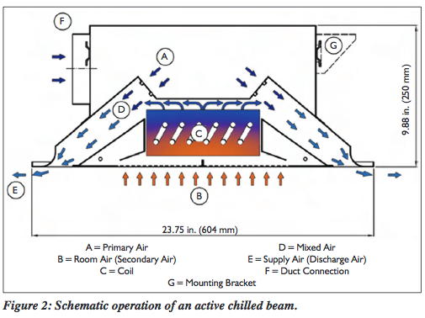
•Must have access for cleaning
•Must not condense on the surfaces of the chill beam
•A sealed curtain wall helps keep humidity out of the building

Slide 40
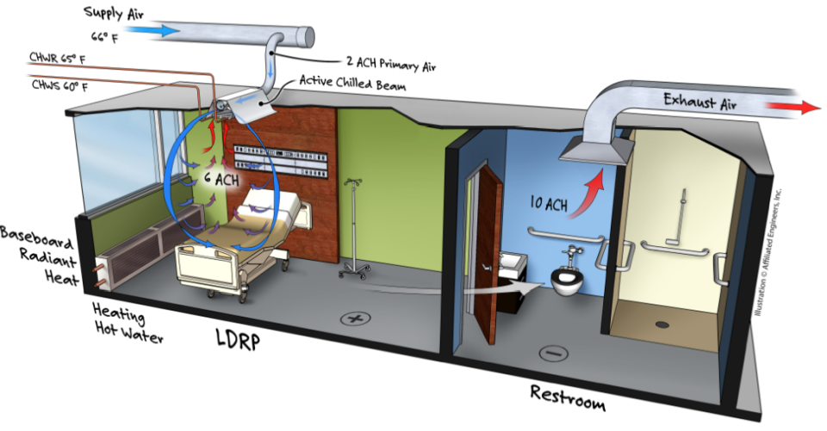

Slide 41
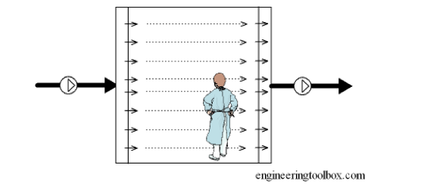
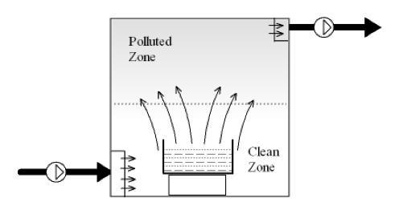
What is displacement ventilation?
Piston airflow
Displacement like piston airflow
moves air in single direction
that displaces air as it moves
The intent being not to mix the
air but pushes is it.

Slide 42
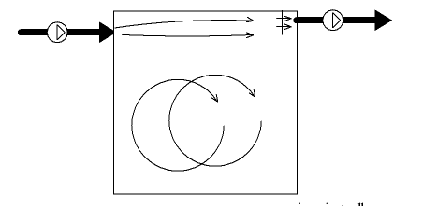
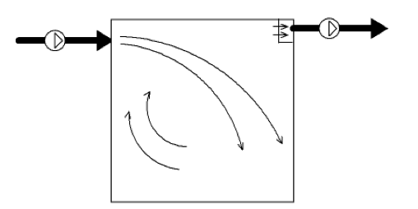
Normal Room Ventilation Conditions
Short circuiting airflow
Mixing ventilation

Slide 43
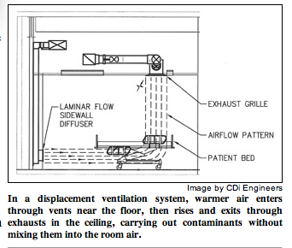
The advantages of Displacement ventilation
Energy saving and moving air out of the breathing zone

Slide 44
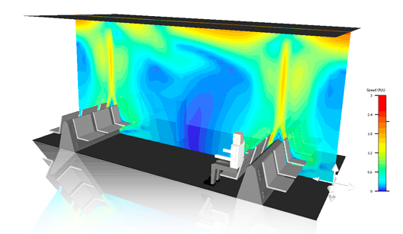
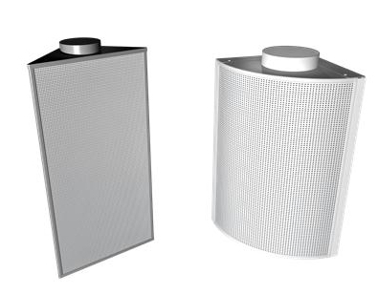
Waiting rooms and atriums are
very good applications for using
this kind of air delivery. DV is also
common in auditoriums
Unique diffusor design allows them to be
Incorporated into building structure at lower
Elevations in respective rooms.

Slide 45
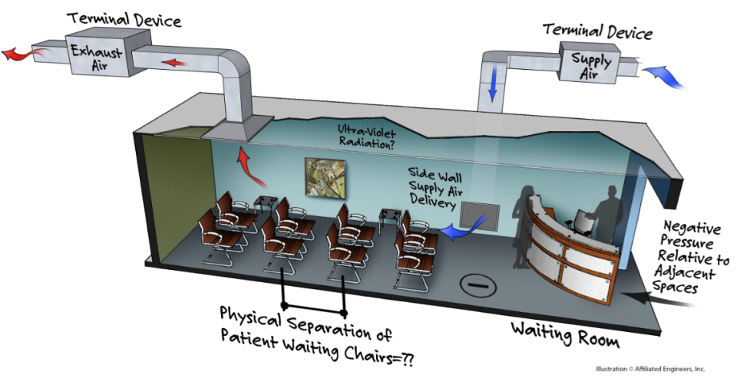

Slide 46
Advantage of Displacement Ventilation for Infection Prevention and
Energy Management
Infection Prevention
-Room temps may seem warmer
due to delivery temp higher.
-Rising temp creates upward
buoyance to lift particles
-When infectious particle above
breathing zone safe?
Energy Management
-Air delivered to room for
comfort already >60F
-Lower energy costs
-Decrease air exchange
for room by using 6 ft
instead of 8 ft for calculation
Disadvantage: Difficult to find space in a patient room to deliver air low

Slide 47
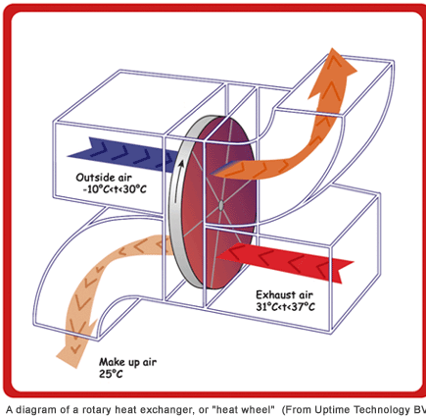
Heat Wheels can Reclaim Energy
Aware of air flow direction (clean to dirty) and need to clean the wheel
How is it maintained?

Slide 48
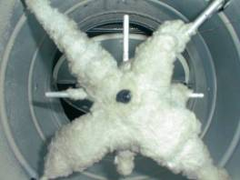
Causes of Ventilation Deficiencies
Plugged Filters
Plugged Temperature Control Coils
Duct Leakage
Dust on Fan Blades
Fan Belt Slippage
Uncalibrated Control Equipment
  Digital Controls
  Pneumatic Controls
    Plugged sensors

Slide 49
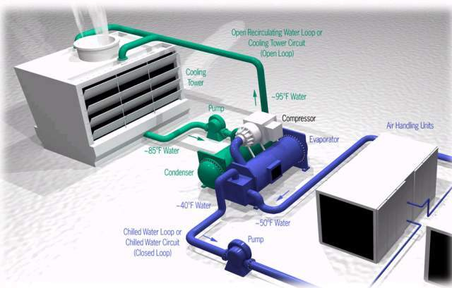
HVAC – Chilled Water System

Slide 50
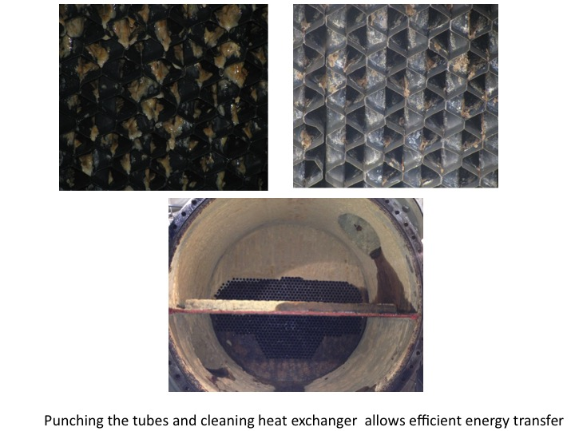

Slide 51
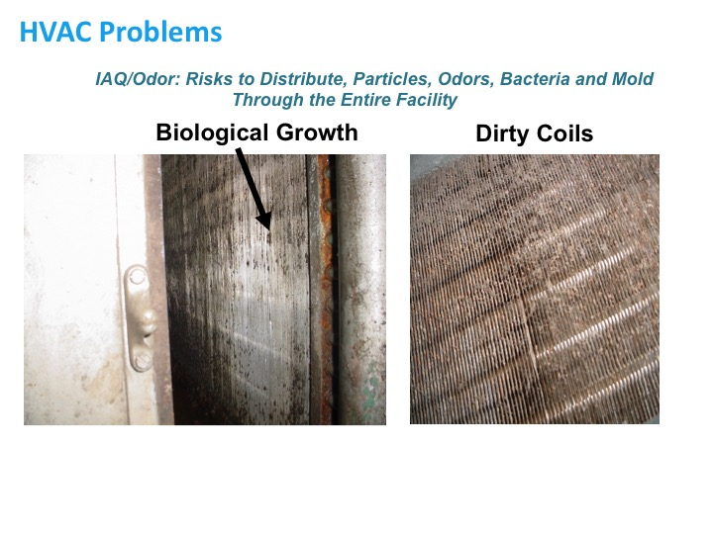

Slide 52
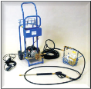
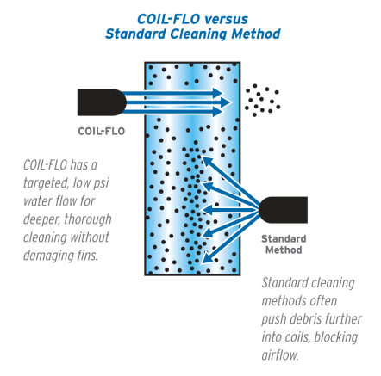
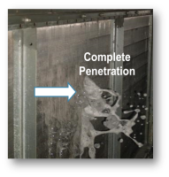
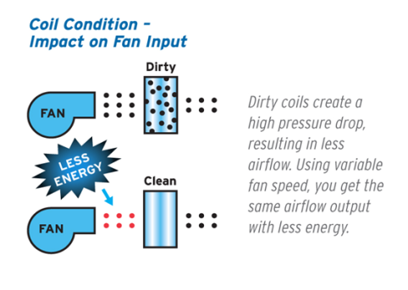
Deep Cleaning Process
Recover Coil Heat Transfer Performance
Result: More air and cooler air

Slide 53
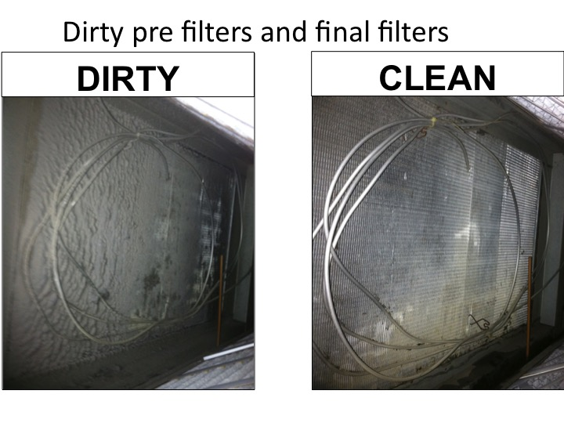

Slide 54
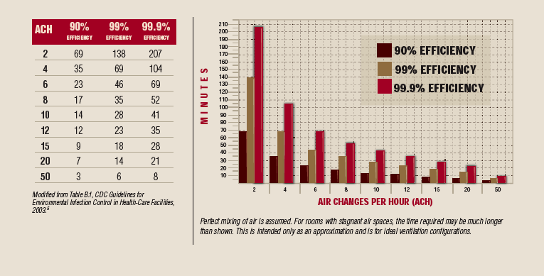
Impact of Air Flow On Room Particle Contamination

Slide 55
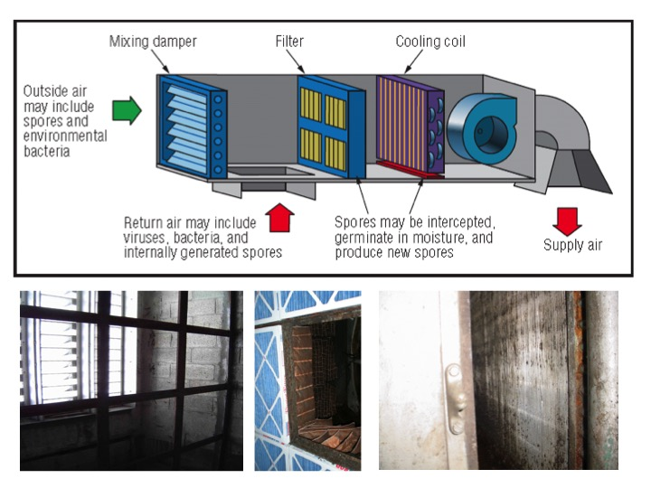

Slide 56



Filter Engineering Solutions
Impact of Innovative Filter Technologies
MAINTAIN
glass fibers
synthetic fibers
Face Loading
Synthetic electro static fibers may degrade quickly
Depth Loading

Slide 57


Slide 58


Removal Efficiency In-Situ by Particle Size and Resistance to Flow
Direction of Airflow
Before
After
Particle Counter
After filter
40 p/ft^3
Before filter
12176 p/ft^3
>99% reduction

Slide 59


Slide 60


Slide 61
Room 206
Door
SUPPLY

Slide 62


Slide 63
Patient Mock-up Room Leakage Application Overview
Why should we seal rooms anyway??

Slide 64


Slide 65


Slide 66


Slide 67

Notes:
29

Slide 68





Case Study- Barrier Management “Leakage”
Total Barrier Management
Infection control
Sound
Energy/ Movement
UL systems
Total Barrier Management practices increase build integrity beyond UL systems with additional secondary attributes
DISCLOSURE HILTI SPONSORED STUDY

Slide 69

Staff/Housekeeping/Clean equipment in-flow
HLIU FLOW
Patient in-flow
Patient/Staff/Housekeeping/Dirty Equipment out-flow
Dirty
Decon
Dirty
Decon
Dirty
Ante
Dirty
Ante
Clean
Ante
Dirty
Ante
Dirty
Ante
Clean
Ante

Slide 70
PROPOSED AIR PRESSURE
-5pa
-7.5pa
-5pa
-5pa
-7.5pa
-5pa
-10pa
-10pa
-7.5pa
-7.5pa
-2.5pa
-2.5pa
-2.5pa
-2.5pa
Interlocking doors

Slide 71


Staff/Housekeeping/Clean equipment in-flow
Patient in-flow
Patient/Staff/Housekeeping/Dirty Equipment out-flow
*Loss of corridor space and 2 x Nurse Alcoves

Slide 72


Slide 73


Slide 74


Slide 75
Application Test Series – Complete Overview
Blower Test # | Test Application | Status | CFM Per Application
1 | ToW | Open | 7000
2 | ToW | Sealed | 98.85
3 | BoW | Open | 98.85
3 | BoW | Sealed | 40.63
4 | Plumbing | Open | 816.3
5 | Plumbing | Sealed | 41.3
6 | Low Voltage | Open | 191.8
7 | Low Voltage | Sealed | 45.96
8 | Electrical Boxes | Open | 135.6
9 | Electrical Boxes | Sealed | 46.52
10 | Mechanical * | Open | 135.6
11 | Mechanical | Sealed | 46.59
Source: Testing implemented by The Energy Conservatory. Testing completed w/ Duct Blaster fan and micromanometer measuring flows from 10 to 1500 CFM.

Slide 76
Case Study- Barrier Management
LIFE SAFETY/FIRE
The most common requirement for control is the UL or life safety considerations as they
pertain to fire and smoke control. Hospital
corridors and other potential fire hazard
need to be sealed
Fire management in healthcare has provided safety to millions of healthcare building occupants resulting in enormous strides in
fire management through regulation. NFPA,
Life safety 99 and 101.
What additional benefits can be realized?
Total Barrier Management
Infection control
Sound
Energy/ Movement
UL systems
Total Barrier Management practices increase build integrity with life Safety and fire secondary attributes

Slide 77
Case Study- Barrier Management
SOUND MITIGATION
Additional benefits of a sealed room include sound mitigation. It is common acoustical knowledge that sound transmission can be partially mitigated by impeding air movement. This practice occurs where airport noise is managed with sealed houses to minimize
sound wave infiltration. HIPPA requires
privacy from hearing patient conditions.
Explain some of the physics of sound transmission
Total Barrier Management
Infection control
Sound
Energy/ Movement
UL systems
Total Barrier Management practices increase build integrity and sound migration secondary attributes

Slide 78
Case Study- Barrier Management
Building design in healthcare includes inoperable windows to prevent infiltration of uncontrolled air. Comfort factors are essential to convalescence therefor to maintain
temperature between 68 and 72 can
be difficult without controlled ventilation.
Leakage reduction will require less heating and cooling??
Does a sealed room/building provide ventilation energy efficiency?
Provide some energy statistics??
ENERGY/COMFORT
Total Barrier Management
Infection control
Sound
Energy/ Movement
UL systems
Total Barrier Management practices increase build integrity and energy & comfort secondary attributes

Slide 79
Case Study- Barrier Management
Control of aerosol important principal for airborne infectious agents causing tuberculosis or aspergillosis depends on airflow control. Aerosol management due to patient derived symptoms needs masking and special room ventilation. Aerosol control is dependent on airflow direction intensity.
Excess room leakage will diminish pressure management design. A sealed room will help provide consistent direction for prevention of occupational exposures to droplet nuclei containing Mycobacterium tuberculosis or chicken pox
INFECTION PREVENTION
Total Barrier Management
Infection control
Sound
Energy/ Movement
UL systems
Total Barrier Management practices increase build integrity and infection prevention secondary attributes

Slide 80
Infection Prevention and Ventilation
Air volumes must be maintained to assure cleaning the air of contaminants
Impediments include: plugged equipment that needs cleaning or change out of filters
Aspiring to have good air quality requires routine maintenance to assure AC/hr, filtration and pressure.

Slide 81


Slide 82

September 24 (Free Teleclass)
EVIDENCE VS. TRADITION: EXAMINING THE EVIDENCE OF BATHING TO
REDUCE HAI’S
Kathleen Vollman, Advanced Nursing LLC
Sponsored by Sage Products (www.sageproducts.com)
September 28 (Free British Teleclass ... Broadcast live from the 2015 IPS conference)
WHAT DID THE ROMANS EVER DO FOR US?
Carole Fry, Healthcare Infection Society
September 29 (Free British Teleclass ... Broadcast live from the 2015 IPS conference)
FAECAL TRANSPLANT TO TREAT CLOSTRIDIUM DIFFICILE DISEASE
Dr. Jonathan Sutton, Betsi Cadwaladr University Health Board, Wales
September 30 (Free British Teleclass ... Broadcast live from the 2015 IPS conference)
THE EMERGENCE OF MERS: FROM ANIMAL TO HUMAN TO HUMAN
Professor Ziad Memish, Prince Mohammed Bin Abdulaziz Hospital, Saudi Arabia
October 14 (FREE WHO Teleclass - Europe)
THE USE OF SOCIAL MEDIA IN SUPPORT OF GLOBAL INFECTION
PREVENTION AND CONTROL

Slide 83


