Slide 1
ENGAGING and Educating Nurses in Evidence-Based Practice
Eileen J. Carter PhD, RN
Assistant Professor of Nursing, Columbia University Irving Medical Center
Nurse Researcher, New York-Presbyterian Hospital
Hosted by Paul Webber
paul@webbertraining.com
www.webbertraining.com
August 22, 2019

Slide 2
Objectives
Discuss the importance of nurses’ engagement in evidence-based practice
Provide tangible strategies to effectively engage nurses in evidence-based practice
2

Slide 3
My experiences
Past
  Clinical nurse
Current
  Teacher
  Mentor
  Researcher
3

Slide 4

4
Daily News, 2012
Notes:
DailyNews December 2012

Slide 5
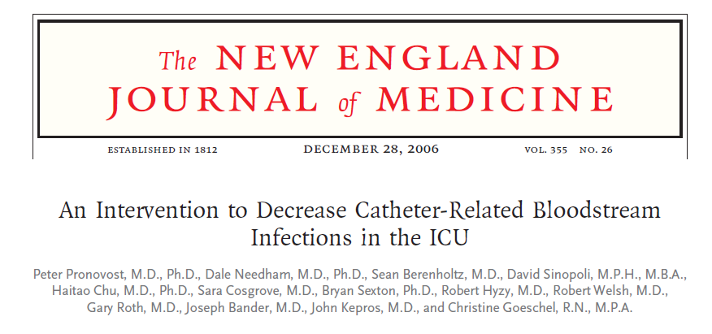
Importance of “WHY?”
Pronovost P et al. N Engl J Med 2006;355:2725-32.
5

Slide 6

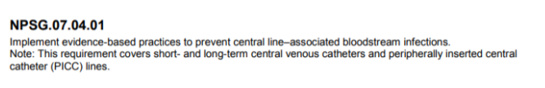
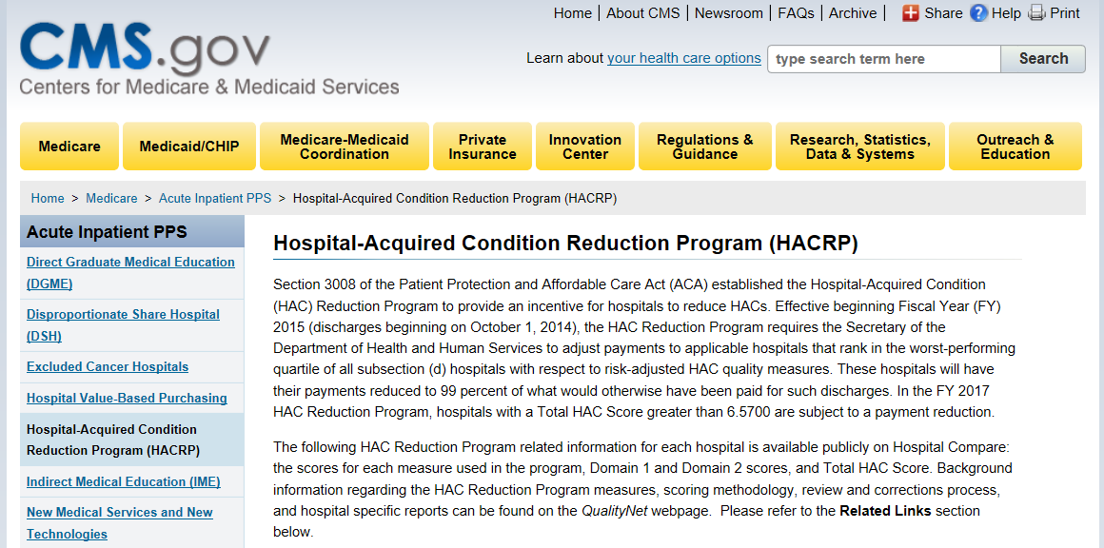
Evidence can be Highly Influential
6
Notes:
https://www.youtube.com/watch?v=-FfMCv8FUXI

Slide 7
Best practices must already be happening
…Right?
7

Slide 8
8
Daily News, 2012
Notes:
DailyNews December 2012

Slide 9
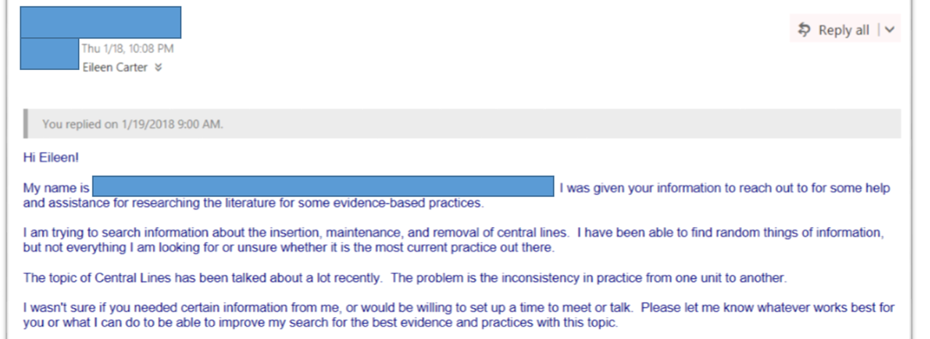
Real World Example
9

Slide 10

Common Barriers to Evidence-Based Practice
Individual Level & System Level
Knowledge/Education
Low prioritization
Time
Resources
Culture
TO DO LIST:
1.
2.
3.
4.
EVERYTHING!!!
Melnyk BM, et al. J Nurs Adm 2012;42(9): 410-7.
Jun et al. Int J Nurs Stud 2016;54-68.
10

Slide 11
Evidence-Based Practice
“Integration of best research evidence with clinical expertise and patient values”
(Haynes et al 2002)
Evidence
Clinician expertise
Patient Preferences
11

Slide 12
What is “Best Research Evidence?”
What is research evidence?
  Systematic inquiry to identify ‘truth’
What is “best”?
  High level of evidence – When performed well, certain study designs are inherently stronger and provide higher quality of evidence for decision making than other study designs (see evidence pyramid)
  High quality –Study results are credible; not due to random (chance) or non-random error (bias)
12

Slide 13
Growing recognition that nurses are critical in optimizing care in practice
What are evidence-based practices?
How can these practices be successfully implemented?
How can we ensure the consistent use of practices over time?
13

Slide 14
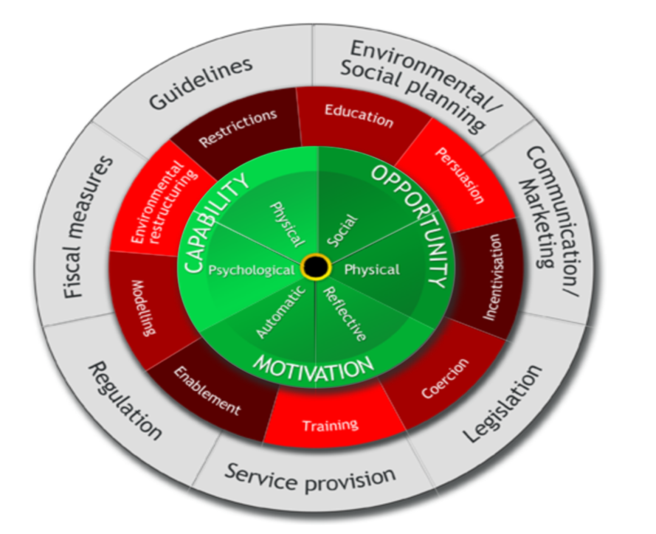
Successful Strategies Target Multiple Sources of Behavior
CAPACITY
OPPORTUNITY
MOTIVATION
Michie S, Atkins L, West R. (2014) The Behaviour Change Wheel: A Guide to Designing Interventions. London: Silverback Publishing. www.behaviourchangewheel.com.
14

Slide 15
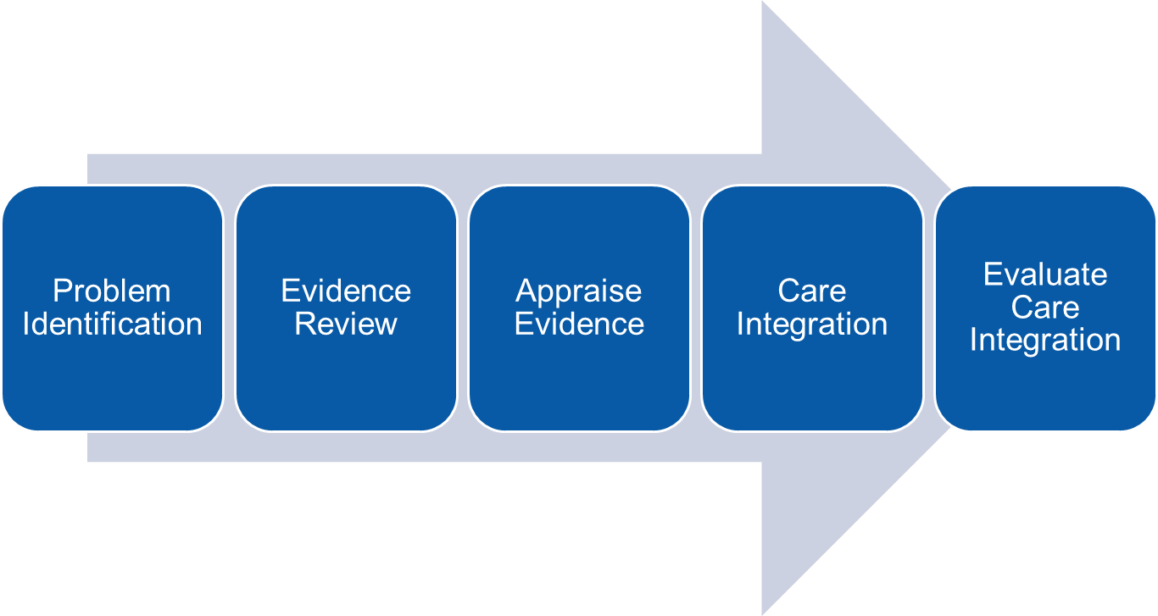
Strategy #1 – Focus on Nurses’ Capacity
Adopt an evidence-based practice framework
  Standardizes the approach; minimizes confusion
Flemming K. Asking answerable questions. Evidence-Based Nursing 1:36-37:1998
Tahan H, Evidence-Based Nursing Practice: the PEACE Framework. Nurse Leader 14:57-61:2016
15

Slide 16
One of your colleagues mentions that falls are a problem on her unit. She wants to know how she can best prepare to prevent falls among her patients. What advice would you give?
Declare ignorance. You know nothing about this topic!
Review the evidence
Formulate a PICO question
Recommend the use of bed alarms
16

Slide 17
Strategy Focus: Nurses’ Capacity
P - Population
I - Intervention
C - Comparison
O - Outcome
17

Slide 18
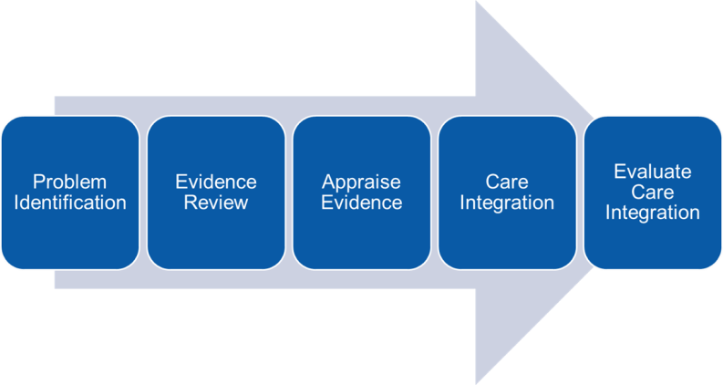
Why PICO is Useful to Nurses
Lays the foundation to the five-step evidence-based nursing process
Helps clarify the actual issue you want to address
Saves time searching – as you can focus your search on evidence that will best address your question
18

Slide 19
Clinical Example
You work as an inpatient medical-surgical nurse. While assessing a new patient, you learn that this patient drinks at least 5 cups of coffee a day. You begin counseling the patient on risks to high caffeine consumption. The patient responds, “But there was just a study that was featured on the news. Coffee prevents depression. I thought I was doing a good thing.”
You are not aware of this study and come to think of it, you haven’t seen many recent articles on this topic. You want to find out more information to ensure that you are properly educating and caring for your patients.
19

Slide 20
Finding What’s Important
Does coffee consumption (I)
compared to no coffee consumption (C)
prevent depression (O)
among adults (P)?
P = Population
I = Intervention
C = Comparison
O = Outcome
20

Slide 21
Formulating a PICO Question
Iterative process
The initial and one of the most difficult steps in evidence-based practice
21

Slide 22
Strategy Focus: Nurses’ Capacity
P - Population
I - Intervention
C - Comparison
O - Outcome
PubMed for Nurses
https://www.nlm.nih.gov/bsd/disted/nurses/cover.html
TRIP Database
https://www.tripdatabase.com/how-to-use-trip
22

Slide 23
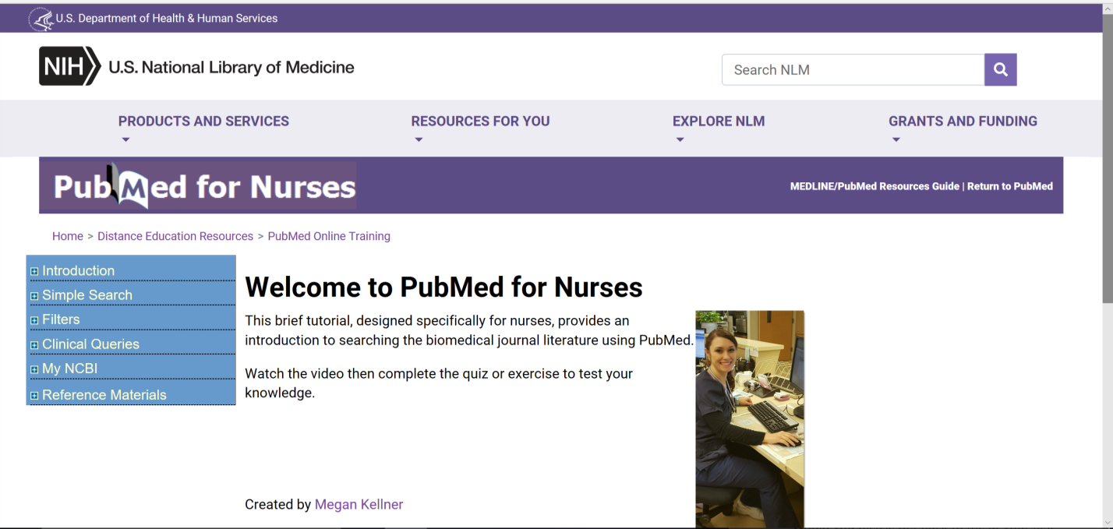
Reviewing Evidence
https://www.nlm.nih.gov/bsd/disted/nurses/cover.html
23

Slide 24

Reviewing Evidence
https://www.tripdatabase.com/how-to-use-trip
24

Slide 25
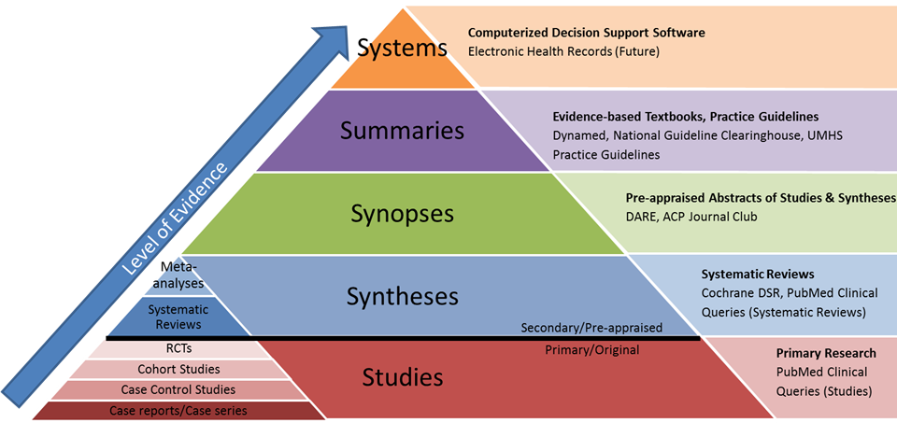
Evidence Pyramid = Level of Evidence
https://guides.lib.umich.edu/nursing/evidence
Modified from: Haynes RB. Of studies, syntheses, synopses, summaries and systems: the “5S" evolution of services for evidence-based health care decisions. ACP J Club. 2006 Nov-Dec;145(3):A8-9
25

Slide 26
Strategy Focus: Nurses’ Capacity
CASP Appraisal Checklists
https://casp-uk.net/casp-tools-checklists/
P - Population
I - Intervention
C - Comparison
O - Outcome
PubMed for Nurses
https://www.nlm.nih.gov/bsd/disted/nurses/cover.html
TRIP Database
https://www.tripdatabase.com/how-to-use-trip
26

Slide 27
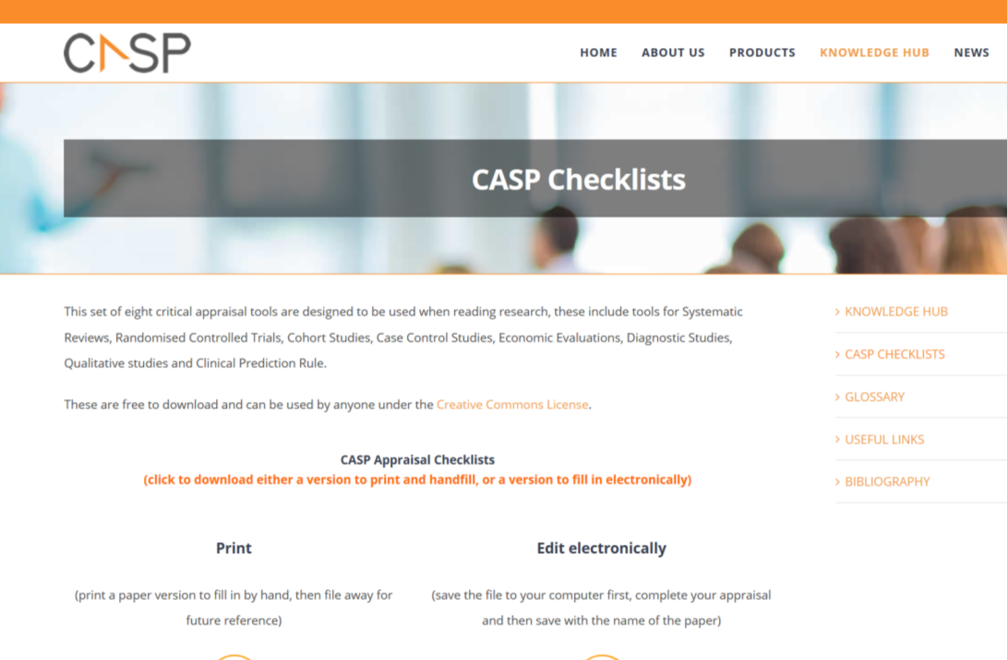
Appraising Evidence
https://casp-uk.net/casp-tools-checklists/
27

Slide 28
As part of an evidence-based practice project, you are responsible for describing the strengths and limitations of research studies. What section of the research paper should you focus most of your energy and time?
Abstract
Introduction
Methods
Results
Discussion
28

Slide 29
Abstract – What it is and what it is not.
The abstract provides a very general description of what was done, why it was done and what researchers found.
Importantly, the abstract DOES NOT PROVIDE SUFFICIENT details on HOW the study was conducted. The way in which a study was conducted can distort results.
In order for clinicians to weigh the merit of an individual study, we must evaluate the strengths and weakness of how a study was conducted and place study findings in context of what’s already known on the topic.
29

Slide 30
Strategy Focus: Nurses’ Capacity
CASP Appraisal Checklists
https://casp-uk.net/casp-tools-checklists/
P - Population
I - Intervention
C - Comparison
O - Outcome
PubMed for Nurses
https://www.nlm.nih.gov/bsd/disted/nurses/cover.html
TRIP Database
https://www.tripdatabase.com/how-to-use-trip
30

Slide 31



Strategy Focus: Academic-Partnerships to Enhance Nurses’ Capacity
“Strategic relationships between educational and clinical practice settings that…advance… mutual interests related to practice, education, and research.”
De Geest, S., Dobbels, F., Schoenfeld, S., Duerinckx, N., Sveinbjarnardottir, E. K., & Denhaerynck, K. (2013). Academic Service Partnerships: What do we learn from around the globe? A systematic literature review. Nursing Outlook, 61(6), 447-457.
31

Slide 32


Strategy Focus: Academic-Partnerships to Enhance Nurses’ Capacity
Joint nurse scientist role is a means to advance scholarly goals across institutions
Characterized by a
PhD prepared nurse appointed in a research role across organizations
32

Slide 33
Timeline
2014
2015
2016
2017
2018
2019
NewYork Presbyterian Hospital (n=4)
Hackensack-Meridian Health (n=1)
Memorial Sloan Kettering Cancer Center (n=2)
Hospital for Special Surgery (n=1)
33

Slide 34
Strategy Focus: Nurses’ Opportunity
Availability and access to scientific articles
Medical library affiliations
Workarounds
34

Slide 35
Strategy Focus: Nurses’ Motivation
Emphasize the ‘Why’
How evidence-based practice improves patient care and outcomes
Evidence-based practice framework makes more efficient use of time and resources
Evidence-based practice projects required for professional advancement
Nurse residency programs
Clinical ladder
35

Slide 36
In Summary
To engage nurses in evidence-based practice, implement strategies that enhance nurses’ capacity, opportunity and motivation in this area
Capacity - provide tools and resources for how nurses may engage in EBP post-presentation
Opportunity – enhance nurses’ access to scientific literature
Motivation – show the importance of evidence-based practices on patient outcomes
36

Slide 37

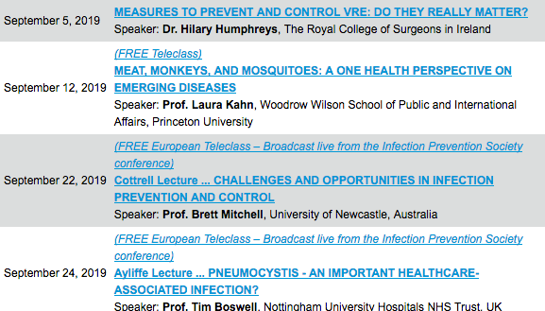

Slide 38


