Slide 1
The Fallout of Fake News in Infection Prevention
… and Why Context Matters
Pierre Parneix
CPIAS Nouvelle Aquitaine, Bordeaux, France
Didier Pittet
Infection Control Program, University of Geneva Hospitals
and Faculty of Medicine, Switzerland
Hosted by Paul Webber
paul@webbertraining.com
www.webbertraining.com
February 14, 2019

Slide 2
Why bother talking about this ?
In the scientific community, we have a tendency to ignore misinformation, thinking that it will go away if we do not give it attention
But in the age of fake news, this just adds fuel to the fire

Slide 3
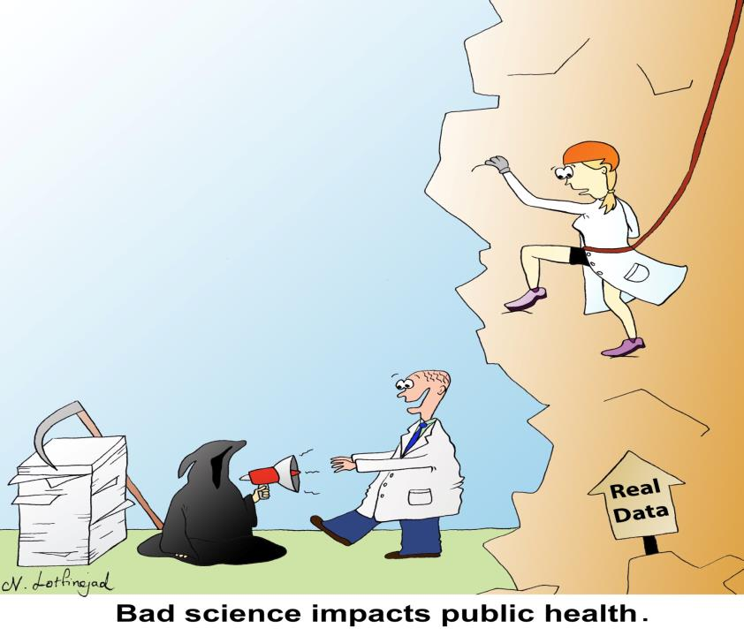
Why bother talking about this ?

Slide 4
“Fake news” and misinformation is a major disruptive force in society
Fake News: deliberate misinformation or manipulation of data
Bad Buzz: misrepresentation of the nature or conclusions in otherwise sound information or studies
Is science «protected» from fake news?
NO!!!!

Slide 5
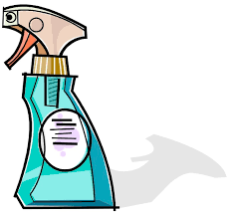
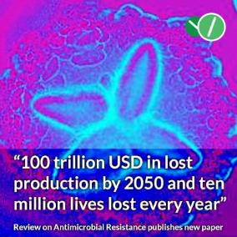
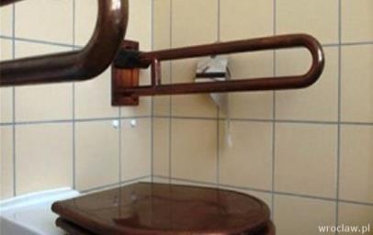

Examples
Hospitals disinfecting non-critical areas in the environment
O’Neill Report projected deaths from antimicrobial resistance
Anti-superbug pajamas
Copper everywhere

Slide 6
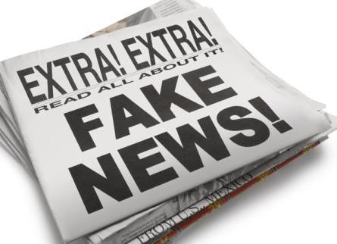
How Fake News & Bad Buzz affects IPC
within the field of IPC we often work with low category of evidence (case reports and expert opinion)
some products and practices originate from the public sphere
nexus and sharing of information between IPC and the public

Slide 7
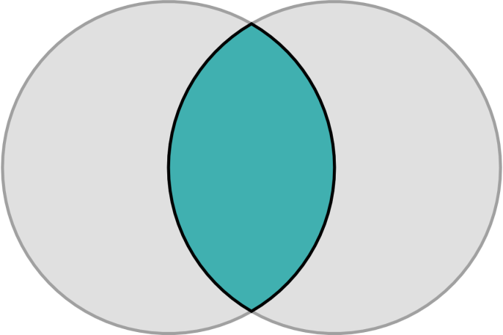
Publication and dissemination of research
IPC
Public

Slide 8

Scientists
Journal/press release
Print/ online Media
Social Media
Missinformation can take place at various levels:
Misleading statements
Ecological fallacy
Inferences without sufficient evidence
A possible way of analyzing if hypotheses are supported is to use the Koch postulates / Bradford Hill criteria (but do not always apply)

Slide 9

Scientists
Journal/press release
Print/ online Media
Social Media
Information / missinformation spread
Abstract misleading compared to paper
Sensationalist / Alarmist titles
Misleading soundbites from scientist commentary

Slide 10

Scientists
Journal/press release
Print/ online Media
Social Media
Information / missinformation spread
Lay press
Specialized medical news sites
Often sensationalized

Slide 11
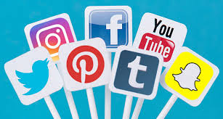
Scientists
Journal/press release
Print/ online Media
Social Media
Information / missinformation spread
In interest groups
Trending on Facebook or twitter
Often a substrate for misinformation to spread rapidly

Slide 12
Why Bad Buzz is a growing concern (1)
Pseudo-science and misinformation have always been an issue
But rapid proliferation of publication platforms make it easier for poor designed studies to get public attention
Normally, in the context of a large number of well-performed studies, one would not expect bad articles to matter or to exert as much influence as they do

Slide 13
Why Bad Buzz is a growing concern (2)
Types of news outlets and platforms
Open access
Online media
Social media
Viral spreading of sensationalism and fear (clickbait)
Real-life consequences
Misinterpreting the quality of a study or the real-life relevance of its conclusions can lead to wasted resources, bad policy making decisions, and increased morbidity and mortality

Slide 14


Slide 15
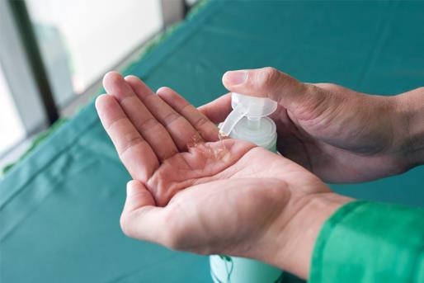
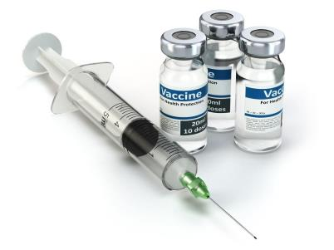
Case Studies in infection prevention & IPC
Measles prevention and ecological fallacy
Misleading science and bad press concerning alcohol-based handrubs
  Bisphenol A
  Triclosan/triclocarban
  E. faecium tolerance to alcohol

Slide 16
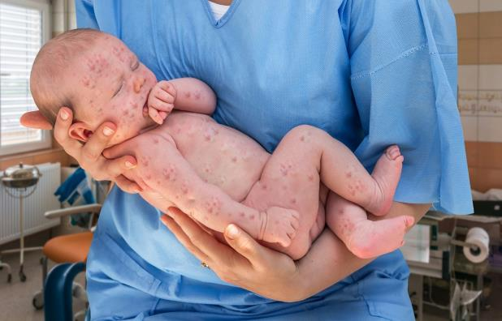
Measles
1998- Wakefield et al. publish in The Lancet about a possible link between measles, mumps, and rubella (MMR) vaccine and autism
  retracted in 2010

Slide 17
Measles
1998- Wakefield et al. publish in The Lancet about a possible link between measles, mumps, and rubella (MMR) vaccine and autism
  retracted in 2010
Reasons for retraction:
- uncontrolled study design
- small sample size
- speculation in the conclusions
- blatant conflicts of interest
- allegations of misconduct & ethical violations

Slide 18
Measles
1998- Wakefield et al. publish in The Lancet about a possible link between measles, mumps, and rubella (MMR) vaccine and autism
  retracted in 2010
20 years later cited over 2800 times
including 1090 times since 2012
The Wakefield article was published and
circulated in the media; people around
the developed world began to
increasingly fear vaccines

Slide 19
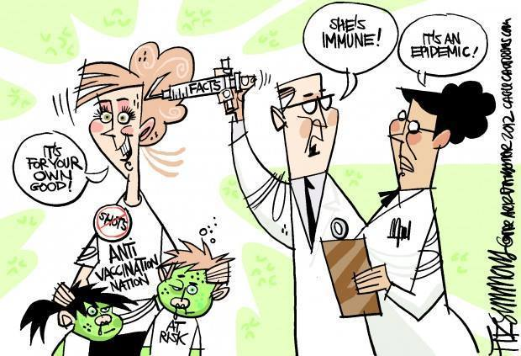
Effects:
Lack of “buy-in”
  Anti vaxx movement
    Dr. Wakefield is a vocal supporter
Social Media (SoMe) as a source of public health misinformation

Slide 20
In the UK…
MMR vaccine coverage dropped from 91% in 1998 to 80% in 2003
measles cases increased from 56 cases per population of 58.5 million in 1998 to 1370 in a population of 61 million in 2008
Coverage too low for herd immunity
Flaherty, D. K. The Vaccine-Autism Connection: A Public Health Crisis Caused by Unethical Medical Practices and Fraudulent Science, OECD Data Available at: http://data.oecd.org/pop/population.htm.

Slide 21
…and around the world
Extremely low vaccination rates in certain areas
  affluent California schools up to 70% of students exempt from vaccination for non-medical reasons
  Worse vaccination rate than South Sudan
2014: measles in the US spiked with 23 outbreaks and 667 cases
2016: 25% of French parents surveyed had an unfavorable perception of the measles vaccine risk–benefit balance
2017: a study showed that healthcare professionals in Italy had even become the vector of transmission in the recent measles resurgence

Slide 22
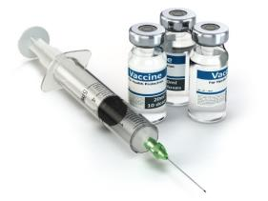

Measles
1998 : Wakefield et al. publish in The Lancet about a possible link between measles, mumps, and rubella (MMR) vaccine and autism
    Retracted in 2010
  2018 : It would be interesting to see a study assessing the negative economic impact of the Wakefield paper
  Ultimately, it did not matter that the paper was retracted, its shortcomings analyzed in the literature, its experiments replicated with different results, and its authors discredited: the damage was done

Slide 23
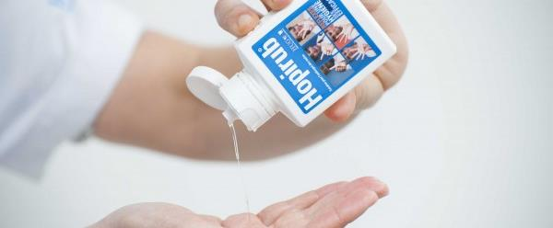
Misleading science and bad press concerning alcohol-based handrubs

Slide 24
Case Studies in infection prevention & IPC
Measles prevention and ecological fallacy
Misleading science and bad press concerning alcohol-based handrubs
  Bisphenol A
  Triclosan/triclocarban
  E. faecium tolerance to alcohol

Slide 25
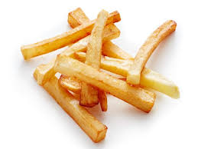
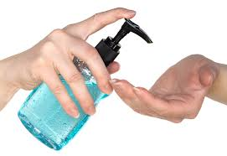
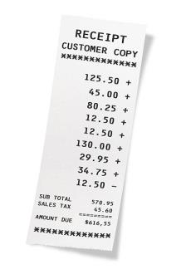
1. Handrub and Bisphenol A: a prime example of a misleading study
  HCW applies a large amount of ABHR containing skin penetration enhancers (such as propylene glycol)
  HCW touches paper containing BPA for an artificially prolonged time (4 min)
  HCW then eats ten French fries after holding each fry for 10 seconds
  Absorbtion of BPA in blood is measured

Slide 26
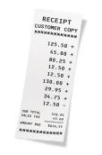
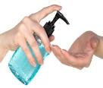
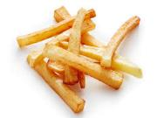

Effect of the study
Drastic reduction in ABHR use by HCW (30% in France)
Luckily did not spread internationally
Possible impact on transmission of healthcare-associated infections

Slide 27
2. Triclosan & Triclocarban
  Media falsely linking triclosan and triclocarban to all ABHRs
    Some recommending to stop using ABHR
The very large majority of ABHRs does not contain these chemicals
Florence Statement might have raised awareness and concern
  Subsequently misplaced in ABHR
To note : Although triclosan was banned from soaps in the USA, it is still present in some toothpaste. No articles published on this topic using this information to advocate stopping the use of toothpaste in general.

Slide 28
3. Increasing tolerance of VRE to alcohol
2018 Australian study Pidot et al. in Science and Translational Medicine
Authors compared older and newer Enterococcus faecium isolates from 1997-2015, and the tolerance of these strains to 23% alcohol
When using a 70% solution, no difference between resistant and sensitive isolates was observed (ABHRs contain 60-90% alcohol)
  Tolerant E. faecium were killed by 70% alcohol
Wiped mouse cage with a 70% isopropanol wipe
CCL: Because ABHRs have been used increasingly over time and while proportion of E. faecium tolerance to 23% alcohol increased from 1997-2015, ABHRs were pointed as causal factor

Slide 29
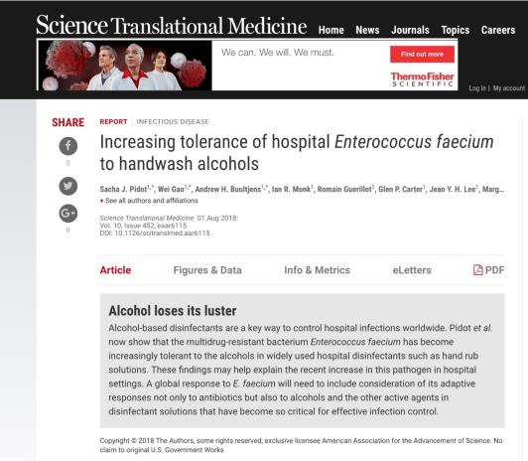
In Summary: Research is important and well-conducted
BUT
Title of paper referring to “handwash alcohols”
Press release: “alcohol loses its luster”
Conflating of hypotheses concerning the role of exposure to alcohol in the environment vs. handrubbing

Slide 30

Effects
Major negative media coverage-
  Guardian, Times, etc.
  Global concern in hospitals
    even in remote areas of the world
Possible loss of faith in over 25 years of research
Lower compliance?

Slide 32
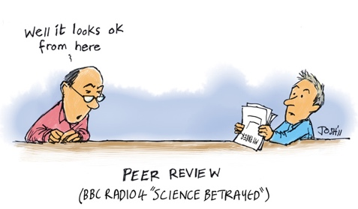
Open platforms and non-peer reviewed literature
Scientific articles and science are presented to the outside world
Many of the increasing number of open-access platforms allow for the publication of “academic” articles without any peer review
Part of a normal process of
democratization of information
in the internet age

Slide 34
The Traditional Model of Publishing
Good scientific medical journals traditionally don’t pay for their articles
Experts review submitted manuscripts for free
Researchers exchange their work for prestige
Journals charge a high subscription fee to their subscribers

Slide 35
Issues concerning traditional journals
Access to information is difficult and expensive
  Especially in the developing world
  For anyone without institutional affiliation
Scientists review for free, and paying for their time falls on other institutions
Leads to conflicts of interest in journals themselves
World Bank has also been working on this:
https://www.theguardian.com/global-development/2012/sep/03/developing-world-open-access-research-hurdles

Slide 36


Scientific Publishing is Big Business
Recently, three publishers account for more than 47% of all papers published
2010: Elsevier’s scientific publishing arm made a profit of £724 million on £2bn worth of revenue, with higher margins than Google or Apple
  £19bn in yearly revenue
Reed-Elsevier 24.1%, Springer 11.9%, and Wiley-Blackwell 11.3% (2013)
For comparison, the whole US music industry in 2016 was calculated at $17.2bn (£12bn)

Slide 37

Open access Journals
The number of open access journals is increasing daily
  Directory of Open Access Journals: over 1,440 open access medical journals
  89 added to the database in the last three months (June 2018)
Authors generally pay for their articles’ publication

Slide 38
Open access - A fast growing « market »
From 53’000 articles published in 2010 to 420’000 in 2014
with articles from Asia and Africa accounting for a disproportionate percentage published
Market of “predatory” publishers at around $74 million per year
Although this problem is far from being dealt with, there are websites dedicated to identifying the growing list of over 1175 “predatory” journals

Slide 39
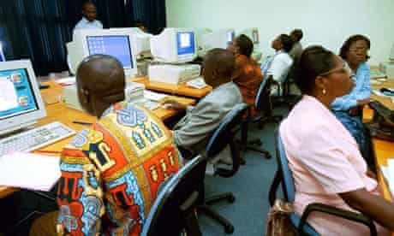
Issues concerning open access journals
Still expensive for some
Motivation of journals to publish as many
authors as possible
Rise of predatory journals (over 1100 counted)
Issues with lack of peer review and bad quality

Slide 40
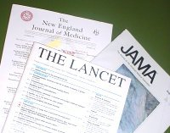
What to do?
Need to discuss new models and ideas
Some journals (such as Lancet ID) make some important content open access
Hard to distinguish facts form fiction
The burden of discernment is left to the reader
  Elsevier has a list of professional level journals
  OMICS International (but fraudulent organization !)

Slide 41

European Initiative for Publishing
«Plan S»
Jointly developed by Science Europe and the European Political Strategy Centre at the European Commission
Aim: that from 1 January 2020, all scholarly publications resulting
from public research funding must be published in Open Access
journals or on Open Access platforms
https://www.scienceeurope.org/making-open-access-a-reality-by-2020/?fbclid=IwAR38Z-i8EEF-E94njW0UgiCA0TIp05nOIlwPXpRGwaiPFADLP6O4_GTEF8k

Slide 42

Open access can be vital
The example of Iran
Access to published material is complex
  limited access to academic journals
  slow internet connections/barriers to access
  results in complications to conduct research
  International sanctions
    no access to international payment networks
    prevents scientists from being able to pay for publications online
    difficult to enroll in international conferences
  Thus: open access is vital
Peters, et al. Fighting the Good Fight: the fallout of fake news in infection prevention and why context matters. Journal of Hospital Infection, 2018.

Slide 43

The European Battle Against Fake News In General

Slide 44

Public Consultation
Two questionnaires (Nov 2017 - Feb 2018)
  one for the citizens
  one for legal persons and journalists reflecting their professional
  experience of fake news and online disinformation
The public consultation : 2986 replies
  2784 from individuals
  202 from legal organisations
https://https://ec.europa.eu/digital-single-market/en/news/summary-report-public-consultation-fake-news-and-online-disinformation

Slide 45
High Level Expert Group
Set up by European Commission (Jan 2018)
  Aim: to advise on policy initiatives to counter fake news and disinformation spread online
  Deliverable: report A multi-dimensional approach to disinformation
  Defines misinformation as: “all forms of false, inaccurate, or misleading information designed, presented and promoted to
  intentionally cause public harm or for profit.”
https://https://ec.europa.eu/digital-single-market/en/news/summary-report-public-consultation-fake-news-and-online-disinformation

Slide 46
Eurobarometer Survey
Via telephone interviews (February 2018)
included all EU Member States
over 26’000 citizens participated
The findings show a clear concern for the
spread of disinformation online in Europe
https://https://ec.europa.eu/digital-single-market/en/news/summary-report-public-consultation-fake-news-and-online-disinformation

Slide 47
Multi-stakeholders Conference
Purpose: to “define the boundaries of the fake news phenomenon, assess the effectiveness of the solutions already put in place by social media platforms and to agree on key principles for further action”
Initial meeting Nov 2018, other meetings after
Published a Code of Practice on Disinformation
https://https://ec.europa.eu/digital-single-market/en/news/summary-report-public-consultation-fake-news-and-online-disinformation

Slide 48
Action Plan: 4 Pillars
Improving the capabilities of union institutions to detect, analyse and
expose disinformation
Strengthening coordinated and joint responses to disinformation
Mobilising the private sector to tackle disinformation
Raising awareness and improving societal resilience

Slide 49

Implications for Science
How do we proceed?

Slide 50

BAD BUZZ: Let’s develop a protocole
Aims:
Understand the inaccuracies
  Materials to collect and review
  Review of each unsupported assertion or inaccurate statement in each publication/media (grouped by relative impact/importance)
Understand the threats
  To institutions and good research
  To Public Health
Understand the consequences

Slide 51
In summary:
Information becoming available to consumers, even the most widely proven and long-standing practices are vulnerable to misinformation
The more alarmist an article is, the more attention and traction it is likely to get
Paywalls limit access to published peer-reviewed work for the majority of the audience that reads scientific articles
General public reads scientific information almost exclusively through open access sources
The average individual does not know how to critically read a scientific study

Slide 52

Looking Forward
Options to eliminate the problem entirely are limited:
  one either has to educate a whole population
  or prevent these types of articles from being published and disseminated
  We could argue that if a journal that looks reputable to a layperson accepts scientific papers, they should be peer-reviewed
  Seal of approval?
  Standards for websites?
  Make more academic research open access?
There are no easy answers, but we need to be having the conversation

Slide 53

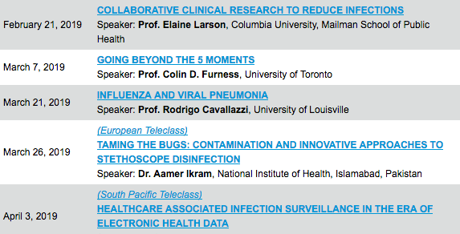

Slide 54


