Slide 1
Hosted by Bruce Gamage Provincial Infection Control Network of BC
www.webbertraining.com
December 3, 2015

Slide 5
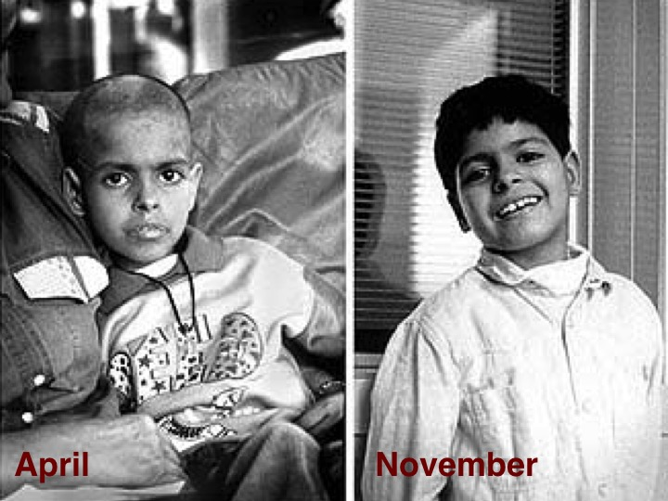

Slide 11
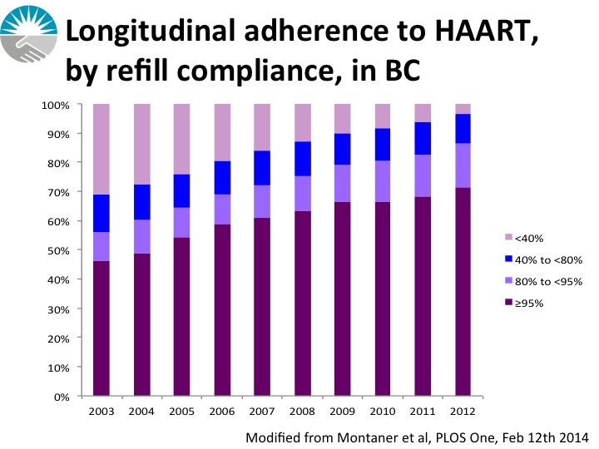

Slide 14
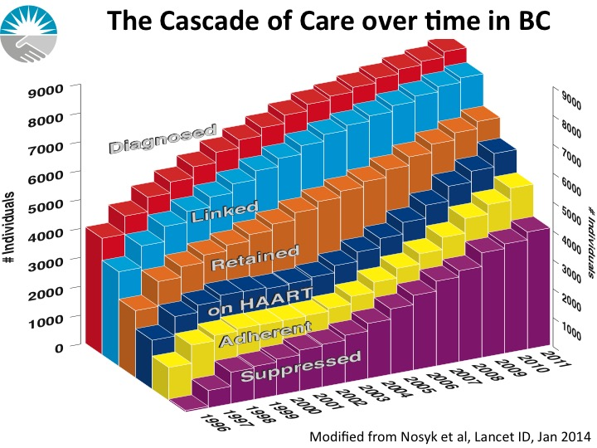

Slide 56
JUST OVER THE HORIZON . . .
2016 schedule now available ... www.webbertraining.com/schedulep1.php

