Slide 1



Hardware or software? Interventions for a sustainable infection control programme
Joost Hopman, MD, DTMH
Consultant Microbiologist, Head of Infection Control Unit
Radboud University Medical Centre Nijmegen, The Netherlands
Senior Lecturer Community Health, Stellenbosch University, South Africa
Hosted by Claire Kilpatrick
WHO Infection Prevention and Control Global Unit
International Ambassador Program
www.webbertraining.com
September 22, 2016

Slide 2
Learning Objectives
1. Identify components of infrastructure that could be improved from IPC perspective
2. To evaluate quality monitoring systems for cleaning and disinfection
3. Compare interventions in high and low resource settings

Slide 3
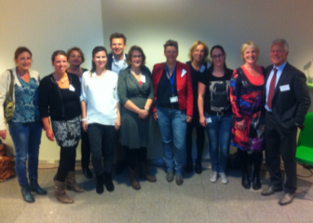
Infectiepreventie=Teamwork
Prof. Andreas Voss
Prof. Shaheen Mehtar (ICAN,Stellenbosch University)
Prof. Benedetta Allegranzi (Infection Control Unit – WHO HQ)
Prof. Hans van der Hoeven
Drs. Cathy van Beek
Prof. Paul Verweij/Prof. Fred Sweep/Prof. Heiman Wertheim
Prof. Stefaan Berge
Prof. Robert Sauerwein
Dr. Jack Meintjes (Stellenbosch University)
Dr. Alma Tostmann
Dr. Chantal Bleeker-Rovers
Drs. Nannet van der Geest
Dr. Janette Rahamat
IPC unit Tygerberg hospital
Afdeling Service bedrijf
Afdeling Medische microbiologie

Slide 4


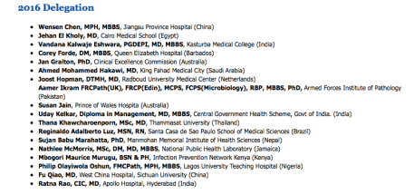
Resistentie
Why infection prevention?
Fu Qiao, MD
Infection Control Practitioner
West China Hospital, 4300 beds, Sichuan University.
Wensen Chen, MPH,MBBS
Jiangsu Province Hospital, 3000 beds

Slide 5
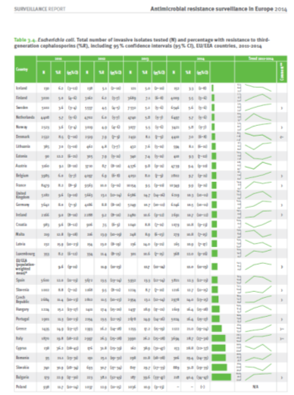
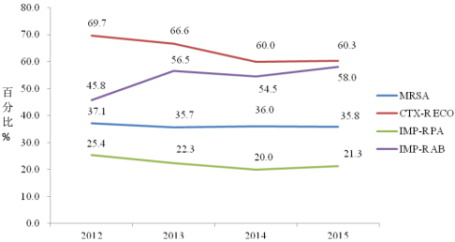
China- CARSS surveillance data
1338 hospitals
4de Netherlands, 2014, E. coli Cephalosporine resistance 5,7%
EU, 2014, E. coli Cephalosporine resistance 12%

Slide 6
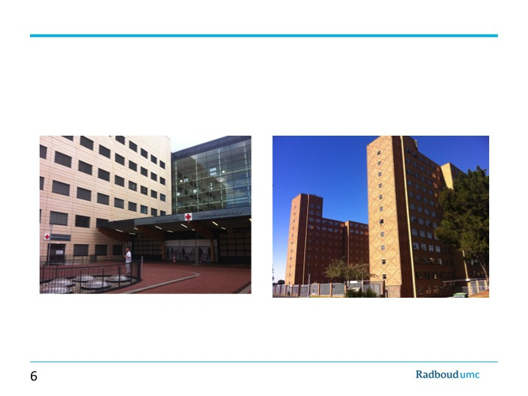

Slide 7
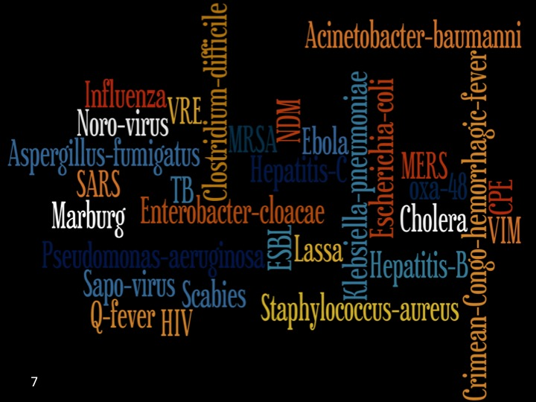

Slide 8
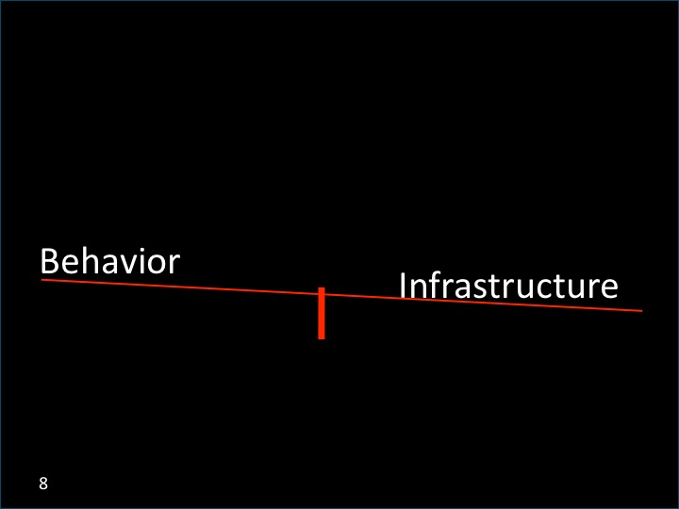

Slide 9
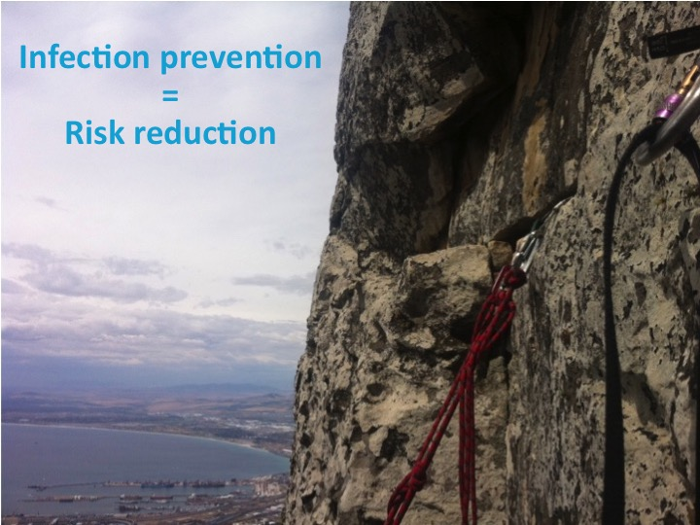

Slide 10
Future of Hospitals
less Bricks, more Bytes,
and a different Behaviour
less and Safer Bricks, more Bytes,
and a different Behaviour

Slide 11


Slide 12
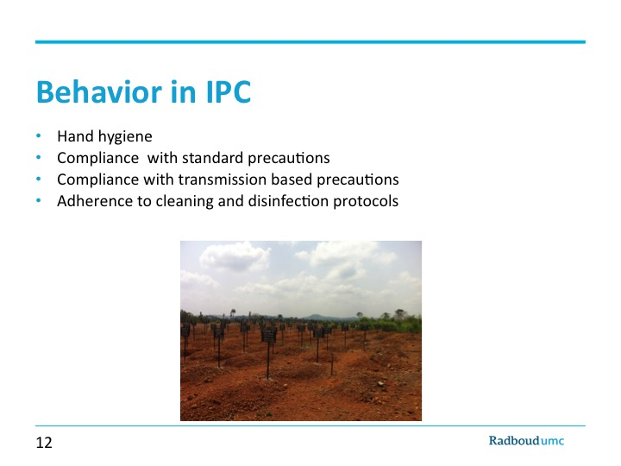

Slide 13

Implementation
J.Hopman, arts-microbioloog, Hoofd HIP

Slide 14
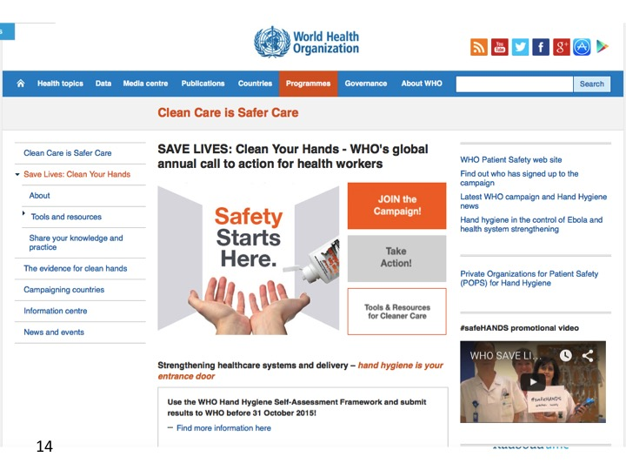

Slide 15
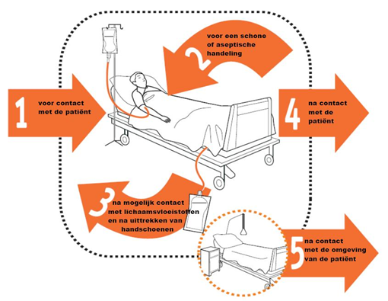
Five moments

Slide 16
Radboudumc Campaign
Clear message and strong leadership
  Board of directors and Department leadership
Intake meetings with head of departments
Advisory board: chair Medical staff, chair nursing staff, chair patient advisory council
Choice of Module A module B
  A: Infrastructure, education, feedback of compliance data
  B: A + accountability culture
Evaluation meetings with head of department
35 clinical departments
2 departments module B

Slide 17
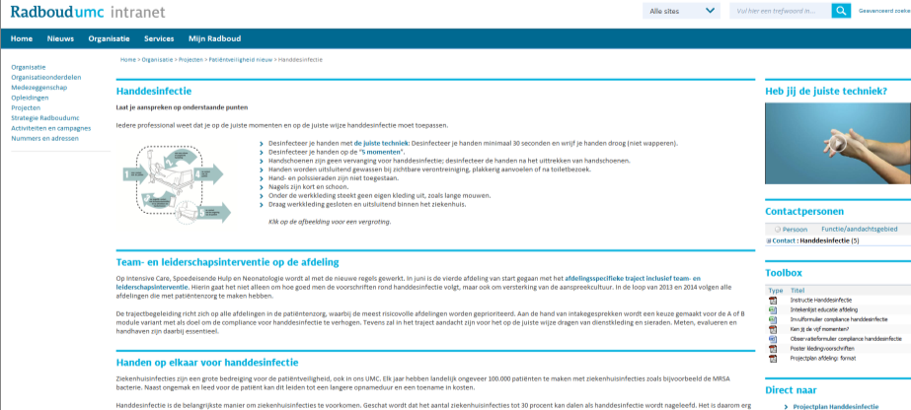

Slide 18


Infrastructure
    Technical improvements:
      Beddispensers and walldispensers
        Addressing allergy and allergy prevention
      Standardized instructions
      Reminders
      Rules with regard to clothes and jewelry:
      Foam, gels and different flavors of disinfectants

Slide 19
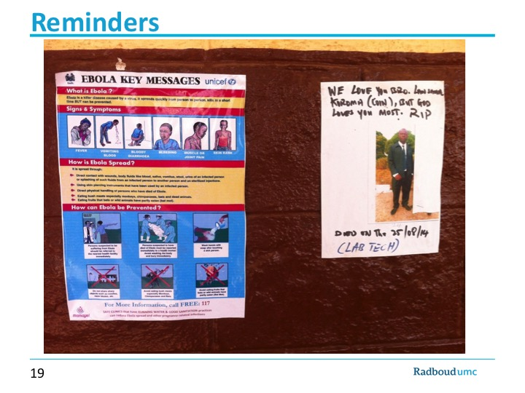

Slide 20
Education
Why Handdisinfection?
All clinical departments:
Staff - head IPC
Nursing -IPC nurse

Slide 21
Awareness in the departments
IPC linked nurses
  Internally educated on IPC
  Central figure for IPC in the department
  Supervised by IPC nurse
Hospital wide meetings with linked nurses from all departments
  Themes
  Difficulties, challenges and best practices

Slide 22
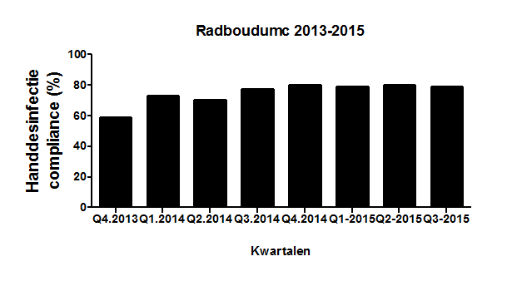
Measuring Hand hygiene Compliance
Baseline in 2011: 4 major departments 38% compliance

Slide 23
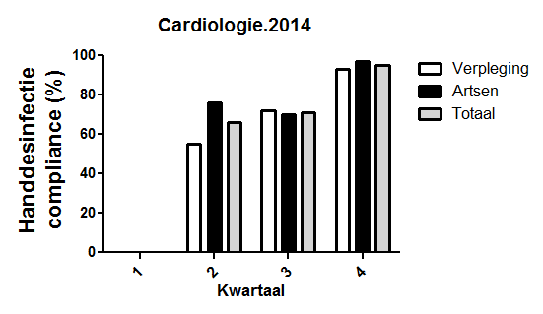
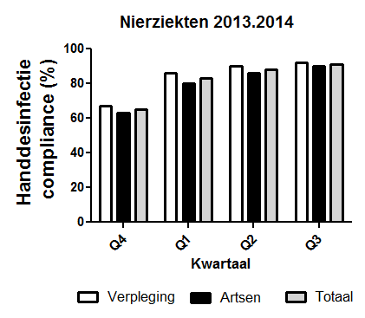
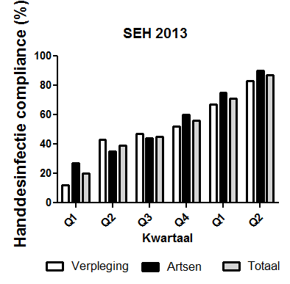
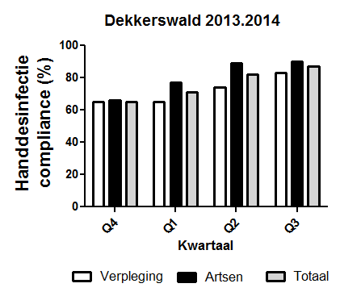

Slide 24
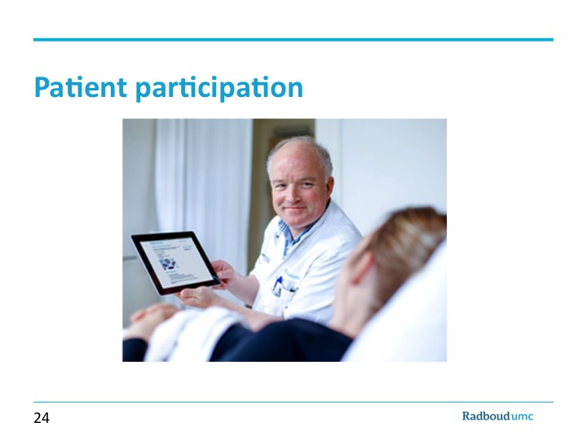

Slide 25
Next steps hand disinfection in 2016
  Focus on OPD
  Keeping up good practices
    Leadership/role models
    Accountability for behavior
    Patiënt participation for specific patient groups
    Sharing of best practices

Slide 26
Conclusion
Multi-modal approach of WHO can be highly effective:
  Facilitate towards an optimal infrastructure
  Compliance Measurements and Feedback
  Education of HCW is underestimated
Hospital-Leadership:
  Full support
  Personal commitment
  Adequate Budget

Slide 27
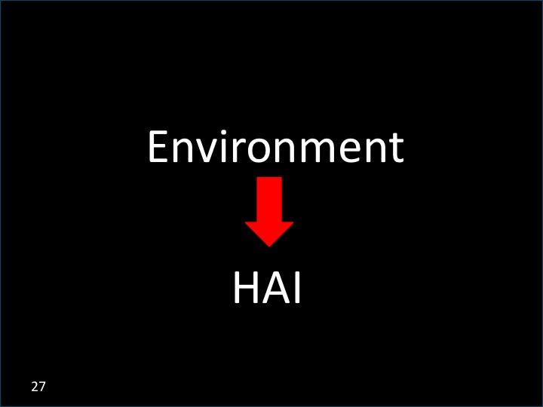

Slide 28
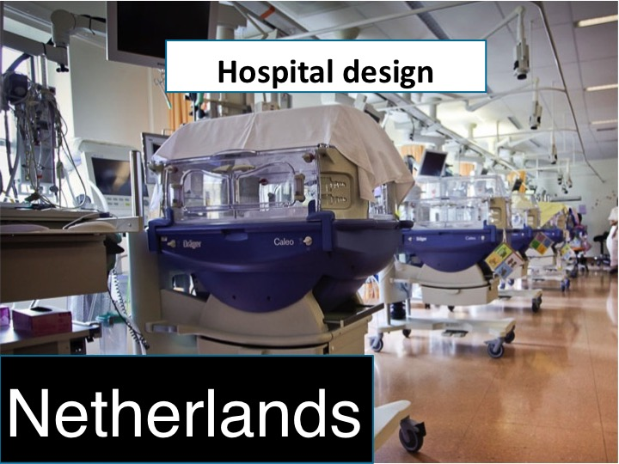

Slide 29
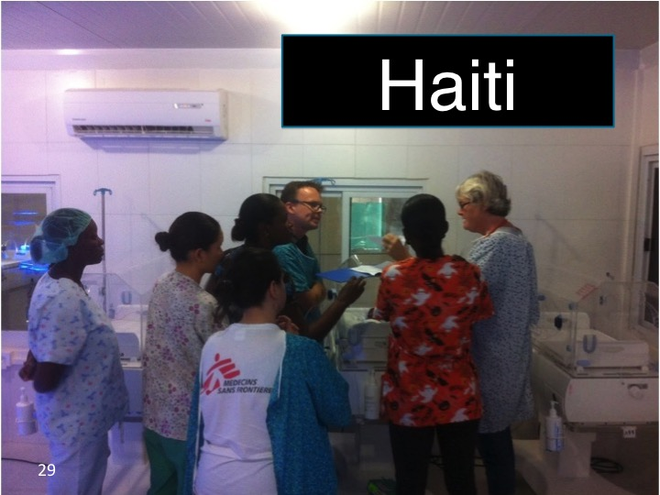

Slide 30
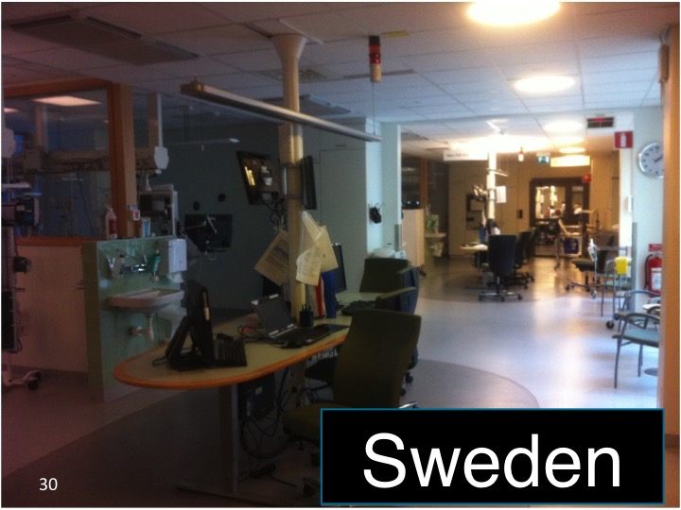

Slide 31
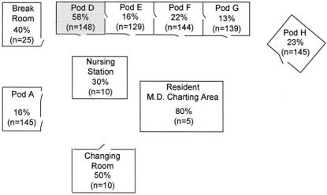
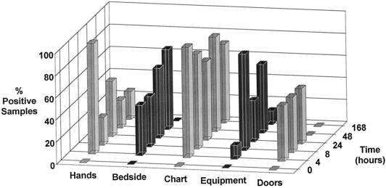
Detection of Transmission in NICU
DNA Markers as Surrogate Indicators
David G. Oelberg, et al, Pediatrics, 2000

Slide 32
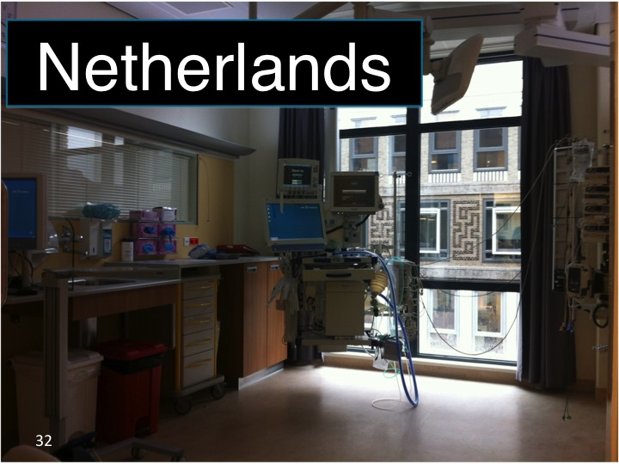

Slide 33
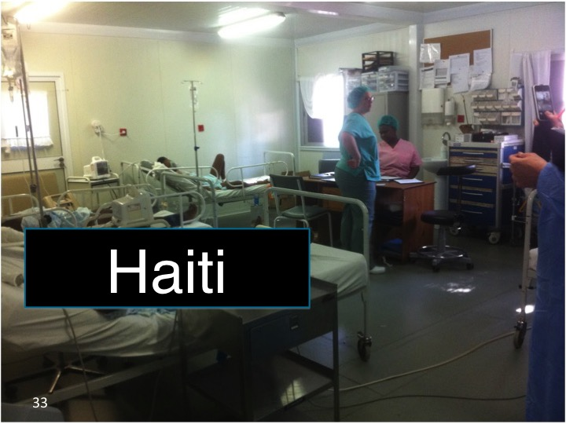

Slide 34
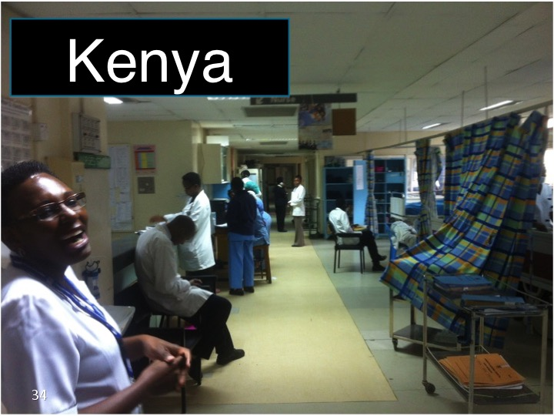

Slide 35
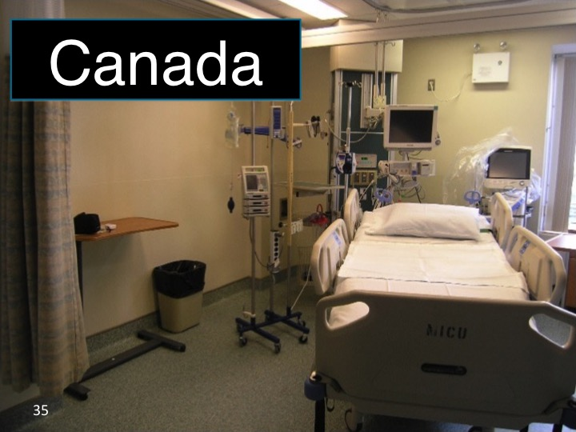

Slide 36

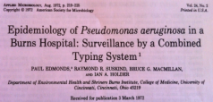
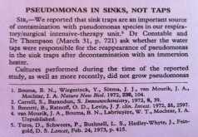
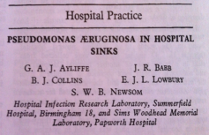
Lessons from history
Edmonds, et al, Applied Microbiology, 1972
Teres, et al, The Lancet, 1973
Removal of the ‘Cholera’ handle of the Broad Street Pump, London,1854
Ayliffe, et al, The Lancet, 1974

Slide 37


ICU in Radboudumc
Radboud university medical center: 953 patient beds
50 single bed ICU rooms, 35 beds operational
Selective digestive tract decontamination (SDD)¹
Low MRSA and VRE rates
Standard contact precautions
Increasing global resistance (GNB)
2 outbreaks related to the sinks
  Klebsiella pneumoniae ESBL
  Enterobacter cloacae ESBL
¹N Engl J Med 2009; 360:2138-2141, may 2009

Slide 38
Study methods
Study design: intervention study
Objective:to investigate the effect of the removal of all hand washing sinks from the patient rooms at the Intensive Care unit on the MDRO colonisation rate in ICU patients
Study period:
  Pre-intervention study period: 12 months prior to sink removal
  Post intervention period: 12 months after sink removal
Intervention: In the summer of 2014, hand washing sinks were removed from all patient rooms at all intensive care units and a ‘water-free’ method of patient care was introduced.

Slide 39
Methods
Patient selection: All patients admitted at the ICU during the pre or post intervention periods
Length of stay: Investigate the effect of prolonged LOS on colonization
Selective digestive tract decontamination: routine weekly screening
  Gram negative Bacilli (GNB)
  Yeast
Main outcome measures:
      1.The MDRO colonisation rate :
        the number of primary positive microbiological results
        1000 ICU admission days
  2.Colonisation rate ratio:
    colonisation rate post-intervention
    colonisation rate pre-intervention

Slide 40
Results
June 2013 - May 2014
September 2014 - august 2015
intervention
Pre-intervention
1351 patients
Median age 62 y [IQR 50-70]
Post-intervention
1307 patients
Median age 63 y [IQR 52-71]

Slide 41
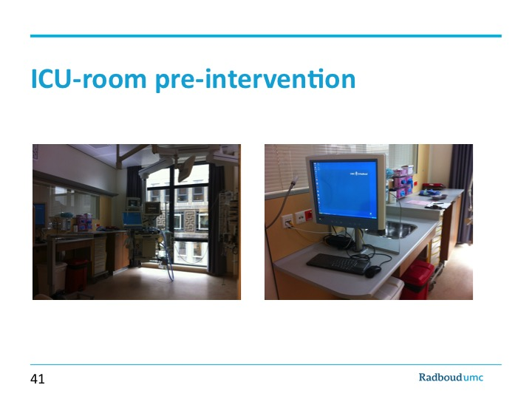

Slide 42
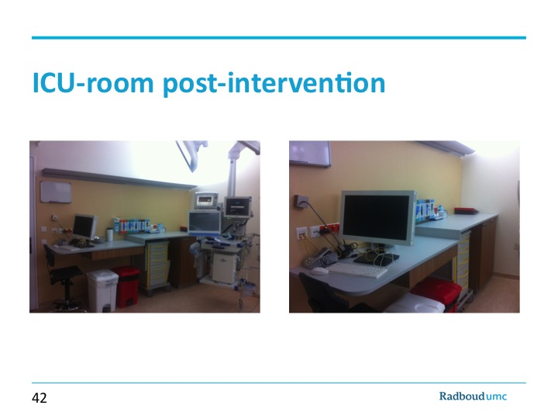

Slide 43
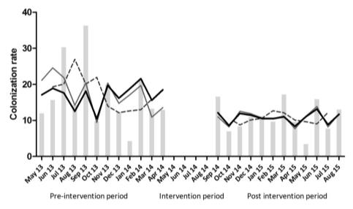
Segmented regression analysis of the interrupted time series data
Statistically significant immediate effect on the colonisation rate of gram negative bacilli, but not on the colonisation rate of yeasts
LOS>3days

Slide 44
Conclusion
This study showed that removal of the hand washing sinks from all patient rooms at the ICU and the introduction of ‘water-free’ patient care resulted in a statistically significant decrease of patient colonization with ICU-acquired GNB .
This decrease in patient colonization was even more apparent for patients with an increased LOS.

Slide 45

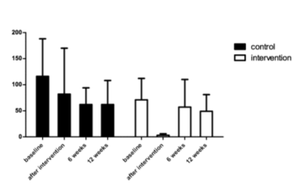
Anti-bacterial coating of surfaces?
Nano-coating toetsenborden
J.Hopman, et al, unpublished data

Slide 46
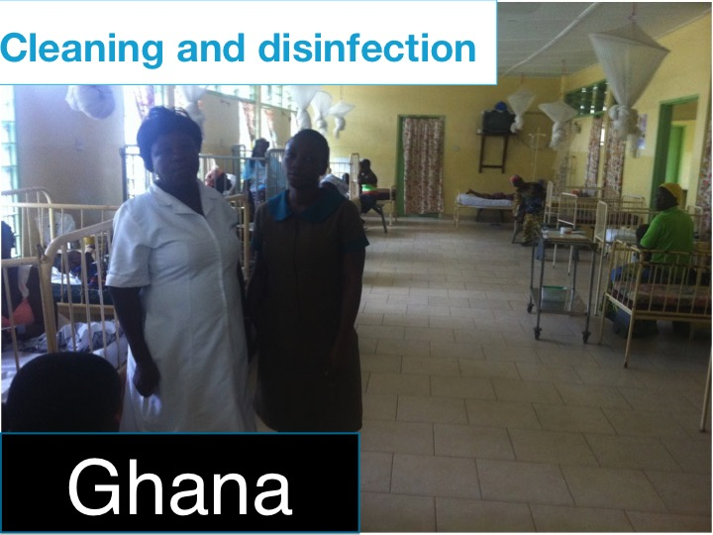

Slide 47
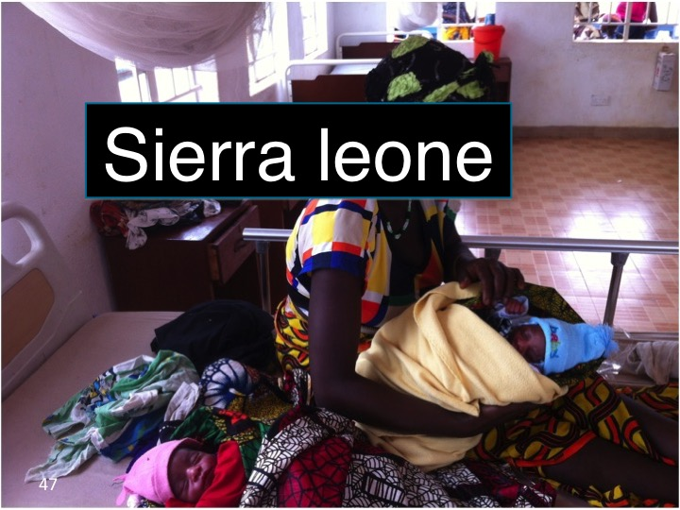

Slide 48
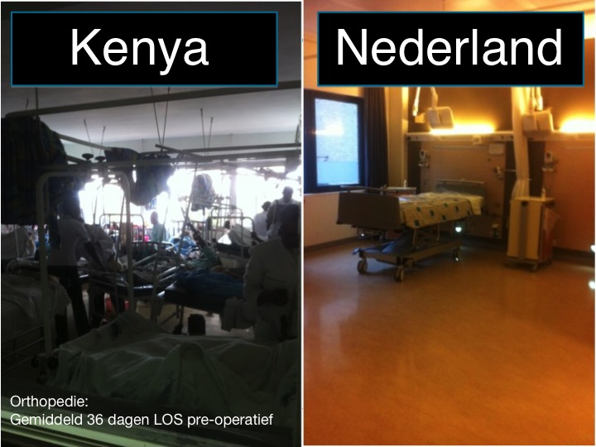

Slide 49
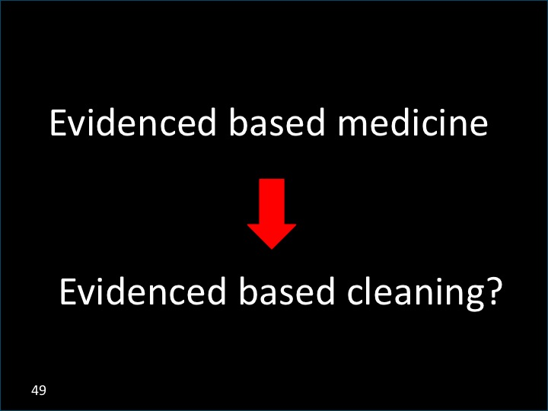

Slide 50
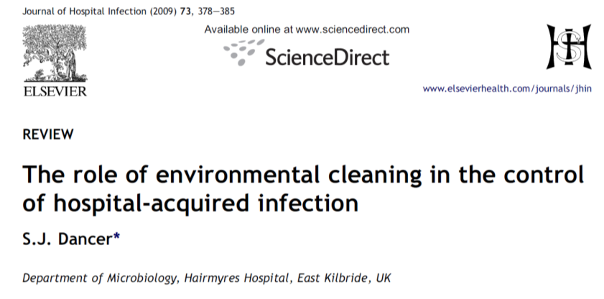
MRSA-positive patients tend to shed their own strain of MRSA into the near-patient environment.
Two-thirds of HCW will acquire the patient’s strain on gloved hands or apron.
Without direct contact 4 out of 10 will still exit the room carrying the patient’s strain of MRSA on hands or apron.

Slide 51
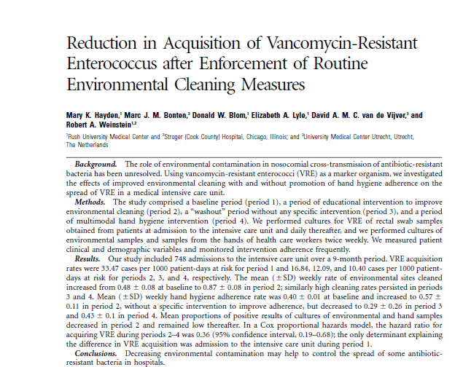
Mean proportion of positive results of cultures of environmental and hand samples decreased in period 2 and remained low thereafter
CID 2006:42 June Hayden

Slide 52
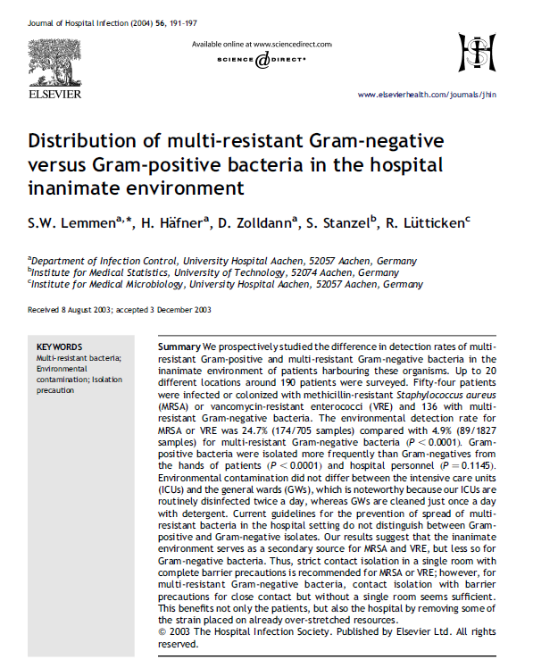
The environmental detection rate for MRSA or VRE was 24.7% compared with 4.9% for multi-resistant gramnegative bacteria

Slide 53
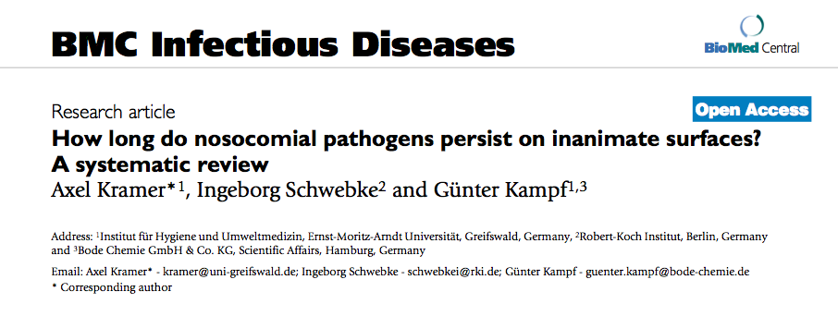
“ The most common nosocomial pathogens( gram positives and Enterobacteriaceae) may well survive or persist on surfaces for months and can thereby be a continuous source of transmission if no regular preventive surface disinfection is performed.”

Slide 54
Sources for transmission
DIRECT
  Hands- contact
  Nasal-droplet
  Throat- droplet
  Stool-aerosol
INDIRECT
  Bedpans/urinals
  Dressing trolleys
  Mattresses
  Mops & buckets
  Hand disinfection equipment

Slide 55
What is included in housekeeping?
Differs from one country to another and from one hospital to another
House keeping falls under a separate section and is not a nursing duty
However, the nurse-in-charge is responsible for the cleanliness of the ward and surrounding areas.
Time pressure, number of nurses available!!

Slide 56
House keeping
Cleaning of the ward and surrounding areas
Removal of waste
Removal of linen
Stocks of fresh linen
Replacing waste containers
Replacing hand decontamination items
Cleaning ward disinfectors
Cleaning non clinical equipment

Slide 57
Systems to evaluate environmental cleanliness, process indicators
Visual inspection
ATP
Fluorescence marker
Microbiology
  Bacterial or viral culture
  PCR

Slide 58
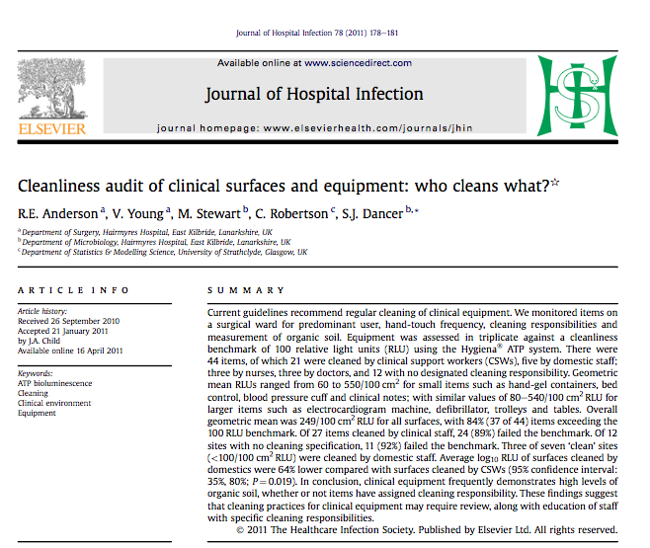
Average RLU cleaned by domestic staff were 64% lower compared with surfaces cleaned by clinical supportive staff

Slide 59
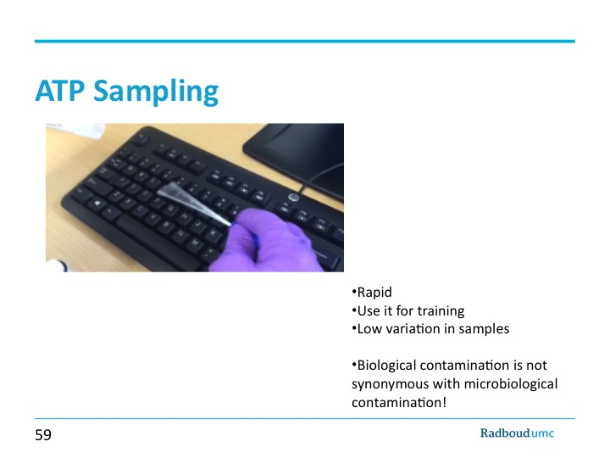

Slide 60
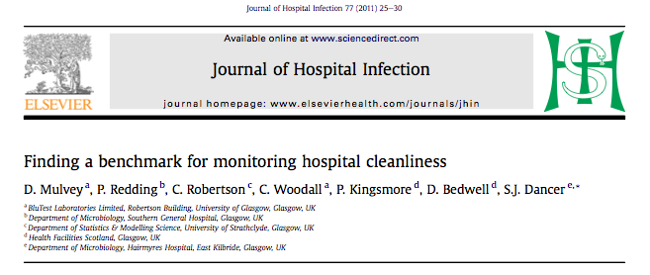

Slide 61
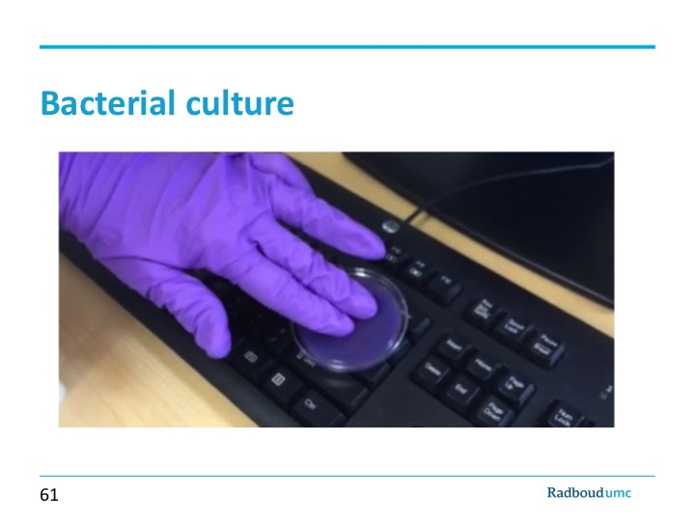

Slide 62
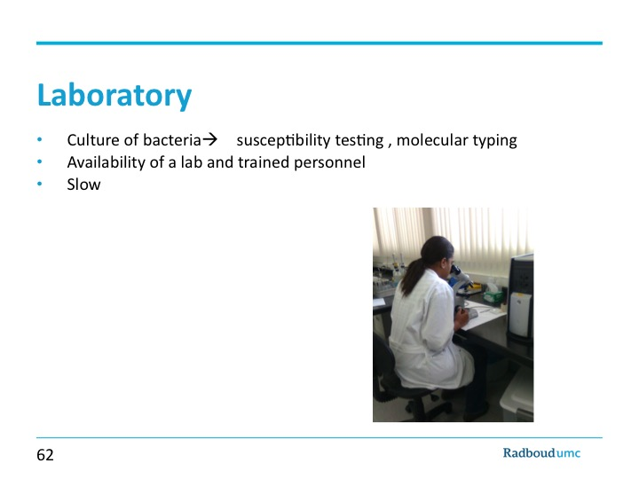

Slide 63
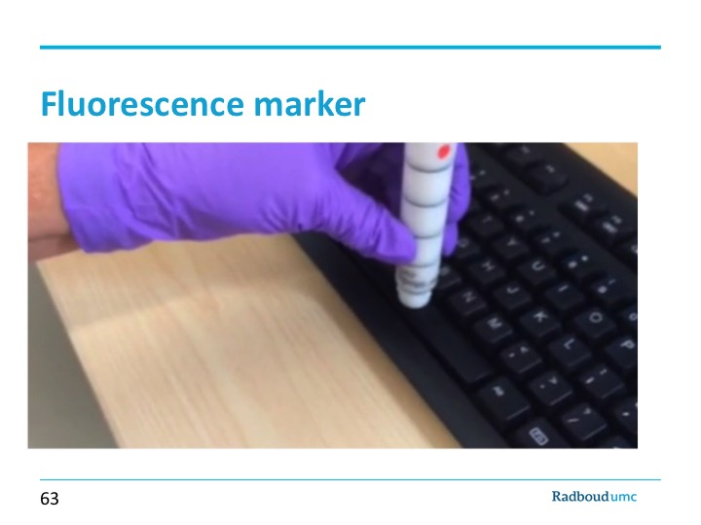

Slide 64


Slide 65

Transfer from rail to fingertip
ranged from 22%-38%

Slide 66


Slide 67

Training of domestic service personnel
J.Hopman et al, JHI 2015

Slide 68

Mechanical versus manual bed cleaning
J.Hopman et al, JHI 2015

Slide 69

Mechanical versus manual bed cleaning
J.Hopman et al, JHI 2015

Slide 70

J.Hopman, JHI 2015

Slide 71

Adenosine triphosphate (ATP) levels (relative light units: RLU) measured before and after manual cleaning in South Africa under ‘routine’ circumstances. Measurements of three locations on 96 beds.

Slide 72

Adenosine triphosphate (ATP) levels (relative light units: RLU) measured on three locations on 150 beds in The Netherlands and 96 beds in South Africa after manual cleaning under ‘routine’ circumstances. ns, not significant.

Slide 73

Tygerberg Academic Hospital: percentage of beds with <250 relative light units (RLU) measured by ATP categorized by type of detergent used for cleaning. Fresh Soap, N = 26; Combination, N = 4; Sparkle, N = 34; Handysan, N = 24; D-germ, N = 2; Bioscrub, N = 6

Slide 74


Slide 75
Conclusions
less and Safer Bricks, more Bytes, and a different Behaviour
Standardized infection prevention is essential for implementation
Focus on 3 pillars:
  Hand hygiëne and standard precautions
  Transmission-based precautions
  Cleaning and disinfection
Included in nursing and MD programs!
Hospital design and infrastructure has major impact on IPC
  High resource settings
  Low resource settings
Feedback of observations!

Slide 76


Slide 77

Keep it empty!

Slide 78

September 26 (Free Teleclass – Broadcast live from the annual conference of the
Infection Prevention Society – www.ips.uk.net)
HOW CAN WE IMPROVE IMPROVEMENT?
Dr. Mary Woods, University of Cambridge Academy of Social Sciences
September 27 (Free Teleclass – Broadcast live from the annual conference of the
Infection Prevention Society – www.ips.uk.net)
Debate: ARE CONTACT PRECAUTIONS ESSENTIAL FOR THE
MANAGEMENT OF PATIENTS WITH MDROs?
Prof. Eli Perencevich, University of Iowa & Dr. Fidelma Fitzpatrick, Royal
College of Surgeons in Ireland
September 28 (Free Teleclass – Broadcast live from the annual conference of the
Infection Prevention Society – www.ips.uk.net)
USING SCIENCE TO GUIDE HAND HYGIENE SURVEILLANCE AND
IMPROVEMENT
Prof. Eli Perencevich, University of Iowa

Slide 79


Slide 80


