Slide 1

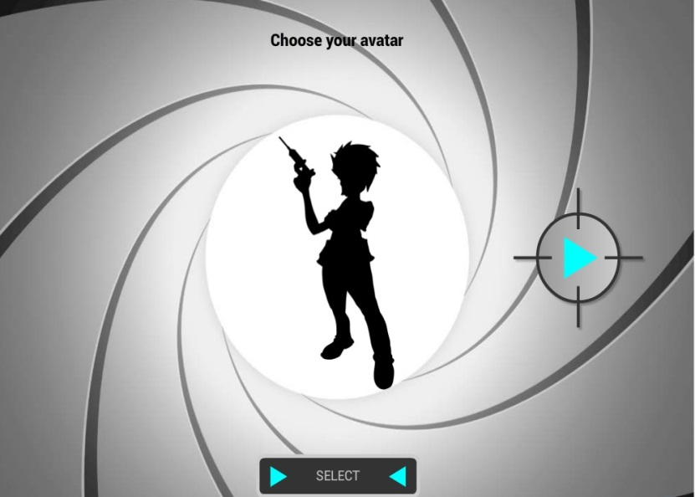
Learning infection control via games?
Dr AG Venier, MD, PhD
Bordeaux, France
HAI prevention centre – Cpias Nouvelle Aquitaine
@AgVenier
anne-gaelle.venier@chu-bordeaux.fr
www.cpias-nouvelle-aquitaine.fr/
Hosted by Paul Webber
paul@webbertraining.com
www.webbertraining.com
August 10, 2017
Notes:
1

Slide 2
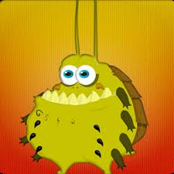
The control of HAI is a challenge
Multiple improvement strategies
  Educational programmes
  Performance feedbacks
  Guidelines
  Bundles
But difficult to change behaviors and beliefs
Need for innovative tools!
Games !
2
Notes:
2

Slide 3
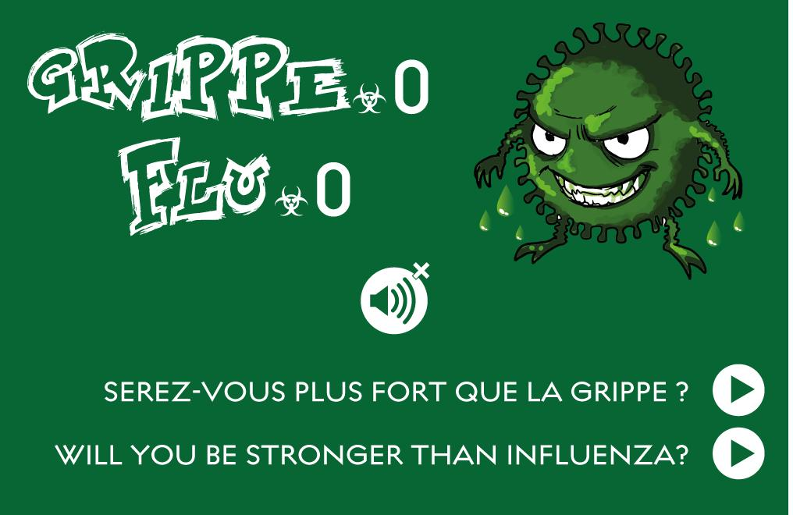
Games?
A serious game is a game designed for a primary purpose other than pure entertainment
Gamification is the use of game design elements in non-games contexts making use of he potential ability of games
3
Cugelman B. JMIR serious games 2013/ Abdulla El-Hilly A. JMIR serious games 2016/ Wattanasoontorn V. Entertainment computing 2013
Notes:
3

Slide 4
Games?
Principles of a game
  Objective + Rules + Means
Why do we play?
  To have fun
  To learn and grow
  To overcome challenges
  To interact with other people
4
Cugelman B. JMIR serious games 2013/ Abdulla El-Hilly A. JMIR serious games 2016/ Wattanasoontorn V. Entertainment computing 2013
Notes:
4

Slide 5
To gamify the work?
Gamification everywhere?
  Yes except if
    The gamification is not adapted
    If the context in the ward is not open
Gamification : yes but only if…
  You expect people change their behaviour
  You can measure their progression
  You can offer a feedback to players
5
Cugelman B. JMIR serious games 2013/ Abdulla El-Hilly A. JMIR serious games 2016/ Wattanasoontorn V. Entertainment computing 2013
Notes:
5

Slide 6
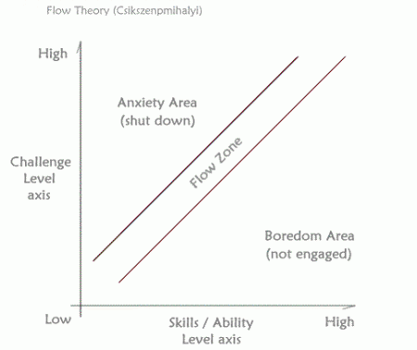
Games to learn and change behavior?
Challenge
  Major component of a game
Key goal is the FLOW
  Absorbed in the task
  We forget what’s around us
  We forget ourselves
  Our brain is learning
6
Csikszentmihalyi M. The psychology of Optimal Experience; 2008 Harper¨Perennial Modern Classics
Notes:
6

Slide 7
Games for health?
Several games exist for healthcare workers or patients
  Role-playing games, Serious video games
  Gamification of serious procedures with goals to achieve
Cochrane 2013 review neither confirmed nor refuted the utility of games as a teaching strategy for health professionals
Literature since 2013
  Games for healthcare workers and patients: improve behaviors
  Games for health students: strongly engaging and stimulating to study longer
  Methodological aspects could be improved
Akl EA. Cochrane database Syst Rev 2013/ Graafland M. Surg Endosc 2017/ Cook DA. JAMA 2011/ Graafland M. JMIR Serious games 2014/ Dankbaar M. BMC medical education 2017/ Dankbaar M Perspect Med Educ 2017
7
Notes:
7

Slide 8
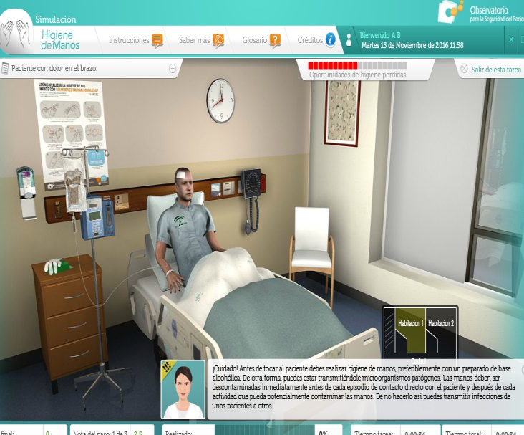
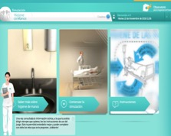
Serious games for infection control
Games but few papers
  Sax and Longtin. BMC Proc, 2011
  Vasquez-Vasquez et al. SeGAH IEEE, 2011
  Bertozzi et al. Gaming comput Mediat Simul, 2013
  Castro-Sanchez et al. CGPIH,2014
  Venier et al. ARIC 2015
8
Notes:
8

Slide 9
Serious games – Cpias Nouvelle Aquitaine experience
2012 …Sarcoptes invasion (scabies)
2013 …Flu.0 (Flu)
2014 …Dojo résistance (XDR bacteria)
2015…Code Name UTI (urinary tract infection)
2017…I control (universal precautions)
https://www.cpias-nouvelle-aquitaine.fr/serious_games/
9
Notes:
9

Slide 10
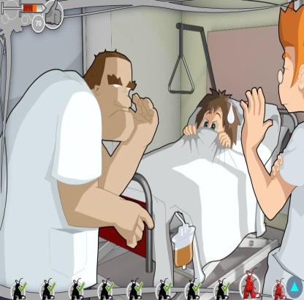
Serious games – Cpias Nouvelle Aquitaine experience
Main game design
  French or English-speaking video games
  Free, can be used everywhere, online or downloaded
  Healthcare worker avatar facing 8-9 scenes
    8 key point questions
    3 possible answers
    explanation of why the answer is correct or not
  A final score evaluates the player’s performance
10
Notes:
10

Slide 11
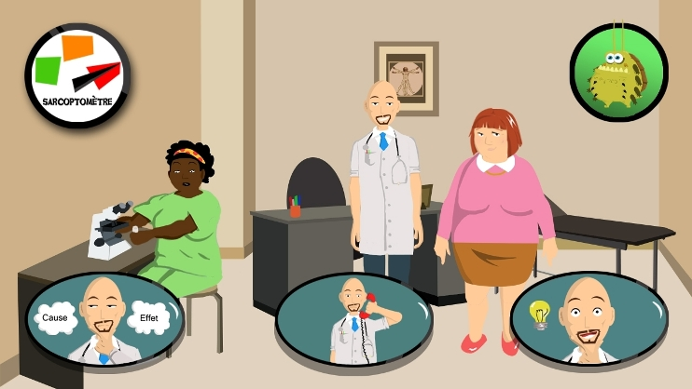
11
Notes:
11

Slide 12
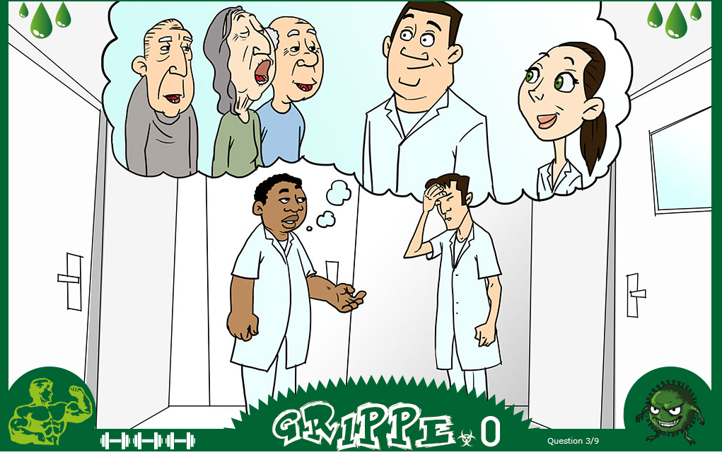
12
Notes:
12

Slide 13
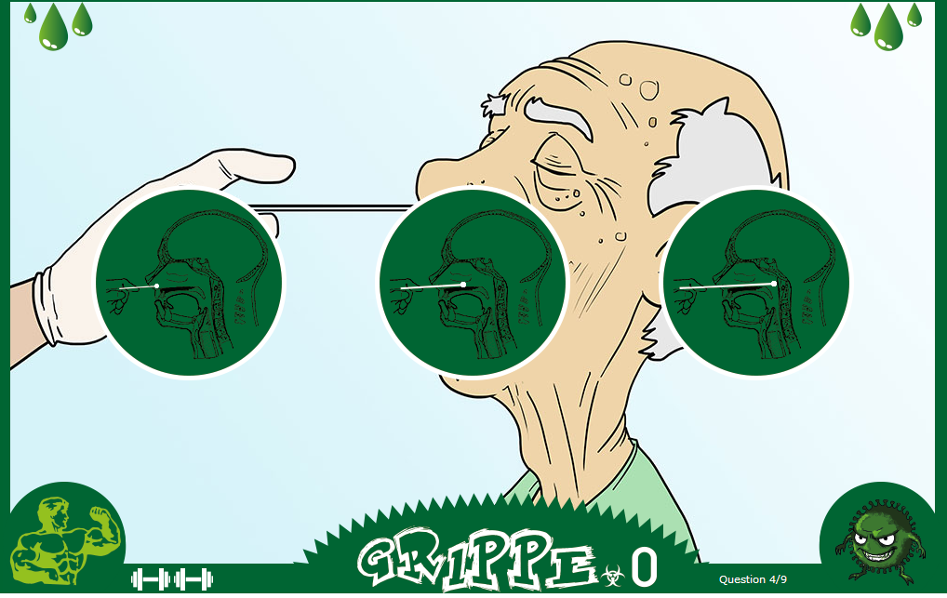
13
Notes:
13

Slide 14
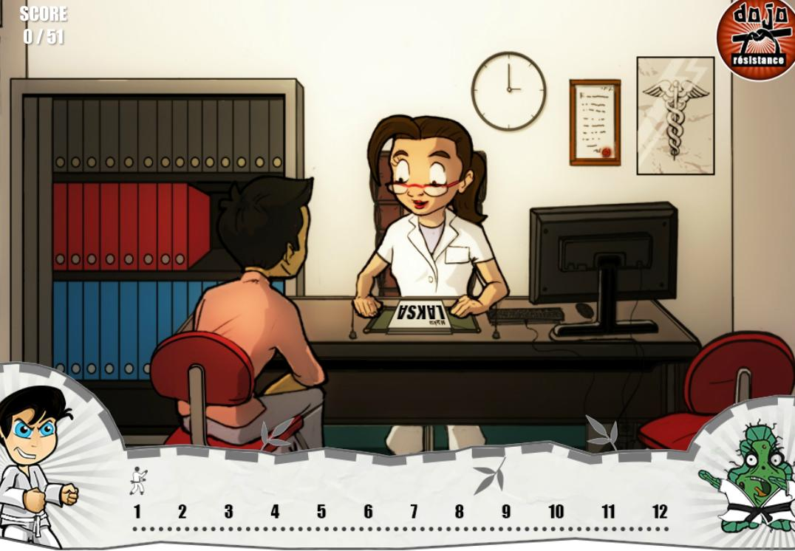
14
Notes:
14

Slide 15
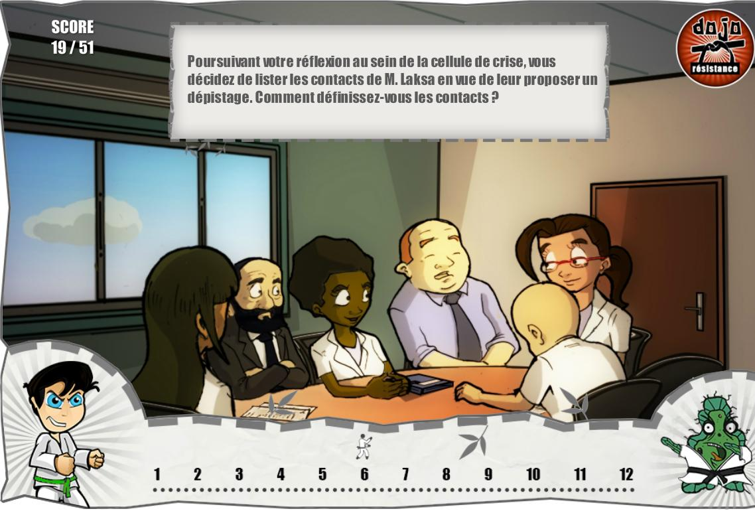
15
Notes:
15

Slide 16
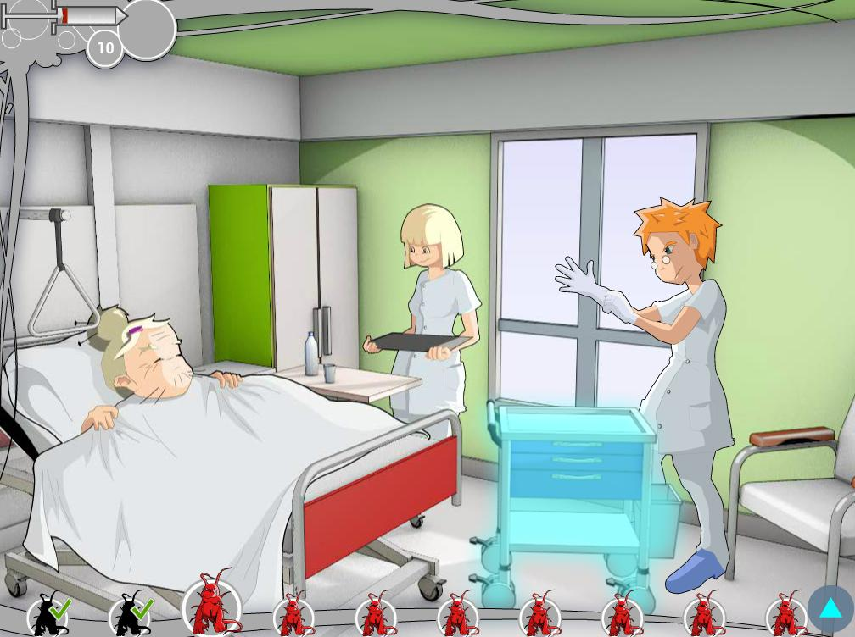
16
Notes:
16

Slide 17
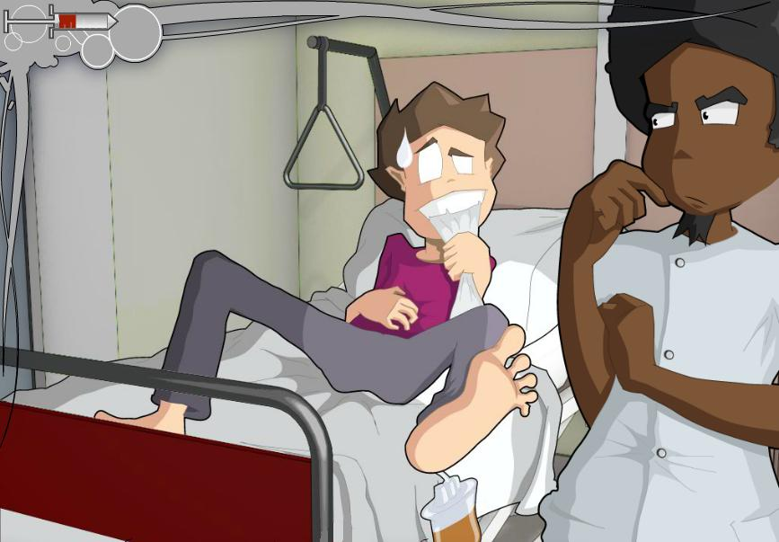
Does it work? Experience of Cpias NA
17
Notes:
17

Slide 18

« Flu.0 » Evaluation
Call for participation to play and evaluate the game
Questionnaire before and after the game
  Opinion on sentences about flu
  What players learnt thanks to the game
  Rate the game
  Main thing they would do differently after this game
Descriptive analysis – khi-square test for evolution
Venier AG. ARIC 2015
18
Notes:
18
18

Slide 19
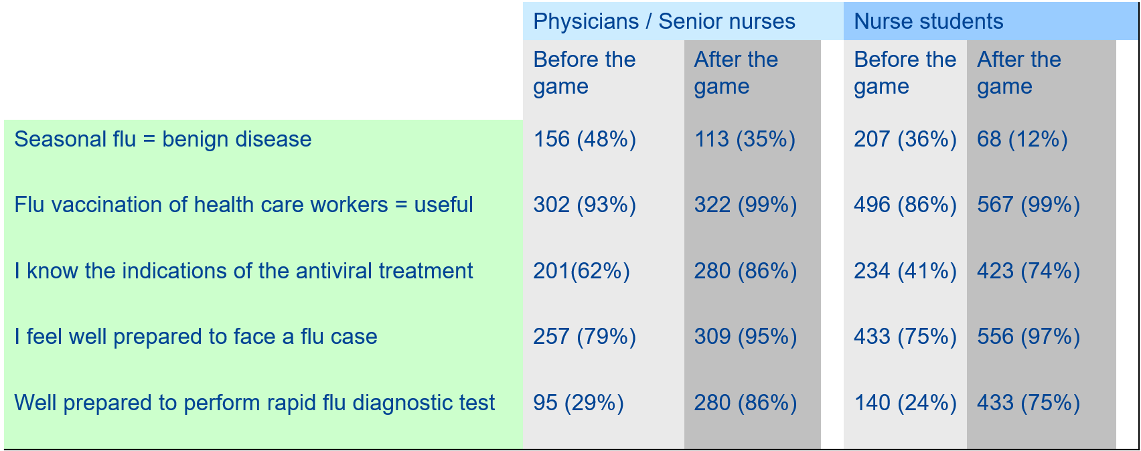
Results
    264 physicians (213 fellows), 62 senior nurses, 577 nurse students
    Rate given to the game 7.9/10
p=0.001
19
Notes:
19

Slide 20
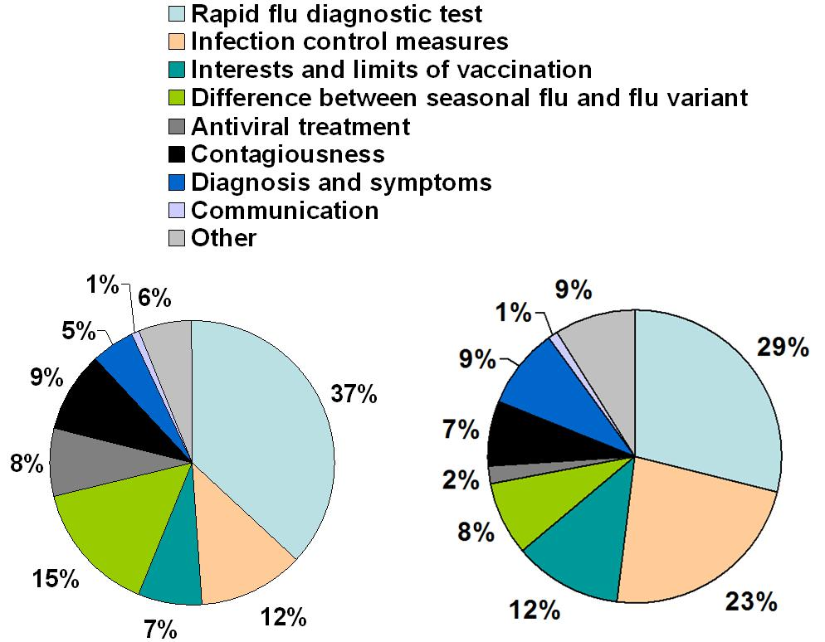
Results
95 % learnt at least one key point
Two key points
52% Physicians, senior nurses
82% Nurse students
Three Key points
16% Physicians, senior nurses
45% Nurse students
Senior
Students
20
Notes:
20
20

Slide 21
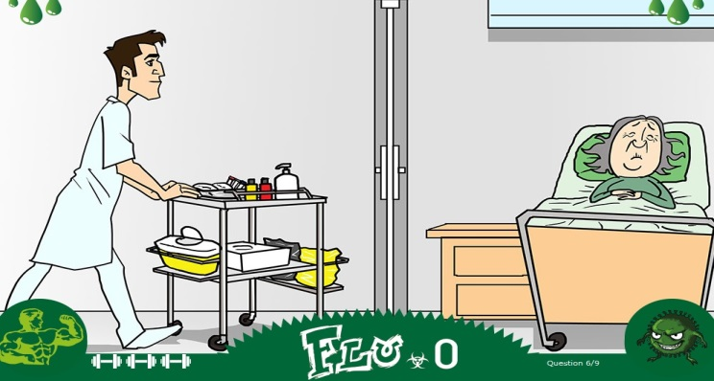
Results
94 % would change their practices after the game
Better droplets precautions
  Physicians/ Senior nurses 47%
  Nurse students 80%
Better Flu diagnosis
  Physicians/ Senior nurses 17%
21
Notes:
21
21

Slide 22
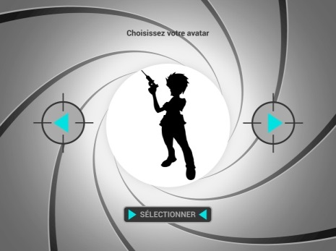
« Code Name UTI » evaluation
Two case-control studies
Students midwives
  17 played « Code Name UTI » in a classroom with voting keypads (15 min)
  16 read a leaflet during 15 min (same keypoints inside)
Nurse students
  295 played « Code Name UTI » / 287 read the leaflet
Questionnaire before and after the game
  Same principle as Flu. 0
  Before and after the intervention
  Two months after the intervention for midwives
Astrugue C Venier AG. In submission
22
Notes:
22
22

Slide 23
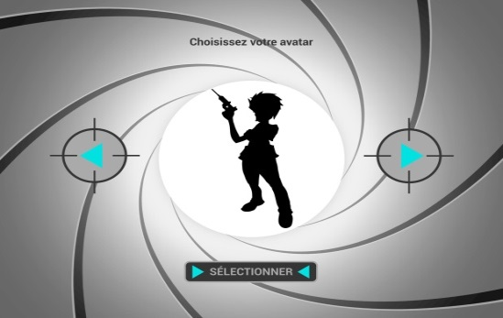
Results
Game vs leaflet
Learnings more specific
Change of practices more precise
More prepared to face a patient with a urinary catheter
23
Astrugue et al, in submission

Slide 24
So… Does it work?
For students
  Attractive and engaging to learn more
  Helpful to have good practices?
For Health care workers
  Knowledge capitalization
  Engaging for behavior change
  Not time-consuming
24
Notes:
24

Slide 25
How to use games for infection control
Check the users’ context is ok
Choose the correct game for the correct population
  Challenge adapted to the competences (novice/ expert/master)
  Game aimed to answer to a problem you want to solve
25
Notes:
25

Slide 26
How to use games for infection control
Use games!
  During a learning session, in a multiple tool strategy, for a special day
  Voting keypads/ Computers/ Smartphone
Don’t be overconfident
  Games can’t exert massive influence across all contexts
  So… add briefing + debriefing +/- synthetic cognitive information
26
Notes:
26

Slide 27
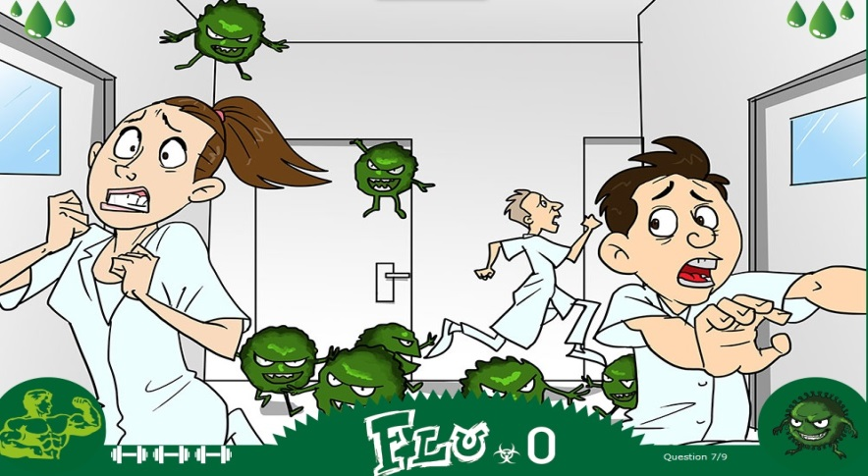
Thank you for your attention
Learning infection control via games, does it work? Yes it can!
So why go without it?
Good Question!
27
Notes:
27

Slide 28


