Slide 1


Measures to Prevent & Control Vancomycin-Resistant Enterococci (VRE).
Do they matter?
Hilary Humphreys
Royal College of Surgeons in Ireland (RCSI)
& Beaumont Hospital
Dublin
Hosted by Prof. Jean-Yves Maillard
Cardiff University, Wales
www.webbertraining.com
September 5, 2019

Slide 2
Declarations
The views expressed are in a professional but personal context & are not necessarily those of the RCSI & Beaumont Hospital, Dublin.
I have recently received research funding from Pfizer & Astellas. I have also provided professional advice to Pfizer

Slide 3
Objectives
To be fully appraised on the current understanding of the clinical importance of VRE
To be fully cognizant of the significance of environmental contamination in the spread of VRE
To understand the arguments for & against maintaining contact precautions as a VRE prevention & control measure

Slide 4
Outline
Introductory Remarks
Clinical Importance
Impact
Costs
Surveillance, Contact Precautions & VRE
For & Against
Environmental Contamination
Conclusions

Slide 5
Introductory Comments

Slide 6
Enterococci
Previously, ‘faecal streptococci’
Normal inhabitants of the gut & genitourinary tract
Low grade pathogens, less virulent than Staph. aureus
Commonest species are Enterococcus faecalis, E. faecium (EFm)

Slide 7
Infections Caused by Enterococci
Urinary tract
Bloodstream infection (BSI)
Endocarditis
Device-associated Peritoneal dialysis
Peritonitis
Surgical

Slide 8
Impact - Overview
A.Enterococci are the 2nd most common cause of healthcare-acquired infections (HCAI) in the USA after S. aureus & 89% of E. faecium associated with central-line-associated BSI are VRE
Infect Control Hosp Epidemiol, 2013
B. VRE are bacteria of serious concern which require prompt & substantial action
CDC, 2013

Slide 9
Clinical
Importance

Slide 10
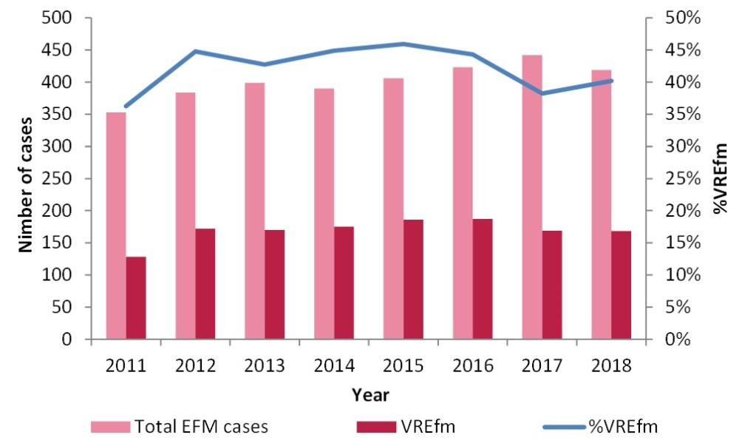
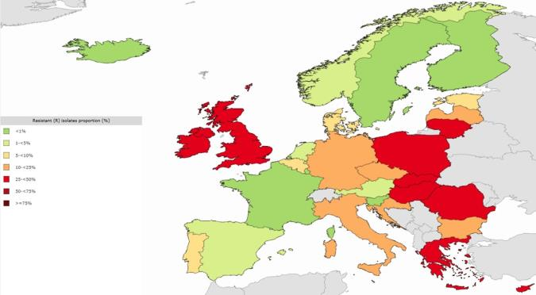
VRE BSI & Ireland
Ireland & Europe
VREFm BSI
EARS-Net & Health Protection Surveillance Centre (Ireland)

Slide 11
Why the higher rates in Ireland?
Dominant & widespread clones different to elsewhere?
Antibiotic use?
Animal-human antibiotic chain?
Greater patient vulnerability?
Inadequate facilities & health resources?

Slide 12
VRE BSI in Tertiary Care Hospital
75 patients, minimal intra-abdominal source
52% vanA
Clonal relatedness with environmental isolates
Similar sequence types & virulence factors to those in Europe
High EFm in Ireland?
J Antimicrob Chemother 2015; 70: 2718-2721

Slide 13
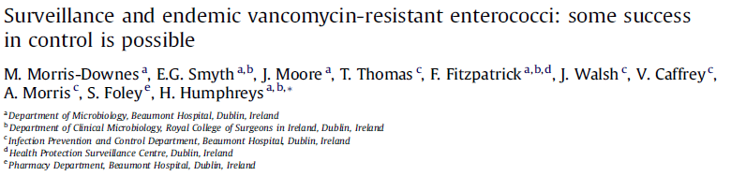

Fluctuating levels of VRE, with a decrease in the early-to-mid 2000s
Was this due to:
  Active surveillance
Electronic alerts
Improved standard precautions/hand hygiene
External audits
Antimicrobial stewardship

Slide 14
VRE – Local Experiences
Endemic VRE
ICU screening & all clinical isolates checked
Inadequate numbers of single rooms
2007
2008
2006
J Hosp Infect 2010: 75: 228-233

Slide 15
VRE – Clinical Impact
 | 2001 | 2003 | 2005 | 2007 | 2008
No. of screens | 1344 | 1525 | 1121 | 1288 | 1220
+ ves | 42 | 63 | 94 | 75 | 92
+ves/10,000 bed days (BD) | 1.96 | 2.94 | 4.06 | 3.18 | 3.85
+ve blood cultures | 2 | 11 | 18 | 8 | 11
VRE BSI/10,000 BD | 0.09 | 0.51 | 0.78 | 0.34 | 0.46
J Hosp Infect 2010; 75: 228-233

Slide 16
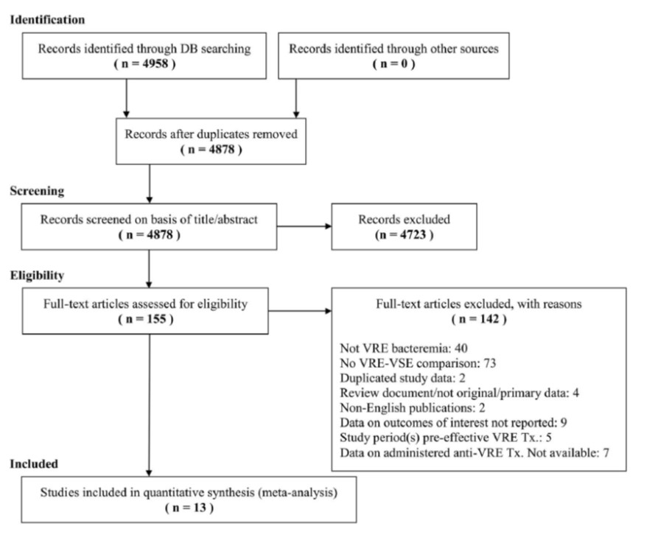
VRE versus VSE Bloodstream Infection (BSI)
Is VRE BSI worse than vancomycin-susceptible BSI in terms of outcome?
Systematic review; 12 cohort studies & 1 case-control
Infect Control Hosp Epidemiol 2016; 37: 26-35

Slide 17
VRE versus VSE BSI
Infect Control Hosp Epidemiol 2016; 37: 26-35

Slide 18
VRE & Renal Dialysis Patients
Meta-analysis from 1982-2014 of prevalence, risk factors & significance
23 studies from 100 dialysis centres involving 4,842 patients
Prevalence, 6.2% (5.2% North America)
Risk of infection increases x 21.6 if VRE +ve
Heterogeneity may reflect differences in infection prevention & control practices & use of antibiotics
Am J Kidney Dis 2015; 65: 88-97

Slide 19
How much does VRE cost us?
Retrospective case-control study, 2005-2008 (inclusive) in 1520-bed German hospital
VRE versus VSE infections (42:42)
Antimicrobial Resist & Infect Control 2018
 | VRE | VSE | p value
Cost/patient | €57,675 | €38,344 | 0.03
Costs before infection | €17,893 | €16,600 | 0.34
Costs after infection | €37,971 | €23,025 | 0.049

Slide 20
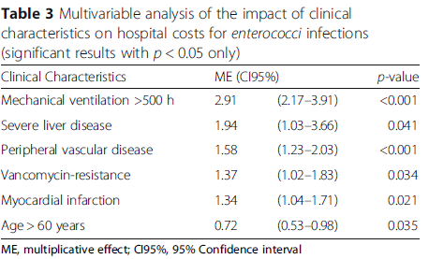
How much does VRE cost us?
Antimicrobial Resist & Infect Control 2018

Slide 21
Surveillance,
Contact Precautions & VRE

Slide 22
How do you prioritise measures to prevent & control a particular HCAI?
Prevalence – common or less common
Impact – virulent or less virulent
Treatment – some or few options
Visibility – seen or not seen to be important

Slide 23
Priorities in HCAI Prevention & Control
Personal Perspective
Carbapenemase – producing Enterobacterales (CPE)
Clostridioides difficile infection (CDI)
Methicillin-resistant Staphylococcus aureus (MRSA)
Vancomycin-resistant enterococci (VRE)
Extended – spectrum β-lactamase producers (ESBL)
Others, antibiotic susceptible bacteria, norovirus, etc

Slide 24
Risk Factors for VRE
Intrinsic | Comment
Immunosuppression | Haematology/Oncology, SOT
Renal dialysis | Healthcare contact
Antibiotics | 3GC, FQ, vanc, B-L/B-L inhibitors
Underlying diseases | Healthcare contact
Extrinsic | Comment
ICU | Most studies
LTCF | ? Underlying disease or lack of prevention
Single room | Inadequate cleaning
Prior hospitalisation | Studies in tertiary centres
J Hosp Infect 2014; 88: 191-198

Slide 25
Control & Prevention of VRE
Surveillance +/- screening
Standard precautions
Contact precautions

Slide 26
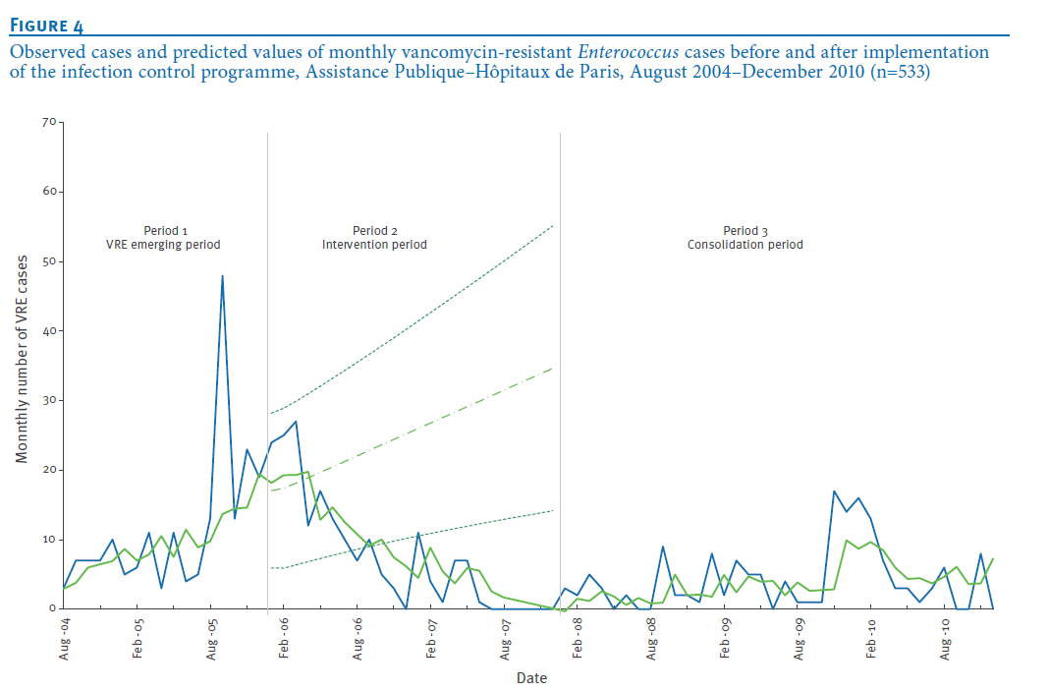
Control of VRE - Outbreak
2004-2010 - 45 outbreaks involving 533 cases in France
Control involved three periods & numbers fell
Similar approach for CPE
Euro Surveill 2012; 17 (30)
Observed
Predicted

Slide 27
Surveillance for VRE
Passive
Only check isolates causing infection to guide therapy
Occasional prevalence surveys of enterococcal isolates
Active
Selective, e.g. admission & weekly in ICU
Universal, all patients in certain clinical units on admission, weekly & on discharge

Slide 28
Studies on Screening
Mixed & sub-optimal in large part due to
    Differences in centres
    Sampling & laboratory methodology
    Patient populations
    Design, retrospective, prospective, case-controlled
    Some are mathematical modelling
  Despite this, there is at least a suggestion that active screening reduces prevalence due to possible increased awareness, indirect measures +/- direct preventative measures

Slide 29
Examples of Screening/Interventions
Setting/Design | Screening | Outcome | Comments
Japan, observational | All hospital admissions | Initial ↑ prevalence but then fell | Improved hand hygiene
US, retrospective | BSI in 2 hospitals, one that screens | Higher BSI rate & cohort in non-screening hospital | Hospitals, similar but not controlled
US, multicentre retrospective | Admission & weekly ICU screen | ↑ detection | -
US, oncology unit Historical controls | Admission & weekly screening | Reduced BSI rates & costs | Single centre
Europe 13 ICUs cluster randomised | Frequent screening | Improved hand hygiene & chlorhexidine bathing most important | Some patients not screened
J Hosp Infect 2014; 88: 191-198

Slide 30
VRE Guidelines in USA, UK & Ireland
USA, 2003, Infect Control Hosp Epidemiol 2003, 24: 362-386
UK, 2006, J Hosp Infect 2006; 62: 6-21
Ireland, 2014 Health Protection Surveillance Centre (www.hpsc.ie)

Slide 31
 | USA | UK | Ireland
Surveillance | Active for high risk patients Periodic | Outbreaks only | Admission & weekly for ICUs, etc. Previously known & transfers
Contact Precautions | Yes & single rooms | Implied & single room on basis of risk assessment | Yes & single rooms if possible

Slide 32
Passive or Active Surveillance
Modelling based on data from Australia
6% & 22% detected by passive & active surveillance, respectively
Ratio of transmission with contact precautions was 0.33 compared to without
VRE acquisition mainly due to background acquisition & antimicrobial stewardship, cleaning & hand hygiene important
BMC Infect Dis 2018; 18: 511

Slide 33

Phase 1 – baseline data
Phase 2 – hand hygiene
Phase 3- screening (molecular & culture) & if +ve, contact precautions
15-22% of patients in single rooms; more than % carriers

Slide 34
Screening
IP & C Measures
Costs
Infection, Length of Stay, Antibiotics &
Investigations

Slide 35
Trade Off in Costs
Peri-rectal cultures taken
1 case of VRE BSI 19 days of hospitalisation
28 cases of VRE BSI ≡ $761,320
VRE IP&C measures ≡ $253,097
Infect Control Hosp Epidemiol 2002; 23: 429-435

Slide 36
What happens when you stop surveillance & contact precautions?
Comparison of different time periods & effect on BSI
But, single centre, malignant haematology patients, no details on hand hygiene & cleaning, & all admissions in single rooms
Infect Control Hosp Epidemiol 2016; 37: 398-403

Slide 37
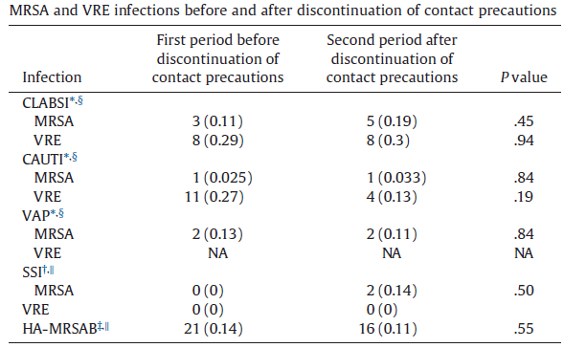
Contact Precautions, or Not For VRE
Retrospective, before & after study in 800-bed Detroit Hospital
Hand hygiene compliance was 73% & 78% Am J Infect Control; 2017: 1369-71

Slide 38
Environmental Contamination

Slide 39
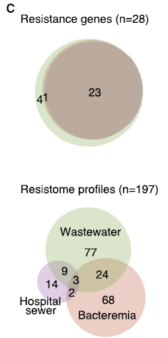
VRE & Wastewater
Isolates of E. faecalis & EFm sequenced from blood cultures & BSI in East of England
28 antibiotic resistant genes, 23 of which were in the hospital sewage, municipal waste & bloodstream
Genome Research, 2019

Slide 40
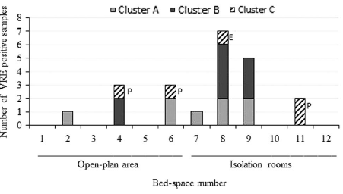
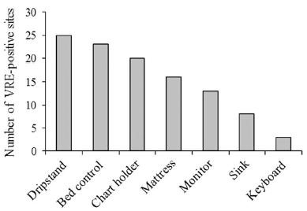
Ongoing VRE in the ICU
12-bed ICU with 6 single rooms, 4 are sub-standard
Patients screened on admission & weekly
157 patients, 19% VRE+ve & 107/1,647 (6.5%) of environmental sites +ve
Infect Control Hosp Epidemiol 2018; 39: 40-45

Slide 41
Cleaning Bundle to Reduce HCAI
11 hospitals in Australia that used audit, feedback & was low cost
Objective was to reduce Clostridioides difficile infection (CDI), Staphylococcus aureus BSI & enterococcal infection
Cleaning improved but no fall in CDI or S. aureus BSI
There was a statistically significant reduction in VRE infections (37%)
Lancet Infect Dis 2019; 19: 410-418

Slide 42
Can we decolonise patients with
VRE as with MRSA?
Not specifically………..
but there may be some possible options

Slide 43
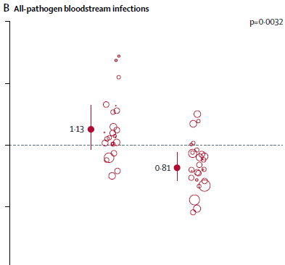
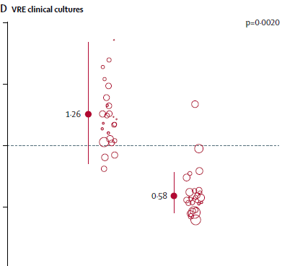
Chlorhexidine Bathing Outside ICU
53 hospitals & >700,000 patients spread over 3 periods
Primary outcome was unit-attributable MRSA or VRE
67% reduction in VRE+ve clinical cultures but no difference in BSI Lancet 2019; 393: 1205-15

Slide 44
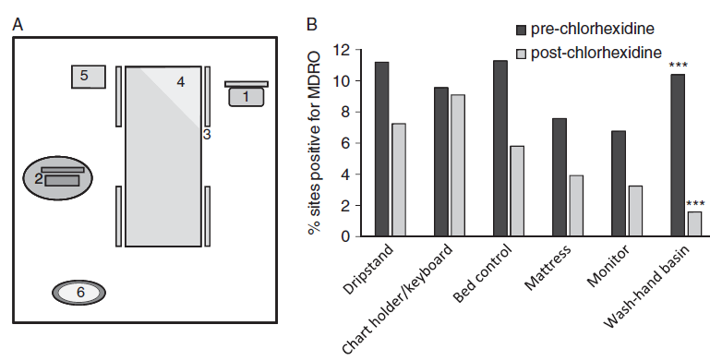
Chlorhexidine Bathing & ICU
Reduction in ESBL/VRE in environmental contamination despite increase in hand hygiene compliance (80-85%)
Bed occupancy (98% to 110%) & reduction in patient stay
Infect Control Hosp Epidemiol 2018; 39: 1131-1133

Slide 45
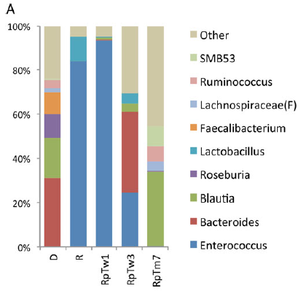
Decolonisation of VRE by Faecal Microbiota Transplant (FMT)
FMT seeks to normalise the faecal flora (microbiota) & used to treat CDI
Interest in using it to control CPE especially in advance of high risk procedures/events
Case report of multiple VRE infections after heart & kidney transplant: donor was the spouse
Open Forum Infect Dis, 2015

Slide 46
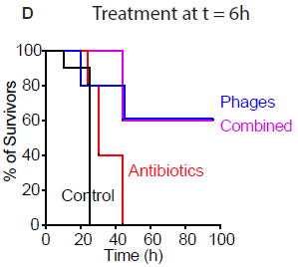
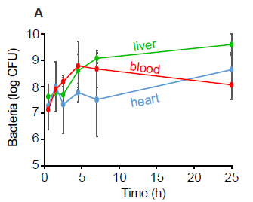
Bacteriophages & Antibiotics to Treat (Decolonise) VRE
Mouse model of septic peritonitis with intra-peritoneal injections
100% survival if phages given 0-7h after inoculation
Res Microbiol 2018; 169: 531-539

Slide 47
Conclusions

Slide 48
Horizontal measures to prevent & control HCAI (e.g. improved hygiene, chlorhexidine decolonisation) are not incompatible with targeted, focussed, vertical measures to prevent VRE (e.g. screening & possible decolonisation)

Slide 49
Conclusions
VRE remain important but profile overtaken by CDI, CPE, etc.
Passive surveillance underestimates prevalence
Contact precautions may not be necessary, if patients are in single rooms & there is high compliance with standard precautions
Horizontal IPC approaches, e.g. chlorhexidine bathing & improved environmental cleaning are important
FMT & phage therapy may in the future be appropriate, when decolonisation required in selected patients

Slide 50


Slide 51

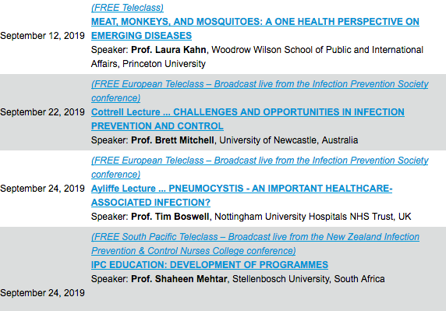

Slide 52


