Slide 1
Look at What the Cat Scratched In
Pet Associated Zoonoses:
What’s New and Relevant for Infection Prevention and Control
Jason Stull, VMD, MPVM, PhD, DACVPM
Assistant Professor
Hosted by Martin Kiernan martin@webbertraining.com
www.webbertraining.com
September 10, 2010

Slide 2
Conflict of Interest Statement
The speaker declares he has no competing interests

Slide 3
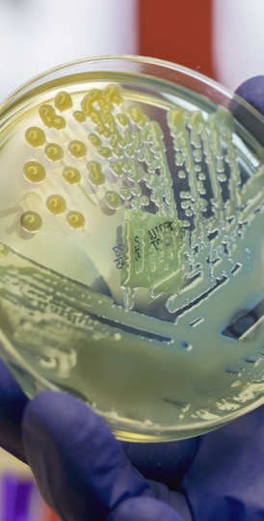
Objectives
Recall key pathogens associated with companion-animal (pet) zoonoses
Describe current knowledge on the epidemiology of these pathogens in human disease
Apply knowledge to develop and implement prevention strategies in various human-animal settings

Slide 4
Pet Ownership is Common
Majority of homes have at least 1 pet
Dog or cat (>50%)
Fish
Birds
Rabbits, hamsters, guinea pigs, gerbils, ferrets, snakes, frogs, turtles, lizards
Photo Source: Pixabay

Slide 5
Human-Animal Bond
Distress & social isolation: ↓ health
Often strong bonds pets and owners
↓ stress, anxiety, loneliness, depression¹
↓ risk cardiovascular disease²
Children: better social skills, self-esteem, empathy³
Catalyst for harm reduction (e.g., tobacco, drug use)⁴
Photo Source: Pixabay
¹ Friedmann 2009 ² Patronek 1993 ³ Melson 1997 ⁴ Lem 2013

Slide 6
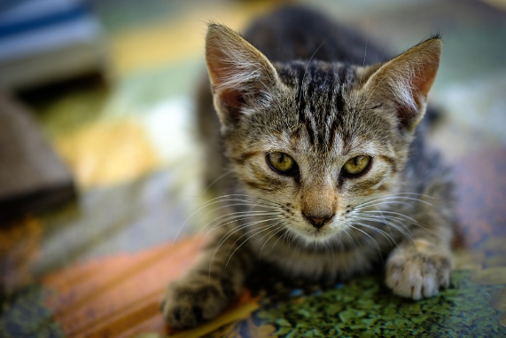
Immunocompromised
Mental & physical isolation
HIV-infected¹
Pet as family member
Source of support and affection
Protect against loneliness
Pet-owners with AIDS less depression than non-pet owners
Cancer patients²
High level of attachment to pets
Having a pet provided health benefits (67%)
Immunocompromised children³
Photo Source: Pixabay
¹ Siegel 1999 ² Larson 2010 ³Stull 2014

Slide 7
Pets incorporated into Human Healthcare¹
Builders of social capital
Harm reduction
Motivators for healthy behavior change
Participants in treatment plans
Photo Source: Pixabay
¹ Hodgson et al., 2015

Slide 9
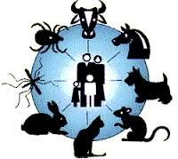
Zoonoses
Naturally transmitted from animals to people
Of 1,415 species pathogenic to people¹
61% zoonotic
75% emerging pathogens zoonotic
¹ Taylor 2001

Slide 10
Pet-Associated Disease
70+ pathogens of pets transmissible to people
Pets often subclinical shedding
Emerging & remerging diseases
Animal and human reservoirs
Further transmission possible
Dogs visiting human healthcare facilities¹
Photo Source: Pixabay
¹ Lefebvre 2009

Slide 11
Pet-Associated Disease Risks
Disease risk greatest
Extremes of age (<5 yrs, ≥ 65 yrs)
Pregnant
Immunocompromised
Higher risk groups
Particular pathogens
Longer duration
More severe/unexpected complications
Pet factors
Photo Source: Pixabay

Slide 12
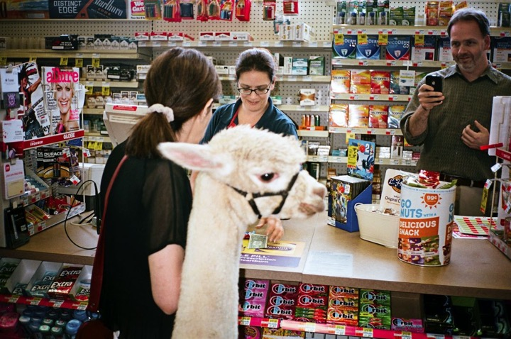
Photo Source: The New Yorker

Slide 13
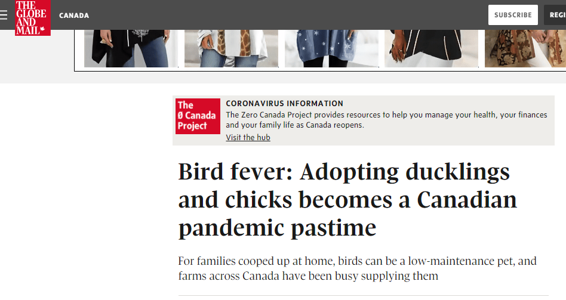

Slide 14
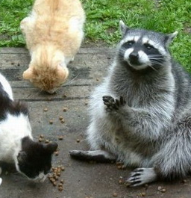
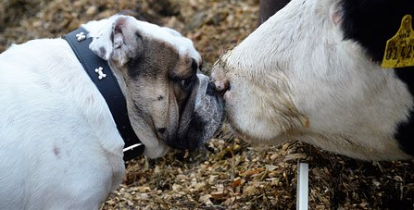
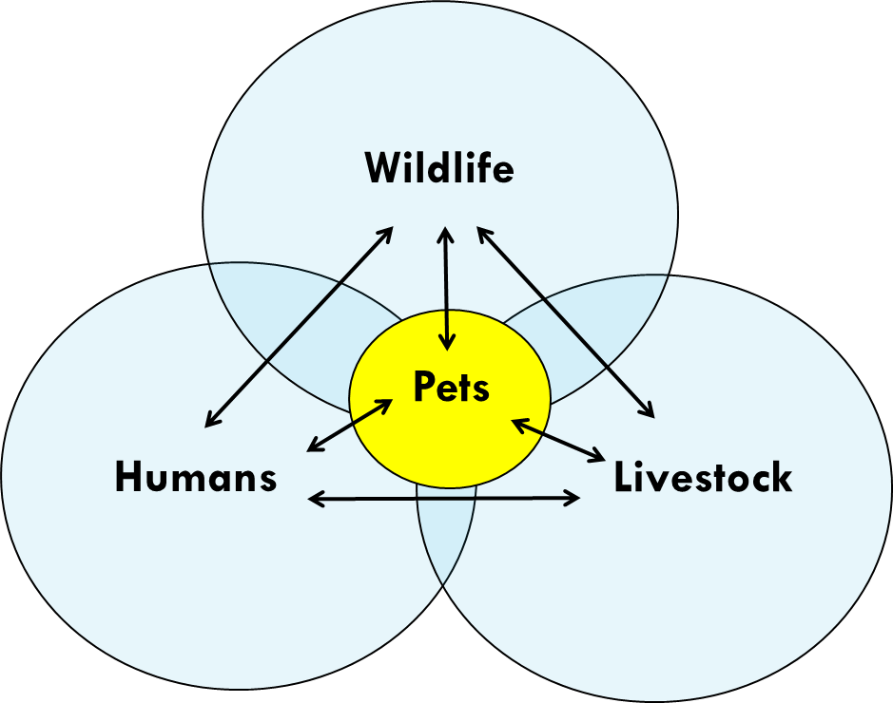
Pet-Associated Disease Transmission
Photo Source: Pixabay

Slide 15
Relevance of Pet-Associated Zoonoses for Infection Prevention
Healthcare programs
Service animals, patient’s pets, therapy animals, visitation animals
Patients
Sick, preventive care, One Health
Simple precautions to greatly reduce risk
Barriers: Lack of knowledge, reduced compliance preventive care
Incorporate into planning & patient history taking

Slide 16
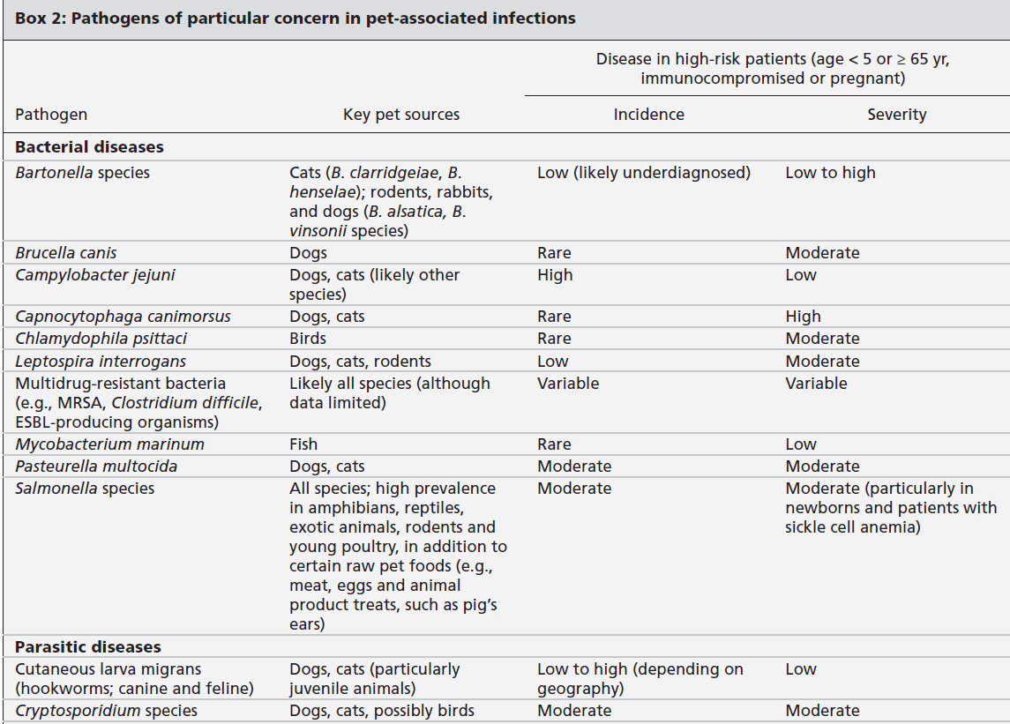
Stull JW, et al. CMAJ 2015
16

Slide 17
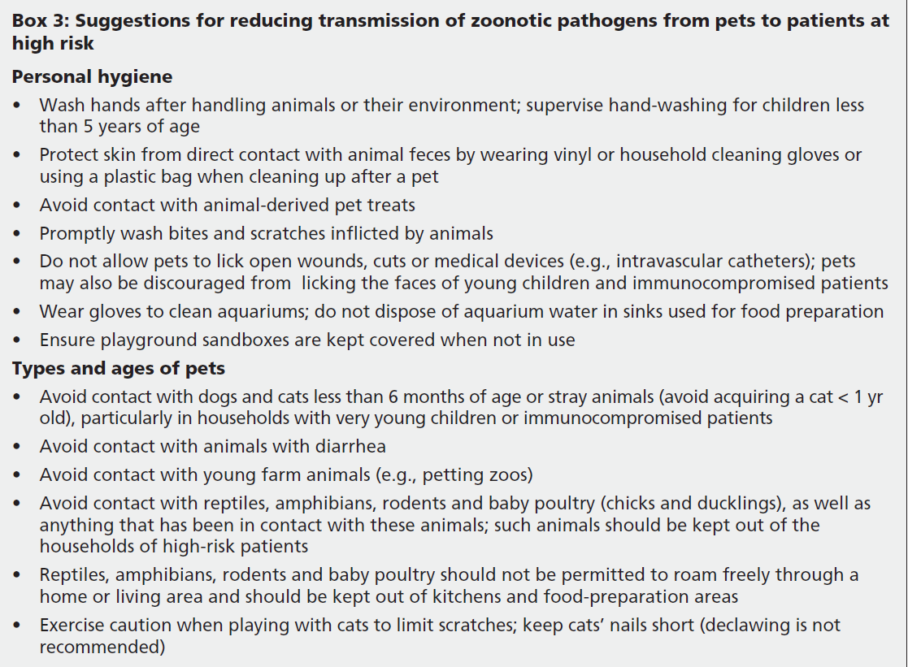
Stull JW, et al. CMAJ 2015
17

Slide 18
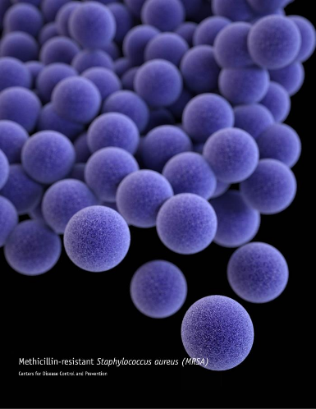
Staphylococcus aureus
MSSA: 12-14% dogs/cats; 50% dog-owner indistiguishable¹
MRSA
0-9% of cats and dogs^{1,2}
RFs: contact children, human hospitals, owned HCW, antimicrobial therapy^{3,4}
Concurrent colonization between pets and owners
14% pets in households with MRSA infected person (14% ↓ odds/day after person dx)⁵
Colonization short-term (weeks)
Pets: clinical cases skin and soft tissue infections
Photo Source: Centers for Disease Control and Prevention
¹ Hanselman 2009 ² Hoet 2013 ³ Lefebvre 2009 ⁴Faires. et al. 2010 ⁵Morris 2012

Slide 19
Methicillin-resistant Staphylococcus pseudintermedius (MRSP)
Antimicrobial resistant bacterium
Predominately in dogs
Uncommon: cats, people
Rapidly emerging
80% resistant to ≥ 7/11 antimicrobials¹
41% dogs with bacterial pyoderma²
Photo Source: Pixabay
¹ Perreten, 2010 ² Beck, 2012

Slide 20
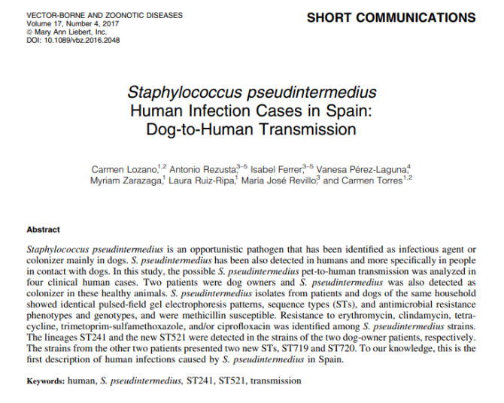
Methicillin-resistant Staphylococcus pseudintermedius (MRSP)
Dogs often colonized without clinical signs
Source of infection
Common cause canine opportunistic infections
Zoonotic (rarely)
¹ Weese, 2012 ²Eckholm, 2012 ³Nienhof, 2011 ⁴Bergstrom, 2012

Slide 21
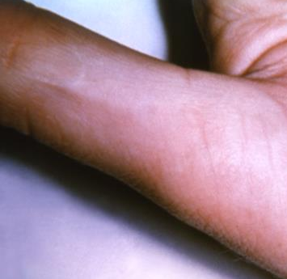
Bartonella Spp (Cat-Scratch Disease)
Bartonella henselae most common
Many species of Bartonella
B. clarridgeiae and B. vinsonii subsp. berkhoffii transmissible from pets
Feline most important reservoir for zoonotic transmission
Transmitted by cat flea (Ctenocephalides felis) feces
Scratches or bites from cats: flea feces enters scratch wound
Photo Source: Centers for Disease Control and Prevention
21

Slide 22
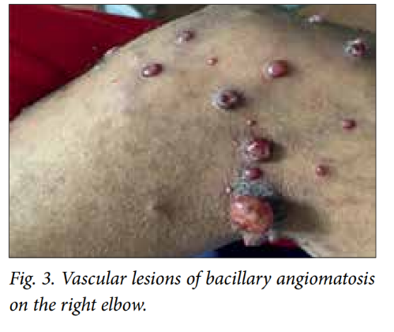
CSD: Frequency of Infection
People
Estimated 22,000 cases diagnosed/yr in US
Children < 10 yrs (33% of all diagnoses)
Most often self-limiting benign disease; regional lymphadenopathy
Cats
Very common (up to 80% seropositive); bacteremia in 25-50% of healthy cats
Chronic, asymptomatic bacteremia for months to years; esp young cats (< 1 year), flea-infested, strays
Photo Source: M C Madua 2015.

Slide 23
Prevention and Control
Flea control on cats
Avoid bites and scratches (training)
Wash (soap and water) bites and scratches
Immunocompromised individuals and pet cats
Flea control!
Promptly wash bites, scratches; prevent licking wounds
Avoid higher risk cats: young (< 1 yr), stray, outdoor
Photo Source: Pixabay

Slide 24
Clostridium difficile: Dogs
Identified in healthy dogs (5-10%)¹
Same strains in people and dogs
Dog-human transmission risks unclear
Healthcare: human to dog
Risk factors
Human healthcare settings²
Accepting treats, licking human patients
Immunocompromised owner⁴
Recent antimicrobials to dog or owner⁴
Photo Source: Pixabay
¹ Clooten, 2007 ² Lefebvre, 2009 ⁴ Weese, 2010

Slide 25
Extended-Spectrum beta-Lactamase–Producing Enterobacteriaceae
Healthy and sick dogs
Same strains as people¹
Pet contact associated with increased risk ESBL colonization²
Antimicrobials RF for ESBL acquisition³
Interest in raw food diets
¹ Damborg P, 2015 ²Meyer, 2012 ³Wedley AL, 2017

Slide 26
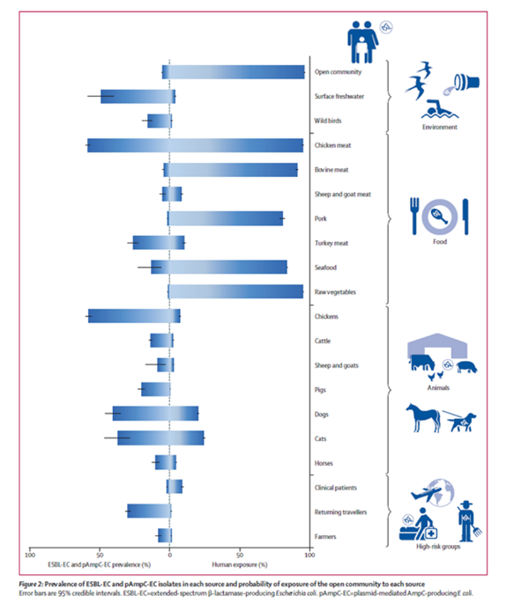
Attributable Sources: ESBL & CMY
E. coli data from Netherlands
Source attribution model based on prevalence and human exposure
Mughini-Gras, 2019
Mughini-Gras, 2019
26

Slide 27
Community Acquired ESBL & AmpC Attributed to…
Other people: 60% (40–74)
Food: 19% (7–38)
Dogs: 5% (0.2–16)
Cats: 2% (0.1–8)
Intracommunity spread alone unlikely to be self-maintaining without transmission to and from non-human sources
Mughini-Gras, 2019

Slide 28
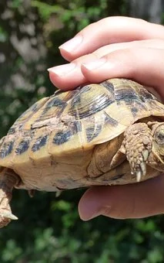
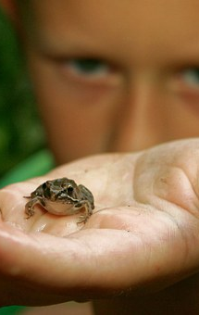
Salmonella spp
Reptiles, amphibians, and exotic species very high prevalence
Photo Source: Pixabay

Slide 29
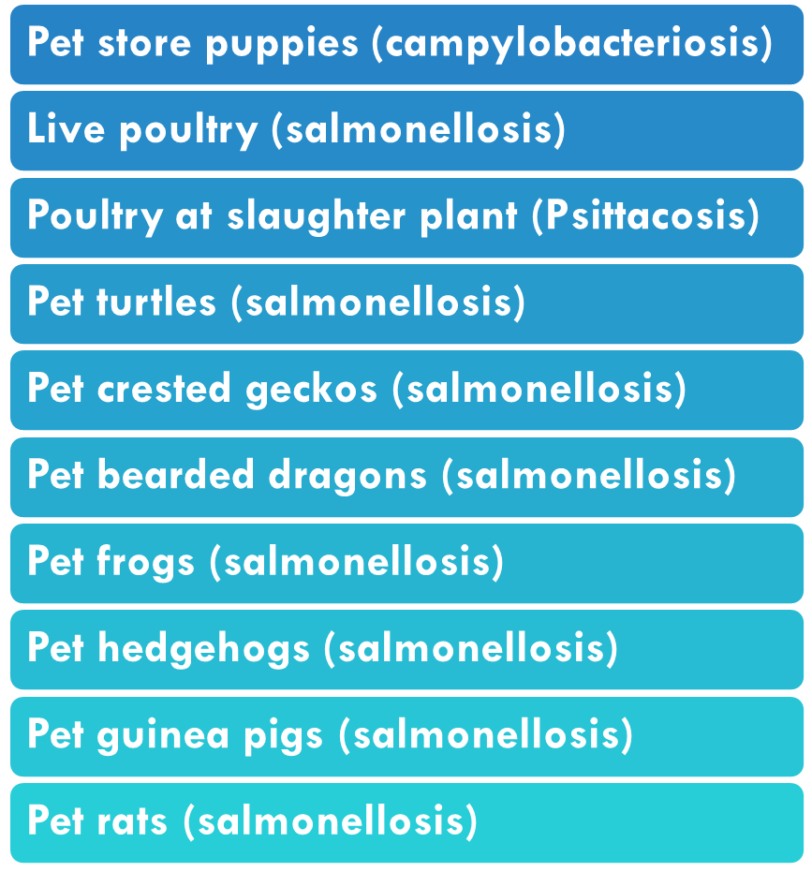
(Some) Animal-associated Human Outbreaks, USA (2011-2020)
Source: Centers for Disease Control and Prevention (https://www.cdc.gov/healthypets/outbreaks.html)

Slide 30
Salmonella spp
Reptiles, amphibians, and exotic species very high prevalence
Overall uncommon in healthy dogs and cats
Raw food diets and treats increase greatly risks (OR=23)¹
Diarrhea
¹ Lefebvre, 2008

Slide 31
Raw Meat-Based Diets and Pets
Bacterial and protozoal contamination
Salmonella, Listeria, E. coli
T. gondii and Cryptosporidium
Exotic agents (e.g., Brucella suis)¹
Asymptomatic shedding
FDA Study (2010-2012)
¹ van Dijk, 2018

Slide 32
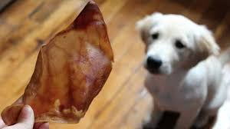
Raw-Meat Based Treats
Outbreaks of human salmonellosis associated with animal-derived pet treats (pig ears)¹
Recent pig ears outbreak²
Photo Source: Pixabay
¹ Clark, 2001 ² CDC, 2019

Slide 33
Fed Raw at Higher Risk
Dogs ate raw 11X as likely to shed 3rd generation cephalosporin-resistant E. coli ¹
Dogs ate raw poultry 48X as likely to shed ESBL E. coli ²
Dogs ate raw poultry 104X as likely to shed E. coli resistant to fluoroquinolones ²
Dogs ate raw meat 2X as likely to shed ESBL producing E. coli ³
Cats ate raw 32X as likely to shed ESBL-producing bacteria⁴
¹ Schmidt, 2015 ² Wedley, 2017 ³ Baede, 2015 ⁴Baede 2017

Slide 34
Atlantic Veterinary College Clients¹ (Reportedly fed during a typical week; n=112)
¹ Evason, 2019

Slide 35
Bite/Scratch Pathogens

Slide 36
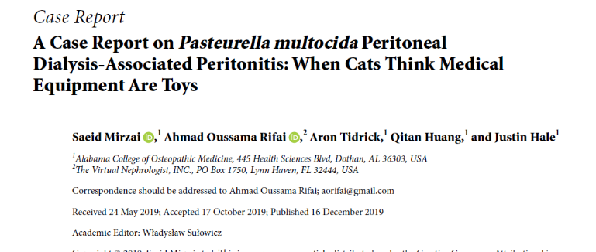
Common Oral Pathogens
Infections typically involve both aerobes and anaerobes
Each animal species carries different resident flora
Some high consequence
Capnocytophaga canimorsus
Pasteurella multocida
Methicillin-resistant Staphylococcus aureus (MRSA)
Streptobacillus moniliformis

Slide 37
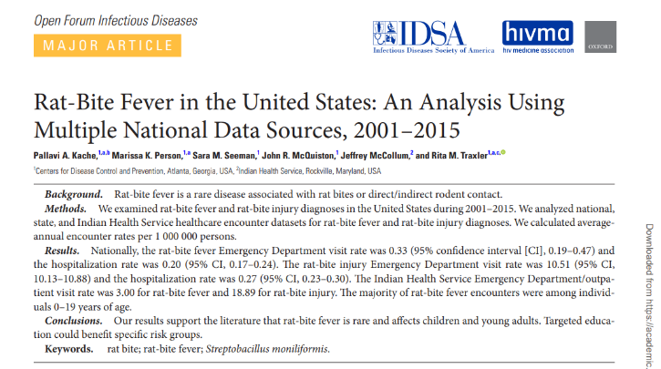
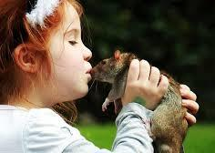
Rat-Bite Fever
Streptobacillus moniliformis
Reservoir: rodents (often rat)
Transmission: bites & scratches
Other direct & indirect contact (kissing, cage cleaning)
Normal rat flora (50-100%); no clinical disease
Rare but ↑ frequency with “pocket pet” ownership?

Slide 38
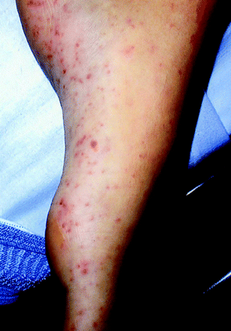
RBF: Disease & Prevention
People (2-3 days up to 3 wks after exposure)
Fever, joint/muscle pain, rash (soles, palms, extremities)
Rarely endocarditis, meningitis, sepsis
High risk: children, those with high rodent exposure
Antimicrobials
Untreated: 7-13% fatality
Sean P. Elliott Clin. Microbiol. Rev. 2007;20:13-22

Slide 39
39

Slide 40
40

Slide 41
Animals & SARS-CoV-2
Infected? Infectious?
Experimental/natural infections¹
Dogs
Cats, ferrets, hamsters
Mink
Virus on fur?
Limited testing
Source: people with COVID-19
El Masry, et al.. 2020. Exposure of humans or animals to SARS-CoV-2 from wild, livestock, companion and aquatic animals: Qualitative exposure assessment. FAO animal production and health,, FAO. https://doi.org/10.4060/ca9959en
Photo Source: Pixabay

Slide 42
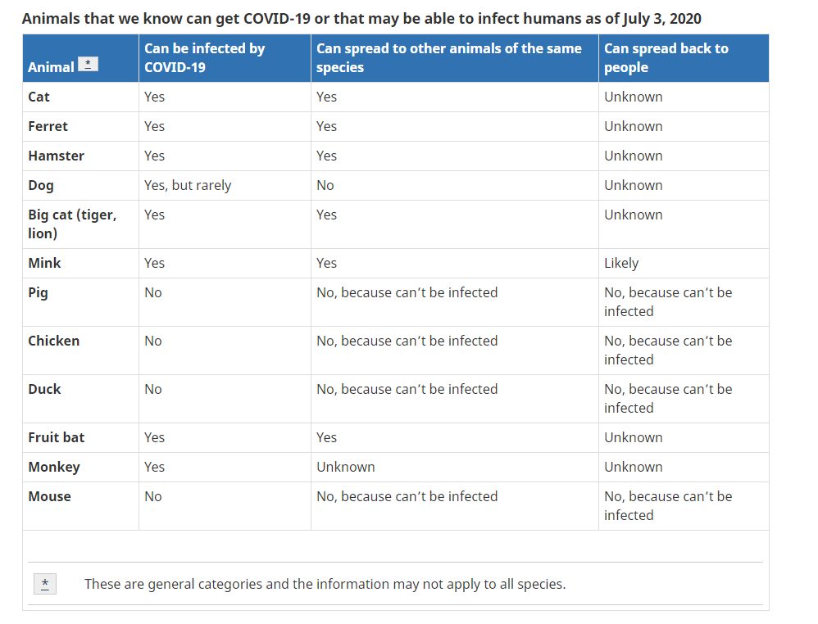
https://www.canada.ca/en/public-health/services/diseases/2019-novel-coronavirus-infection/prevention-risks/animals-covid-19.html#a1

Slide 43
Animals and Healthcare/Public Settings (SARS-CoV-2)
Main risks people (owners, handlers) of pets
Screen handler and pet before entry
Low-risk (eg no exposure in past 14 days)
Routine COVID-19 measures
Hand hygiene, not with COVID-19 cases/suspects, mask use for all people
Limit: closed/crowded spaces, close/continuous contact
Limit # handlers, single facility
Follow existing (general) recommendations
Maintain log for contact tracing (who, how long)
Communication between handler and facility

Slide 45
Murthy R, et al. Animals in healthcare facilities: recommendations to minimize potential risks. Infect Control Hosp Epidemiol. 2015
45

Slide 46
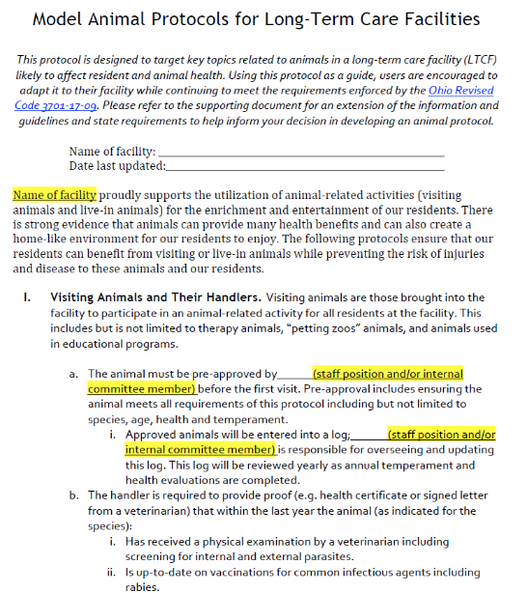
http://www.go.osu.edu/nhpets

Slide 47
Prevention: Final Tips
Develop/refine protocols for animal interactions
Hand hygiene
Exclusion policies – species, illness, recent antimicrobial therapy, preventive care
Incorporate questioning and prevention advice into well & sick patient visits
Stay up-to-date on zoonotic diseases
https://www.wormsandgermsblog.com/

Slide 48
