Slide 1
Rapid reporting of emerging disease outbreaks using unofficial sources: Lessons from ProMED
Larry Madoff, MD
ProMED, International Society for Infectious Diseases
University of Massachusetts Medical School
Massachusetts Department of Public Health
Hosted by Prof. Timothy Landers
The Ohio State University College of Nursing
www.webbertraining.com
June 1, 2017

Slide 7
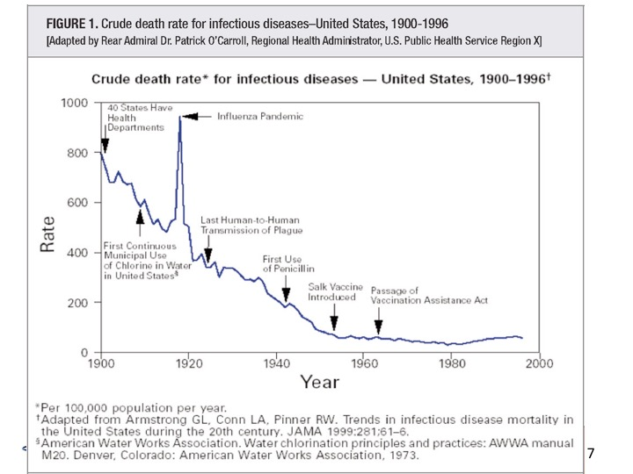

Slide 20
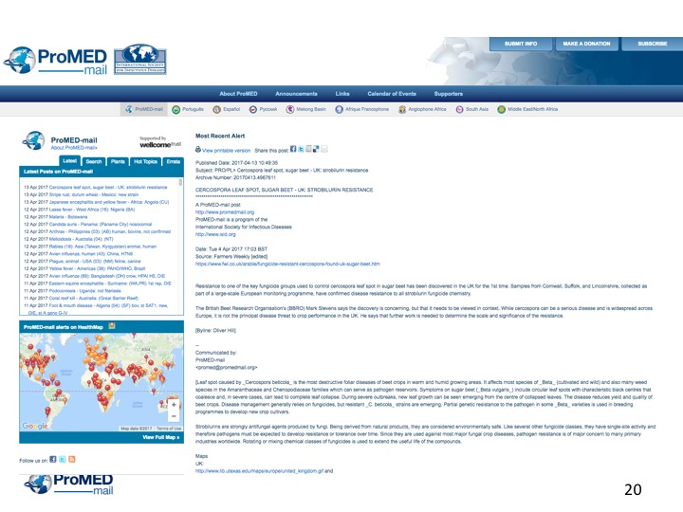

Slide 22
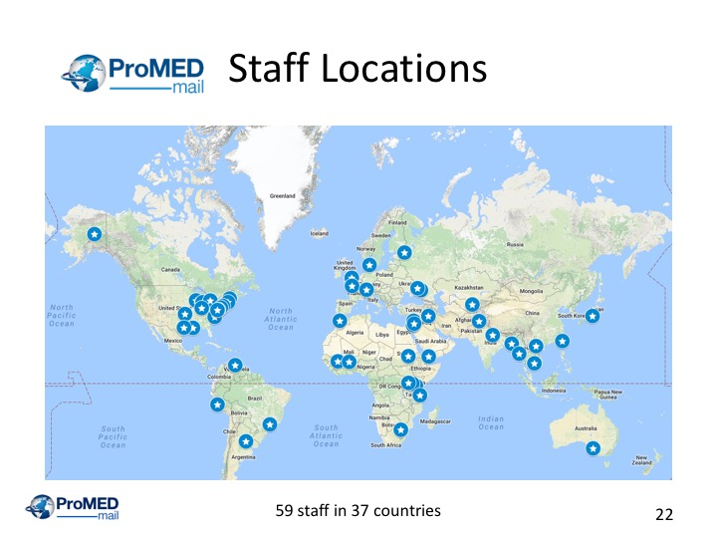

Slide 23
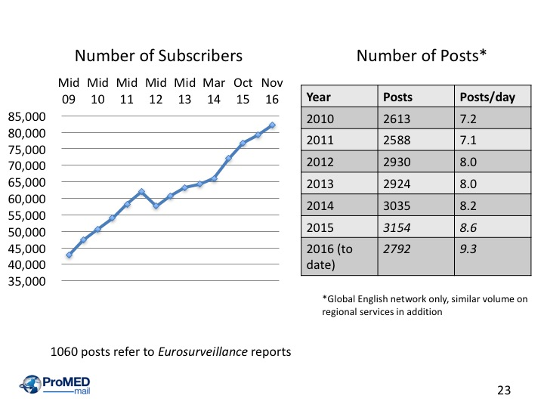

Slide 24
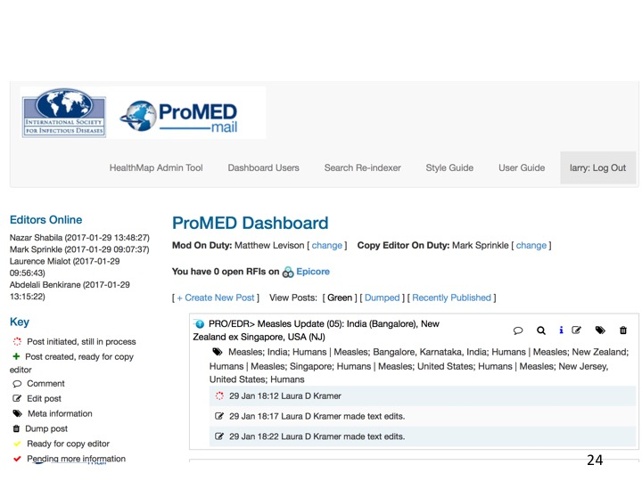

Slide 25
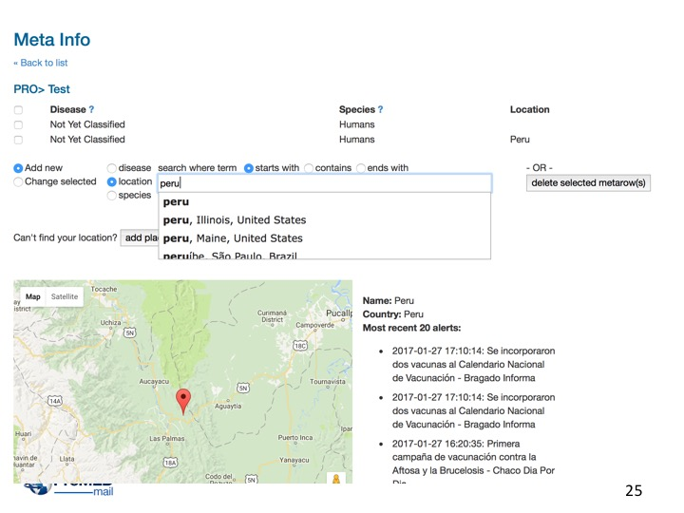

Slide 26
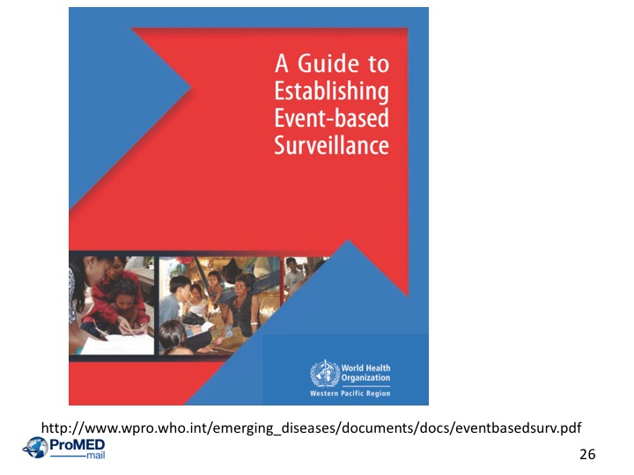

Slide 31
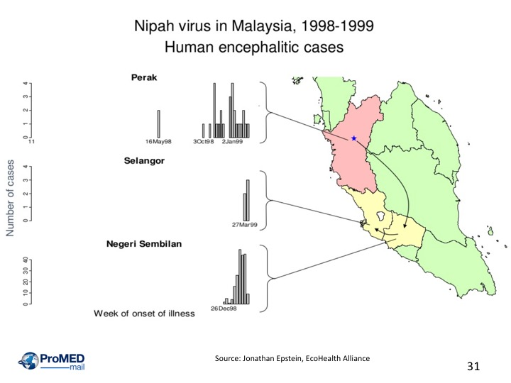

Slide 36
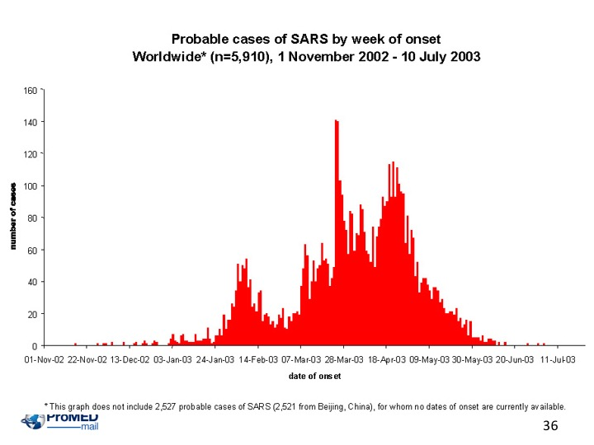

Slide 40
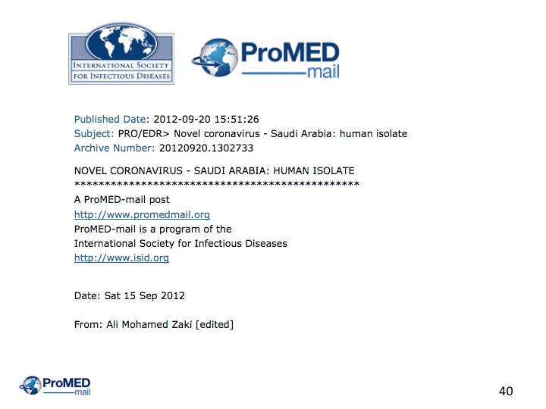

Slide 44
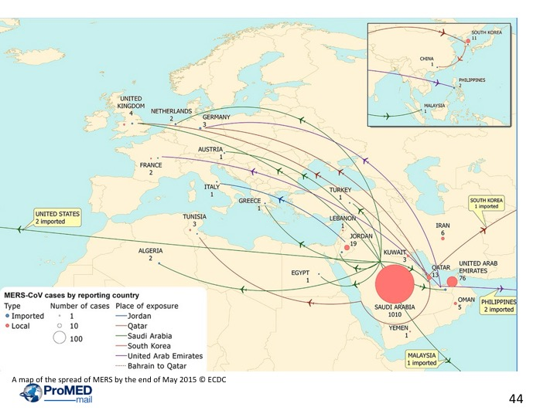

Slide 45
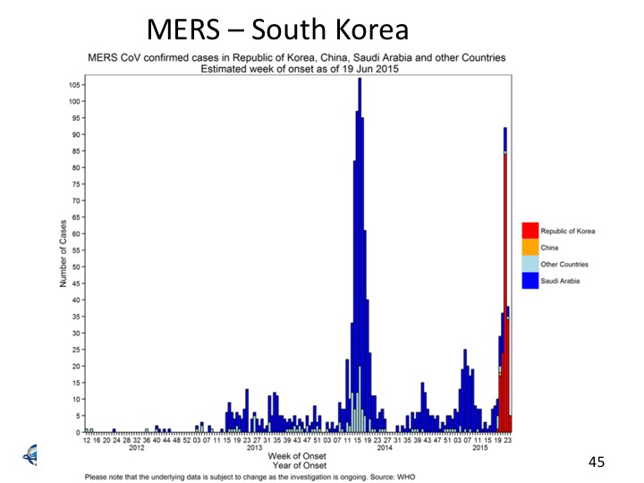

Slide 51
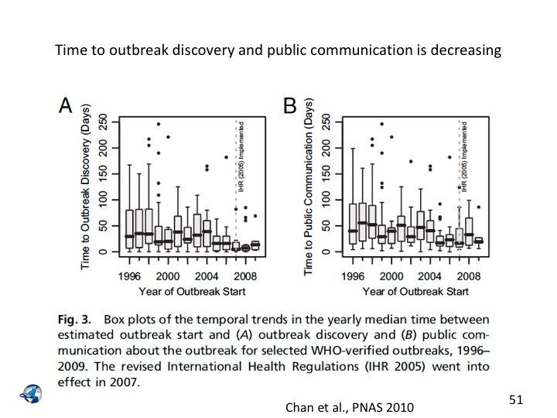

Slide 63
