Slide 1


The role of dry surface contamination in healthcare infection transmission
Jon Otter, PhD FRCPath
Imperial College London
j.otter@imperial.ac.uk
@jonotter
Blog: www.ReflectionsIPC.com
You can download these slides from www.jonotter.net
Hosted by Martin Kiernan
martin@webbertraining.com
www.webbertraining.com
February 28, 2017

Slide 2
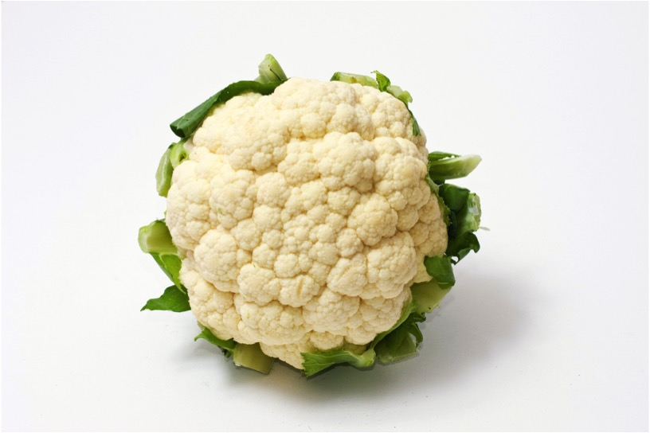

Slide 3
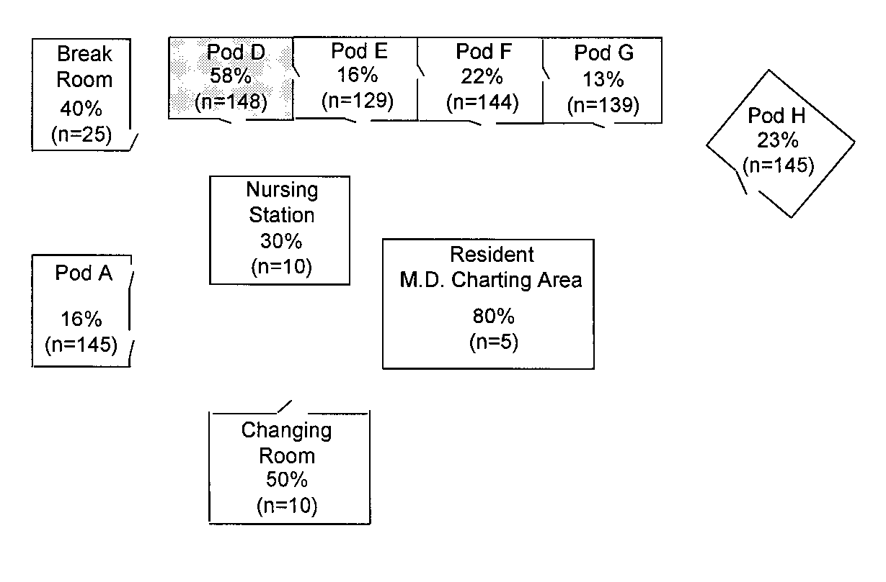
Transfer of a surrogate marker in a NICU
Oelberg et al. Pediatrics 2000;105:311-315.

Slide 4
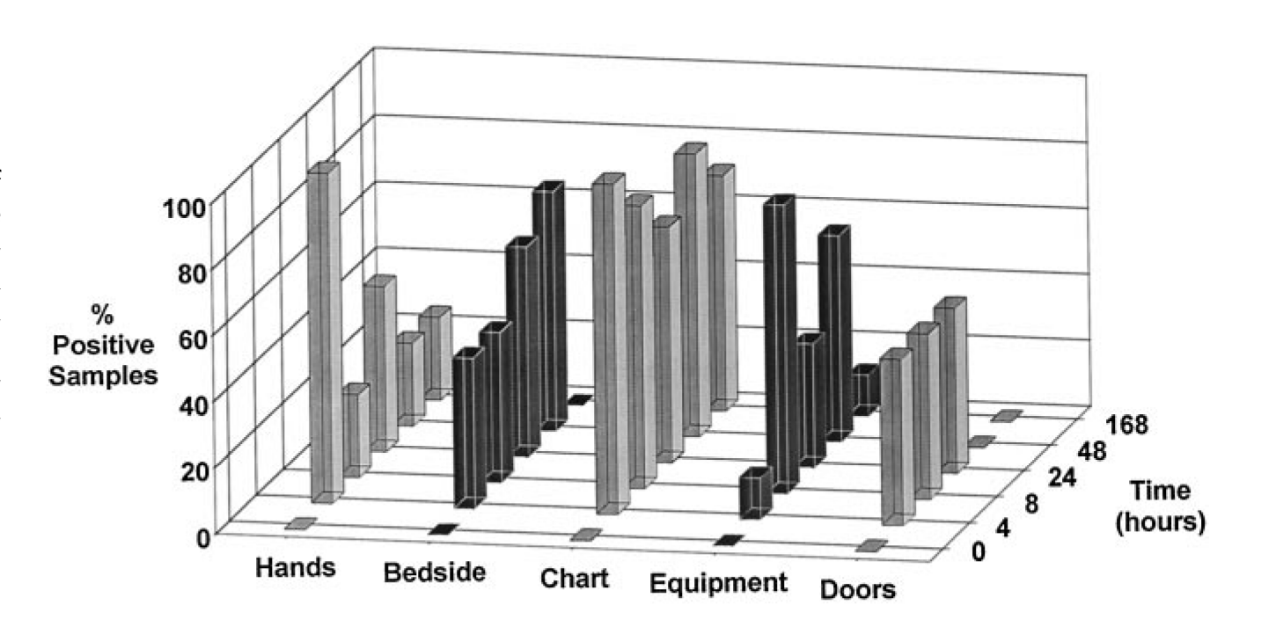
Transfer over time: inoculated pod

Slide 5
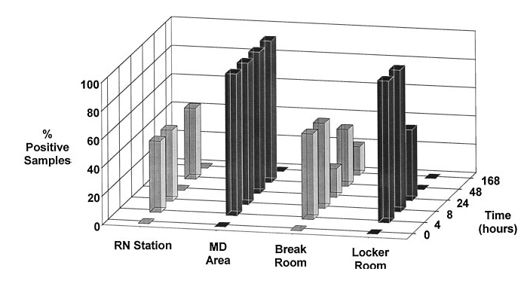
Transfer of a surrogate marker in a NICU

Slide 6
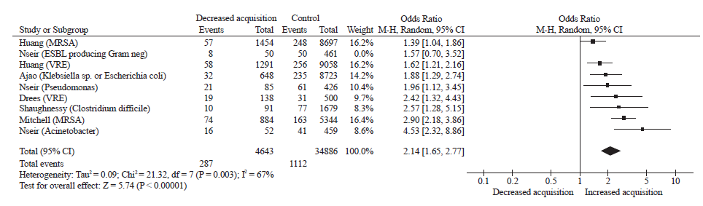
Your hospital room can make you sick!
Mitchell et al. J Hosp Infect 2015;91:211-217.

Slide 7
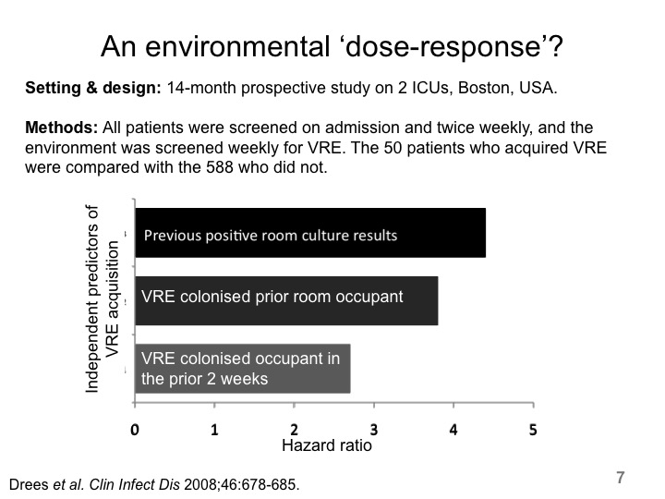

Slide 8
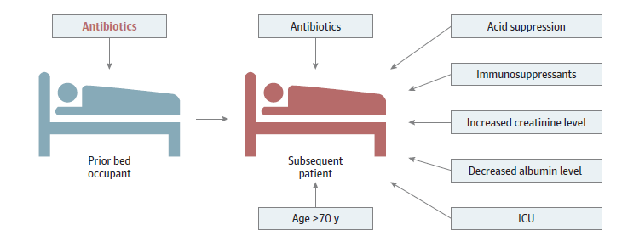
Chased by an antibiotic-induced C.difficile-shaped shadow!
Significant risk factors for CDI.
Freedberg et al. JAMA Intern Med 2016 in press.

Slide 9
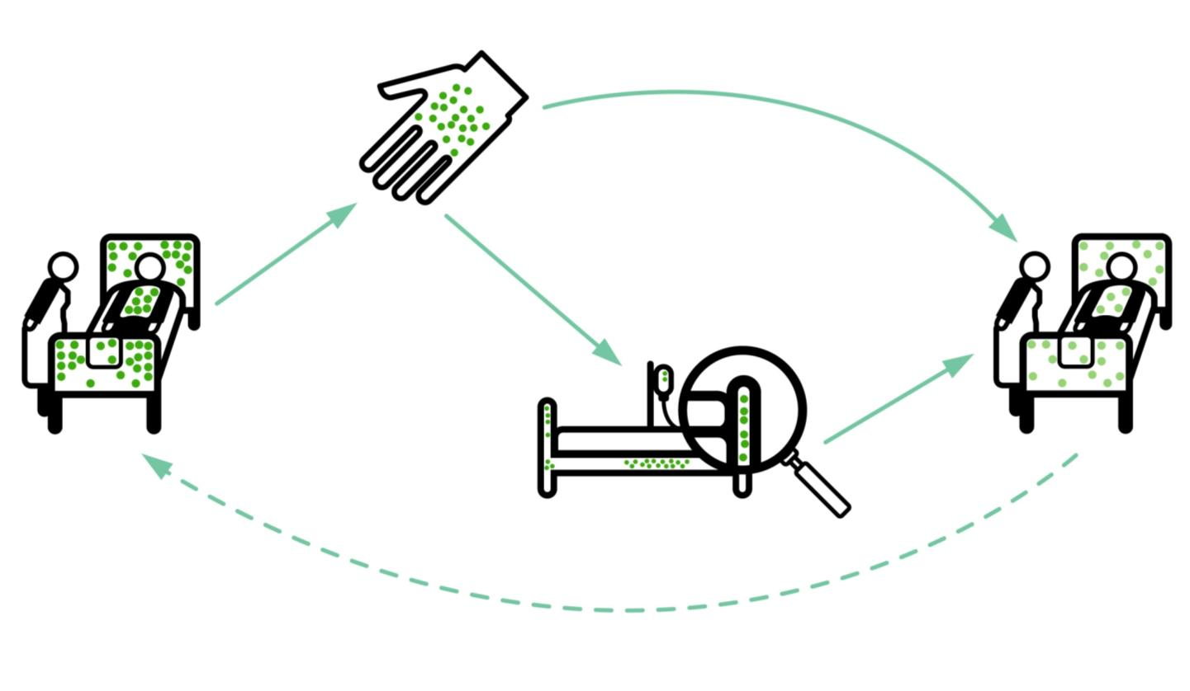
Transmission routes
Otter et al. Infect Control Hosp Epidemiol 2011;32:687-699.

Slide 10
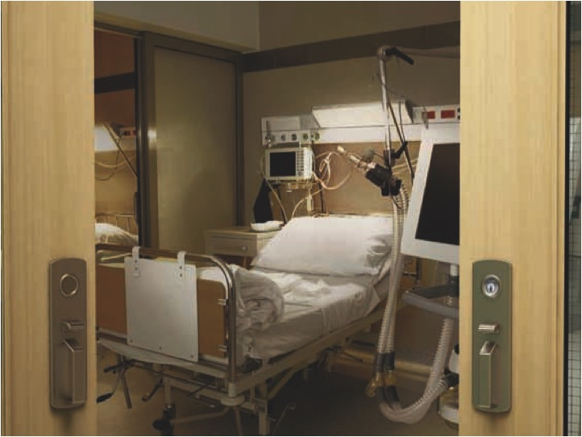
86%
58%
93%
85%
59%
French et al. J Hosp Infect 2004;57:31-37.
96%
Notes:
Survive for extended periods

Slide 11
Surface survival
Organism | Survival time
Clostridium difficile (spores) | 5 months
Acinetobacter spp. | 3 days to 5 months
Enterococcus spp. including VRE | 5 days – 4 years (!)¹
Pseudomonas aeruginosa | 6 hours – 16 months
Klebsiella spp. | 2 hours to > 30 months
Staphylococcus aureus, inc. MRSA | 7 days – 7 months
Norovirus (and feline calicivirus) | 8 hours to > 2 weeks²
SARS Coronavirus | 72 hours to >28 days³
Influenza | Hours to several days⁴
Adapted from Kramer et al. BMC Infect Dis 2006;6:130.
Wagenvoort et al. J Hosp Infect 2011;77:282-283.
Doultree et al. J Hosp Infect 1999;41:51-57.
Rabenau et al. Med Microbiol Immunol 2005;194:1-6.
Bean et al. J Infect Dis 1982;146:47-51.

Slide 12
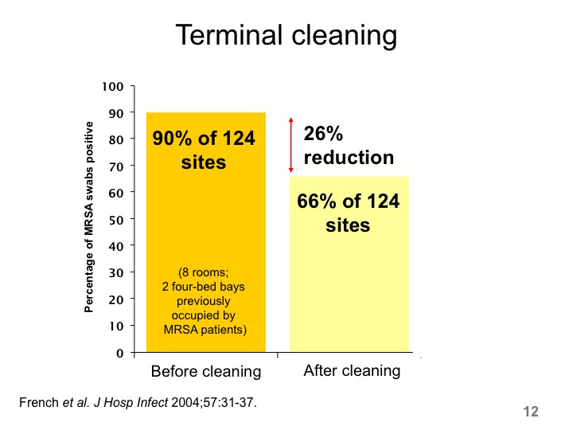

Slide 13
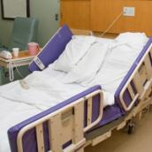
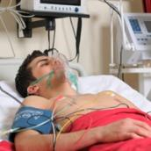
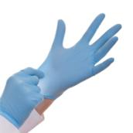
Surface -> Hand -> Patient
Pathogens can be transferred from surfaces to HCW hands without direct patient contact¹⁻²
52% of 23 HCW acquired VRE on their hands³ | Contact with patient or surface = ~10% risk of acquiring VRE³
45% of 50 HCW acquired MRSA on their hands⁴ | 40% of 50 HCW acquired MRSA on their hands⁴
50% of 30 HCW acquired C. difficile on their hands⁵ | 50% of 30 HCW acquired C. difficile on their hands⁵
Compliance with hand hygiene: 50%⁶ | Compliance with hand hygiene: 80%⁶
Boyce et al. Infect Control Hosp Epidemiol 1997;18:622-627.
Bhalla et al. Infect Cont Hosp Epidemiol 2004;25:164-167.
Hayden et al. Infect Control Hosp Epidemiol 2008;29:149-154.
Stiefel et al. Infect Control Hosp Epidemiol 2011;32:185-187.
Guerrero et al. Am J Infect Control 2012;40:556-558.
Randle et al. J Hosp Infect 2010;76:252-255.

Slide 14
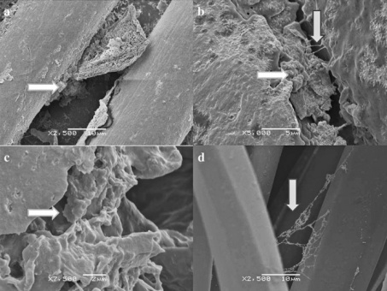
Rethinking the ‘inanimate’ environment
Scanning electron microscopy identified biofilm on 5/6 dry hospital surfaces from an Australian ICU (including MRSA on 3/5).¹
Followup study identified biofilm on 41/44 (93%) of surfaces in an ICU; MRSA from 18%, ESBL from 11% and VRE from 8% of the samples.²
Could explain why vegetative bacteria can survive on dry hospital surfaces for so long
Be part of the reason why they are so difficult to remove or inactivate using disinfectants
Explain (to some degree) the difficulty in recovering environmental pathogens by surface sampling
1. Vickery et al. J Hosp Infect 2012;80:52-55.
2. Hu et al. J Hosp Infect 2015;91:35-44.

Slide 15
“It’s airborne”
Detection of C. difficile in the air samples from the rooms of 50 patients.
Best et al. Clin Infect Dis 2010; 50: 1450-7.

Slide 16
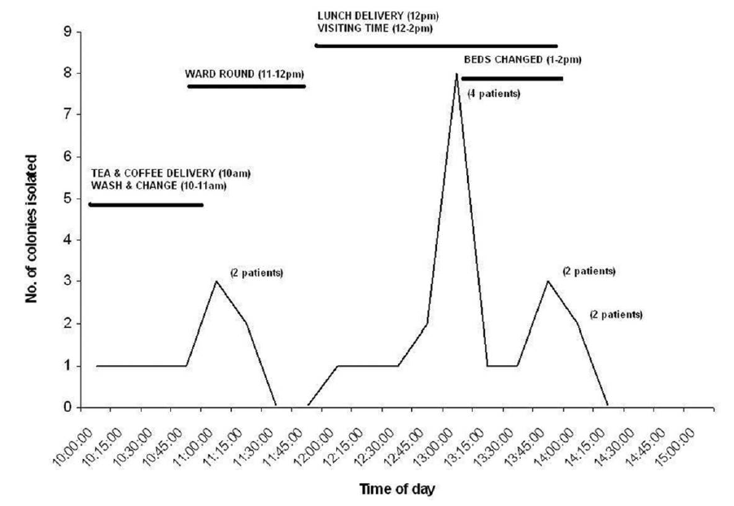
“It’s airborne”
Results of intensive air sampling surrounding 10 patients. C. difficile was detected in the air in 7/10 patients.

Slide 17
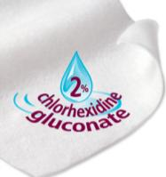
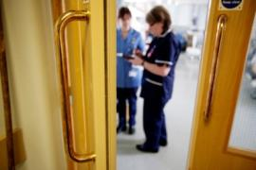


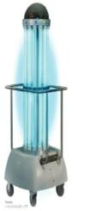
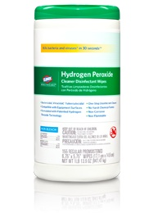
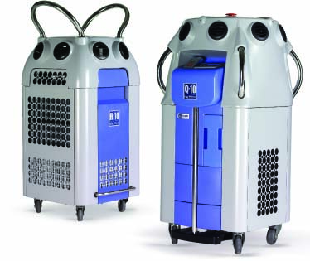
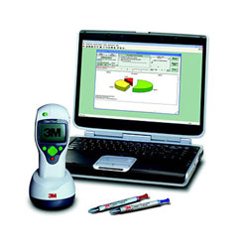
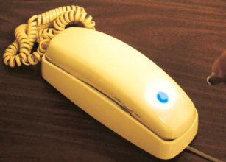
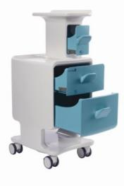
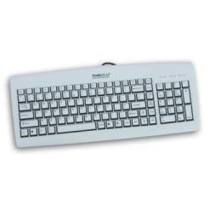
Improve existing procedures
Try something new!

Slide 18
Education & training
Improve existing procedures
Question | “Answer”
What to clean? | Focus of “high-touch” sites seems sensible
Who cleans what? | Checklists can help
What agent(s) to use? | Depends on the situation; sporicidal agent for C. difficile
What materials to use? | Microfibre may help Wipes have pros and cons “Bucket method” most effective
How to educate staff? | More than we currently do! Difficult task
Daily cleaning: how often? | Evidence for daily or twice daily
Terminal cleaning: optimal protocols? | More stringent protocol should be used for terminal disinfection

Slide 19
Improve existing procedures
Try something new!

Slide 20
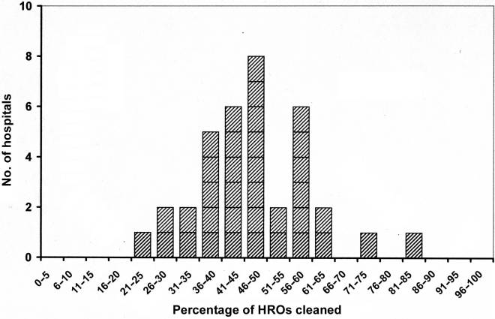
Why bother?
Improve existing procedures
Baseline cleaning rates of ‘high-risk objects’ in 36 acute US hospitals, as determined by removal of a fluorescent marker.
Carling et al. Infect Control Hosp Epidemiol 2008;29:1035-1041.

Slide 21
Method comparison
Improve existing procedures
 | Visual | Micro | ATP | Fluorescent
Ease of use | High | Low-Moderate | High | High
Quantitative | No | Yes/No | Yes | No
Correlation with microbial contamination | Poor | Accurate | Indirect | Indirect
Identifies pathogens | No | Yes/No | No | No
Risk of “gaming” by staff | Low | Low | Low | Moderate
Identifies ‘dirty’ surfaces* | Yes | No | Yes | No
Published evidence of attributable clinical impact | No | Yes | No | No
* Non-microbial soiling

Slide 22
Improve existing procedures
Try something new!

Slide 23
Contamination-sparing therapy?
n = 66 patients (rooms) and 264 surfaces for vancomycin / metronidazole, and 68 patients (rooms) and 272 surfaces for fidaxomycin. p<0.05 for both rooms and surfaces.
Biswas et al. J Hosp Infect 2015;90:267-270

Slide 24
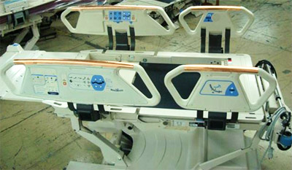
Antimicrobial surfaces (e.g. copper)
614 pts in 3 hospitals randomised to ‘copper’ or ‘non-copper’ ICU rooms
-44%
p=0.020
Bedrails
Overbed tables
IV poles
Visitor chair arms
Nurse call button*
Computer mouse*
Computer palm rest*
Rim of monitor*
(* = some rooms only)
-58%
p=0.013
Salgado et al. Infect Control Hosp Epidemiol 2013;34:479-486.

Slide 25
Candidate | Application | Pros | Cons
Metals
Copper | Manufactured in / liquid disinfectant | Rapidly microbicidal; large evidence-base; evidence of reduced acquisition. | Sporicidal activity equivocal; cost, acceptability and durability may be questionable.
Silver | Manufactured in / liquid disinfectant | Broadly microbicidal. | ? sporicidal; tolerance development; relies on leaching so surface loses efficacy over time.
Chemicals
Organosilane | Liquid disinfectant | Easy to apply. | Limited microbicidal activity; questionable “real-world” efficacy.
Light-activated (e.g. titanium dioxide or photosensitisers) | Manufactured in / liquid disinfectant | Broadly microbicidal; can be activated by natural light. | ? sporicidal; requires light source for photoactivation (some require UV light); may lose activity over time.
Physical alteration of surface properties
“Liquid glass” (silicon dioxide) | Liquid application | Reduces deposition; improves ‘cleanability’. | Not microbicidal; some evidence of reduced contamination; unknown required frequency of application.
Sharklet pattern | Manufactured-in | Reduces deposition; reduced. biofilms. | Not microbicidal; not feasible to retrofit.
Advanced polymer coatings (e.g. PEG) | Manufactured-in | Reduces deposition; some can be ‘doped’ with copper or silver. | Not microbicidal; may be expensive; scale up to large surfaces questionable; not feasible to retrofit.
Diamond-like carbon (DLC) films | Manufactured-in | Reduces deposition; can be ‘doped’ with copper or silver. | Not microbicidal; likely to be expensive; feasibility of scale up to large surfaces questionable; not feasible to retrofit.

Slide 26
Control contamination at the source
Pre-post study in a 16-bed ICU in Korea; CHG daily bathing implemented for 12 months after 14-month pre-intervention period. Significant reduction in rate of carbapenem-resistant Acinetobacter baumannii acquisition and environmental contamination.
Chung et al. Am J Infect Control 2015;43:1171-1177.

Slide 27
Improve existing procedures
Try something new!

Slide 28
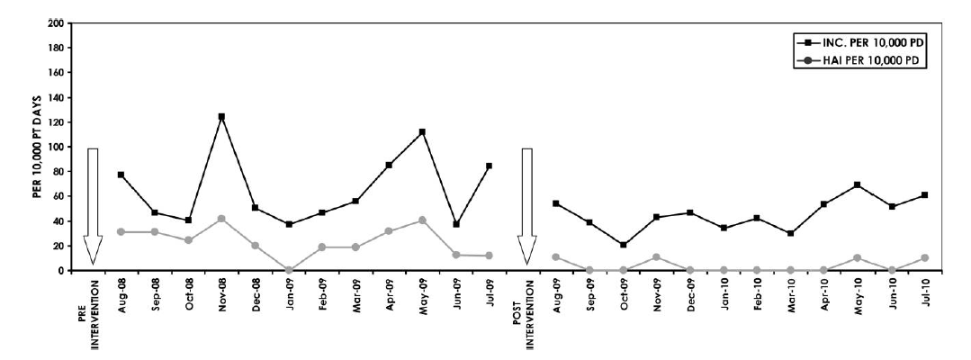
Wiping away infection
Impact of changing from QAC to bleach wipes for daily disinfection of all rooms. Cleaning thoroughness was 97-98% throughout the study using ATP benchmarking (<250 RLUs).
2.4
cases / 1000 patient days
0.4
cases / 1000 patient days
Orenstein et al. Infect Control Hosp Epidemiol 2011;34:521-523.

Slide 29
Cleaning / disinfection failure
External
Product
Procedure
29

Slide 30
‘Given the choice of improving technology or improving human behavior, technology is the better choice’.
Dr Bob Weinstein
30
Weinstein RA. Emerg Infect Dis 1998;4:416-420.

Slide 31

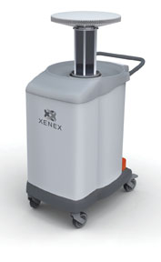
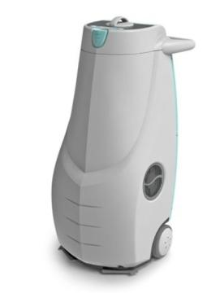
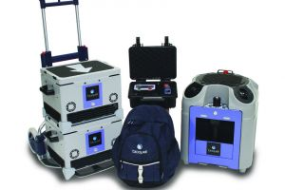
Automated room decontamination (ARD)
Hydrogen peroxide vapour
30% H₂O₂ (HPV)
Aerosolised hydrogen peroxide 5-6% H₂O₂ (AHP)
Ultraviolet radiation (UVC)
Pulsed-xenon UV (PX-UV)
Otter et al. J Hosp Infect 2013;83:1-13.
31

Slide 32
ARD systems - overview
 | HPV 30-35% H₂O₂ vapour | AHP 5-6% H₂O₂ + Ag aerosol | UVC UVC (280 nm) | PX-UV Pulsed-xenon UV
Efficacy | 1 >6-log reduction | 2 ~4-log reduction | 3 ~2-4 log reduction | 4 ~1-3 log reduction
Distribution | 1 Homogeneous | 2 Non-homogenous | 3 Line of sight issues | 3 Line of sight issues
Ease of use | 4 Multiple units; sealing / monitoring | 3 Sealing & monitoring | 2 Multiple positions; no sealing / monitoring | 2 Multiple positions; no sealing / monitoring
Cycle time | 3 ~1.5 hrs single room | 4 >2 hrs single room | 1 ~10-30 mins | 1 ~10-30 mins
Purchase cost | 2 | 1 | 3 | 3
Running cost | 4 | 3 | 1 | 1
Otter et al. J Hosp Infect 2013;83:1-13.

Slide 33
Persistent contamination – sorted!
140 samples from 9 rooms after 2xbleach
5705 samples from 312 rooms after 4xbleach
2680 sites from 134 rooms after HPV
HPV
Manian et al. Infect Control Hosp Epidemiol 2011;32:667-672.
33

Slide 34
HPV: clinical impact
30-month prospective cohort intervention study performed on 6 high-risk units (5 ICUs) including 8813 patients at Johns Hopkins Hospital.
64% reduction in the rate of MDRO acquisition
Standard cleaning / disinfection
HPV decontamination
Passaretti et al. Clin Infect Dis 2013;56:27-35.

Slide 35
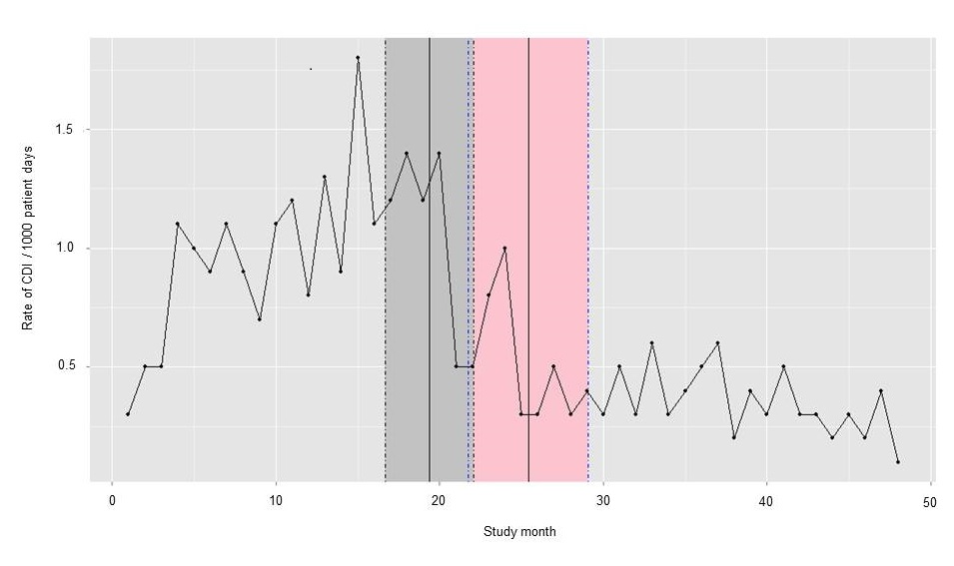
HPV: clinical impact
2 years before HPV, 2 years during HPV. Breakpoint model indicated significant reduction in rate of CDI when HPV implemented (1.0 to 0.4 per 1000 patient days, 60% reduction).
McCord et al. J Hosp Infect 2016.

Slide 36
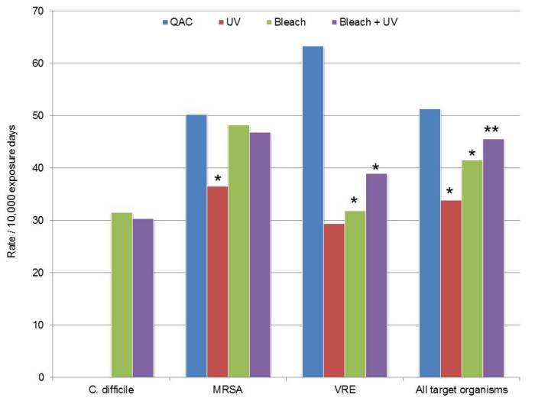
UVC: clinical impact
Cluster randomised study over >2 years across 9 hospitals including >25,000 exposed patients (admitted into a room where the previous occupant was known to have an MDRO). * = statistically significant reduction in the per-protocol analysis. ** = statistically significant when rooms occupied by patients with C. difficile removed from the analysis.
Anderson et al. Lancet in press.

Slide 37
UVC vs. HPV
Characteristics | HPV | UV systems
Cycle time (for single room) | 90 mins | 15 mins to >1hr
Practicalities | Door and air vent sealing and leak detection required | No door and air vent sealing or leak detection required
Distribution | Homogeneous | Affected by line of sight
Microbiological efficacy | Elimination of pathogens from surfaces; 6-log sporicidal reduction | Does not eliminate pathogens from surfaces; 1-3 log sporicidal reduction
Evidence of clinical impact | Published evidence | Emerging evidence
Cost | Lower purchase cost; higher running costs | Higher purchase cost; lower running costs
Otter et al. J Hosp Infect 2013;83:1-13.

Slide 38
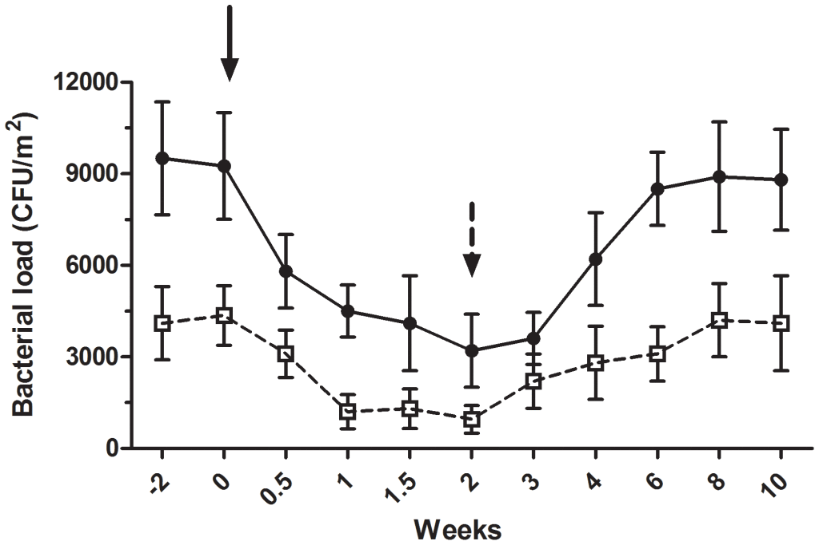
Spread contamination to stop contamination?
Bacterial load of coliforms (black circles) and S. aureus (white circles). Black arrow = beginning of the “live” cleaning agent; black dotted arrow = conventional cleaning agent.
Vandini et al. PLoS One 2014;26;9(9):e108598.
More here if you’re interested.

Slide 39
Improve existing procedures
Try something new!

Slide 40
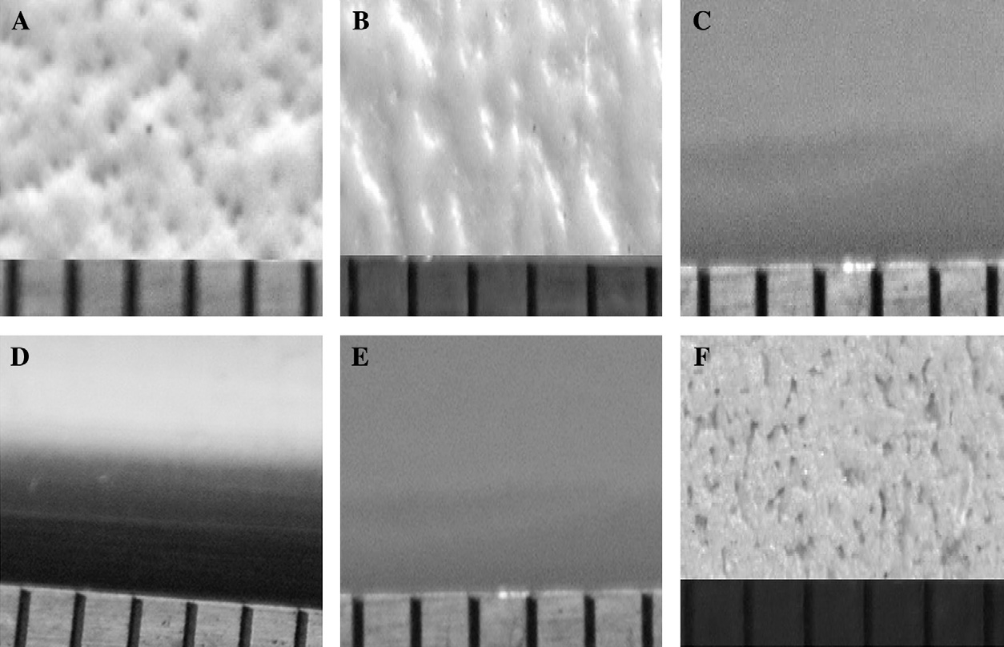
Try something new!
Microbe unfriendly design
The surface finish of 6 hospital bedrails; ease of cleaning was inversely proportional to the transfer of S. aureus from the surfaces
Ali et al. J Hosp Infect 2012;80:192-198.

Slide 41
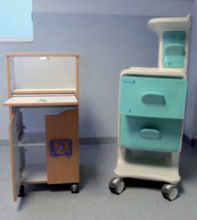
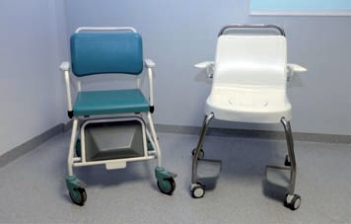
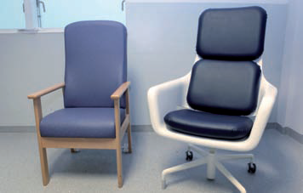
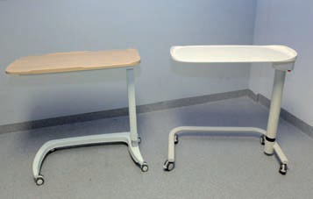
Try something new!
“Design bugs out!”
Design Bugs Out – Product Evaluation Report. The Healthcare Associated Infection Technology Innovation Programme. UK Department of Health. 2011.

Slide 42
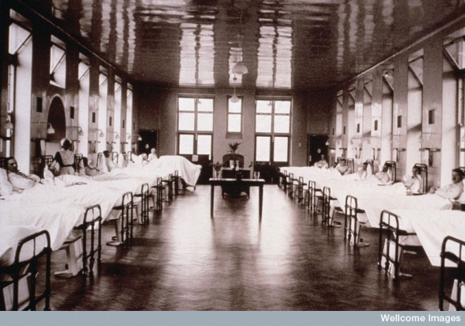
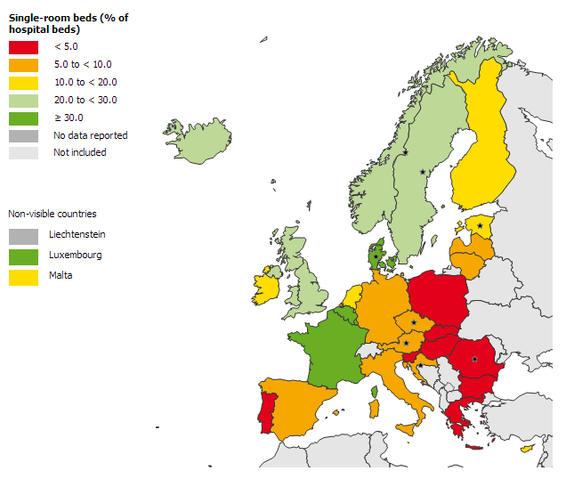
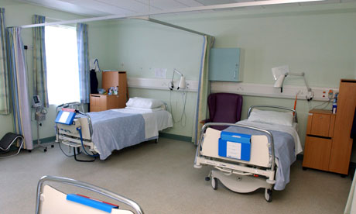
Try something new!
Single room shortage
ECDC Point Prevalence Survey of healthcare-associated infections and antimicrobial use in acute care hospitals (HAI-Net PPS) in the period 2011-2012 as reported to TESSy as of 2013-02-06 14:06:48

Slide 43
Try something new!
Single rooms vs. bays
Single Rooms | Bays
Reduced HCAI¹⁻⁶ Better hand hygiene compliance Improved air containment | Reduced risk of adverse events¹¹⁻¹² Fall risk, tracheostomy, confused Better observation by staff
Some patients more satisfied⁵⁻⁹ Improved privacy Less disturbance from others | Patients report:¹¹⁻¹⁴ Reduced feelings of isolation More social and HCW contact
Fewer “mix up” errors¹⁰⁻¹¹ through uninterrupted patient contact | Reduced staffing levels and patient: HCW ratios^{14,15}
Teltsch et al. Arch Intern Med 2011; 171: 32-38.
van de Glind et al. Health Policy 2007;84:153-161.
Borg MA. J Hosp Infect 2003;54:316–318.
Haill et al. J Hosp Infect 2012;82:30-35.
King et al. Building and Environment 2013;59:436-447.
Moore et al. J Hosp Infect 2010;76:103-107.
Jolley S. Nursing Standard 2005;20:41–48.
Barlas et al. Ann Emerg Med 2001;38:135–139.
Lawson & Phiri. Health Serv J 2000;110:24–26.
Ulrich et al. White Paper #5. The Center for Health Design. 2008.
Maben J. Nurs Manag 2009;16:18-19.
Stelfox et al. JAMA 2003;290:1899–1905.
Tarzi et al. J Hosp Infect 2001;49:250-254.
Young & Yarandipour. Health Estate 2007;61:85-86.
Mooney H. Nursing Times 2008;104:14-16.

Slide 44
‘Privatization’ of an ICU
Try something new!
*
*
Intervention
24 bed ICU
2x10 bed and 4xsingle rooms
Converted to 100% single rooms in 2002
Comparison
25 bed ICU
2, 5, 6 or 8 bed rooms
No change in unit configuration
Change in the acquisition rate ratio before and after privatisation; * = not statistically significant.
Teltsch et al. Arch Intern Med 2011;171:32-38.

Slide 45
Improve existing procedures
Try something new!

Slide 46
The role of dry surface contamination in healthcare infection transmission
Jon Otter, PhD FRCPath
Imperial College London
j.otter@imperial.ac.uk
@jonotter
Blog: www.ReflectionsIPC.com
You can download these slides from www.jonotter.net

Slide 47

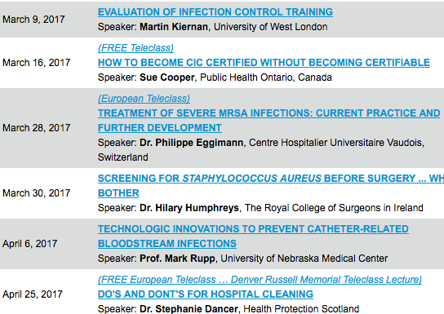

Slide 48


