Slide 1
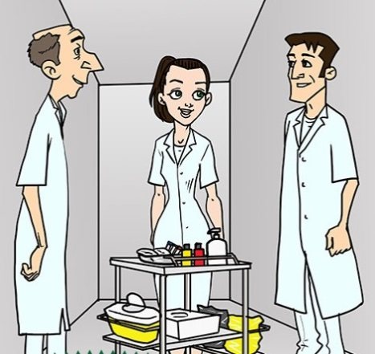

Root cause analysis to support IC teams daily work
Flu.0©
Dr Anne-Gaëlle Venier, MD, PhD
Cpias Nouvelle-Aquitaine
Bordeaux, France
@AgVenier
anne-gaelle,venier@chu-bordeaux,fr
Hosted by Jim Gauthier
Senior Clinical Advisor Infection Control
Diversey
www.webbertraining.com
February 22, 2018

Slide 2
WHO RCA definition
Systematic analysis of all the factors which (…) have the potential to prevent an error
Can be applied to incidents or to ‘near misses’
Explains how the incident occurred
Designs mechanisms to prevent the incident from happening again

Slide 3
http://www.chfg.org/wp-content/uploads/2012/03/Vincent-Essentials-of-Patient-Safety-2012.pdf

Slide 4
Root cause analysis
http://www.ncbi.nlm.nih.gov/pmc/articles/PMC1117773/pdf/777.pdf

Slide 5

RCA basics
What has arrived?
Time line /
Chronology
How it has arrived?
Gaps /
Immediate
causes
Why it has arrived ?
Root - latent
causes

Slide 6
RCA basics
What has arrived?
Time line /
Chronology
Prevention phase
(before the event)
How it has arrived?
Gaps /
Immediate
causes
Attenuation phase
(after the event)
Why it has arrived ?
Root - latent
causes

Slide 7
Root Cause Analysis
Patient factors
Clinical condition
Physical factors
Social factors
Psychological/ mental factors
Interpersonal relationships
Task factors
Guidelines/
procedures/
protocols
Decision aids
Task design
Working condition factors
Administrative
Design of physical environment
Environment
Staffing
Workload and hours time
Team factors
Role congruence
Leadership
Support + cultural factors
Organisational + strategic factors
Organisational structure
Priorities
Externally imported risks
Safety culture
http://www.nrls.npsa.nhs.uk/resources/collections/root-cause-analysis/

Slide 8
RCA and IC teams daily work
Many tools and methods are available
  Fishbone diagram
  Five why’s
  Causal tree analysis
  Affinity diagram
Documentation is easy to find
  NHS root cause analysis tools
  France HAS RCA guide

Slide 9
Root Cause Analysis - end 2017: several good experiences!
Corwin GS et al. Root cause analysis of ICU adverse events in the veterans health administration. Jt Comm J Qual patient Saf 2017; 43(11): 580-590
  84% of the implemented actions had a better reported effectiveness
Boussat B et al. Involvement in root cause Analysis and patient safety culture among hospital care providers, J patient Saf 2017, doi:10,1097/PTS.0000000000000456
  Participation in routine RCA activities was associated with higher patient safety culture scores
Abdi Z, Ravaghi H. Implementing RCA in Iranian hospitals: challenges and benefits. Int J Health Plann manage 2017; 32(2): 147-62
  RCA improved patient care, fostered teamwork and communication among staff, safety culture
Tchangai B et al. Incidence, root cause, and outcomes of unintentionally retained intraabdominal surgical sponges: a retrospective case series from two hospitals in Togo. Patient Saf Surg. 2017; 26: 11:25.

Slide 10
Focus
Percarpio KB, Watts BV. A cross sectional study on the relationship between the utilization of RCA and patient safety at 139 Department of Veterans Affairs medical centers, USA Jt Comm J Qual Patient Saf. 2013;39:32-7
  Analysis on RCA utilization from 2004 through to 2006
  Average utilization rate 4.86 RCA per year (3-59)
  Postoperative sepsis was significantly different across RCA utilization
  Higher rates of postoperative complications when < 4 RCA/ year

Slide 11
Focus
Peterson TH, Teman SF, Connors RH. A safety culture transformation: its effects at a children’s hospital. USA. J Patient Saf. 2012;8:125-30.
  Implementation of a 2-year initiative to improve patient safety
    Safety-based staff training
    Training in root cause analysis
    Other trainings and multidisciplinary collaboration
    Transparency of safety events
  Results
    Hand hygiene compliance 56% 95%
    Ventilator associated pneumonia bundle adherence 2% 96%
    Major decrease of ventilator associated pneumonias

Slide 12
Root Cause Analysis : mitigated experiences!
Hibbert P et al. Are root cause analyses recommendations effective and sustainable? An observational study. Int J Qual Health Care 2018; 1-8
  227 RCAS reviewed
  Few strong recommendations
Kellogg K et al. Our current approach to root cause analysis: is it contributing to our failure to improve patient safety? BMJ Qual Saf 2017; 26: 381-387
  302 RCA reviewed
  106 with solutions and actions
  Most common actions : training (20%), process change (20%), policy reinforcement (15%)
  But repeated events despite multiple RCA
  Most common action = weaker actions
Peerally MF et al. The problem with root cause analysis. BMJ Qual Saf 2016, 0 : 1-6
  Lessons not learned
  Poor feedback
  Confusion about blame

Slide 13

Field experience in South West France
Cpias Nouvelle-Aquitaine = HAI control centre
  Aimed to prevent HAI
  Gives technical expertise and trainings
  Creates tools to improve patient safety
  Receives rare or severe HAI notifications from facilities
    Helps for investigations
    Promotes root cause analysis
    Promotes sharing of experiences
Teaching videos https://www.cpias-nouvelle-aquitaine.fr/outils_videos/
Serious games https://www.cpias-nouvelle-aquitaine.fr/serious_games/
Web https://www.cpias-nouvelle-aquitaine.fr/ Twitter @CpiasNA

Slide 14

RCA process
Define the incident or near-miss to investigate
Select a multidisciplinary team (yes but not necessary)
Gather information (interviews, documents, observations)
Establish the timeline of the event
Identify problems
Identify contributory factors and root causes (with the staff)
Identify solutions (with the staff)
Prioritize and implement solutions (with the staff)
Write a report (with planned action and give it to the staff)
Flu.0©

Slide 15
Field experience example #1
ESBL K. pneumoniae bacteraemia on implanted port
  68 year old woman, lumbar spinal stenosis surgery, surgical site infection leading to 3 revision surgeries + antibiotics for months.
  Admission to a rehabilitation centre with an implanted port for antibiotics administration.
  During hospitalization, frequent obstructions of the port. Patient transferred twice to the hospital to clear the obstruction.
  Three weeks after admission, a bacteraemia occurred. The patient was transferred to the hospital, the implanted port was removed, central venous catheter was used, antibiotics were adapted to the micro-organism and the patient recovered.

Slide 16
ESBL K. pneumoniae bacteraemia on implanted port
Facts | Problems | Causes | Solutions
Admission to a rehabilitation centre of a patient with an implanted port for antibiotics administration. | Nurses discovered the device at admission. | No transmission from the hospital. | Better communication between the hospital and the rehabilitation centre concerning devices to anticipate the patients arrival.
 | No correct needles for this type of device in the rehabilitation centre. | Patients with central catheter and implanted port were rare in this centre so few needles were available and other types had to be ordered.

Slide 17
ESBL K. pneumoniae bacteraemia on implanted port
Facts | Problems | Causes | Solutions
During hospitalization, frequent obstructions of the port. | Most nurses did not know how to use and maintain such ports. No pulsed-flushing technique. | No existing protocol. Most nurses were not trained on such devices. The few nurses who knew the port did not share their experience because of bad communication in the ward. | Theoretical and practical training + protocol. Enhance communication and experience sharing in the ward.
Patient transferred twice to the hospital to clear the obstruction. | Hospital and rehabilitation centre did not realize the abnormality of so many obstructions. | HCWs in rehab. centre not aware of normality. No incidents analysis culture in the hospital. | HCWs training. Collaborative work between the 2 facilities.

Slide 18
ESBL K. pneumoniae bacteraemia on implanted port
Prioritized solutions
  Theoretical and practical training for health care workers of the rehabilitation centre
  Better communication between the hospital and the rehabilitation centres concerning devices to anticipate the patients arrival

Slide 19
Field experience example #2
Surgical site infections following bariatric surgery
  In a two-month period, 4 surgical site infections following bariatric surgery (mostly by-pass surgery) occurred. The IC team investigations showed universal precautions needed to be optimized.
  The IC team gave recommendations regarding hand hygiene and skin preparation.
  During the next 4 months, 7 new surgical site infections occurred. Surgical site infection rate was 8.7% in this six-month period whereas usual surgical infection rate in this ward was only 3.1%. Various micro-organisms were involved (cutaneous and digestive flora).
  The IC team decided to perform RCA.

Slide 20
Surgical site infections following bariatric surgery
 | Problems | Causes | Solutions
Patients | Patients usually with poor cutaneous state. | Patients with comorbidities.
 | Difficulties to shower alone before surgery. | Mechanical difficulties due to obesity. | Help patients to shower.
 | Patients did not ask for help to shower before surgery. | Psychological difficulties accepting someone looking at them. | Patients education to make them aware that showering before surgery is necessary.

Slide 21
Surgical site infections following bariatric surgery
 | Problems | Causes | Solutions
Health care workers | Did not check the cutaneous state of patients neither that they correctly shower before surgery. | No protocol for such checking. | To integrate in the check-list the cutaneous state and the realization of the shower.
 | Did not offer to help patients to shower. | Psychological difficulties to ask patients about showering and to offer help. | Awareness to make them be confident that showering before surgery is a care which needs to be checked.
 |  | No training or protocol to help patients shower. | HCWs training + protocol.
 | Wearing rings and wrist watches in the ward. | Underestimation of the risk. | Forbid rings and wrist watches.

Slide 22
Surgical site infections following bariatric surgery
 | Problems | Causes | Solutions
Tasks | Boxes of surgery devices were opened a long time before surgery. | Increase in the activity. Small time between interventions. | Stop early box opening by respecting time between interventions and adapting the program activity.
 | Complex postoperative dressings. | Ward habits. | Discussion on medical prescriptions.
 | Increased nursing workload because of many patients with a Picc-line. | Picc-line were used instead of peripheral venous access in obese patients because physicians thought it was easier to use. | Only use Picc-line when justified.

Slide 23
Surgical site infections following bariatric surgery
 | Problems | Causes | Solutions
Context and organization | Increased nursing workload because of reduction in paramedical workers. | Institutional strategy.
 | Nurses were regularly interrupted when performing cares and dressings. | Nurses had to frequently answer the telephone. | To be more organized to stop answering the phone when performing a care.

Slide 24
Surgical site infections following bariatric surgery
Prioritized solutions
  To help the patient to shower before surgery
    Protocol
    Patients and healthcare workers education
    Cpias NA Video for patients and healthcare workers French or English
    https://www.youtube.com/watch?v=7XD0I_OCHFY
  To be more organized to limit cares’ interruption
  To restrict the indication of PICC lines
  Return to SSI baseline rate

Slide 25
Field experience
RCA helped IC teams to be more efficient and recognized
    IC teams found feasible and efficient solutions
    IC teams had the leadership so as to choose between actions
    IC teams used RCA for their own errors and near-misses

Slide 26
RCA to support IC teams daily work
An IC team correctly using a RCA process for a HAI
  implements more adequate prevention measures
  improves clinical practices
  improves collaborative working and teamwork
  reduces the risk of HAI… and more!

Slide 27

Conclusion
RCA should be integrated in IC teams daily work
  It is a useful tool for HAI investigation and prevention
  It is a useful tool to improve IC teams practices
RCA brings value to IC teams work
RCA, yes we can!
Flu.0©

Slide 28
Free tool in English : RCA for SSI
Surgery site infections are complex…tools are needed!
A new free tool to perform RCA
  Excel
  In English or French
  https://www.cpias-nouvelle-aquitaine.fr/gdr/analyse-approfondie-causes-aac/

Slide 29
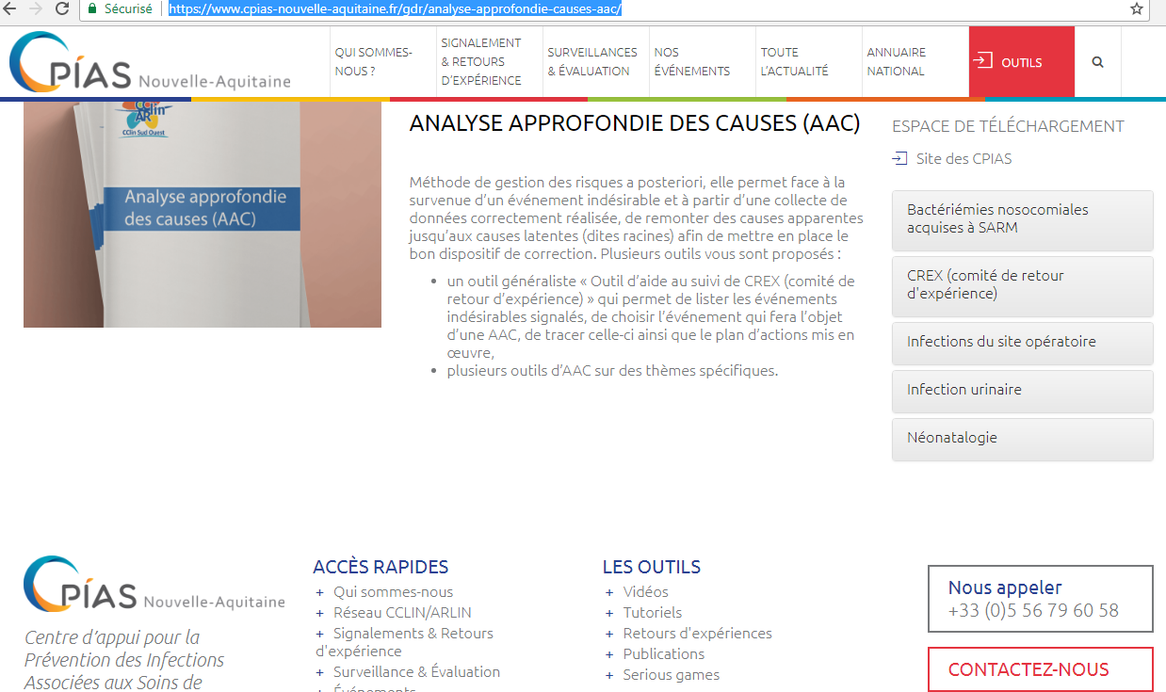

Slide 30
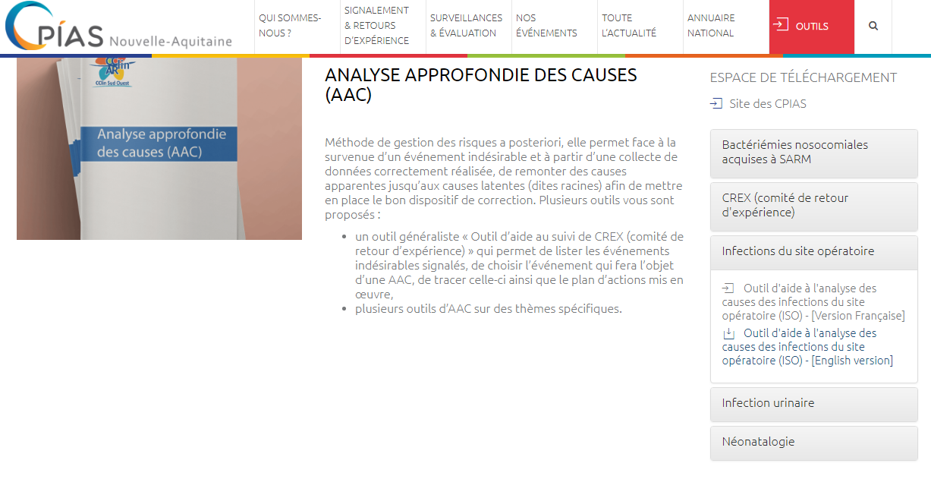

Slide 31
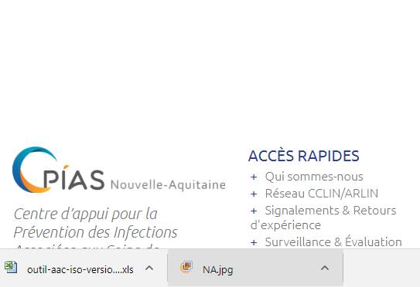

Slide 32
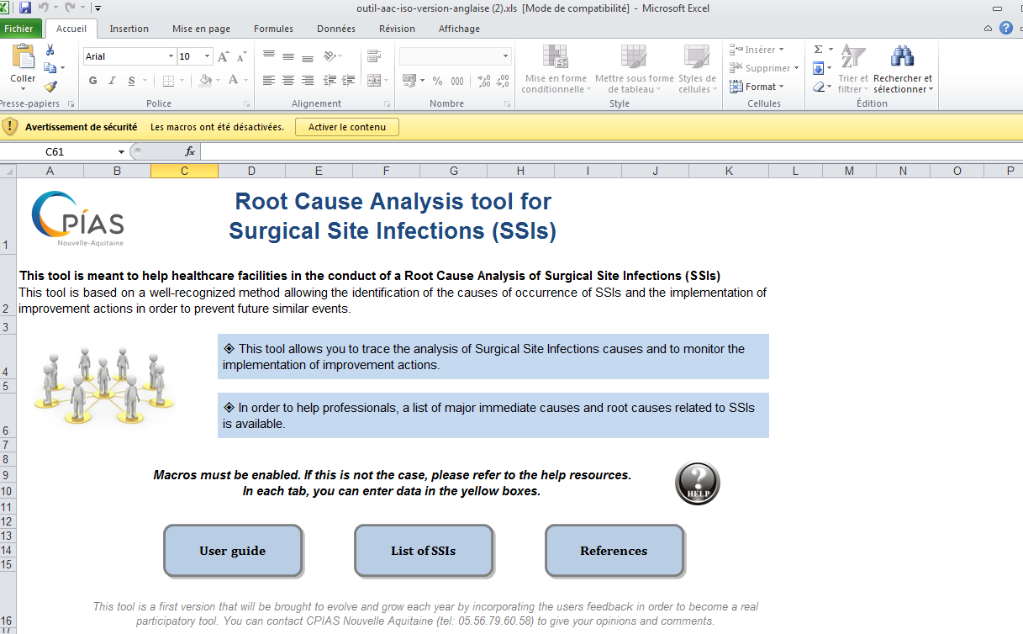

Slide 33
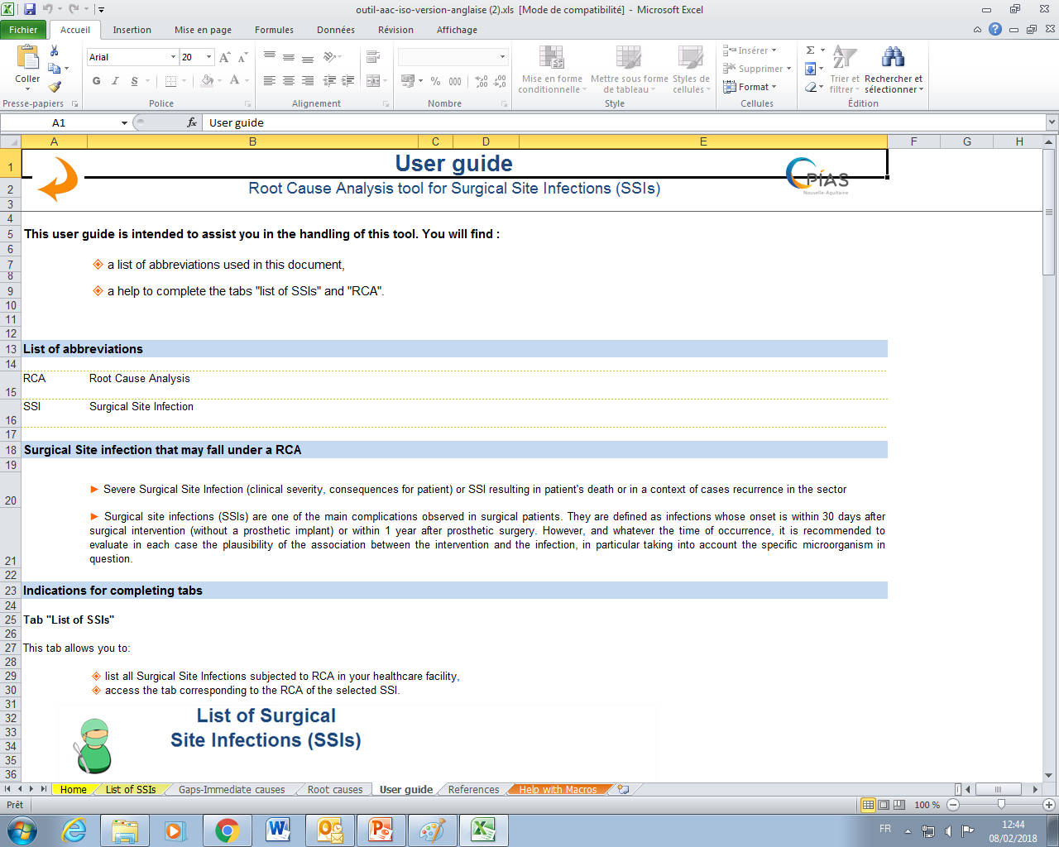

Slide 35
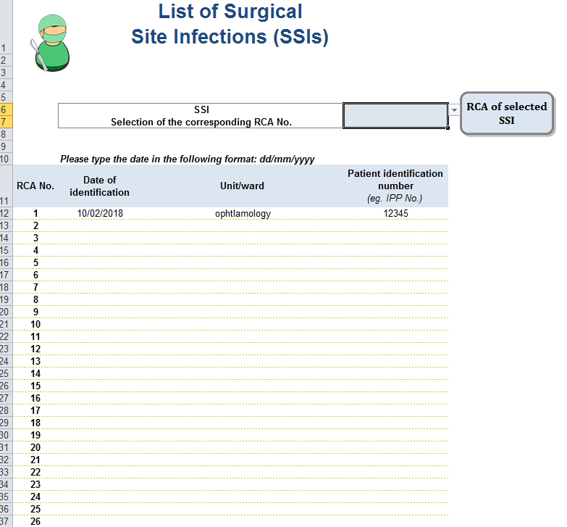

Slide 36
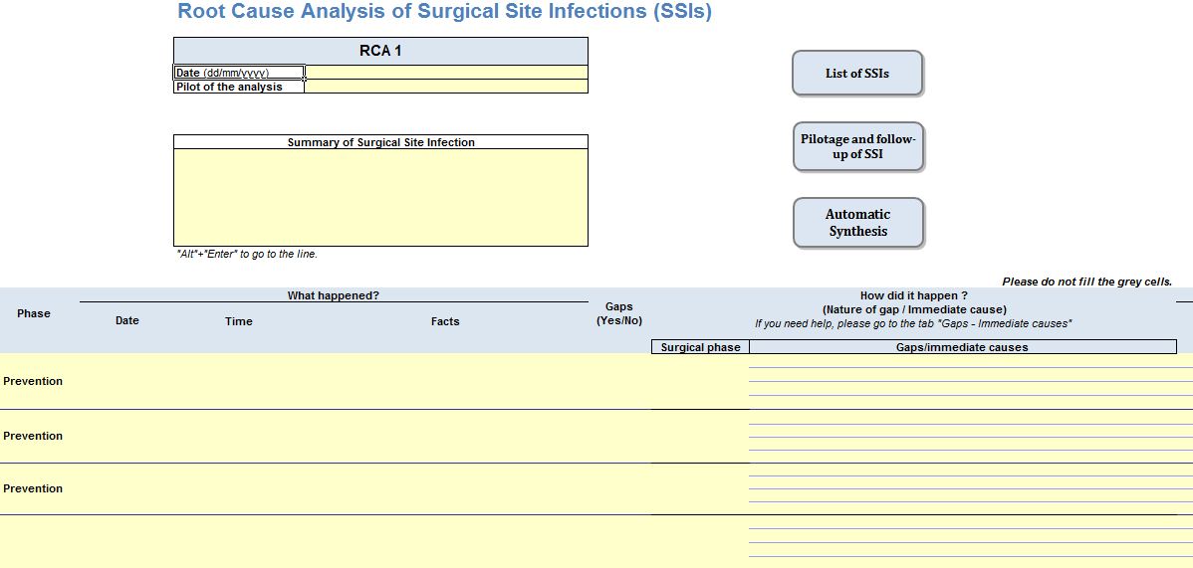

Slide 37
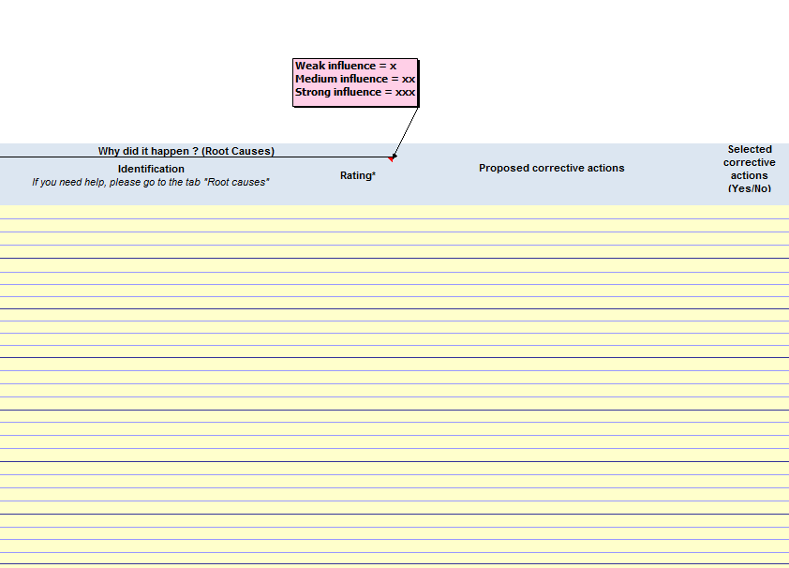

Slide 38
Help to search immediate causes and root causes

Slide 39
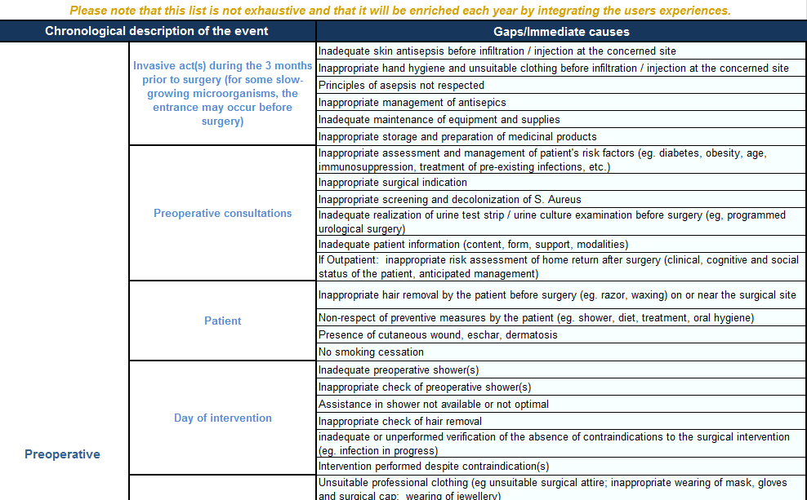
+ perioperative + postoperative causes

Slide 40
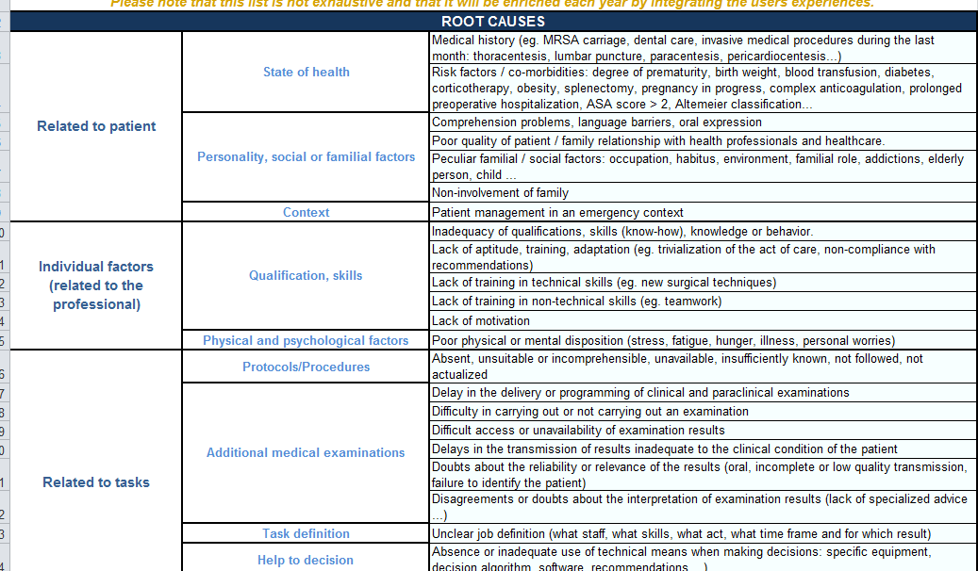
… more root causes in the excel tool

Slide 41
RCA for SSI: don’t hesitate to use it!
BEFORE you perform the RCA with the staff, please:
  Read the literature and look at youtube video about the type of surgery + antibioprophylaxy, search if there are new recommendations about this surgery + antibioprophylaxy
  Prepare the file with the most complete story and the immediate causes you think that happened
  Read the sheets “immediate causes” and “root causes” in order to not be compelled to look at them systematically during the analysis

Slide 42
RCA for SSI: don’t hesitate to use it!
When you perform the RCA with the staff, please:
  Enhance dialogues with goodwill
  Try to finish in one hour maximum
  Keep the discussion focussed on the event
  Ask the staff to choose one or two actions they assume to do and guide them to choose actions that will really avoid a new event

Slide 43
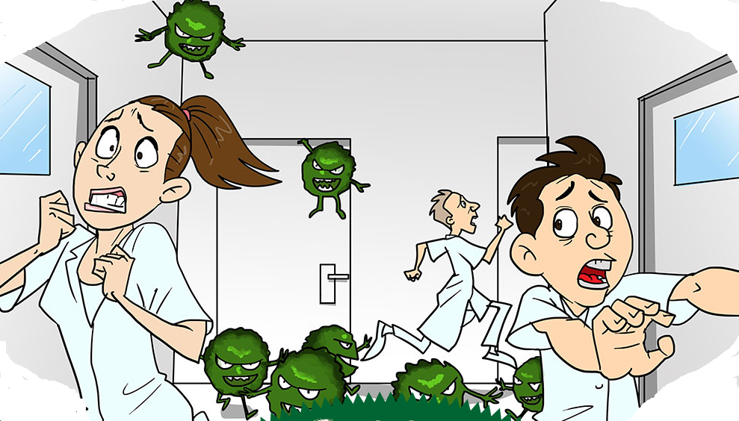
Thank you for your attention
Learn from yesterday, live for today, hope for tomorrow.
The important thing is not to stop questioning.
Albert Einstein
I think we should perform a RCA!
Yes!
Serious game Flu.0©

Slide 44

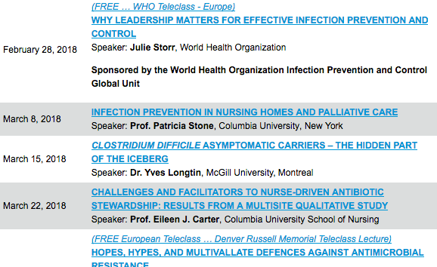

Slide 45


