Slide 1


Screening for vancomycin-resistant enterococci (VRE)
Why bother?
Hilary Humphreys
Department of Clinical Microbiology, Royal College of Surgeons in Ireland (RCSI) & Beaumont Hospital, Dublin, Ireland
Hosted by Suzanne Rhodenizer-Rose
Nova Scotia Health Authority
www.webbertraining.com
June 9, 2016

Slide 2
Declarations
The views expressed are in a professional but personal context & are not necessarily those of the RCSI & Beaumont Hospital, Dublin.
I have recently received research funding from Pfizer & Astellas. I have also provided professional advice & or education for Novartis, AstraZeneca & Cepheid

Slide 3
Outline
Clinical impact of VRE
Different surveillance approaches
Laboratory detection
Conclusions

Slide 4
Clinical Impact of VRE

Slide 5
Enterococci
Part of the normal bowel flora
Cause urinary, bloodstream & abdominal infections
Probably not as virulent as Staphylococcus aureus & most Enterobacteriaceae such as Escherichia coli
Enterococcus faecalis & Enterococcus faecium, the two most important species
E. faecium (EFm) more associated with vancomycin-resistance

Slide 6
Vancomycin-Resistance
Originally described in 1980s in renal patients
Different genetic determinants of which vanA & vanB the most common
Bloodstream infection (BSI) monitored as part of EARS-Net (European surveillance)
Alternatives available to treat infections in last 10-15 years such as linezolid & daptomycin

Slide 7
Impact - Overview
Enterococci are the 2nd most common cause of HCAIs in the USA after S. aureus & 89% of EFm associated with central-line-associated BSI are VRE
Infect Control Hosp Epidemiol, 2013
B. VRE are bacteria of serious concern which require prompt & substantial action
CDC, 2013

Slide 8
Hospital-Onset BSI
Retrospective study over 5 years in Detroit, USA
Pitt bacteraemic score to quantify severity of illness
Time to appropriate treatment calculated from when cultures taken & 1st dose of appropriate treatment
Results
190 patients
62.6% VRE
linezolid (32%), daptomycin (31%) & ampicillin (26%)
Clin Infect Dis, 2016

Slide 9
Hospital-Onset BSI
30-day mortality was 14.6% if initial appropriate therapy compared to 45.3% if > 48h delay
Longer duration of BSI if delayed & vancomycin-resistant phenotype associated with delayed appropriate treatment
Clin Infect Dis 2016

Slide 10
VRE versus VSE BSI
Systemic review & meta-analysis of outcomes
Infect Control Hosp Epidemiol 2016; 37: 26-35

Slide 11
VRE versus VSE BSI
Infect Control Hosp Epidemiol 2016; 37: 26-35

Slide 12
VRE & Renal Dialysis Patients
Meta-analysis from 1982-2014 of prevalence, risk factors & significance
23 studies from 100 dialysis centres involving 4,842 patients
Prevalence, 6.2% (5.2% North America)
Risk of infection increases x 21.6 if VRE +ve
Heterogeneity may reflect differences in infection prevention & control practices & use of antibiotics
Am J Kidney Dis 2015; 65: 88-97

Slide 13
Different Surveillance
Approaches

Slide 14
Surveillance for VRE
Passive
Only check isolates causing infection to guide therapy
Occasional prevalence surveys of enterococcal isolates
Active
Selective, e.g. admission & weekly in ICU
Universal, all patients in certain clinical units on admission, weekly & on discharge

Slide 15
Risk Factors
Intrinsic | Comment
Immunosuppression | Haematology/Oncology, SOT
Renal dialysis | Healthcare contact
Antibiotics | 3GC, FQ, vanc, B-L/B-L inhibitors
Underlying diseases | Healthcare contact
Extrinsic | Comment
ICU | Most studies
LTCF | ? Underlying disease or lack of prevention
Single room | Inadequate cleaning
Prior hospitalisation | Studies in tertiary centres
J Hosp Infect 2014; 88: 191-198

Slide 16
Studies on Screening
Mixed & sub-optimal in large part due to
  Differences in centres
  Sampling & laboratory methodology
  Patient populations
  Design, retrospective, prospective, case-controlled
  Some are mathematical modelling
  Despite this, there is at least a suggestion that active screening reduces prevalence due to possible increased awareness, indirect measures +/- direct preventative measures

Slide 17
Examples of Screening/Interventions
Setting / Design | Screening | Outcome | Comments
Japan, observational | All hospital admissions | Initial ↑ prevalence but then fell | Improved hand hygiene
US, retrospective | BSI in 2 hospitals, one that screens | Higher BSI rate & cohort in non-screening hospital | Hospitals, similar but not controlled
US, multicentre retrospective | Admission & weekly ICU screen | ↑ detection | -
US, oncology unit Historical controls | Admission & weekly screening | Reduced BSI rates & costs | Single centre
Europe 13 ICUs cluster randomised | Frequent screening | Improved hand hygiene & chlorhexidine bathing most important | Some patients not screened
J Hosp Infect 2014; 88: 191-198

Slide 18
Laboratory
Detection

Slide 19
General Issues
Samples Rectal swabs or stools
Culture Direct, enrichment, chromogenic media
Molecular Resistance detection, species, clones

Slide 20
Sensitivity & Specificity
CHROM agar 99% sensitive, 94.8% specific
Molecular
Light cycler poor predictive value for vanB
Cepheid positive prediction value of 54%
Excludes VRE being present, & highly specific for vanA
J Hosp Infect 2014; 88: 191-198

Slide 21
Screening
IP & C Measures
Costs
Infection, Length of Stay, Antibiotics & Investigations

Slide 22
Trade Off in Costs
Peri-rectal cultures taken
1 case of VRE BSI 19 days of
hospitalisation
28 cases of VRE BSI ≡ $761,320
VRE IP&C measures ≡ $253,097
Infect Control Hosp Epidemiol 2002; 23: 429-435

Slide 23
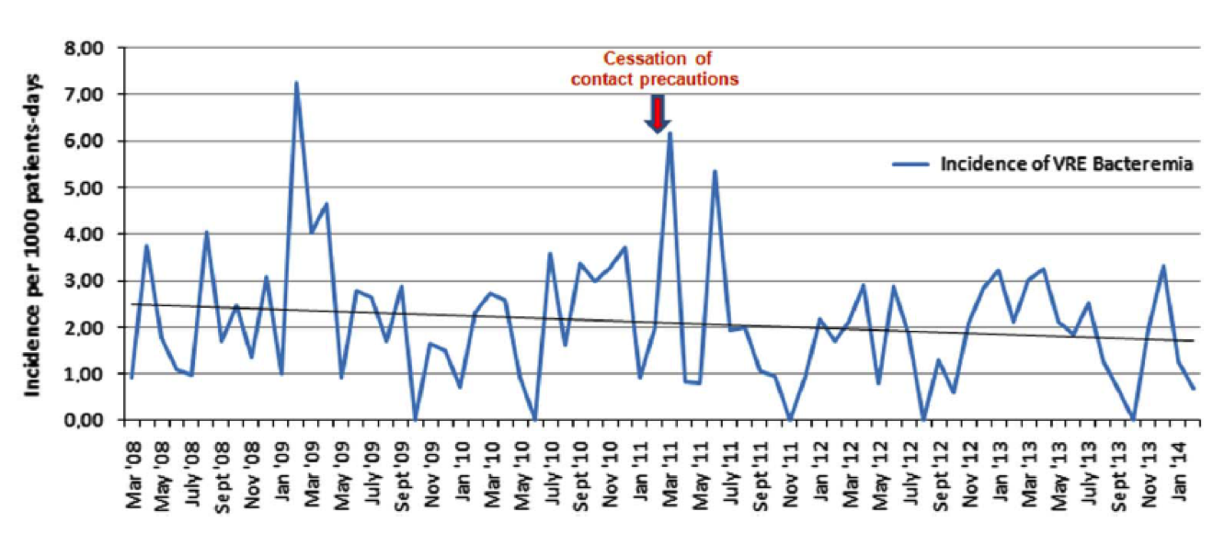
What happens when you stop surveillance & contact precautions?
Comparison of different time periods & effect on BSI
But, single centre, malignant haematology patients, no details on hand hygiene & cleaning, & all admissions in single rooms
Infect Control Hosp Epidemiol 2016; 37: 398-403

Slide 24
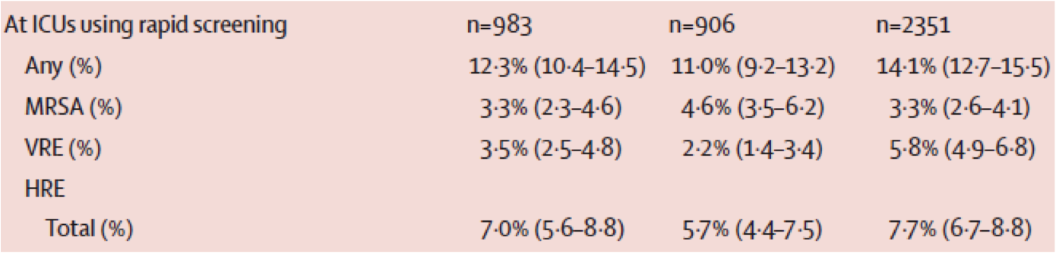

Phase 1 – baseline data
Phase 2 – hand hygiene
Phase 3- screening (molecular & culture) & if +ve,
contact precautions
15-22% of patients in single rooms; more than % carriers

Slide 25
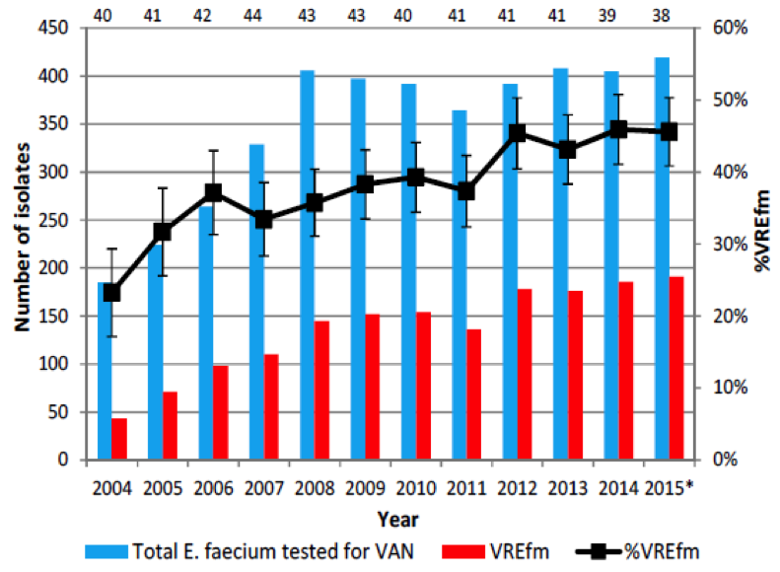
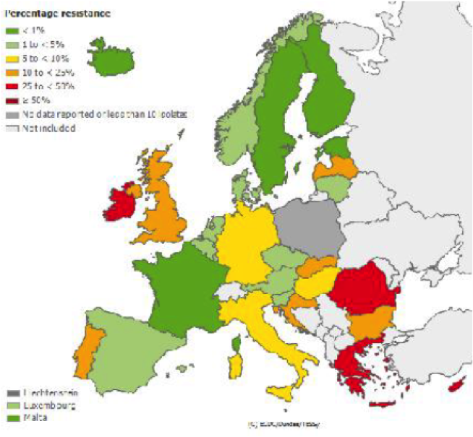
VRE & Ireland
Ireland & Europe
VREFm BSI
EARS-Net & Health Protection Surveillance Centre (Ireland)

Slide 26
Why the higher rates in Ireland?
Dominant & widespread clones different to elsewhere?
Antibiotic use?
Animal-human antibiotic chain?
Greater patient vulnerability?
Inadequate facilities & health resources?

Slide 27
VRE BSI in Tertiary Care Hospital
75 patients, mainly intra-abdominal source
for BSI
52% vanA
Clonal relatedness with environmental
isolates
Similar STs & virulence factors to those in
Europe
High EFm in Ireland?
J Antimicrob Chemother 2015; 70: 2718-2721

Slide 28
VRE – Local Experiences
Endemic VRE
ICU screening & all clinical isolates checked
Inadequate numbers of single rooms
2008
2007
2006
J Hosp Infect 2010: 75: 228-233

Slide 29
VRE – Clinical Impact
 | 2001 | 2003 | 2005 | 2007 | 2008
No. of screens | 1344 | 1525 | 1121 | 1288 | 1220
+ ves | 42 | 63 | 94 | 75 | 92
+ves/10,000 bed days (BD) | 1.96 | 2.94 | 4.06 | 3.18 | 3.85
+ve blood cultures | 2 | 11 | 18 | 8 | 11
VRE BSI/10,000 BD | 0.09 | 0.51 | 0.78 | 0.34 | 0.46
J Hosp Infect 2010; 75: 228-233

Slide 30
Conclusions

Slide 31
VRE is endemic in many healthcare settings & the extent underestimated
Predisposing factors are multiple & include healthcare & community factors
Not as virulent as S. aureus or Enterobacteriaceae
Control measures are worthwhile

Slide 32
Invasive infections occur in vulnerable patients
Studies on the value of screening & preventative measures are flawed
Surveillance & the feeding back of data has positive effects
Much unknown about reservoirs & environmental factors

Slide 33
What you don’t know, you can’t solve

Slide 34

Thank You

Slide 35

June 13 (FREE Teleclass - Broadcast live from the 2016 APIC conference)
BRIDGING THE GAP BETWEEN RESEARCH AND PRACTICE IN LONG-
TERM CARE: AN INNOVATIVE MODEL FOR SUCCESS
Sharon Bradley, Pennsylvania Patient Safety Authority
June 13 (FREE Teleclass - Broadcast live from the 2016 APIC conference)
BEING HEARD: THE INFECTION PREVENTIONIST AND THE
ORGANIZATIONAL STRUCTURE
Sharon Glowicz, Texas Health Resources, Presbyterian Hospital of Denton, Texas
June 16 STRATEGIES TO REDUCE SKIN INJURY IN CRITICALLY ILL PATIENTS
Kathleen M. Vollman, Advanced Nursing LLC
June 23 EXPLORING THE ROLE OF ENVIRONMENTAL SURFACES IN
OCCUPATIONAL INFECTION PREVENTION
Dr. Amber Mitchell, International Safety Center, and Barbara DeBaun, Cynosure Health

Slide 36


Slide 37


