Slide 1
Strengthening IPC Structures Through Education Capacity Building in Africa
Prof Shaheen Mehtar
Chair Infection Control Africa Network (ICAN),
and Stellenbosch University, Cape Town, South Africa
smehtar@sun.ac.za
Hosted by Paul Webber paul@webbertraining.com
October 12, 2017

Slide 2
Objectives
1. How to set up education programmes with low resources
2. What, and where, to start such programmes
3. How does one measure progress of such education systems
4. Why high income systems don’t always work in LMICs

Slide 3
Challenges in setting up education programmes in IPC in Africa
Level of basic education (primary and high school) is varied
Learning is by rote; critical thinking is not well developed
Difficult to understand concepts where there is a lack of infrastructure
Irregular access to the internet; self learning is limited
Little or no access to current literature
Adopting concepts and guidelines from other countries without being able to adapt them locally
Few publications from Africa (now improving) to inform local guidelines
Irregular supply of water and electricity (WASH inadequate)

Slide 4
Notes:
Within health systems there are major challenges. The finances needed for health are either non existent or diverted to other areas. Unfortunately, there is also a lot of waste mainly due to ignorance. There was, and still is, very little concentrated and structured training because of the lack of accountability

Slide 10
Notes:
Start by looking at the learning pyramid. Teaching others is the best way to learn. Giving lectures is the worse!

Slide 12
Current IPC training in Africa
Varied provision for healthcare delivery by province
IPC is not recognised as a speciality in its own right
No established career path in IPC which requires specialised training
Considered a nursing speciality- doctors are not involved- therefore there are no teams!
Surveillance: information gathering is limited
Guidelines and policies are neither well advertised nor promoted
The WHO Core Components (2016) recommends the “presence of a fully trained IPC practitioner for 250 acute beds”!

Slide 14
Types of training offered
Classroom teaching- face to face
E- learning platform across Africa
Skills development – practical classes for all cadres of health staff
Train the trainers (Master Trainers)
Managers courses
Capacity building and knowledge transfer to communities
Developing guidelines and apps specifically for Africa’s needs

Slide 16
Face to Face Teaching
Advantages of face to face
Disadvantages of face to face
Close relationship develops between tutors and within the class - networking
Revision when necessary
Modification of method of teaching if necessary
Demonstrations and visual teaching is understood better
Expensive for both students and faculty
Time consuming
Short term engagement
Routine and sometimes boring
Tutor dependent transfer of knowledge
16
Notes:
Travelling to the various teaching venues is expensive for both the students and tutors. It is rigid and time consuming. Sometimes the students and tutors get bored. Constant reminders are needed to prompt behavioural change and these are lacking- the constant stimulus. However, students and tutors love the personal touch and can judge the atmosphere in the room- as to whether the students have understood or not.

Slide 18
Barriers to teaching
Cultural
Do not argue with elders (teachers)
Cannot say how much you know
Cannot tell an older person what to do.
accept what one is told without question
Hierarchical-
“I cannot question the boss”
“ I AM THE BOSS!”
Language- different words mean different things!

Slide 20
Barriers to learning- cultural
Hierarchal barriers
“What you learnt in class stays there!! Here you do what you are told!”
“Why do I need to know this? It is not my job”
Despite knowledge in IPC difficulty in maintaining standards due to lack of resources
Will not advise superiors- do not want to appear aggressive or a show off
So,
Notes:
HCW will say that are not allowed independent thought and have to follow the manager’s instruction.
Usually the manager is not trained in IPC and will insist that things stay the same. And here are some quotes.
Therefore education of the managers becomes an essential part of IPC education.

Slide 21
Notes:
When talking to managers we always talk about cost. Cost to the HCF, cost to staff and cost to themselves. Here is an example from TBH where we demonstrated the impact of an IPC team and what happens when this team is not supported by management. Above is the number of infections in the ICU from 2006 to 2010- below is the cost of infection calculated in 2010 which is now much more.
It is also difficult to say that there is no money when so much is spent needlessly. We can demonstrate the cost effectiveness of IPC Teams- much like Haley did in the early 70’s

Slide 22
Cost of an IPC programme
In the USA, a reduction of only 6% would off set the cost IPC by saving on reduced hospitalisation.
BSI are the highest costing HCAI of all the types of infection
Cost in India of BSI infection in a cardiac hospital cost $15000 more per patient compared with those that did not develop infection.
ABHR introduction at point of use and other costs = $23.7 saved for every $1 spent . (Chen Y, Sheng W, Wang J, et al. PLoS One 2011;6:e27163)
ABHR is less costly and greater compliance.
Communicating (feed back) relating to HH activities and encouraging each other increased compliance (p<0.01)

Slide 23
Notes:
Instead of bombarding the students with a lot of written material which they never read, we rely more on demonstrations as shown in the picture above. They dress up and feel what it is like. They simulate and demonstrate
Below, the two students are role playing and critiquing each other on clinical history and examination- the tutors observe both

Slide 24
Notes:
The culture is oral and therefore HCW especially nurses prefer a face to face discussion and verbal instruction. There is not much reading material on one’s subject and most of the HCW do not read.
Not many hospital have these

Slide 25
Train the Trainer course
Selection- wants to teach and has passed the basic IPC course with good marks
Course structure
Taught how to teach adults (applying principles)
Will return to place of work and train a minimum of 5 students
Examiners will visit workplace and
examine the 5 students taught (50% transfer of knowledge required)
Evaluate training material used to teach students
Hours of training
Pre and post assessment of student knowledge
If the students get 50% or more, the Tutor will get a certificate of competence (TTT)
If not, then the Tutor will only get a Basic IPC course certification.
The students will be certified by their local institutions

Slide 26
Notes:
We run a train the trainer course which is quite unique. Those who have done well in the Basic IPC course are asked to join the TTT course. They are taught to teach, transfer knowledge and they are judged by their peers. Then they have to go back to their place of work and train 5 more people. We then go and test the 5 people they trained- if 50% of knowledge has been transferred accurately, they get their certificate of competence.

Slide 27
Notes:
It is apparent that the batch we taught recently showed a measurable increase in knowledge. When we went back to their hospitals the change in practice was truly apparent.

Slide 28
Training in Ebola
263 healthcare workers trained in IPC by ICAN
Back to basics!
Sound knowledge about the mode of transmission will give confidence to treat EVD cases as they deserve to be treated
Contact precautions
Single or isolation
Look after your hands- hand hygiene & gloves
Protection from splashes- gowns & face shield
No need to spray with chlorine! Wipe only- if needed
Manage linen with heat disinfection
Manage waste with heat and/ or incineration

Slide 34
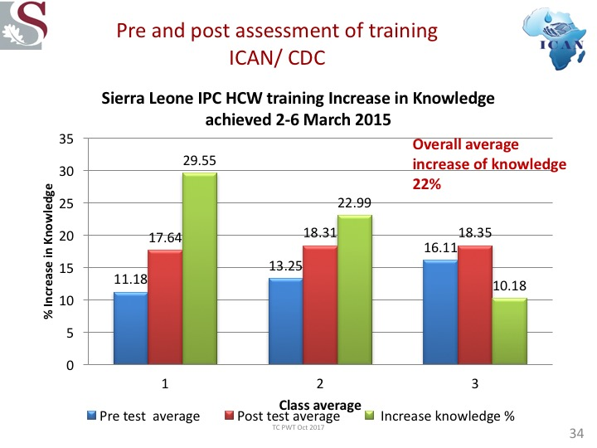

Slide 35
Notes:
Knowledge transfer by this route was saturated and other reminders were needed to continue good IPC

Slide 41
Notes:
Kilian Fox from the Observer in the UK reported that in Africa alone there were 280 million subscribers to phones of which 85% were mobile phone user.

Slide 42
e- IPC education for Africa
Advantages
Disadvantages
Interactive lectures - exciting
Quizzes interspersed in the lectures – test of knowledge
Movement within the talks
Can learn in one’s own time and repeat if necessary
Much more user friendly once you get used to it.
Can be linked to an SMS programme
Standardised measure of outcome
New concept for IPC
Access to the internet restricted
The programmes might be too big for the band width
Unfamiliar territory
May be resistance from learners
Resistance from tutors
42

Slide 43
Notes:
This is an inexpensive yet helpful tool which contains all the core elements of IPC and is used as a reference for the HCW.

Slide 44
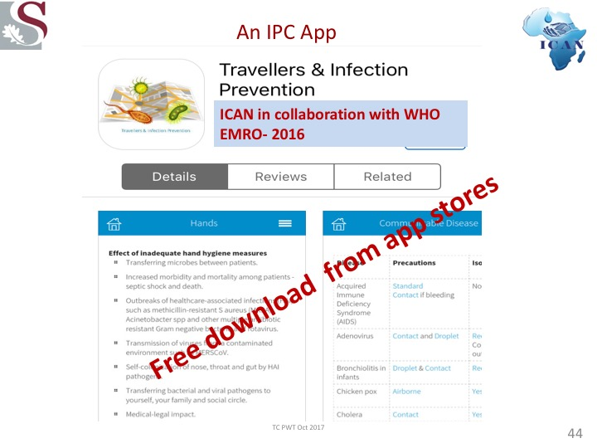

Slide 46
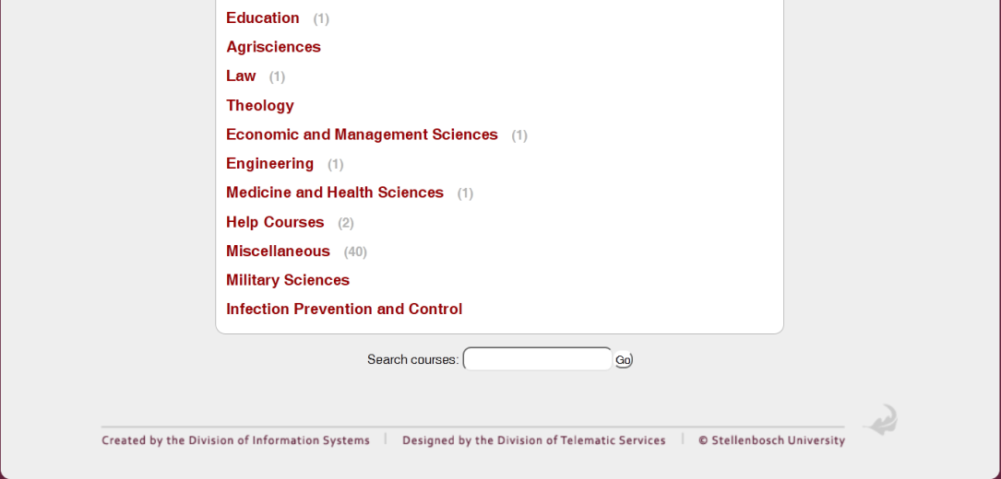
Designing distance learning IPC courses- for African universities
Uses moodle which is not only educational, but also has strategies for teaching–learning and for assessing progress and performance.
Distance Learning AMS course –ISC & ICAN
Also looking for private public partnership
SUN Moodle home page
IPC course
46

Slide 47
Notes:
And finally feed back- Julian Archer

Slide 48
Notes:
To make sure that at team focus develops, it is best to teach basic IPC to a combined class of doctors, nurses and if decontamination is being taught, then SSD staff

Slide 51
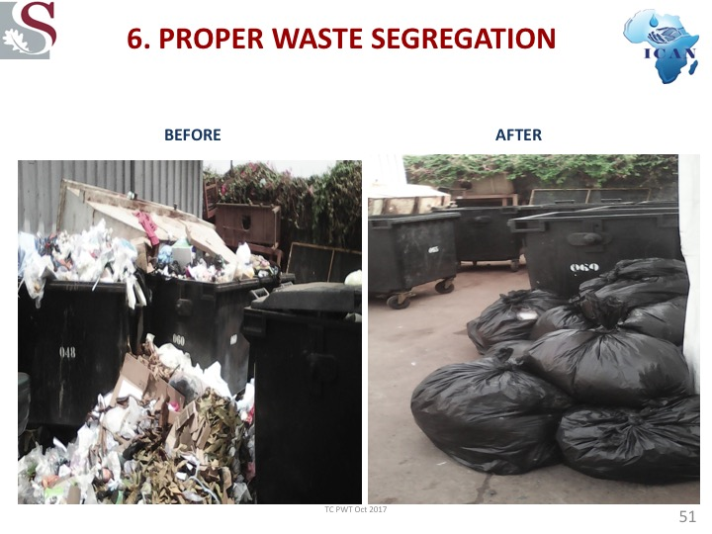

Slide 52
Finally.......
“The current approach to educating and training our health care providers has outlived its effectiveness and utility.
With the growing complexity of health care and the accelerated pace of accumulation of knowledge, significant reform of health professions education is required”.
“For LMI countries we should encourage
Multi modal approaches (which are culturally sensitive to sustain effect)
Educational intervention could be extremely cost effective-
Educating healthcare workers to optimal (hand hygiene) practices is effective.”

Slide 53
What actions can be taken
Apply activities which take less funding
Better and cost effective outcomes
Put effective structures into place.
Most important
Knowledge
Reduce waste by reducing cost of HAI, environmental cleaning, purchasing poor quality items
Donations- be careful what you wish for?
Reinvest what has been saved by reducing HAI

Slide 54
Think outside the box……
While there will be shortages, well trained IPC practitioners and HCW can think “outside-the-box” and deliver healthcare reasonably safely for patients and themselves
Understand the community and work closely with them
Need to reassess teaching methods in LMIC using more innovative ways of getting the message across- A WhatsApp IPC group in SL!

Slide 56
Notes:
Focus of MEPI project: Development, implementation and evaluation of innovative models for rural and underserved communities in Africa
George Washington University serves as the coordinating center, in partnership with the African Center for Global Health and Social Transformation.
28 Universities in 12 African countries

Slide 57
MBChB graduate survey: IPC curriculum II
Question n = 181 | Agree totally/ strongly | Agree | Disagree/quite strongly
IPC is important | 82.9% | 17.1% | 0%
Adequately covered in curriculum? | not at all/inadequate % | basic % | adequate /comprehensive %
Sharps disposal | 4.5 | 7.9 | 87.7
Hand hygiene | 5 | 12.7 | 82.3
Aseptic procedures | 7.9 | 15.3 | 76.8
Use of PPE | 7.9 | 17.9 | 74.3
Transmission-prec. | 10.8 | 22.6 | 66.6
Decontamination | 11.1 | 22.9 | 66
Waste management | 19.4 | 28.9 | 51.8
IPC policies | 28.5 | 39.7 | 31.8
HCW behav. change | 28.2 | 37.9 | 33.9
Occup. health | 34.4 | 39.4 | 26.2

Slide 58
Medical education in IPC: proposed SU model
MB 1 | MB 2 | MB 3 | MB 4 | MB 5 | MB6
Foundation phase |  | Early clinical | Middle clinical | Late Clinical
IPC teaching in theory modules |  | IPC teaching in skills laboratory |  | Integrated IPC teaching in clinical disciplines
OUTCOME: understands IPC principles & terminology |  | OUTCOME: applies IPC principles to clinical scenarios & attains IPC clinical skills |  | OUTCOME: evaluates healthcare services & reduces clinical risk by application of IPC principles

Slide 60
Conclusion
We need to use all the available facilities to teach and improve knowledge
Verbal communication (face to face learning)
Electronic platforms
Mobile Phones and telecommunication
Social media
Think of innovative ways of transferring knowledge!
Think of ways of sustaining knowledge!

Slide 62
