Slide 1
The Power of Influence
Broadcast live from IPAC Canada 2015 Conference
Michael Grinder Michael Grinder Associates Battleground, WA
Teleclass broadcast sponsored by
www.gojo.com
www.webbertraining.com
June 15, 2015

Slide 2
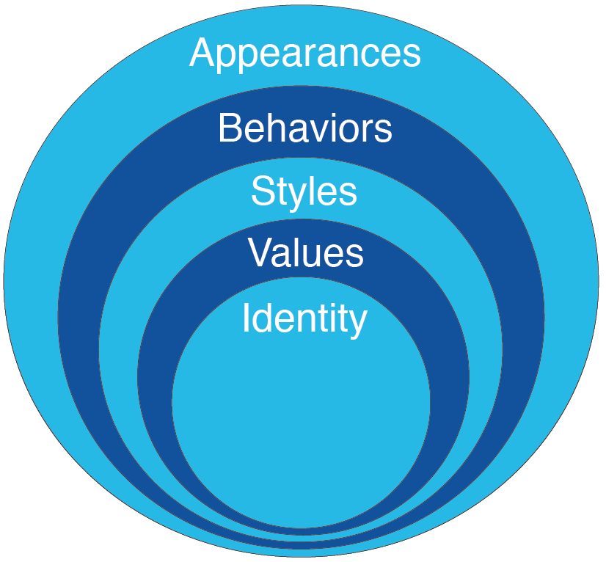
Circles of Humanness

Slide 3
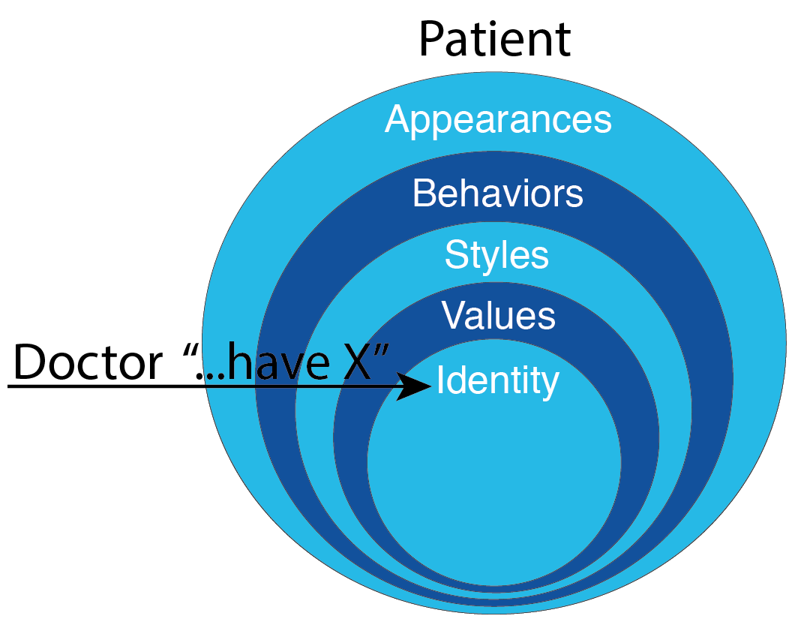
Authority + “-” w/eye contact

Slide 4
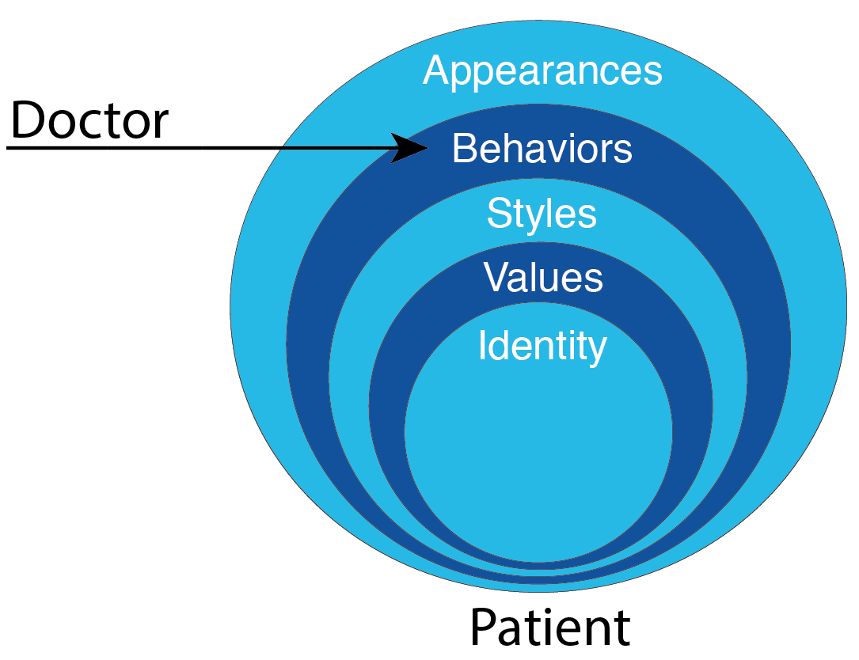
Authority + “-” w/o eye contact

Slide 5
Eye Contact

Slide 6
Eye Contact
1
2

Slide 7
2-Point Communication

Slide 8
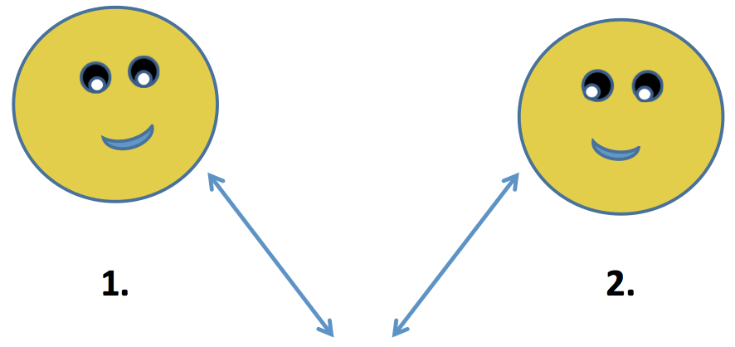
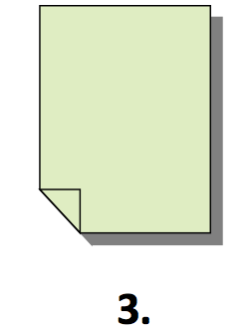
X-Ray

Slide 9
“+” Content
2 Point
“-” Content
3 Point

Slide 10
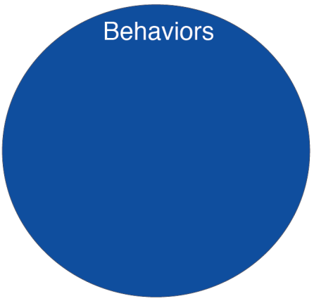

Slide 11
Old way of self-talk
New way of self-talk

Slide 12
Old way of self-talk
“I am dyslexic”
“I am an asthmatic”
“I am ADHD”
New way of self-talk
“I have dyslexia”
“I experience asthma”
“I have ADHD symptoms”

Slide 13
Feedback
Have the paper in front of the patient
Sit with your dominant hand closest to the patient
Coordinate your eyes and hand when transitioning from eye contact to looking at the paper

Slide 14
Feedback
When looking at the patient, use a friendly, approachable voice.
When looking at the paper, use a more business-like, credible voice
Pause when looking at the paper
Offer assistance

Slide 15
The Power of Influence
We are inadvertently in love
with the Influence of Power
We need to be in love with
the Power of Influence

Slide 16
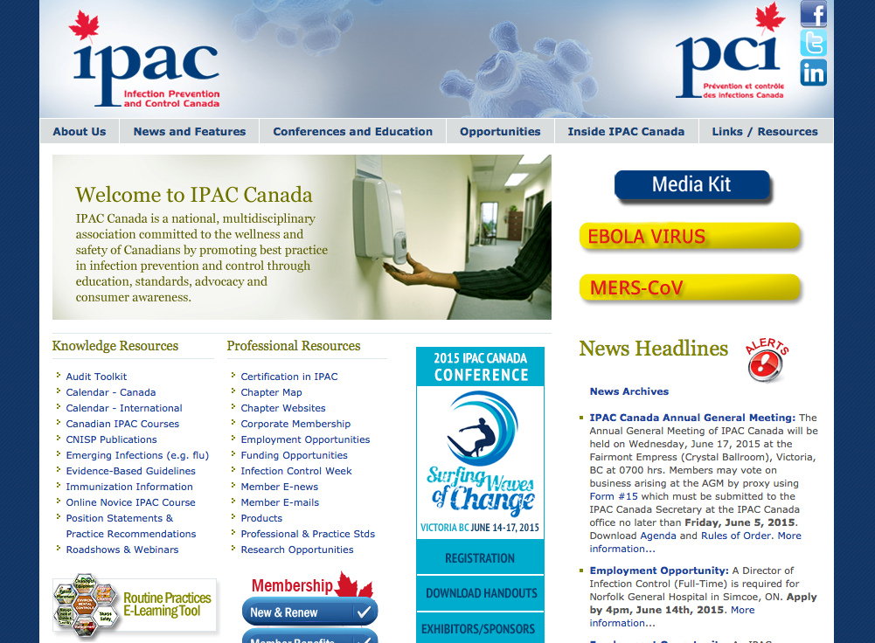
www.ipac-canada.org

