Slide 1
Hosted by Dr. Michael Gardam University of Toronto
www.webbertraining.com
July 16, 2015

Slide 12
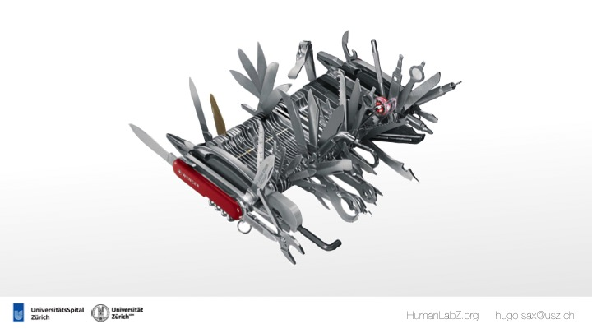

Slide 27
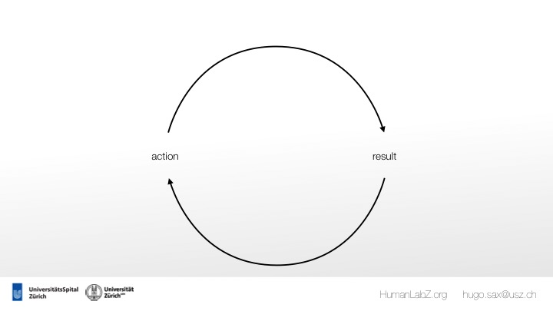

Slide 35
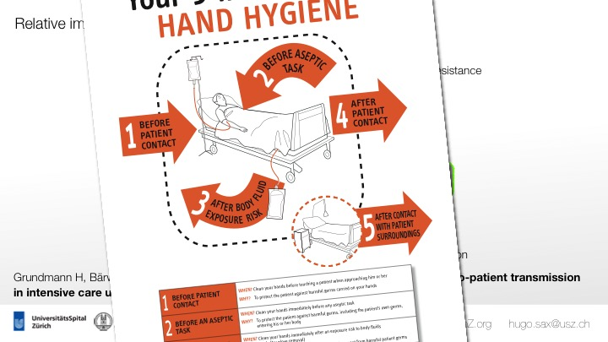

Slide 43
