Slide 1
To Glove or Not to Glove? How to answer the question
Dr Jennie Wilson
Reader, Healthcare Epidemiology, Richard Wells Research Centre
Hosted by Martin Kiernan
martin@webbertraining.com
www.webbertraining.com
July 21, 2015

Slide 2
Background
Hands recognised as major vehicle for transmission of infection in healthcare settings
Hand hygiene interrupts transmission
  Removes microorganisms acquired transiently through touch
    Soap and water
    Alcohol hand gel/rub

Slide 3
Rationale for the use of clinical gloves
Universal precautions (1987)
    Guidance in response to HIV to protect HCW from acquiring BBV via damaged skin
    disposable gloves for direct contact with blood and body fluid from all patients
Standard precautions (mid-1990s)
  Introduced gloves to routine clinical care
  Dual purpose of protecting vs BBV and reducing risk of transmission of pathogens from BBF
  Select to use by risk assessment of likely exposure to BBF

Slide 4
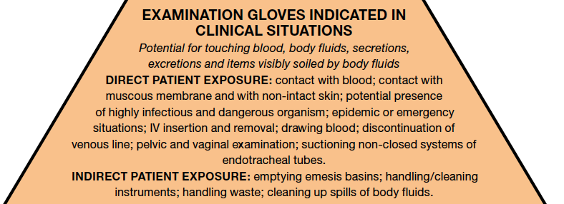
WHO Hygiene Guideline 2009: Gloves use

Slide 5
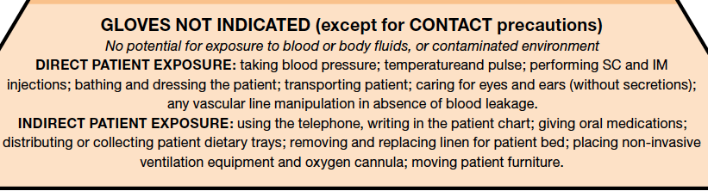
But gloves should not be worn…..

Slide 6
And if gloves are worn they…..
Must be changed between patients
Must be changed between procedures
Hands must be decontaminated after removal

Slide 7
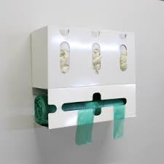
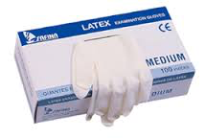
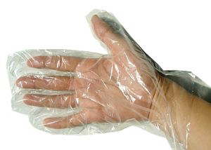

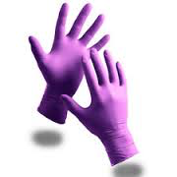
Evolution of gloves use in healthcare: 1980 - 2015

Slide 8
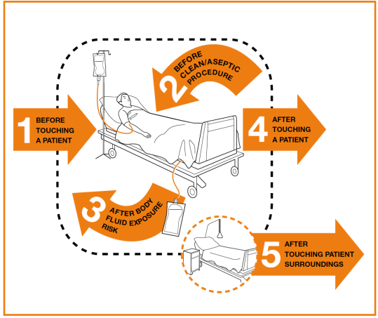
How are clinical gloves integrated into My 5 Moments of Hand hygiene?
Non-sterile gloves:
‘a second skin to prevent exposure of hands to body fluids’
‘glove removal represents a strong cue for hand hygiene’
Sax et al 2007

Slide 9
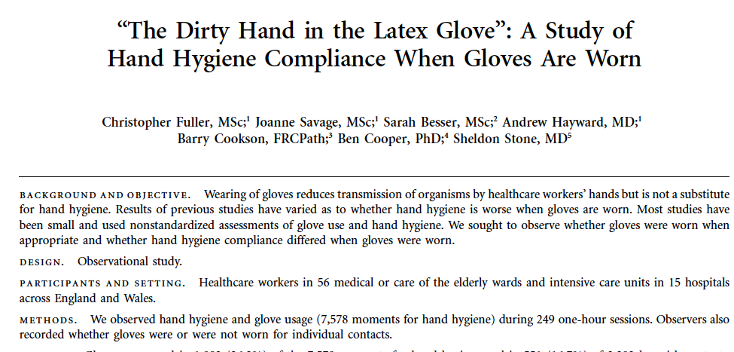
Gloves worn appropriately and associated with less hand hygiene
7578 moments of HH
Gloves worn for 26.7%
16.7% of moments when gloves were were low risk
HH after glove use 40%; no glove use 50% (p<0.01)
Fuller et al 2011, ICHE

Slide 10
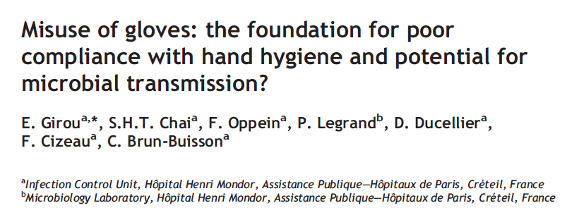
Gloves become contaminated with pathogens
Observed 120 HCW
64% gloves not changed, after contact
18.3% potential microbial transmission
22 gloves sampled: 100% grew bacteria, 86% grew pathogens; 59% same m’org as patient
Girou et al 2004, JHI

Slide 11
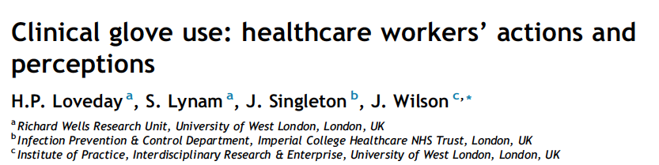
Glove use widespread and often inappropriate
Observed 163 glove use episodes
42% glove use inappropriate (used for low risk procedures)
37% associated with risk of cross contamination
Interviewed 25 staff: Decision to wear gloves influenced by emotion and socialisation
Loveday et al 2013, JHI

Slide 12
Summary of current evidence
Clinical gloves account for substantial NHS costs
They are often used inappropriately (Bearman et al 2007, Chan et al 2011, Flores et al 2006)
Associated with potential risk of cross contamination because not changed between procedures
Little is known about the patients perspective
Need to understand motivations for HCW using gloves to develop effective improvement strategies

Slide 13
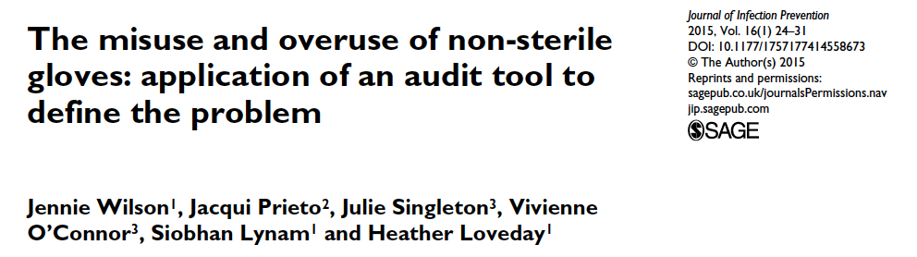
Validated tool to measure appropriate glove use and risk of cross contamination
Wilson et al 2015, JIP

Slide 14
Aim of this study
Refine methods used in a previous study in a single teaching hospital (Loveday et al 2014) to 2 other acute hospitals to:
  observe patterns of glove use behaviour in relation to ‘My Five Moments of Hand Hygiene’
  identify key influences on glove use behaviour
Determine public perceptions of clinical glove use in acute healthcare settings

Slide 15
Study Design
Phase 1
Observational Audit
Phase 2
Qualitative Interviews
Phase 3
Public survey

Slide 16
Phase 1: Observation
Conducted by IPCNs at 2 hospitals
Followed an episode of care
  with or without gloves
Record every item touched
  when gloves put on/taken off & HH performed
Analyse sequence to determine if risk of cross contamination occurred

Slide 17
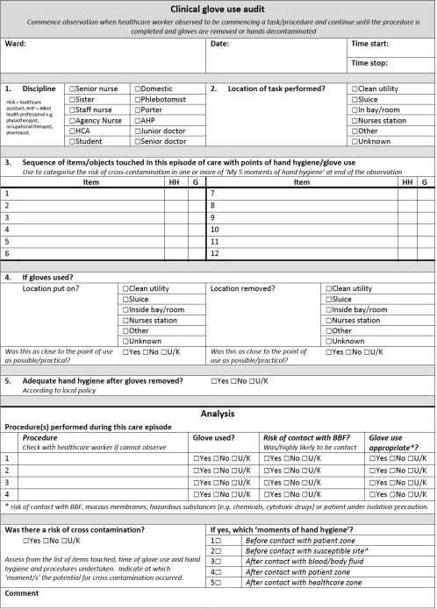

Slide 18
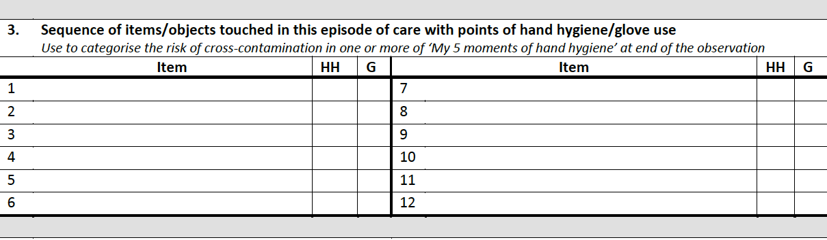
Record sequence of items touched

Slide 19
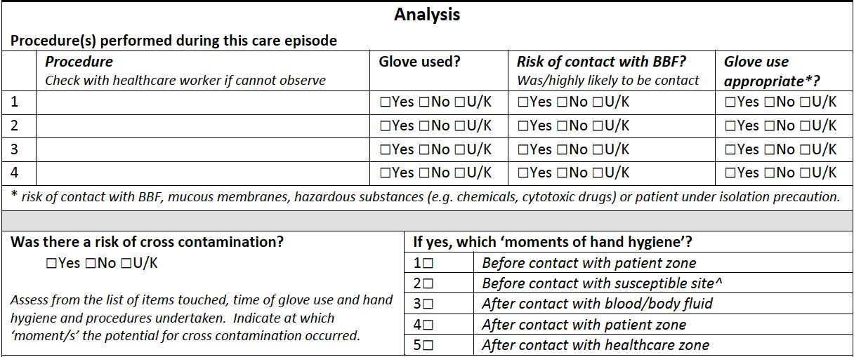
Identifying inappropriate use and risk of cross contamination

Slide 20
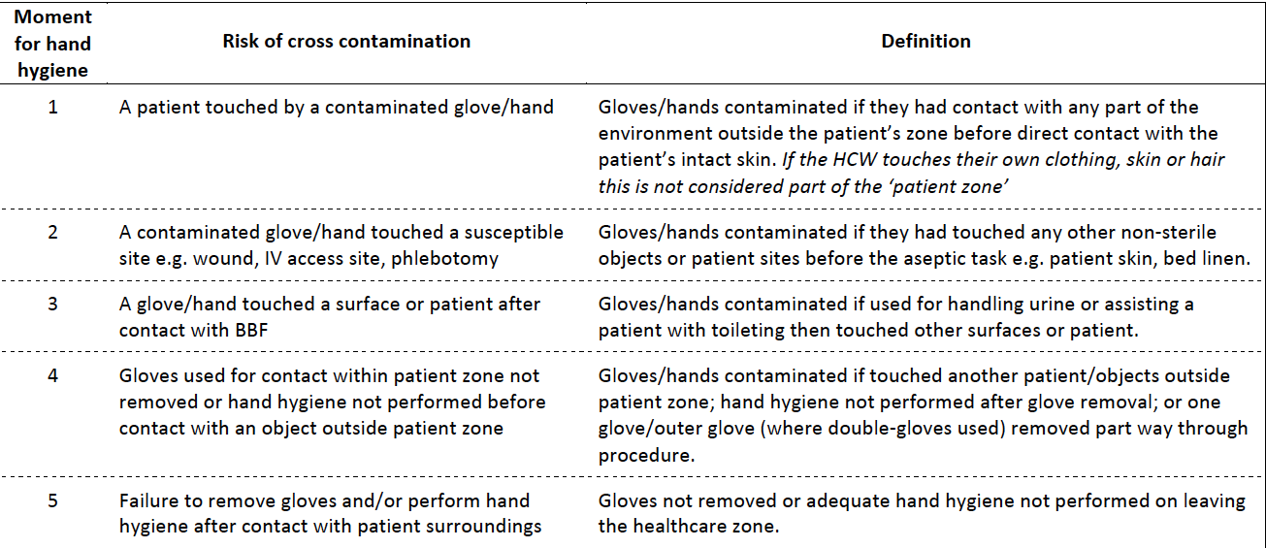
Defining risk of cross contamination linked to 5 moments

Slide 21
Type of staff observed

Slide 22
Results:
Risk of cross-contamination and appropriateness
 | No. episodes | % cross contamination* | No. procedures | % use inappropriate#
Hospital A | 69 | 58% | 104 | 38%
Hospital B | 109 | 43% | 191 | 68%
OVERALL | 178 | 49% | 295 | 57%
*p=0.065; #p<0.01

Slide 23
Differences between staff
Staff type | No. observed | No. risk of cross contamination | % risk of cross contamination
Nurse | 102 | 50 | 49%
HCA | 38 | 21 | 55%
AHP | 19 | 8 | 42%
Doctor | 7 | 6 | 86%
No. episodes of care with gloves = 178

Slide 24
Most common procedures observed

Slide 25
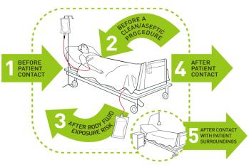
Moments of HH breached n = 178 episodes using gloves

Slide 26
No. breaches per episode

Slide 27

Example of how gloves are used
IV drugs
Prepare IV fluids in drug room
Press button to open door
Push door open
Carry drug to bedside
Central IV line flush and disconnection
Equipment trolley
Central line flush
IV monitor
Central line
IV infusion lines
Central line flush
IV pump
IV lines discarded into waste bin
Bed controls
IV pump
Same gloves: more than one task
Emptied catheter bag
Gave patient mouth care
Checked patients blood sugar

Slide 28
Gloves commonly used for contact isolation
They should be used as indicated for SP and for contact with infectious material
Hand hygiene (soap or gel*) is perfectly adequate for decontamination after contact with surfaces etc that may be contaminated
Infectious material? Think about the route of transmission!
Hazards of glove use
Porter puts on gloves to collect patient in isolation with Multi-resistant pathogen
Helps patient into wheelchair
Leaves room (still wearing gloves)
Pushes green door release button to exit ward….
Lift?, Xray department? Etc etc
*Except C. difficile and norovirus

Slide 29
Phase 2: Qualitative Interviews
Advert for volunteers in hospital newsletter
27 semi-structured interviews
16 Nurses; 5 HCA; 3 AHP; 1 Doctor; 2 other
Questions:
  Why/when wear gloves; has this changed
  Influences on glove use; Challenging others; Changing practice
Thematic analysis
  Inductive, data-driven
  Manually coded

Slide 30
Main themes emerging from interviews
Protecting self/Protecting patient
  Body fluids; dirt; chemicals; infections
  From contamination; minimise spread of infection
Influences on glove-use behaviour
  Automatic – its second nature
  Training (Ward sister; ICN)
  Peers (told on ward; observe colleagues)
  Used more now-a-days (Glove availability)
  Policy (confusion)
  Own decision
  Emotion
  “it’s a routine that you put on gloves”…”you don’t stop to think, oh I don’t need them”

Slide 31
Main drivers of glove use
S
Barrier – psychological
Barrier - physical
Contentment
Disgust
Fear
Peers
Training
Experience
Habit
EMOTION
SOCIALISATION
Professional
Stigma
Barrier to touch
Expectations
Preference (patients)
Preference (staff)
Policy
Time-saving
Availability
Attitudes
Conformity
SOCIALISATION
Organisational
SOCIALISATION
Empathetic

Slide 32
Emotion a powerful driver
  Disgust
  “they’ve got skin conditions where their skin goes brown and nasty, it looks horrible, so I understand why they want to wear gloves”
  Fear
  Cant rely on ‘handover’ to tell me if patient has something contagious
  Perception of risk
  “I am going to touch a patient and need to protect myself”
  Perception of risk
  “I find that when I’ve got gloves the gloves on I’m less OCD about needing to wash my hands”
  Fear
  [Gloves] “make me feel safer, more relaxed, more confortable, more confident”

Slide 33
Gloves provide a psychological barrier
  Psychological barrier
  “if I wasn’t wearing gloves [for washing a patient] I think I’d feel a bit kind of awkward”
  Strangers…?
  “some of the nurses didn’t wear gloves to suction”… ”they’ve built up such a strong relationship with that family they see wearing gloves as quite impersonal”
‘Personal areas’
Obviously if its quite personal areas you’re definitely going to wear your gloves…

Slide 34
Empathetic socialisation?
  Expectations
  “patients expect them to be worn – no-one washes their hands in Casualty”
  “I guess for the patient, it might come across that you see them as dirty”
  Interferes with therapeutic touch
  “you don’t get to touch the patient, there’s that barrier ….”
  Psychological barrier (more ‘clinical’)
  “around their like private areas, I wear gloves just to protect myself and just for them it’s a bit nicer as well”
  Give impression of hygiene
  “people I think like to see that you present yourself nice because they don’t know if we’ve washed our hands”

Slide 35
Professional socialisation
  Training
  Students say they are told in college – tutors say they don’t
Peers
You get told on the ward and when you’re doing your training when and where to wear the gloves……its just something you do rather than something you overly think about
Habit
Its probably force of habit. Anything that I am doing away from the nurses station or in a bay, tend to wear gloves
Peer pressure
If everybody else in the room suddenly puts gloves on then you think maybe I should be putting gloves on as well… peer pressure in a sense
‘Experience’
I would use personal experience and knowledge. I wouldn’t be influenced by somebody saying you don’t need to wear gloves if I feel I need to wear gloves I would wear them

Slide 36
Organisational socialisation
  Doing the right thing
  “to make sure you are safe because if something were to happen [….] well you’re liable for it because we’ve not taken proper care”
  Its quick & easy
  “it takes what, 5 seconds to pull a pair of gloves from a dispenser and put them on”
  Attitudes
  Student challenged about wearing gloves to receive a patient in theatre:
  “she [said] she didn’t know anything about the patient and she wanted to protect herself…”
Availability
What I like about here is that there are always gloves available everywhere and I thinks that’s really important because if you need then, for example in an emergency

Slide 37
Confusion about policy & practice
  “I mean I am not sure why some of them use gloves to wash patients and others don't”
  Efficacy of hand hygiene
  “even if you wash your hands you can’t guarantee that they are totally clean”
  “we’re not giving a clear enough message” ……”no-one’s ever sure where the information originally came from and it gets twisted…”
  “Obviously you’d wear them for washing, dressing and for taking patients to the toilet”
  “I know when we change the bedding on the ward, like, you have to wear aprons and gloves”

Slide 38
Perceived to protect staff AND patients
Obviously the idea is to protect yourself and the patient from infection so I suppose you could say that you should wear them all the time, which all of us do to be honest, you don’t know what patients have got infections you don’t know that if you haven’t got information then you need to treat everybody the same so you’re protecting yourself and you’re protecting the public

Slide 39
Recognising inappropriate practice in others
  “people just walk around in gloves and aprons from one bay to another” …..”come back and pick up the phone, that sort of thing”
  “things like bed-making – I don’t think we should be wearing gloves for that”
  “often X-ray people will come and what they’re doing is putting an x-ray plate behind the patient, they’re not actually touching the patient, and they’ll put a pair of gloves on”
I might not tell [someone] he should be wearing gloves but … sometimes. You think ‘really’?

Slide 40
Challenging practice of others
  “Sometimes I have mentioned that actually you don’t need gloves on and a couple of them have said, oh but I prefer to, and I am not going to say well take them off because that’s not really my place”
  Hierarchical constraints
  “Because sometimes when you challenge them [the doctors] they sort of give you a look and it makes you feel about this sort of big”
  ‘oh for God’s sake , another hand hygiene audit”
  “Because the patient is awake, you don’t want to create a scene”
  “If someone was challenging me, its like a form of aggression isn't it?”

Slide 41
Phase 3: The public perspective
Survey monkey questionnaire
Sent out to HCAI Service Users Research forum
Snowball sample via facebook
Views how they feel about HCW glove use (n= 142)
Experience of HCW glove use (hospital in last 6 months) (n = 59)
Experience of challenging HCW about glove use (n = 26)

Slide 42
Public responses to HCW glove use

Slide 43
Patients in hospital in last 6 months
29% (23/59) reported inappropriate use of gloves by HCW (admin task; no BBF)
36 comments
  Used to protect staff not patient
  Not changed
  Used instead of hand hygiene
  A barrier – touch is important
  Gloves gave feeling of confidence
  Expected gloves were clean – free from infection
  Not asked about latex allergy

Slide 44
I asked the Dr to change his gloves after he answered the phone, adjusted my table, collected bottles and opened doors before taking my blood. He told me they were for his benefit not mine. I politely and firmly insisted he change them, which he did but rather dramatically!

Slide 45
Patients may prefer to see HCW wear gloves but not if they see it increases the risk of cross infection
A relative’s story……

Slide 46
So does glove use matter?
Compromises hand hygiene
  HH audit data misleading as does not account for gloves use
  Gloves used in place of hand gel
Costs
  £302,813 in 2013/14 in one 500 bed acute NHS Trust
Environmental damage
  disposed of as clinical waste when mostly not contaminated with BBF!

Slide 47

Facilitates transmission of infection
2 patients with Gp A Strep bacteraemia
  1 colonised patient; 1 HCW
33% (10 of 34) curtains contaminated with GAS

Slide 48
Factors that influence hand hygiene behaviour (Whitby et al 2006)
Inherent ‘community’ hand washing
  Attitudes developed in the community translated to healthcare setting
  Patterns established early in life
  Driven by emotional concepts of ‘dirtyness’ and ‘cleanliness’
Elective hand washing
  Indications for had hygiene not covered by inherent drivers e.g. touching patient, environment

Slide 49
Dirt and disgust as key drivers in nurses’ infection control behaviours (Jackson & Griffiths, 2014)
Fear of contact with dirt, particularly dirt belonging to those who were unknown, was a key driver in behaviour carried out to reduce threat.
Familiarity with the patient resulted in a reduction of the protective behaviours required.
These behaviours, which initially appeared as part of an infection prevention strategy, were primarily a form of self-protection from patients, who at first encounter were considered as dirty.

Slide 50
Triggers for hand hygiene not the same if gloves worn
Emotion of disgust increases the triggers for using gloves (in place of hand hygiene)
but if gloves are worn then lose focus on the critical points for glove removal and hand hygiene

Slide 51
Indications for wearing gloves
Gloves indicated | Gloves not indicated
Touching body fluids | Taking patient observations
Contact with mucous membranes | Handling used linen (unless soiled)
Insertion/removal invasive device | Injections
Contact with non-intact skin | Administration/preparation IV drugs
Vaginal examination | Manipulating IV lines
Tracheal suctioning | Bathing/dressing patient
Handling hazardous chemicals | Feeding patient
Taking blood | Mobilisation/Physiotherapy

Slide 52
How can this behaviour be changed?
  Identify problems with current practice
Clearly define & communicate policy
  Vague references to ‘risk assessment’ not helpful
  Tackle perverse perceptions of risk & ’infection control folklore’
  May require dialogue and reaching a consensus
  Discriminate infection prevention requirements
  Discuss and agree what is acceptable
  Be consistent

Slide 53
Innovative dissemination strategies
Don’t rely on mandatory training to get messages across
  Chinese whispers are more powerful
Implement change at local level
  Discuss scenarios
  Audit & feedback
  Address poor practice
  About mandatory training..
  “I don’t think people take it in properly, just something they have to do so they go and say they’ve been”

Slide 54
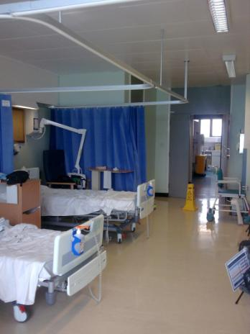
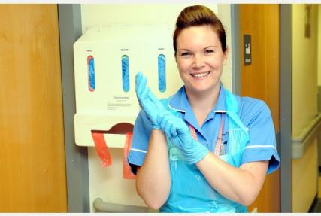
Structural changes?
  “gloves are around everywhere [now, so] people tend to use them more”
Location of gloves?
More hand gel?
  individual dispensers

Slide 55

Acknowledgements
Collaborative Research Award, 2013
Research Partners:
Jenny Wyeth/Linda Hosie: Royal Berkshire Hospital NHS Trust
Yvonne Carter & IPCNs: Royal free Hospital NHS Trust
Aggie Bak, Research Assistant, UWL
Siobhan Lynham, UWL

Slide 56

July 26 GASTROINTESTINAL ENDOSCOPES: A NEED TO SHIFT FROM
DISINFECTION TO STERILIZATION?
Prof. William Rutala, University of North Carolina Medical School
August 13 ASSESSING THE IMPACT OF AN EDUCATIONAL INTERVENTION ON
VENTILATOR-ASSOCIATED PNEUMONIA
Prof. Arti Kapil, All India Institute of Medical Sciences, New Delhi, India
September 3 (Free South Pacific Teleclass – Broadcast live from the 2015 IPCNC New Zealand
Conference)
IS MANDATORY INFLUENZA FOR HEALTHCARE WORKERS THE
BEST WAY TO PROTECT OUR PATIENTS?
Dr. Michael Gardam, University Health Network, Toronto
Sponsored by Johnson & Johnson (www.jnjnz.co.nz)
September 17 CAN ENERGY MANAGEMENT BENEFIT INFECTION PREVENTION?
Andrew Streifel, University of Minnesota

Slide 57


