Slide 4
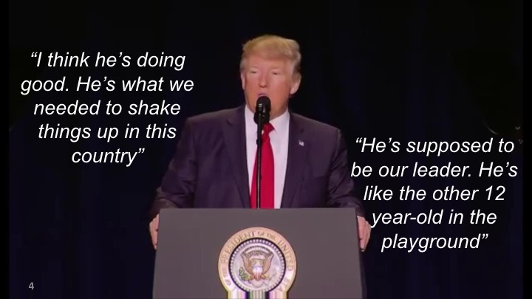

Slide 8
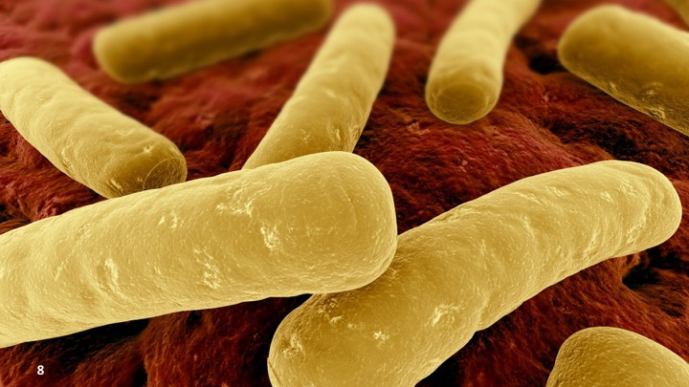

Slide 33
Notes:
UNDERSTAND, PREPARE, COMMUNICATE

Slide 35
