Slide 1
Vaccination of Healthcare Providers:
A Critical Step Toward Patient Safety
Helena Maltezou, MD, PhD
Department for Interventions in Health Care Facilities
Hellenic Center for Disease Control and Prevention
Athens, Greece
Hosted by Paul Webber
paul@webbertraining.com
www.webbertraining.com
May 7, 2015

Slide 2
Topics
1. Transmission of vaccine-preventable diseases (VPDs) in healthcare facilities
2. Rationale for vaccination of healthcare providers (HCPs)
3. Vaccination policies for HCPs
4. Susceptibility to VPDs, vaccination coverage and attitudes of
HCPs about vaccinations
5. Toward an holistic approach of HCPs’ vaccinations
6. Conclusions

Slide 3
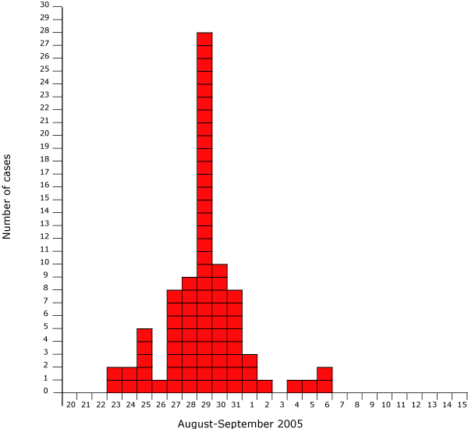
1. Transmission of vaccine-preventable diseases (VPDs) in healthcare facilities
Transmission of VPDs and large outbreaks continue to challenge healthcare facilities even in developed countries with long-standing vaccination programs.
Re-emergence of measles in Europe and the United States and pertussis in the United States

Slide 4
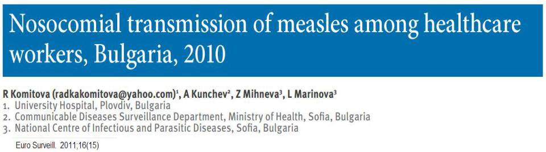
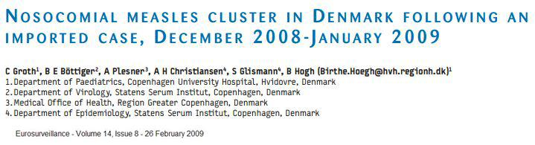

Slide 5
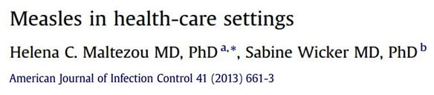
● extremely contagious (starting 4 days prior the onset of rash)
● outbreaks in closed settings when < 90% of persons are immune
● 14 – 45% of cases of measles in measles-free countries (e.g . United States) are acquired in healthcare facilities
● increased occupational risk for HCPs (x18.6 times compared with adults in the community)
● complications occur more frequently in adults compared with school-aged children.

Slide 6
Measles outbreaks in Emergency Departments
● congregation of large numbers of patients
● delay in implementation of infection control measures
● in developed countries young physicians may not be familiar with measles
● the vaccination history of HCPs is often unknown or history of one dose
● thousand contacts for tracing and investigation
● in one healthcare associated outbreak in the US in 2008:
7 cases 8.231 contacts 800.000 US$ total costs
Maltezou HC, Wicker S. Nosocomial measles. American Journal of Infection Control 2013;41:661-663

Slide 7
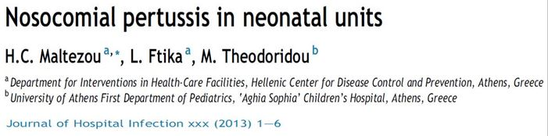
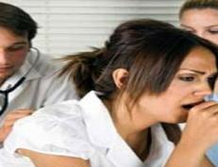
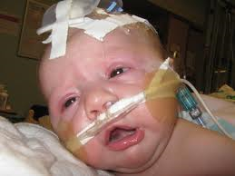
Attack rate up to 15.8% among neonates and 50% among HCPs
HCPs with compatible symptoms constitute the main source of infection
In an outbreak in a Neonatal Unit, a HCP had cough for at least one month until suspicion of pertussis contact with 113 neonates (11 with pertussis)!

Slide 8
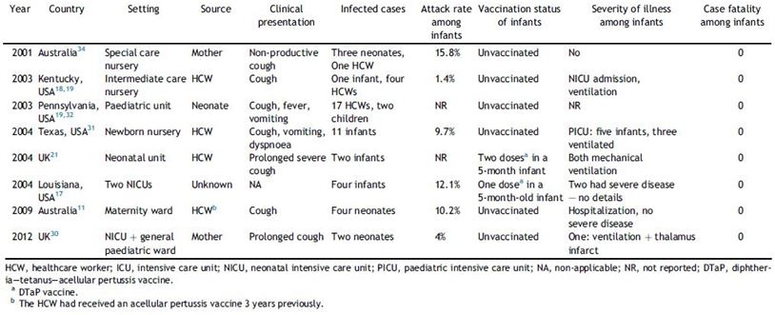

Slide 9
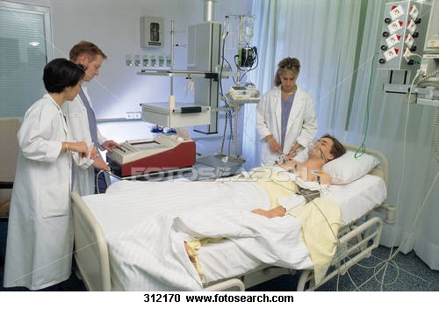
Nosocomial influenza outbreaks
● Intensive Care Units
● Neonatal ICUs
● Internal Medicine, Pulmonary Clinics
● Bone Marrow Transplant Units
● Longterm Care Units

Slide 10
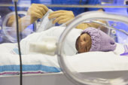
Nosocomial influenza outbreaks
Attack rate up to 55% among patients
and up to 18% among HCPs*
Up to 25% mortality rate in NICUs*
* Meara et al. Influenza A outbreak in a community hospital. Irish Medical Journal 2006;99: 175-177
** Munoz et al. Influenza A virus outbreak in a neonatal intensive care unit. Pediatric nfectious Diseases Journal 999;18:811-815

Slide 11
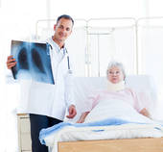
Nosocomial influenza: significant morbidity and mortality
● patients with underlying conditions
● immunocompromised patients
● elderly, neonates & young infants
high risk groups

Slide 12
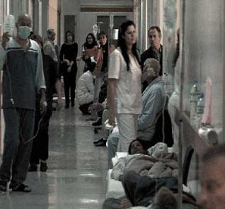
Sources of nosocomial influenza
unsuspected or undiagnosed patients with influenza
visitors
unvaccinated HCPs
Maltezou HC. Nosocomial influenza new concepts and practice. Current Opinion in Infectious Diseases 2008;21:337-343

Slide 13
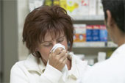
HCPs continue to work while having influenza-like symptoms

Slide 14
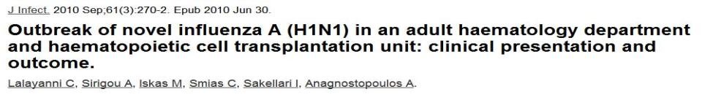
8 (38%) of 29 patients developed influenza
5 patients with severe lower respiratory tract infection
3 patients in ICUS
3 patients died
2 survivals remained in oxygen therapy for 2 - 3 months

Slide 15
Indirect consequences of nosocomial influenza
● increased hospitalization costs
(diagnosis, prolongation of hospitalization, treatment, prophylaxis, infection
control)
● absenteeism of HCPs
● disruption of healthcare services

Slide 16
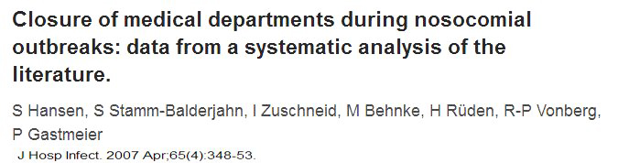

review of 1.561 nosocomial epidemics
38.5% closure rate of a department in order to contain an
outbreak of influenza
influenza was the cause for the closure of an entire hospital
in 3 of 10 such events

Slide 17
Susceptible HCPs in healthcare facilities occupational exposure to infectious agents source of VPDs for patients and other HCPs vehicles for the evolution of outbreaks

Slide 18
Occupational exposure and onset of VPDs among HCPs measles rubella mumps hepatitis Α hepatitis Β pertussis chickenpox multi-drug resistant tuberculosis meningococcal

Slide 19
Transmission of VPDs from HCPs to patients influenza pertussis rubella chickenpox hepatitis A hepatitis Β onset of serious nosocomial epidemics with high associated morbidity, mortality and

Slide 20
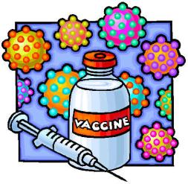
2. Rationale for vaccination of HCPs direct protection of HCPs indirect protection of susceptible patients
(immunocompromised, pregnant, infants) from nosocomial transmission of VPDs

Slide 21

Vaccination of HCPs against influenza: shield of protection
High vaccination coverage among personnel
reduction of transmission of influenza among patients
1. Salgado et al. Preventing nosocomial influenza by improving the vaccine acceptance rate if clinicians. Infection Control and
Hospital Epidemiology 2004;25:923-928
2. Weinstock et al. Control of influenza A on a bone marrow transplant unit. Infection Control and Hospital Epidemiology 2000;21:730-732

Slide 22
Influenza vaccination of HCPs in long-term care facilities
total mortality
influenza-like illness mortality
admissions to hospitals
__________________________________________________________________________________________________________
1. Potter et al. Influenza vaccination of healthcare workers in long-term-care hospitals reduces the mortality of elderly
patients. J Infect Dis 1997;175:1-6
2. Lemaitre et al. Effect of influenza vaccination of nursing home staff on mortality of residents: a cluster-randomized trial.
J Am Geriatr Soc 2009;57:1580-6
3. Hayward et al. Effectiveness of an influenza vaccine programme for care home staff to prevent death, morbidity, and
health care use among residents: cluster randomized controlled trial. Br Med J 2006;333:1241
4. Carman et al. Effects of influenza vaccination of health-care workers on mortality of elderly people in long-term care:
randomized controlled trial. Lancet 2000;355:93-7

Slide 23

Influenza vaccination of HCPs in acute-care hospitals
influenza episodes
febrile respiratory illnesses
absence from work
___________________________________________________________________________________________________________________
1. Dunais et al. Influenza vaccination: impact of an intervention campaign targeting hospital staff. Infect Control Hosp Epidemiol
2006;27:529-531
2. Pearson et al. Influenza vaccination of health-care personnel. Recommendations of the Healthcare Infection Control Practices
Advisory Committee (HICPAC) and the Advisory Committee on Immunization Practices (ACIP). MMWR Recomm Rep 2006;55:1-16
3. Wilde et al. Effectiveness of influenza vaccine in healthcare professionals. JAMA 1999;281;908-913

Slide 24
3. Vaccination policies for HCPs
The United States Centers for Disease Control and Prevention recommendations for HCPs vaccination
● all HCPs against influenza, varicella, measles-mumps-rubella
● specific groups of HCPs against hepatitis B, pertussis, meningococcus
● BCG by case, following risk assessment
______________________________________________________________________
CDC. Immunization of health-care workers: recommendations of the Advisory Committee on Immunization Practices (ACIP) and the Hospital Infection Control Practices Advisory Committee (HICPAC). MMWR 1997;46(RR-18):1–44

Slide 25
Influenza vaccination for HCPs in the United States
● Mandatory vaccination policies were adopted by several healthcare institutions and professional societies the past years
● Use as an index of healthcare quality
______________________________________________________________________
CDC. Immunization of health-care workers: recommendations of the Advisory Committee on Immunization Practices (ACIP) and the Hospital Infection Control Practices Advisory Committee (HICPAC). MMWR 1997;46(RR-18):1–44

Slide 26
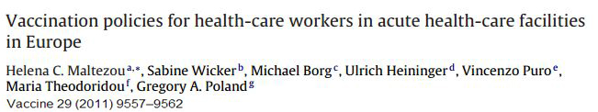
* 27 countries in the European Union, Norway, Switzerland & Russia
Hepatitis B Influenza Measles – Rubella Mumps Varicella Tetanus – Diphtheria Pertussis Poliomyelitis Hepatitis A BCG Men C or A, C, W135, Y

Slide 27
Mandatory vaccination of HCPs in Europe against: measles-mumps-rubella in Finland hepatitis A in Slovakia hepatitis B in France, Slovakia & Slovenia
ΒCG in France, Italy and Slovakia poliomyelitis & tetanus-diphtheria in France
In case of refusal the HCP is moved to a low-risk department or to a post with no contact with patients

Slide 28
With the notable exception of hepatitis B and influenza vaccinations, significant country-to-country differences exist in
Europe in terms of vaccines, implementation frame (mandatory or recommendation), target HCP subgroups and healthcare settings.
Maltezou HC, Poland GA. Vaccination policies for healthcare workers in Europe. Vaccine 2014;32:4876

Slide 29

4. Susceptibility to VPDs, vaccination coverage and attitudes of HCPs about vaccinations*
Measles susceptibility rates in Europe: 6% - 17%
Mumps susceptibility rates in Italy, Brazil and Japan: 15.9% - 20.1%
Rubella susceptibility rates in Italy, Brazil and Japan: 4.5%-15%
* recent publications

Slide 30
Susceptible HCPs (%) in healthcare facilities in Greece, 2010 - 2011
Maltezou et al. American Journal of Infection Control 2013;41:66-70
Maltezou et al. Journal of Infection 2012;64:319-324
▪ HCPs in acute-care
hospitals (n=505)
▪ HCPs in primary-
care centers (n=2055)

Slide 31
Vaccination coverage of HCPs against influenza
low vaccination rates worldwide (< 40%)
mandatory vaccination in US hospitals: > 98%
1. Maltezou HC. Nosocomial influenza: new concepts and practice. Current Opinion of Infectious Diseases 2008;21: 337-43
2. Babcock et al. Mandatory influenza vaccination of health care workers: translating policy to practice. Clinical Infectious Diseases 2010;50:459-464

Slide 32
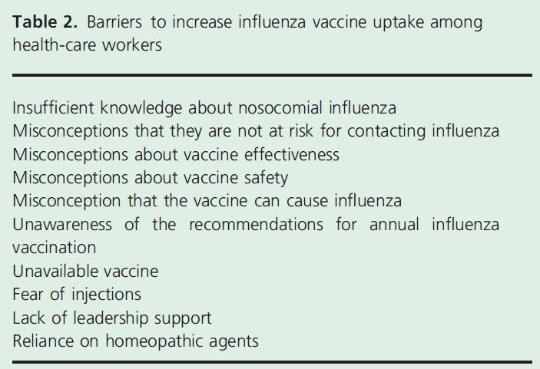
Maltezou HC, Tsakris A. Vaccination of health-care workers against influenza: our obligation to protect patients. Influenza and Other Respiratory Viruses 2011; 5:382-388

Slide 33
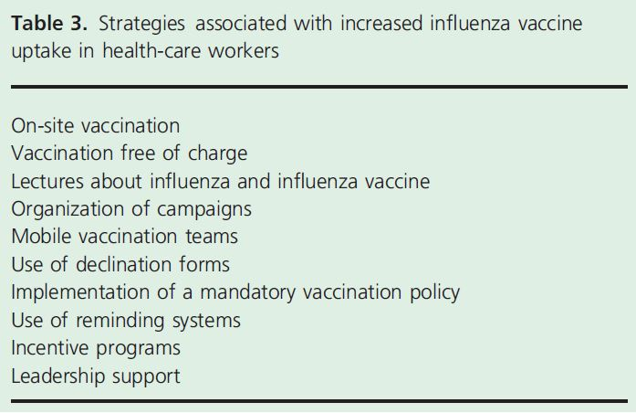
Maltezou HC, Tsakris A. Vaccination of health-care workers against influenza: our obligation to protect patients. Influenza and Other Respiratory Viruses 2011; 5:382-388

Slide 34
Vaccination coverage of HCPs in healthcare facilities in Greece, 2010-11
Maltezou et al. American Journal of Infection Control 2013;41:66-70
Maltezou et al. Journal of Infection 2012;64:319-324
Measles Mumps Rubella Varicella Hepatitis A Hepatitis B Tetanus - Diphtheria

Slide 35
Acceptance of mandatory vaccination policies for HCPs in healthcare facilities in Greece, 2010-2011 (n=1545)
Vaccinations should be mandatory
● for all HCPs 52%
● for HCPs caring for high-risk patients 71%
Maltezou et al. American Journal of Infection Control 2013;41:66-70
Maltezou et al. Journal of Infection 2012;64:319-324

Slide 36
Acceptance of mandatory vaccination policies for HPCs by VPD and patient category in Greece, 2010-2011 (n=1005)
Maltezou et al. American Journal of Infection Control 2013;41:66-70
Maltezou et al. Journal of Infection 2012;64:319-324
▪ Mandatory vaccination for HCPs in
contact with high-risk patients
▪ Mandatory vaccination for all HCPs
Influenza Measles Mumps Rubella Varicella Hepatitis A Hepatitis B Pertussis

Slide 37
5. Toward an holistic approach of HCPs’ vaccinations
● Need to address the fragmentation of vaccination policies for
HCPs.
● Vaccination policies should be implemented following risk assessment and taking into account the epidemiological trends, the movement of people across borders and overall immunity gaps.
● Mandatory vaccinations against VPDs which can be transmitted to patients and for which safe and effective vaccines exist should be considered for HCPs.

Slide 38
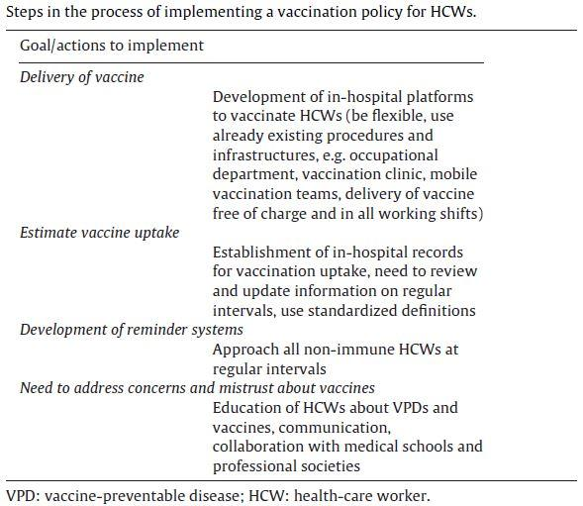
Maltezou HC, Poland GA. Vaccination policies for healthcare workers in Europe. Vaccine 2014;32:4876-4880

Slide 39
6. Conclusions
Significant country-to-country differences in HCPs vaccinations exist.
Need to study the reasons for suboptimal vaccination rates and to overcome mistrust about vaccinations among HCPs.
Studies indicate that acceptance of mandatory vaccination policies are vaccine-specific, profession-specific and patient-specific.
The possibility of implementing mandatory vaccination policies for HCPs should be addressed.
Communication to HCPs is critical in order to raise vaccine uptake.
Need to improve awareness of HCPs about vaccines, their efficacy and safety as well as their ethical responsibility toward patients.

Slide 40

«Κάλλιον το προλαμβάνειν ή το θεραπεύειν»
“Prevention is better than cure”
Hippocrates, Greek physician (460-377 BC)

Slide 41
Thank you for your attention !

Slide 42

May 13 (Free WHO Teleclass – Europe)
UNDERSTANDING CONSUMER PERCEPTIONS OF HAI AND HAND HYGIENE THROUGH A GLOBAL SURVEY
Claire Kilpatrick, WHO, and Dr. Maryanne McGuckin, McGuckin Methods International
May 21 (Free Teleclass)
IS YOUR PHONE BUGGED? THE ROLE OF MOBILE TECHNOLOGY IN INFECTION CONTROL
Richard Brady, Western General Surgery, NHS, UK
May 27 (South Pacific Teleclass)
FOOD SAFETY CULTURE – FROM FARM TO FORK
Dr Douglas Powell, Powell Food Safety, Australia
June 02 (Free British Teleclass ... Denver Russell Memorial Teleclass Lecture)
PHAGE THERAPY IN A POST-ANTIBIOTIC ERA
Dr. Martha Clokie, University of Leicester, UK

Slide 43


