Slide 1
Viability of Bacteria on Fabrics
Jerry H. Kavouras, Ph.D.
Professor and Chair of Biology
Hosted by Paul Webber
paul@webbertraining.com
www.webbertraining.com
December 8, 2016

Slide 2
Objectives
To identify factors that affect the viability of bacteria on fabrics
To relate the viability of bacteria on fabrics to the transmission of infectious diseases

Slide 3
Acknowledgements
Colclasure, V. J. et. al. (2015). American journal of infection control, 43(2), 154-158
Funded by the Colonel Stephen S. and Lyla Doherty Center for Aviation & Health Research and supported by Lewis University

Slide 4
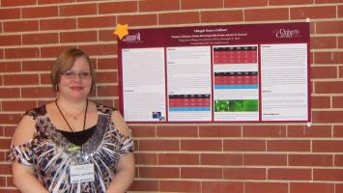
Acknowledgements
Victoria Colclasure
Thomas Soderquist
Thomas Lynch
Nina Schubert
Deirdre McCormick
Erika Urrutia
Corey Knickerbocker
Devon McCord

Slide 5
Research Question
How long do coliform bacteria survive on fabrics exposed to different environmental conditions?

Slide 6
Previous Work
Focused on the viability of clinically significant microbes on fabrics & fomites, or studied fabrics with antibacterial properties.
Most clinical studies that focused on the association between fabrics and bacteria, looked at viability of single isolate species and survival length.

Slide 7
Research Novelty
It utilized environmental isolates that people may encounter at recreational sites rather than clinical isolates.
The focus was on the number of bacteria instead of solely viable cells remaining.
The environmental conditions mimicked common scenarios at which these organisms would be exposed.

Slide 8
Bacterial Isolates
Coliform bacteria are indicator organisms of contamination and pathogens
Isolates from recreational areas
Fabric inoculations included three species of coliform bacteria

Slide 9

Protocol
Sunlight, Room Temperature
Dark, 25°C
Dark, 37°C
Coliform Suspensions
Tests:
1. MPN
2. Colony morphology

Slide 10
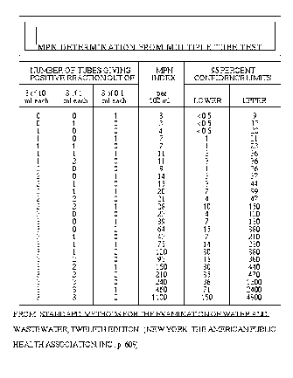
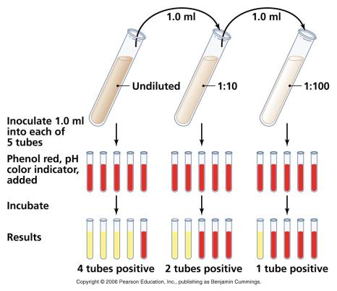
Most Probable Number
Technique allows detection of microbes in low numbers

Slide 11
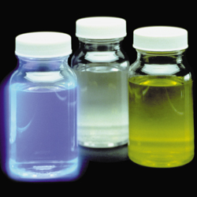

Colilert® reagent
IDEXX Laboratories

Slide 12
Fabrics
Cotton
  Retained 99% of coliform suspension
Blended cotton
  Retained 86% of coliform suspension
Silk
  Retained 73% of coliform suspension

Slide 13
Environmental Conditions
Sunlight, Room Temperature
  Coliforms inactivated by sunlight
Dark, 25°C
Dark, 37°C
  Optimal growth temperature

Slide 14
Cotton
Dark, 25°C
Dark, 37°C
Direct Sunlight
Bacteria per mL

Slide 15
Blended-cotton
Bacteria per mL
Dark, 25°C
Dark, 37°C
Direct Sunlight

Slide 16
Silk
Bacteria per mL
Dark, 25°C
Dark, 37°C
Direct Sunlight

Slide 17
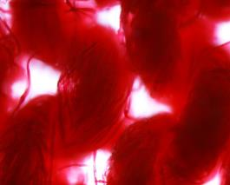
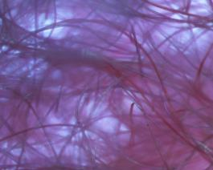

Fabric Architecture
Cotton
Blended-cotton
Silk

Slide 18
Conclusions
It appears that coliform bacteria can survive on fabrics longer than previous studies have reported.
Coliform bacteria survive better in the dark, at lower temperatures, and on fabrics that can retain moisture.
These findings can be applied directly to the viability of bacteria on clothing and potential human exposure to fecal pathogens

Slide 19
Infectious Dose
Enteric Pathogen | Dose
Shigella | 10-100 organisms
E. coli O157:H7 | <10 organisms
Campylobacter jejuni | 10²⁻⁶ organisms
Salmonella | 10⁵ organisms

Slide 20
Thank you
Contact Information
E-mail: kavourje@lewisu.edu
Phone: 815-836-5723
FAX: 815-836-5119

Slide 21


December 15 (FREE Teleclass)
INFECTION CONTROL IN ELDERLY CARE INSTITUTIONS – WHERE
SHOULD WE GO?
Prof. Andreas Voss, Radboud University Medical Centre, The Netherlands
January 19 THE ROLE OF INTERSECTIONAL INNOVATIONS IN PREVENTING
INFECTION
Prof. Sanjay Saint, University of Michigan Medical School
January 26 HEATER-COOLER UNIT ASSOCIATED MYCOBACTERIUM CHIMAERA
INFECTIONS: AN OUTBREAK IN SLOW MOTION
Prof. Michael Edmond, University of Iowa Hospitals & Clinics

Slide 22


Slide 23


