Slide 2
Notes:
Andrew Streifel
Vent/Water
2

Slide 3
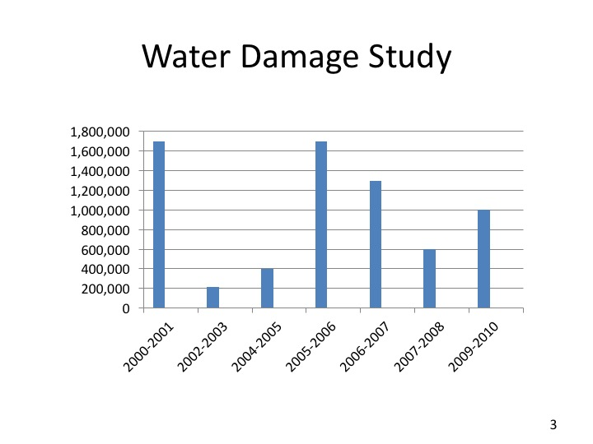

Slide 20
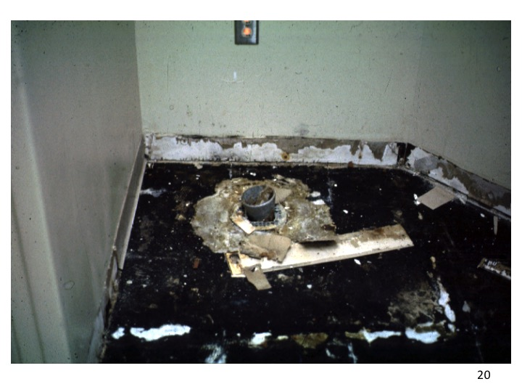

Slide 42
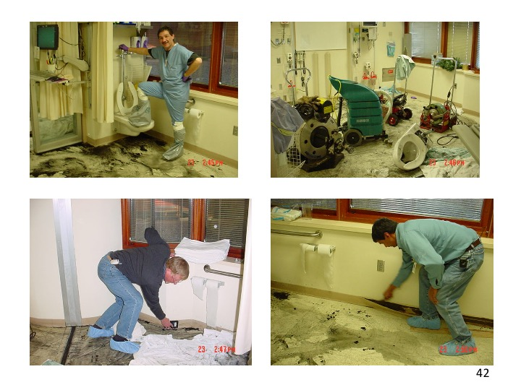

Slide 49
49

