Slide 1


WATERBORNE PATHOGENS: WHY IS THEIR PROFILE CHANGING?
SYED A. SATTAR, PhD
PROF. EMERITUS OF MICROBIOLOGY, FACULTY OF MED., UNIV. OF OTTAWA, OTTAWA, ON, CANADA
ADJUNCT RES. PROF., CIVIL & ENVIRON. ENGINEERING, CARLETON UNIV., OTTAWA, ON, CANADA
CHIEF SCIENTIFIC OFFICER, CREM CO INC., MISSISSAUGA, ON, CANADA
Hosted by Prof. Jean-Yves Maillard
Cardiff University, Wales
September 24, 2020

Slide 2
ACKNOWLEDGEMENTS
MR. PAUL WEBBER
PROF. JEAN-YVES MAILLARD
MY STAFF & STUDENTS
CONFLICT OF INTEREST?
NONE TO DECLARE!

Slide 3
OBJECTIVES
DISCUSS MAJOR CLASSES OF WATERBORNE PATHOGENS
IMPACT OF DEMOGRAPHY & CLIMATE ON PATHOGEN SPREAD BY WATER
FRESH WATER SHORTAGES & ITS IMPACT ON HYGIENE
WATER-BASED BIOFILMS AS SOURCES OF OPPORTUNISTIC PATHOGENS
EXAMPLES OF SUCCESSES IN PREVENTING WATERBORNE SPREAD
FUTURE PROSPECTS
1970 ARBITRARILY CHOSEN AS THE STARTING POINT TO ILLUSTRATE THE CHANGES
I HAVE EXPERIENCE IN WORKING WITH NEARLY ALL PATHOGENS TO BE DISCUSSED.

Slide 4
WHAT IS THE ISSUE?
WATER – THE ULTIMATE RECEPTACLE FOR TERRESTRIAL MICROBES
A BEWILDERING VARIETY OF INDIGENOUS AQUATIC MICROBES
A COMMON VEHICLE FOR MANY TYPES OF PATHOGENS
CHANGING TECHNOLOGY PROVIDING NEW NICHES FOR MICROBES
SELECTIVE PRESSURES FOR MICROBIAL ADAPTATION
‘MODERNIZATION’ MAKING US ‘SOFTER’ & MORE VULNERABLE

Slide 5
THE MICROBIAL WORLD IS INCREDIBLY VAST!
ESTIMATED NUMBER OF SPECIES:
  BACTERIA - 5-10 MILLION; PROTOZOA - 65,000; FUNGI - 70,000-1,500,000
  VIRUSES (MOSTLY BACTERIOPHAGES)
EACH NEWBORN BECOMES A MICROBIAL ‘GALAXY’
MORE MICROBES THAN THE NUMBER OF STARS!

Slide 6
KNOWN HUMAN PATHOGENS (TAYLOR ET AL. 2001)
TOTAL NUMBER OF KNOWN HUMAN PATHOGENS = 1,415
538 BACTERIA
(38%)
217 VIRUSES &
PRIONS (15%)
287 HELMINTHES
(20%)
307 FUNGI (22%)
66 PROTOZOA
(5%)

Slide 7
COMMON TERMS DEFINED
PATHOGEN: FRANK & OPPORTUNISTIC (PERIKAIROTS: ENVIRONMENT-BASED)
ZOONOTIC PATHOGENS: ANIMAL PATHOGENS THAT CAN INFECT HUMANS AS WELL
PREMISE PLUMBING: PART OF POTABLE WATER SUPPLY SYSTEM INSIDE A BUILDING
BIOFILM: A SLIMY LAYER OF MICROBES ON SURFACES SUBMERGED IN LIQUIDS
  MICROBIOME: TOTALITY OF MICROBES IN THE BODY OR AT AN ENVIRONMENT SITE
  MICROBIOTA: COMBINES ‘MICROFLORA’ & ‘MICROFAUNA’

Slide 8
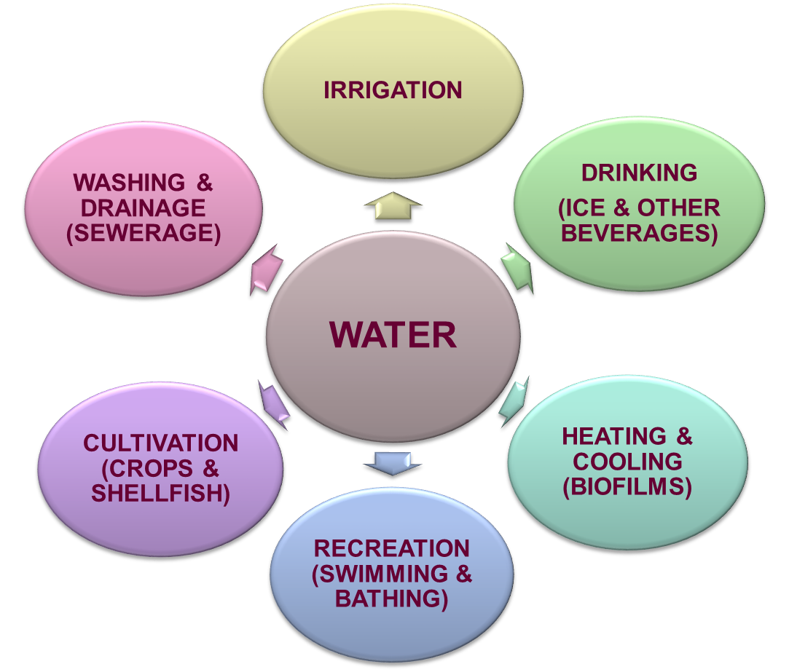
SPREAD OF PATHOGENS BY WATER

Slide 9
RELATIONSHIPS BETWEEN WATER & PATHOGENS
WATER-BORNE: INGESTION/INHALATION OF CONTAMINATED WATER (CHOLERA, TYPHOID FEVER, HEPATITIS A, LEGIONNAIRES’ DISEASE)
WATER-WASHED (WATER HYGIENE): DUE TO LACK OF SUFFICIENT WATER FOR PERSONAL HYGIENE (TYPHUS CARRIED BY LICE; TRACHOMA)
WATER-BASED: CAUSED BY EXPOSURE TO PARASITES FOUND IN INTERMEDIATE HOSTS LIVING IN WATER (SCHISTOSOMIASIS)
WATER-RELATED: DUE TO INSECT VECTORS WHICH BREED IN WATER (MALARIA)

Slide 10
WHICH PATHOGENS TO FOCUS ON?
THE FOCUS HERE WILL BE ON:
  ENVIRONMENTAL MYCOBACTERIA
  ENTERIC PROTOZOA (CRYPTOSPORIDA)
  ENTERIC VIRUSES (NOROVIRUS)
  VEGETATIVE BACTERIA (LEGIONELLA PNEUMOPHILA)

Slide 11
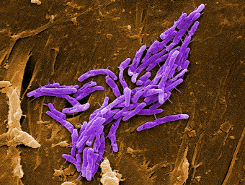
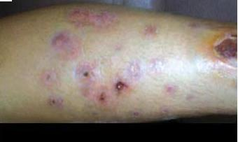
ENVIRONMENTAL MYCOBACTERIA
ENVIRONMENTAL MYCOBACTERIA
OTHER THAN THOSE CAUSING TUBERCULOSIS & LEPROSY
MANY NEWLY DISCOVERED SPECIES; TYPICAL PERIKAIROTS
IN BIOFILMS IN HOT & COLD WATER STORAGE SYSTEMS
HIGHER RESISTANCE TO WATER DISINFECTING CHEMICALS
SEVERE SKIN INFECTIONS FROM FOOTBATHS IN PEDICURE
SHOWER HEADS & AEROSOLIZED MYCOBACTERIA
SKIN LESIONS FROM MYCOBACTERIA IN A FOOTBATH (NEJM 2002)

Slide 12
MYCOBACTERIUM GORDONAE IN A SAMPLE FROM A WATER COOLER

Slide 13
ENTERIC PROTOZOA
CRYPTOSPORIDIUM, TOXOPLASMA & GIARDIA (ZOONOSES)
STABLE & RESISTANT TO DISINFECTANTS (E.G., CHLORINE)
SPREAD VIA POTABLE & RECREATIONAL WATERS
TOXOPLASMOSIS & LONG-TERM SEQUELAE?

Slide 14
WATERBORNE SPREAD OF CRYPTOSPORIDIUM
AMONG THE MAJOR EMERGING PATHOGENS
SEVERAL LARGE WATERBORNE OUTBREAKS ALREADY RECORDED
  LARGEST CRYPTO OUTBREAK IN MILWAUKEE, WI (MACKENZIE ET AL., 1993)
PARTICULARLY SERIOUS FOR THE IMMUNOCOMPROMISED & ELDERLY
OOCYSTS HIGHLY RESISTANT TO CHEMICALS COMMONLY USED FOR DISINFECTION OF WATER; UV IRRADIATION MAY HELP
OOCYSTS ALSO SURVIVE IN WATER FOR AT LEAST SEVERAL DAYS

Slide 15
WATERBORNE OUTBREAK OF TOXOPLASMOSIS
(BOWIE ET AL., 1997)
LARGEST SUCH OUTBREAK RECORDED IN VICTORIA, BRITISH COLUMBIA, IN 1995
SURFACE WATER WAS UNFILTERED BUT CHLORAMINATED
AT LEAST 110 CASES, INCLUDING 12 NEWBORNS, WERE DETECTED
THE EXACT SOURCE OF THE PATHOGEN REMAINS UNKNOWN, BUT WILD CATS & FIELD MICE ARE SUSPECTED

Slide 16
ENTERIC VIRUSES
MANY TYPES CAN BE WATERBORNE
IMPORTANCE ON RISE WITH BETTER CONTROL OF BACTERIA
CURRENT INDICATORS OF FECAL POLLUTION INADEQUATE
NO CHEMOTHERAPY & LIMITED VACCINES
NOROVIRUS (NV) & HEPATITIS E VIRUS

Slide 17
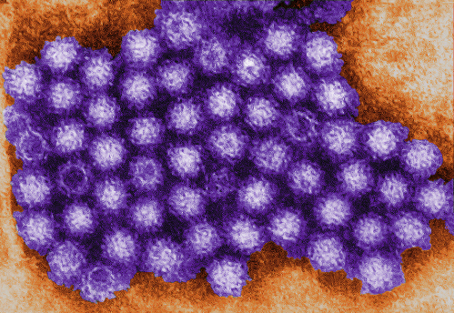
NOROVIRUS (NV)
NOROVIRUS
FOUND IN EARLY 1970s; ~27 NM IN DIAM.; HIGHLY PROLIFIC!
GLOBALLY, MOST COMMON CAUSE OF ACUTE NON-BACTERIAL GASTROENTERITIS; INCUBATION PERIOD ~12 HOURS!
>200,000 FATALITIES/YEAR FROM DEHYDRATION
  NO CLEAR TARGET AGE OR SEASONALITY; REINFECTIONS
  HIGHER RESISTANCE TO DISINFECTANTS THAN ENTERIC BACTERIA
  VIRUS IN FECES & IN VOMITUS
  NO VACCINES OR SPECIFIC DRUGS AVAILABLE
  NV REMINISCENT OF INFLUENZAVIRUSES IN GENETIC CHANGES

Slide 18
HEPATITIS E VIRUS
A RELATIVELY NEWLY RECOGNIZED WATERBORNE PATHOGEN
NOW CLASSIFIED AS A CALICIVIRUS
CAUSES OUTBREAKS INVOLVING THOUSANDS
FORMERLY CALLED ENTERIC NONA-NON-B HEPATITIS VIRUS
PARTICULARLY DANGEROUS FOR PREGNANT WOMEN
CERTAIN CASES MAY BE ZOONOTIC IN ORIGIN
DIFFICULT TO CULTURE; NOT MUCH KNOWN ABOUT ITS SURVIVAL & DISINFECTION

Slide 19
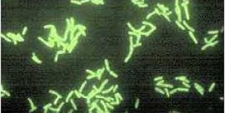
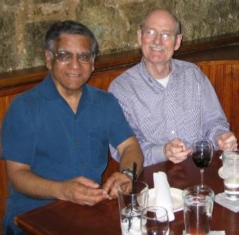
LEGIONELLA PNEUMOPHILA & OTHER SPECIES
PICTURE OF LEGIONELLA
  DISCOVERED ONLY IN 1976 BY DR. JOE McDADE (CDC)
  INHALATION & A POTENTIALLY FATAL PNEUMONIA
  HABITAT IS WATER-BASED BIOFILMS (PREMISE PLUMBING)
  A PERIKAIROT (CLOSE LINKS WITH FREE-LIVING PROTOZOA)
  RARE SECONDARY CASES!
  WATER DISINFECTION A MAJOR CHALLENGE!
WE FOUND THEM IN GROUNDWATERS (2000)
WITH DR. JOE McDADE (2005)

Slide 20
DRINKING WATERBORNE OUTBREAKS IN THE U.S. (1971-2006)
(CRAUN ET AL, CLIN. MICROBIOL. REV. 2010)

Slide 21
THE CHANGING FOREGROUND
CHOLERA
TYPHOID
VIRAL DIARRHEAS
ENVIRON. MYCOBACTERIA
TOXOPLASMA
CRYPTOSPORIDIUM
DYSENTARY
HEPATITIS E
HEPATITIS A

Slide 22
WHY IS THE PROFILE OF WATERBORNE PATHOGENS CHANGING?

Slide 23
MORE HOSTS THE BETTER FOR PATHOGENS!
9.1 BILLION
TOTAL HUMAN POPULATION INCREASE FROM ONE BILLION TO >9 BILLION IN 246 YEARS
(1804 TO 2050)
POPULATION IN BILLIONS
(U.N. POPULATION BUREAU)
YEAR

Slide 24
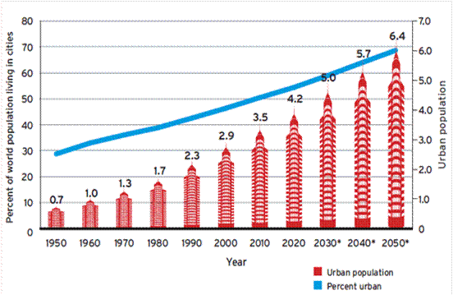
INCREASING URBANIZATION OF THE GLOBE (https://theurbantechnologist.com/2013/12/)
INCREASING POPULATION DENSITY MAKES IT EASIER FOR PATHOGENS TO JUMP FROM HOST TO HOST!
CITIES WITH >10 MILLION:
1970 – 3
1990 – 10
2014 – 28
2030 - 41

Slide 25
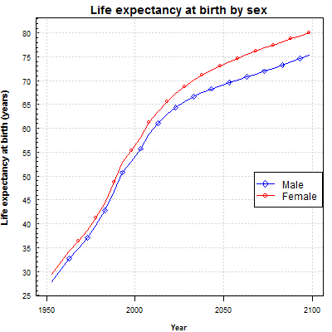
INCREASING GLOBAL LIFE EXPECTANCY AT BIRTH (https://esa.un.org/unpd/wpp/Graphs/DemographicProfiles/; accessed on Sept 14, 2020)
NATURAL IMMUNOSUPPRESSION INCREASES WITH ADVANCING AGE WITH HIGHER VULNERABILITY TO FRANK & OPPORTUNISTIC PATHOGENS!
LIFE EXPECTANCY AT BIRTH (YEARS)
IN 1950, THE GLOBAL AVERAGE LIFE EXPECTANCY WAS 47 YEARS. IT IS NOW ABOUT 70 YEARS & IS PROJECTED TO REACH 86 YEARS BY 2150!
YEAR

Slide 26
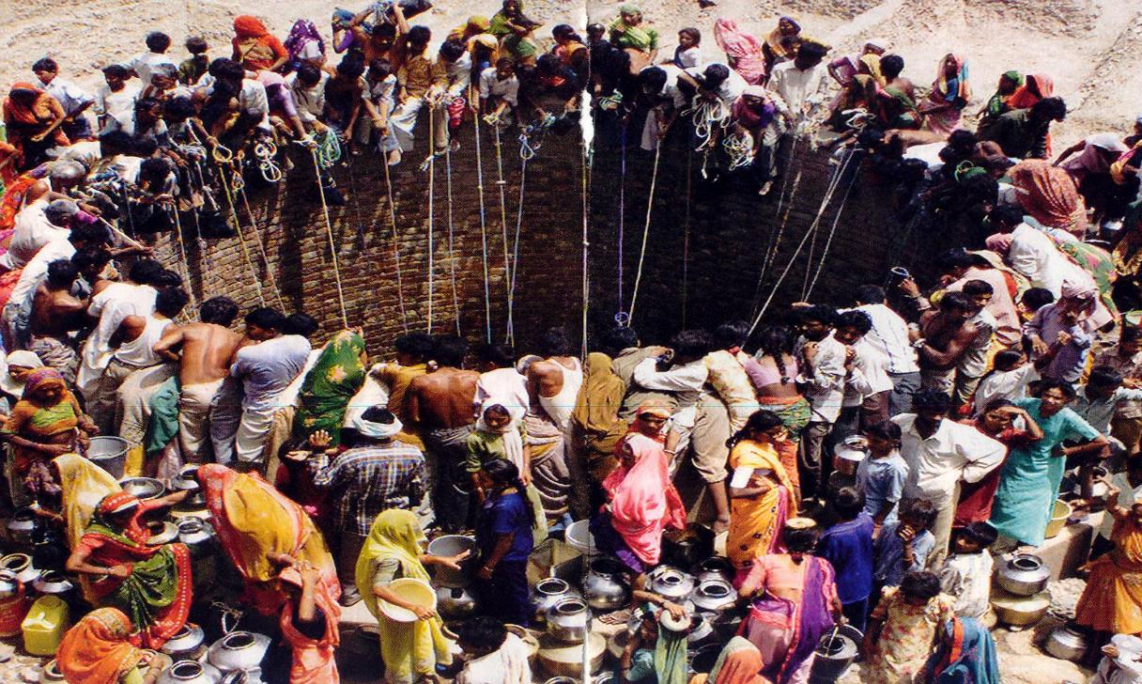
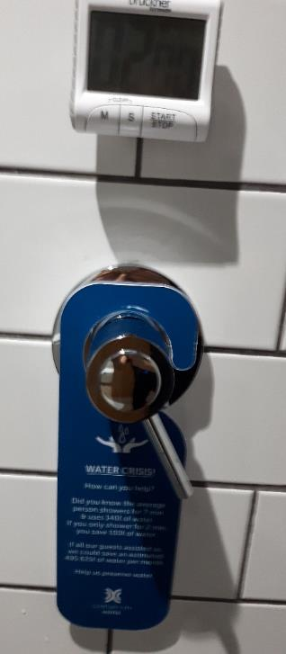
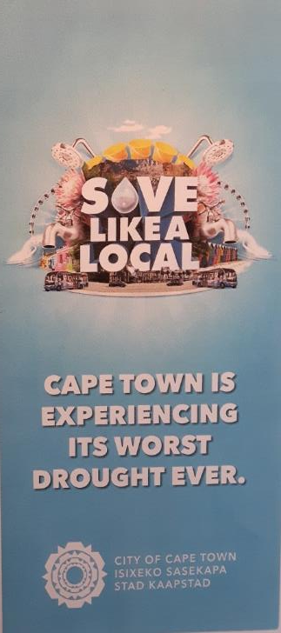
FRESH WATER SHORTAGES
(GUJRAT, INDIA; TIME MAGAZINE, DEC. 2003)
INCREASING DEMAND
(CAPE TOWN, SOUTH AFRICA; JULY 20018)

Slide 27
MICROBIAL MUTATIONS & ADAPTATIONS
DRUG RESISTANCE (POST-ANTIBIOTIC ERA!)
COMBINED IMPACT OF CHEMICALS & PATHOGENS (‘CHEMBIOACTION’)!
PREMISE PLUMBING
SINKS AS SOURCES OF PATHOGENS
MULTI-ETIOLOGIC INFECTIONS

Slide 28
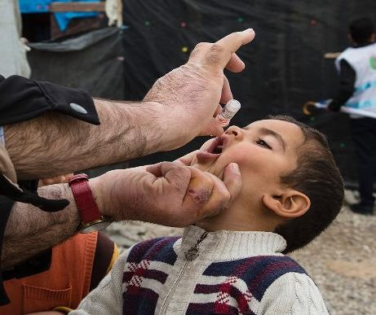
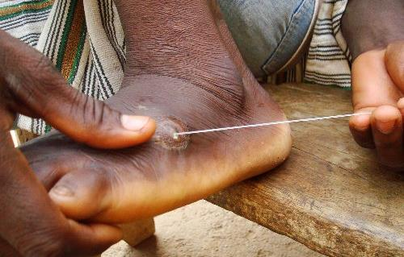
IS THERE ANY GOOD NEWS?
POLIOMYELITIS AT THE VERGE OF ERADICATION!!
~350,000 CASES IN 1988 AT START OF GLOBAL VACCINATION
FIRST WATERBORNE DISEASE TO BE ERADICATED!
GUINEA WORM DISEASE (DRACUNCULIASIS); FIRST WATER-BASED DISEASE TO BE ERADICATED; NO VACCINES OR DRUGS!
IN 1986, 3.5 10⁶ CASES IN 20 COUNTRIES; NOW REACHING ZERO!
INGESTION OF WORM-INFECTED WATER FLEAS (CYCLOPS)
COMMUNITY EDUCATION & COARSE WATER FILTRATION
JIMMY CARTER’S CENTER PLAYING A KEY ROLE
SABIN VACCINATION (WHO)
http://www.traveljournals.net/pictures/147271.html

Slide 29
CHALLENGES?
CLIMATE CHANGE & INCREASING WATER POLLUTION
POPULATION INCREASE, MOVEMENTS & CHANGING DEMOGRAPHICS
INCREASING POLLUTION & FRESH WATER SHORTAGES
MICROBIAL ADAPTATIONS & CONTINUING EMERGENCE
DRUG RESISTANCE; LIMITED VACCINES

Slide 30
OPPORTUNITIES?
REINVENTION OF THE TOILET
BETTER & MORE SUSTAINABLE WATER TREATMENT
WATER PROTECTION DURING DISTRIBUTION & DELIVERY
  TAP WATER MAY NOT BE THE SAME AS POTABLE WATER!
WATER RECYCLING & CONSERVATION
BETTER & MORE WIDE-SPREAD IMMUNIZATION
POPULATION CONTROL AN URGENT NEED!

Slide 31
LITERATURE CITED
Bowie, WR et al. (1967). Outbreak of toxoplasmosis associated with municipal drinking water. Lancet. 350: 173-177.
MacKenzie, WR et al. (1994). A massive outbreak in Milwaukee of cryptosporidium infection transmitted through the public water supply. N Engl J Med. 331:161-167.
Taylor, LH et al. (2001). Risk factors for human disease emergence. Philos Trans R Soc Lond B Biol Sci. 356:983-989.

Slide 32
“If there is magic on this planet, it is contained in water.”
- Loren Eiseley
THANK YOU!

Slide 33

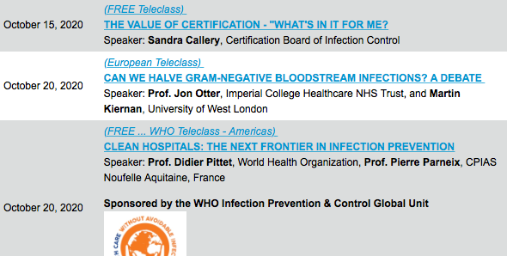

Slide 34


