Slide 1

What did the Romans ever do for us?
Or do we learn from history?
Carole Fry
EM Cottrell lecture 2015
www.webbertraining.com
September 28, 2015

Slide 2


Slide 3

Lets go back to the very beginning….
….as it is a very good place to start

Slide 4
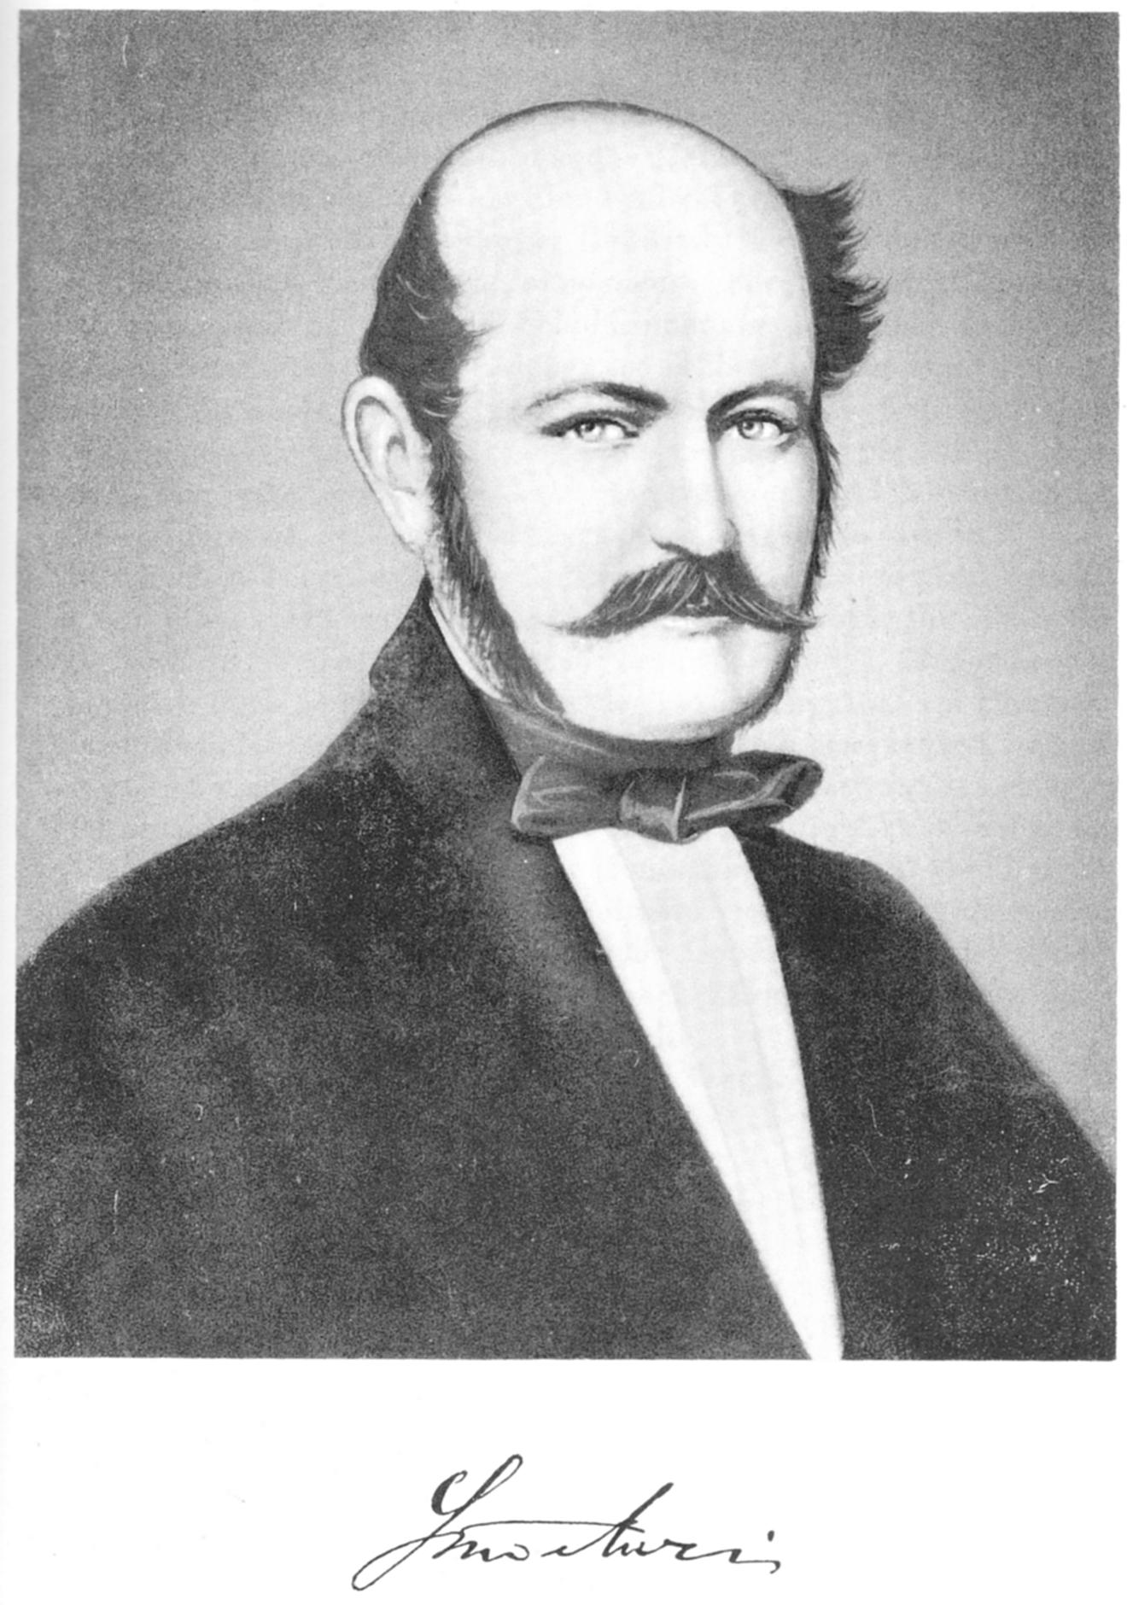
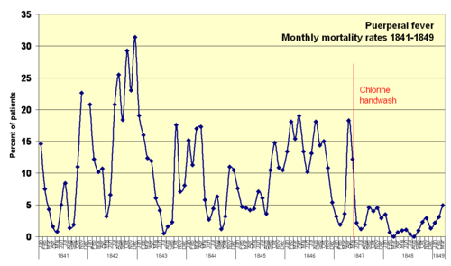
Semmelweis (1818 – 65)

Slide 5
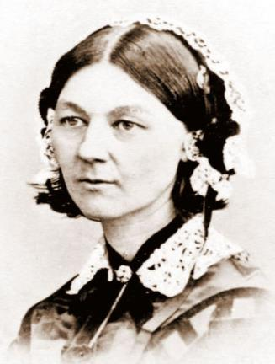
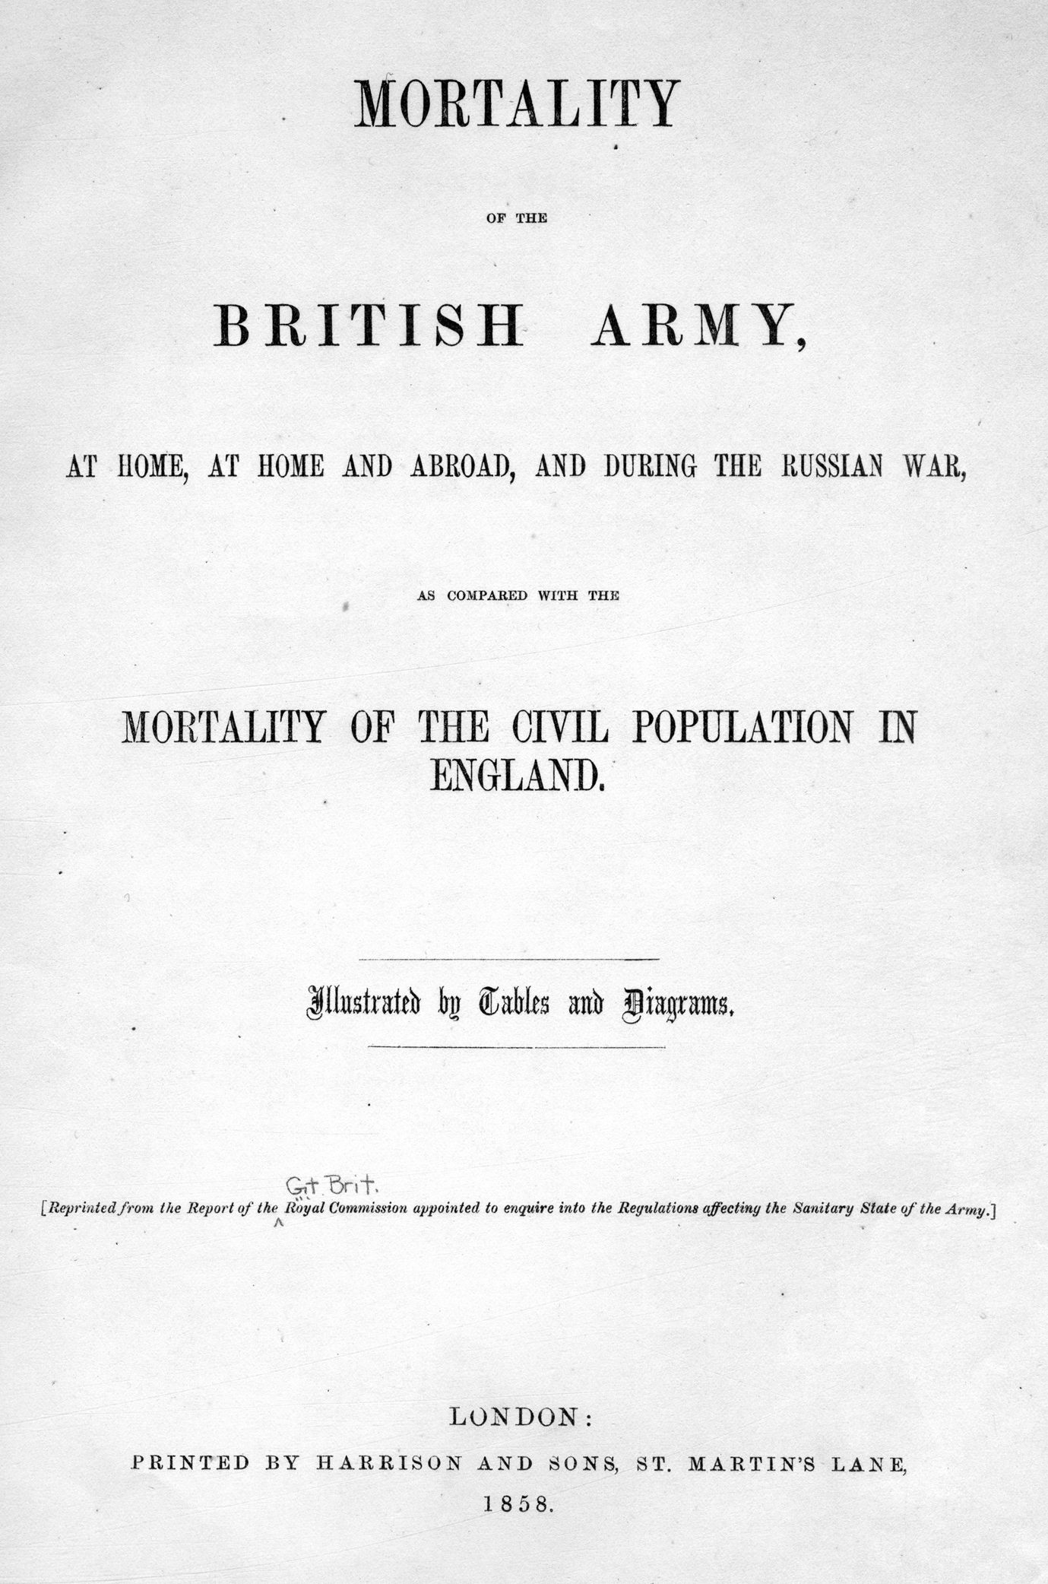
Florence Nightingale
“The very first requirement in a hospital is that it should do the sick no harm.”
― Florence Nightingale, Notes on Nursing: What It Is, and What It Is Not

Slide 6
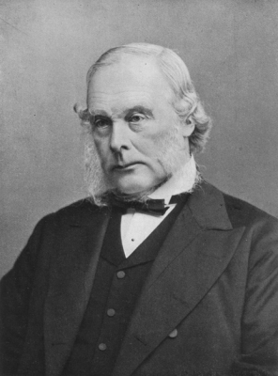

Joseph Lister (1827- 1912)

Slide 7
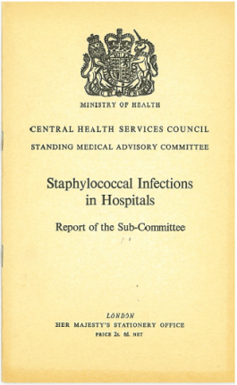
Infection control beginnings
In 1944, MRC recommended establishing an ICC in every hospital
Published in 1959 – concern about Staphylococcal sepsis
Also concerns about penicillin resistance
Recommended the appointment of an Control of Infection Officer “the success of any scheme of control will depend on him”

Slide 8
EM Cottrell
Theatre superintendant appointed by Dr Brendan Moore in 1959
To act as a liaison officer to all those concerned with control of infection – record keeping a major part of the role
Lancet paper stated that the appointment was a ‘successful experiment’
Met resistance in some quarters, but soon other hospitals followed suit
Gardner et al. The Infection Control Sister – a new member of the infection control team in general hospitals.
Lancet 1962;2:710-711

Slide 9

What goes around comes around?
Role of the environment/fomites
AMR/AMS
Adequate staffing
Clear roles and responsibilities
Monitoring & measuring
Ventilation
Hand hygiene
Mattress cleaning
Bed spacing
Epidemiological investigation
Cohorting
Good communication and liaison
New builds not less than 20% single rooms
Outbreak management & control
Good documentation & record keeping
Avoid unnecessary dressing changes…

Slide 10
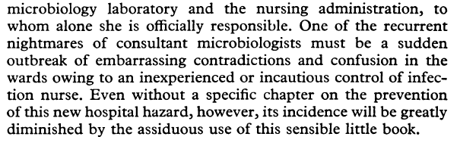
One microbiologist’s view
When reviewing ‘Hospital-acquired infection – Ayliffe, Collins & Taylor (1982)
Selywn. S Hard Facts about hospital infection.
BMJ 1982;284: 1895 - 1896

Slide 11
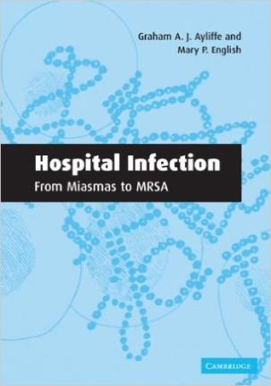
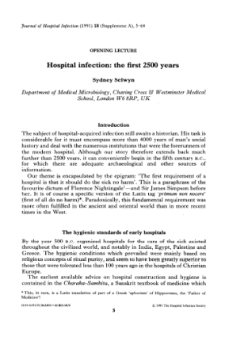
Information sources

Slide 12
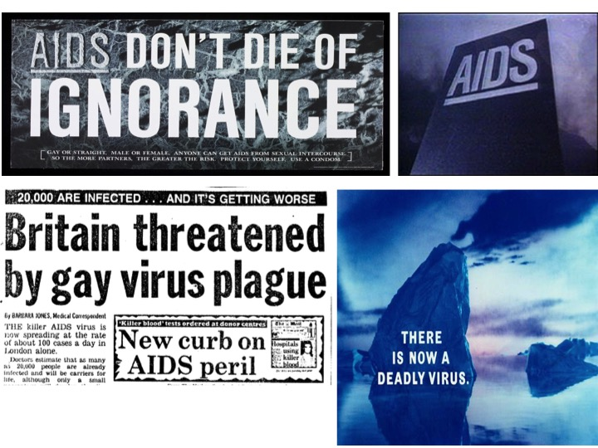

Slide 13
Watershed moment in IC
Recommendations for Prevention of HIV Transmission in Health-Care Settings
MMWR August 21, 1987 / 36(SU02);001 published by the Epidemiology Program Office, Centers for Disease Control, Public Health Service, U.S. Department of Health and Human Services, Atlanta, Georgia 30333.
Blood and body fluid precautions
Perspectives in Disease Prevention and Health Promotion Update: Universal Precautions for Prevention of Transmission of Human Immunodeficiency Virus, Hepatitis B Virus, and Other Bloodborne Pathogens in Health-Care Settings June 24, 1988 / 37(24);377-388

Slide 14
Aim of UP
To protect HCWs from acquiring a blood borne virus – discovery of HIV was the catalyst for this
1988 – all body and body fluids containing visible blood, mucous membranes & non-intact skin to be considered a potential risk regardless of their infection status
Historically IC precautions dictated by symptoms or confirmed diagnosis

Slide 15
Development of UP
Lynch & Jackson expanded UP to include all moist body substances – faeces, urine, sputum – greater protection for HCWs
Over time, UP and BSI merged into standard precautions.
Realisation, if implemented well, SP prevent cross infection and therefore protect patients also.

Slide 16
Standard Principles in England
Epic 1introduced standard principles for preventing hospital acquired infections which went beyond clinical practice
Also adopted the term standard precautions
Environment
Hand hygiene
Appropriate use of PPE
Safe use of sharps

Slide 17
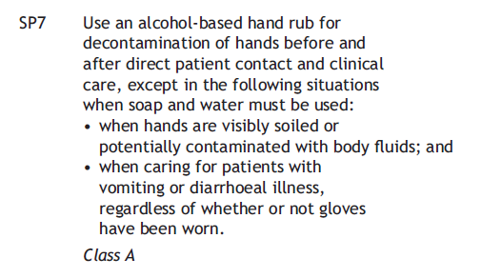
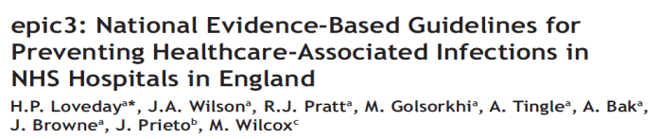
Evidence base?

Slide 18
It’s getting complicated
CDC now recommend:
standard precautions
transmission based precautions
  contact precautions – wear gown & gloves (+/- isolation) patients with diarrhoea, MDRO, draining wounds, uncontrolled secretions, pressure ulcer (~15% US inpatients)
  droplet precautions
  airborne precautions

Slide 19
MRSA

Slide 20
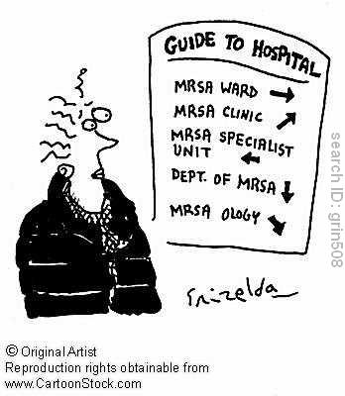
MRSA

Slide 21
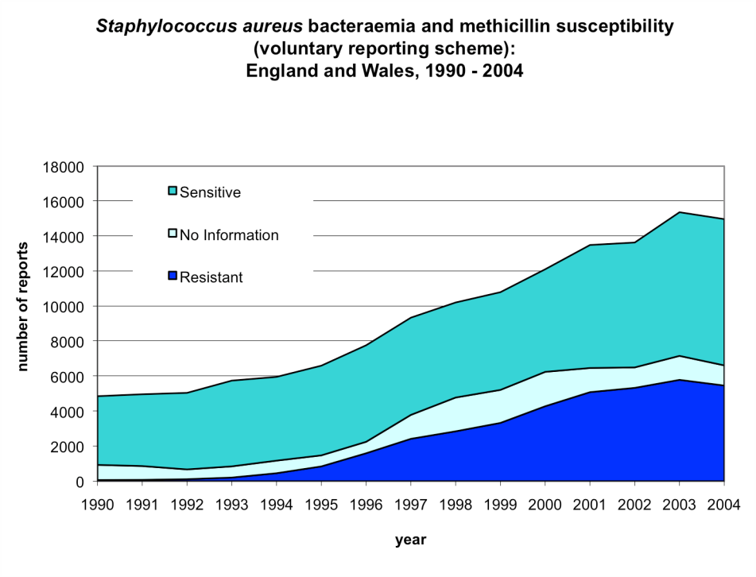

Slide 22
MRSA Target
Announcement in November 2004 to ‘halve MRSA infections by 2008’
Baseline 2003-04; Start date April 2005
  Monthly returns
Performance management
MRSA objectives followed – aimed at outliers

Slide 23
Achievable?
Surveyed ICTS believed on average that 15% reduction in HAI was achievable (NAO 2000)
First national infection reduction target

Slide 24
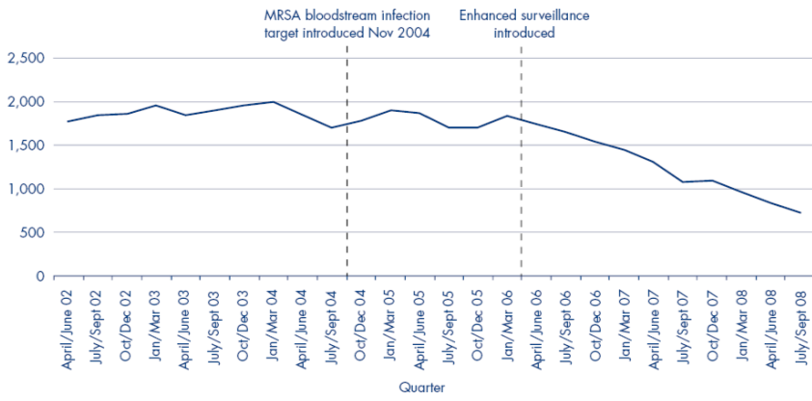
MRSA bacteraemias & interventions
cleanyourhands
Saving Lives &
CoP
Imp teams
Modern matrons
Deep clean
MRSA screening
The control of meticillin-resistant S.aureus blood stream infections in England. Duerden B, Fry C, Johnson A and Wilcox M. Open Forum Infect Dis (Spring 2015) 2 (2)

Slide 25
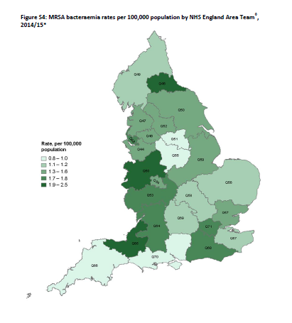
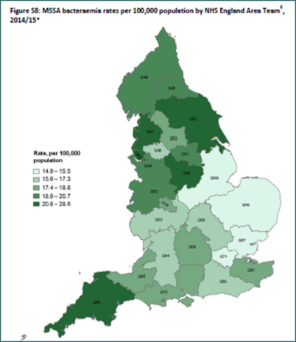
MRSA vs MSSA
Source: PHE annual commentary 2014/15

Slide 26
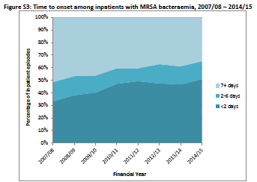
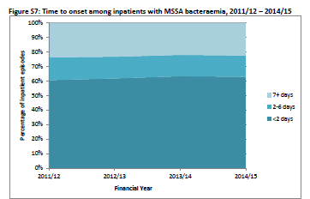
Time to onset bacteraemia
Source: PHE annual commentary 2014/15

Slide 27
Staphylococcus aureus – the next challenge?
Report of meticillin susceptible, vancomycin-resistant Staphylococcus aureus
Conclusion ‘Emergence of vancomycin resistance in MSSA would indicate that this resistance trait might be poised to disseminate rapidly among S.aureus and represents a major public health threat’.
Panesso D et al. EID. Vol 21: 10: October 2015

Slide 28
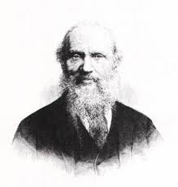
Surveillance
‘When you can measure what you are speaking about, and express it in numbers, you know something about it.’
Lord Kelvin, Popular Lectures and Addresses, 1889

Slide 29
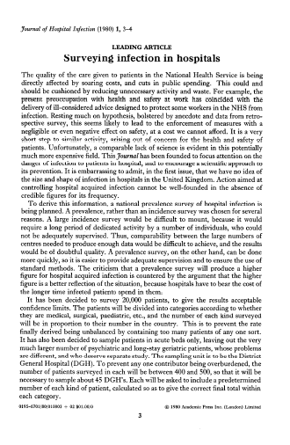

Surveillance in the UK

Slide 30
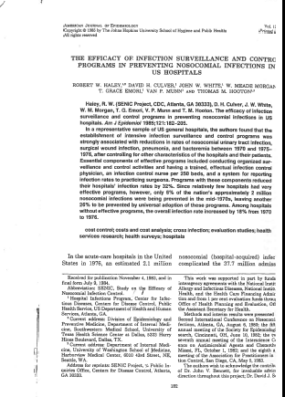
…while in the US - SENIC
Initiated by CDC in 1974
6586 hospitals
HAI rates could be reduced with an effective IC programme (↓32%) and 1 ICN: 250 beds
Hospitals without an effective programme HAI rates ↑

Slide 31
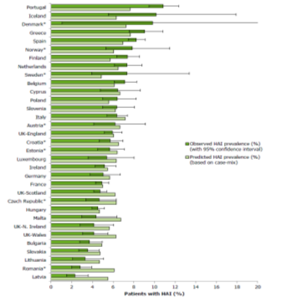
HCAI prevalence
6 % of patients in Acute Hospitals had a HCAI in 2011
Estimated 243,746 patients per year
Prevalence of HCAI decreasing; in 2006 prevalence was 8.2%
Pneumonia/Lower respiratory tract, Urinary tract infections & Surgical site infections account for c. 60% of all HCAI
Top three HCAI pathogens: E. coli 17%, S. aureus 15%, & C. difficile 12.4%
Next PPS: 2016

Slide 32
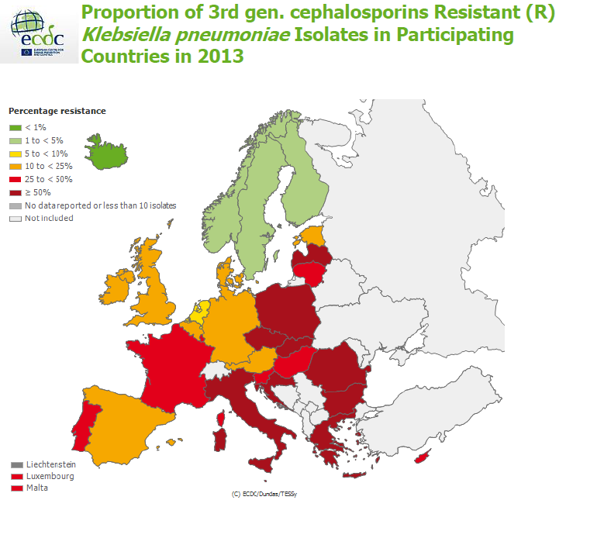

Slide 33
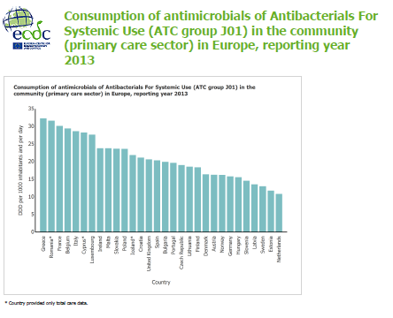

Slide 34
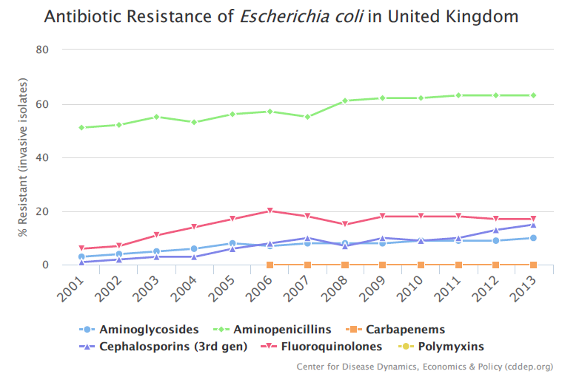
http://resistancemap.cddep.org/

Slide 35
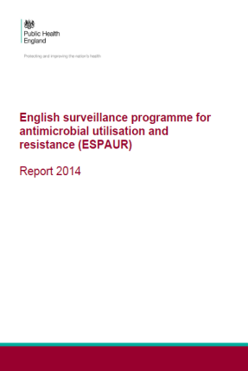
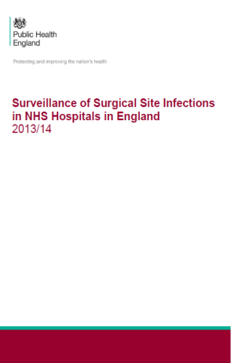
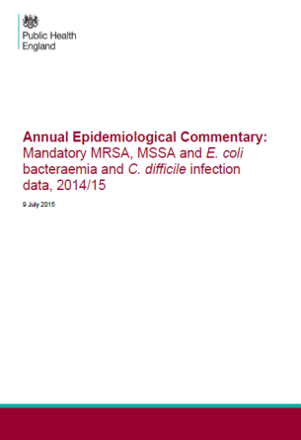
Data – we’ve got lots

Slide 36
Public reporting of HCAI
MRSA bacteraemias - followed by
  Orthopaedic SS1
  Glycopeptide resistant enterococci
  Clostriduim difficile infection
  meticillin sensitive Staphylococcus aureus
  E.coli bacteraemias

Slide 37
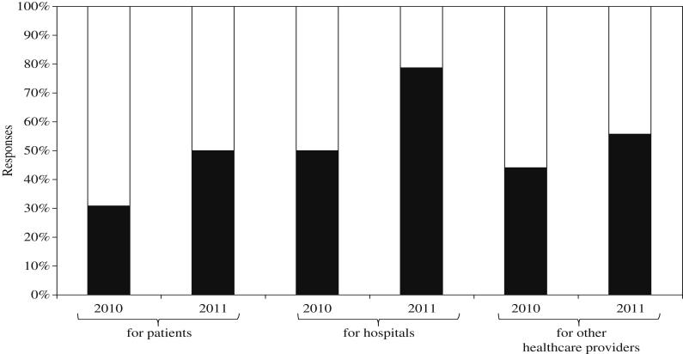
Public reporting
Martin, M: Zingg,W: Hansen,S: Gastermeir, P et al. JHI 83 (2013) 94-98

Slide 38
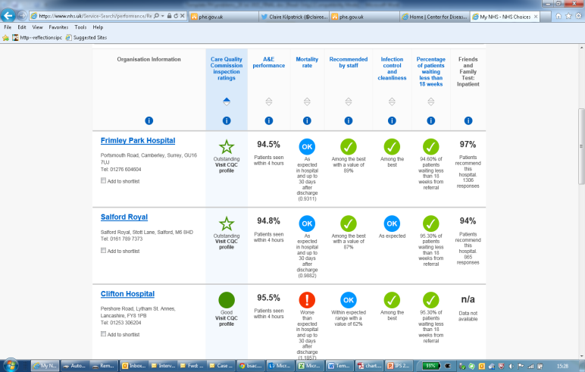
Do these data inform the public?
Source: NHS Choices

Slide 39
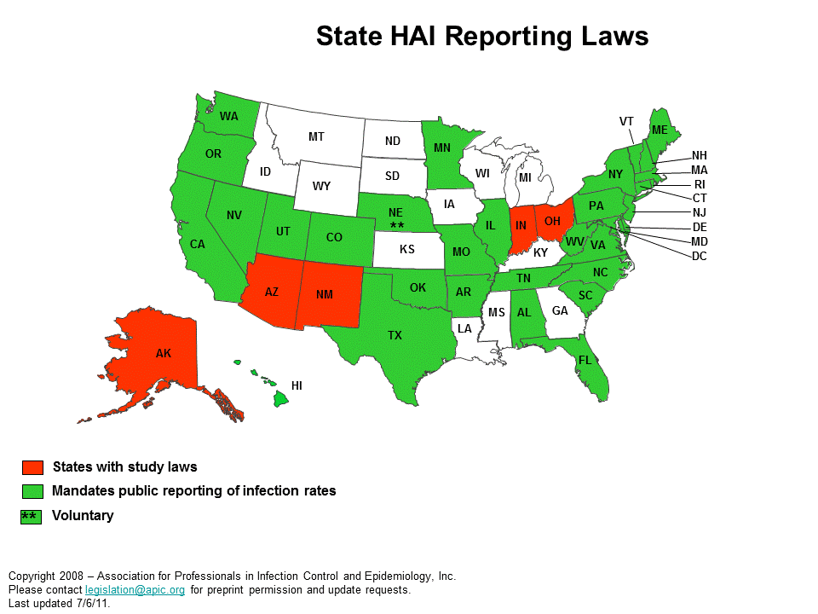

Slide 40
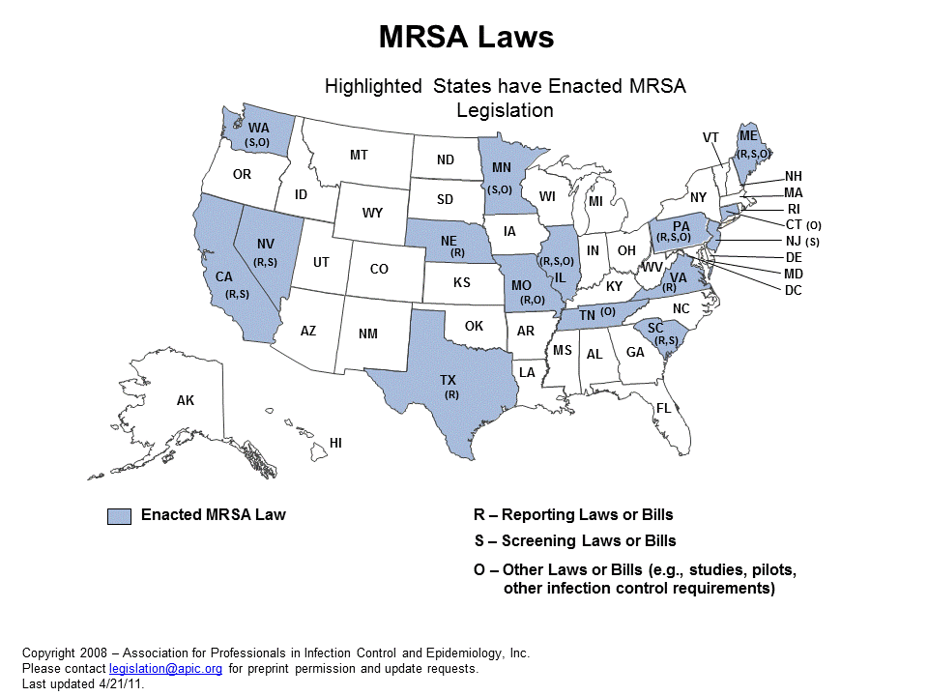

Slide 41
Public reporting
Difficult for the public to interpret
Public are consumers
Risk of hospital league tables
Currently a blunt instrument
No strong evidence that public reporting improves patient safety

Slide 42
Public reporting of data
Transparency important
Risk of skewed reporting/data to avoid sanctions
Need to agree granularity of reporting eg: organisation, unit, clinician
‘Destructive triangulation has arisen between administrators, clinicians & infection control departments that has lead to consequences beyond those intended by monitoring agencies’.
Horowitz, HW. Infection control: Public reporting, disincentives & bad behaviour. AJIC 43 (2015) 989 - 91

Slide 43
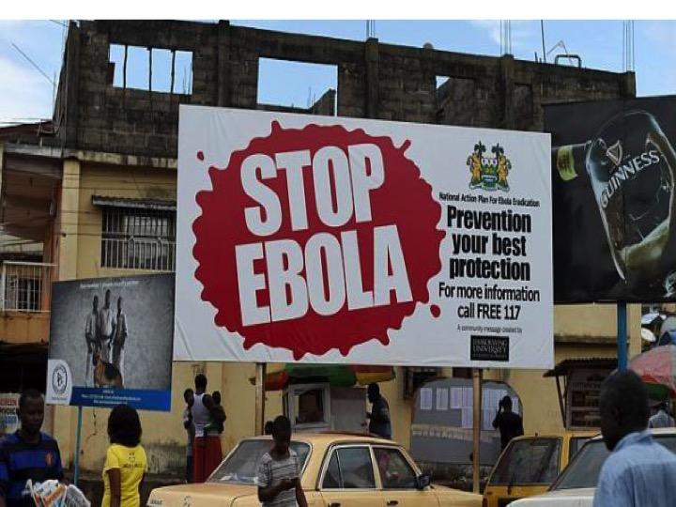

Slide 44
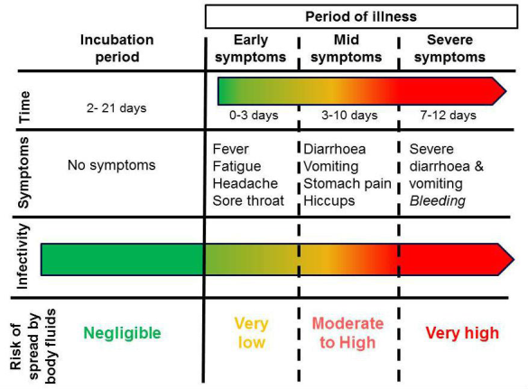
Infectivity increases as disease progresses

Slide 45
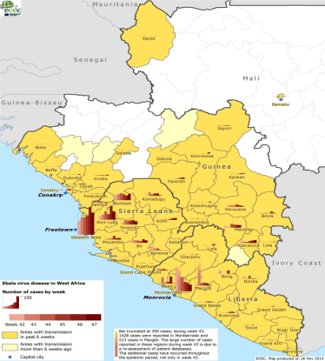
EVD epidemic West Africa
ECDC November 2014

Slide 46
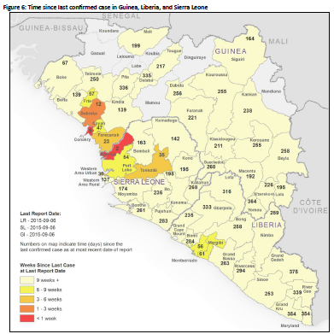
EVD epidemic West Africa
WWHO sitrep 09/09/15

Slide 47
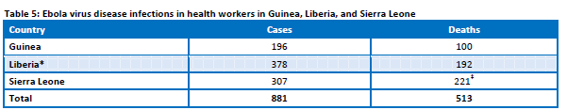
Risk to HCWs
Health-care workers have frequently been infected while treating patients with suspected or confirmed EVD. This has occurred through close contact with patients when infection control precautions are not strictly practiced.

Slide 48
Prevention of transmission
In the absence of an effective vaccine, rigorous adherence to infection prevention and control practice is required:
  Personal protective equipment
  Hand hygiene
  Spatial separation
  Clean to dirty workflows
  Discipline in donning and doffing
  Training

Slide 49
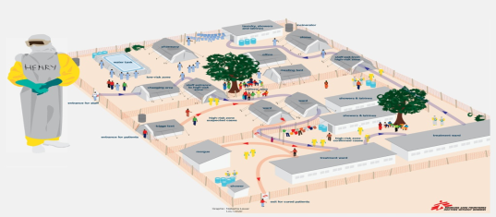
Staff safety is paramount
All clinical activity needs to be planned – healthcare workers should only proceed when it is safe to do so, and if they have the appropriate level of training
Clean to dirty work flows should be maintained

Slide 50
Staff safety
The need for clear instructions for putting on and removal of personal protective equipment (PPE)
PPE buddies must be trained
Healthcare facilities need to plan in advance how they will manage suspect cases and the staffing implications, eg maximum PPE working times, need for breaks

Slide 51
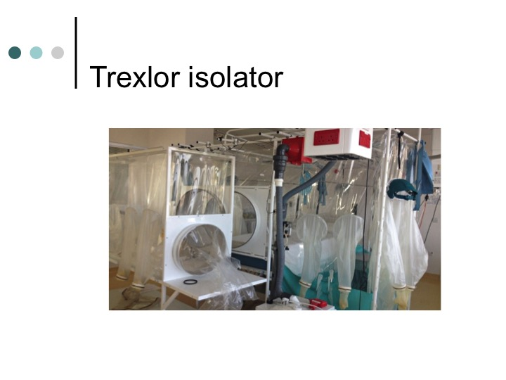

Slide 52
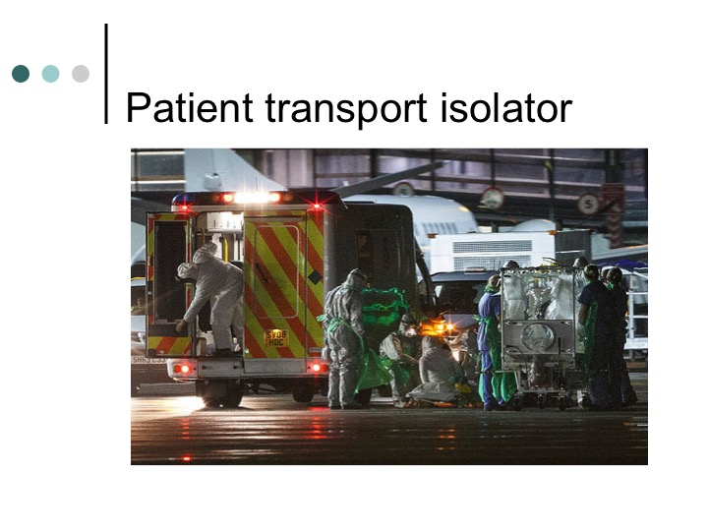

Slide 53
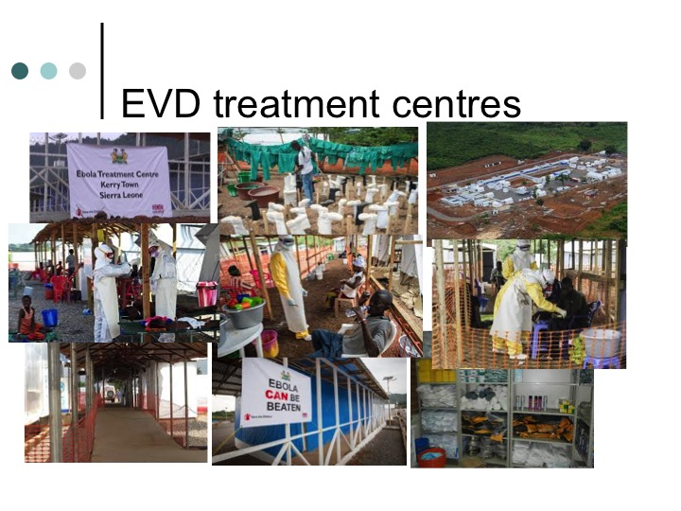

Slide 54
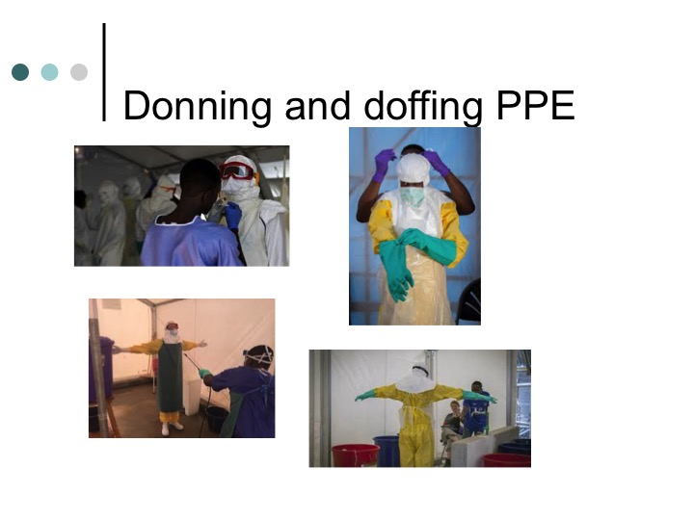

Slide 55
Conclusions – what next?

Slide 56
US approach – aspirational?

Slide 57
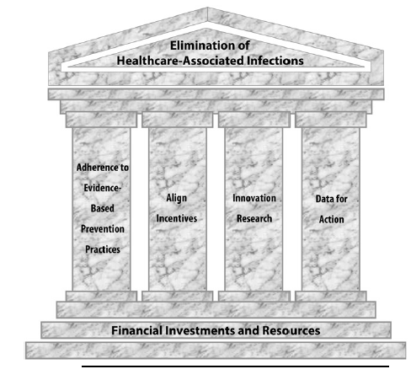
APIC pillars of HAI elimination

Slide 58

E. coli bacteraemia
Mandatory Surveillance
2014, 20% E. coli bacteraemia HCAI, c. 7k cases a year
LabBase2 data

Slide 59
Conclusions
Progress over last 10 years, with dramatic changes
Changes in HCAI prevalence related to reductions in incidence of MRSA and CDI
Increasing incidence & prevalence Gram negative resistance
ICU (all ages) & Surgical specialties - highest risk
Cognisant of the ever changing health and social care infrastructures

Slide 60
Conclusions
Whilst we have to look to the future, we must also learn from the past.
^{Thank you}

Slide 61
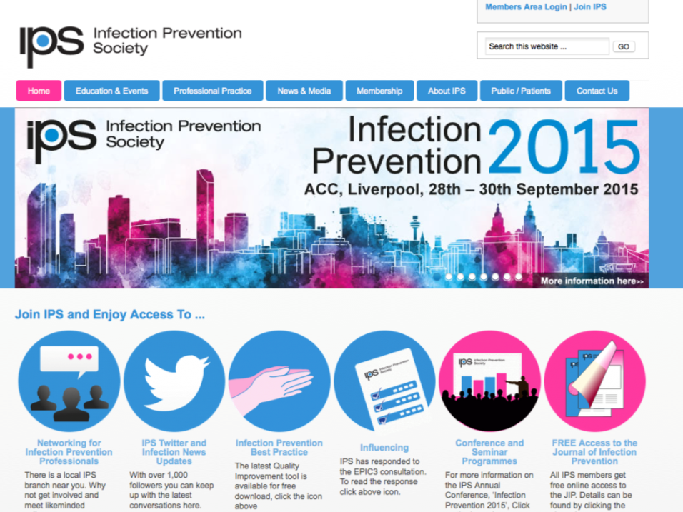
www.ips.uk.net

Slide 62


